Slide 1
Cholinergic Neurotransmission
Dr. Nirbhay Kumar
Asstt. Professor & Head
Deptt. of Veterinary Pharmacology & Toxicology
Bihar Veterinary College, Bihar Animal Sciences University, Patna

Slide 2
Cholinergic Transmission
The impulse transmission on nerve or neuroeffector junction that is mediated by acetylcholine (ACh) is called cholinergic transmission.
The different sites of cholinergic transmission are –
1. Parasympathetic neuroeffector junctions
2. Autonomic ganglia
3. Adrenal medulla
4. Somatic myoneural junctions
5. Certain regions of CNS.

Slide 3
Synthesis, Storage, Release & Catabolism of Acetylcholine
1. Synthesis:
Hemicholinium (a synthesis blocker of ACh) competitively blocks choline uptake in the neurone and thus depletes the ACh stores in the neurone terminals.
Uptake of choline is the rate limiting step in the biosynthesis of ACh.

Slide 4
Synthesis, Storage, Release & Catabolism of Acetylcholine continued…….
2. Storage:
After synthesis in the cytoplasm, ACh is transferred to axonal vesicles in the nerve terminals where it is stored for release whenever necessary.
Transport of ACh into synaptic vesicles is blocked by Vesamicol (storage blocker).
3. Release:
Two toxins interfere with cholinergic transmission by affecting release –
1. Botulinum toxin (release blocker) inhibits release
2.Black widow spider toxin induces massive release and depletion.

Slide 5
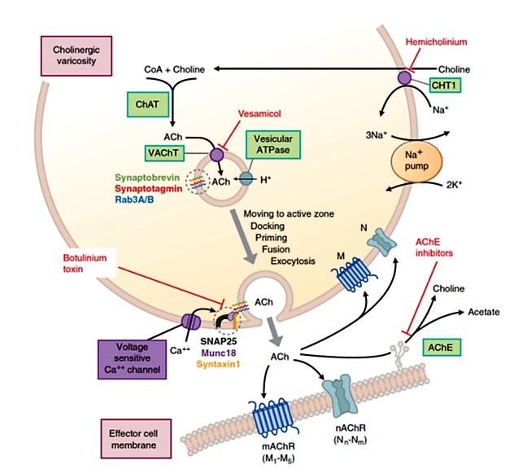
Synthesis, Storage, Release & Catabolism of Acetylcholine continued…….
Figure: A typical cholinergic neuroeffector junction
Abbreviations used:
ACh : Acetylcholine
AChE : ACh esterase
CHT : Choline transporter
ChAT : Choline acetyl transferase
VAChT : Vesicular ACh transporter
SNAP : Soluble NSF attachment protein, synaptosome-associated protein

Slide 6
Synthesis, Storage, Release & Catabolism of Acetylcholine continued…….
4. Destruction of ACh:
After serving the transmitter function, ACh within the junctional space is rapidly inactivated by hydrolysis by a specific enzyme, acetylcholine esterase (AChE).
AChE is present in cholinergic nerves, autonomic ganglia and neuromuscular & neuroeffector junctions.
A somewhat similar enzyme, butyrylcholinesterase (a pseudocholinesterase) is present in serum and other body tissues. It is primarily synthesized in the liver and its likely vestigial physiological function is the hydrolysis of ingested esters from plant sources.

Slide 7
Differences between two types of cholinesterases
Distribution Hydrolysis ACh Methacholine Benzoylcholine Butyrylcholine (iii) Inhibition (iv) Function | Acetylcholinesterase (True Cholinesterase) | Butyrylcholinesterase (Pseudo-cholinesterase)
 | All cholinergic sites, RBCs, gray matter. Very fast (in microseconds) Slower than ACh Not hydrolyzed Not hydrolyzed More sensitive to Physostigmine Termination of ACh action | Plasma, liver, intestine, white matter Slow Not hydrolyzed Hydrolyzed Hydrolyzed More sensitive to organophosphates Hydrolysis of ingested esters.

Slide 8
Cholinergic Receptors
Cholinergic Receptors
Muscarinic Receptors
M₁
M₂
Nicotinic Receptors
N₁ (N_{M})
M₃
M₄
M₅
N₂ (N_{N})
Muscarinic receptors (G-protein coupled receptors)
A mushroom plant (Amanita muscaria) alkaloid, muscarine was found to mimic the activity of ACh at the parasympathetic neuroeffector junctions in heart muscle, smooth muscle and secretory glands but not at the previously described nicotinic receptors. So, the type of receptors present at cholinergic neuroeffector junctions in muscle and glands were designated as Muscarinic cholinergic receptors.
Nicotinic receptors (Ligand gated cation channels)
Small doses of nicotine mimicked certain actions of ACh and large doses inhibited the same ACh responses. The nicotinic responsive sites were found to be present in autonomic ganglia, adrenal medullary chromaffin cells and also the neuromuscular junction of somatic nervous system. Accordingly, receptors on these sites were called as Nicotinic cholinergic receptors.

Slide 9
Muscarinic Receptors
 | M₁ | M₂ | M₃
Location and function subserved | Autonomic ganglia: Depolarization Gastric glands: Histamine release and acid secretion CNS: Not precisely known | SA node: Hyperpolarization, lowered rate of impulse generation AV node: Lowered velocity of conduction Atrium: Shortening of action potential duration, decreased contractility. Ventricle: Lowered contractility (slight) - due to sparse cholinergic receptors Cholinergic nerve endings: Decreased ACh release | Visceral smooth muscles: Contraction Exocrine glands: Secretion Vascular endothelium: Release of nitric oxide (NO)  vasodilatation
Agonist | Oxotremorine | Methacholine | Bethanechol
Antagonist | Pirenzepine, Telenzepine | Methoctramine | Hexahydrosiladifenidol

Slide 10
Nicotinic Receptors
 | N_{M} or N₁ | N_{N} or N₂
Location and function subserved | Neuromuscular junction: Depolarization of muscle end plate ⇨ contraction of skeletal muscle. | Autonomic ganglia: Depolarization ⇨ post-ganglionic impulse. Adrenal medulla: Catecholamine release. CNS: Site specific excitation or inhibition.
Agonists | PTMA, Nicotine | DMPP, Nicotine
Antagonists | Tubocurarine, a-Bungarotoxin | Hexamethonium, Trimethaphan

Slide 11
Actions of Acetylcholine
[I]. Muscarinic actions:
1. Heart: SA node : Hyperpolarization, Rate of impulse generation reduced and bradycardia.
AV node & His-Purkinje fibres : Conduction slowed.
Atria : The force of atrial contraction is markedly reduced.
Ventricles : Contractility also reduced but not marked.
2. Blood vessels: Vasodilatation ⇨ Fall in B.P. Vasodilatation is primarily mediated through EDRF (NO).
3. Smooth muscles:
Smooth muscles contracted. Tone and peristalsis in the GI tract is increased and sphincters relax ⇨ abdominal cramps and evacuation of bowel.
Peristalsis in ureter is increased. The detrusor muscle contracts while the bladder trigone and sphincters relax ⇨ voiding of urine.
Bronchial muscles constrict, asthmatics are highly sensitive ⇨ dyspnoea, precipitation of an attack of bronchial asthma.

Slide 12
Actions of Acetylcholine continued…..
[I]. Muscarinic actions (continued…):
4. Glands: Secretion from all parasympathetically innervated glands is increased ⇨ sweating, salivation, lachrimation, tracheobronchial and gastric secretion. The effect on pancreatic and intestinal glands is not marked. Secretion of milk and bile is not affected.
5. Eyes: Contraction of circular muscles of iris ⇨ miosis. Contraction of ciliary muscles of iris ⇨ spasm of accommodation, increased outflow facility, reduction in intraocular tension.
[II]. Nicotinic actions:
1. Autonomic ganglia: Both sympathetic and parasympathetic ganglia are stimulated. The effect is manifested at higher doses. High dose of ACh given after atropine causes tachycardia and rise in B.P.
2. Skeletal muscles: Contraction of fibre, fasciculations etc.

Slide 13
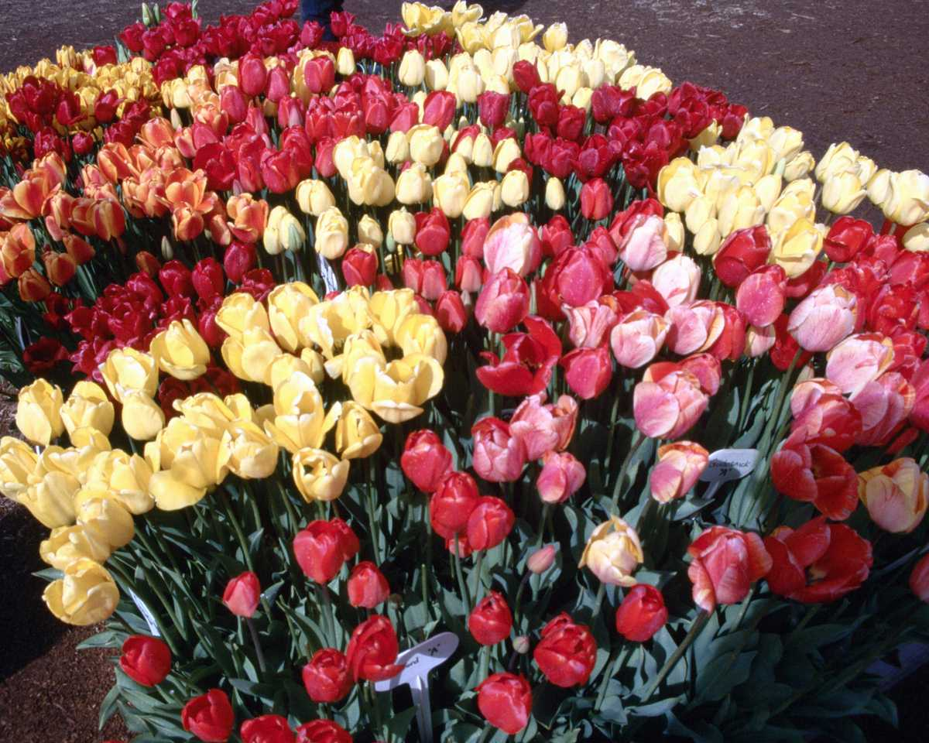
Thank You

