Slide 1
Classical Swine Fever
Dr. Kaushal Kumar
Assistant Professor and Head
Department of Veterinary pathology
Bihar Veterinary College,
Bihar Animal Sciences University, Patna, Bihar

Slide 2
CLASSICAL SWINE FEVER
Synonym:-
Classical swine fever
European swine fever
Hog cholera
Swine plague,
A most important viral disease in swine production

Slide 3
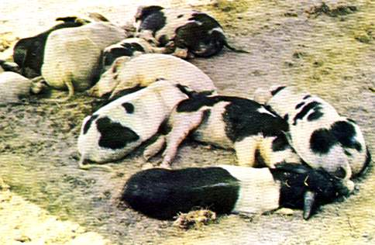
SWINE FEVER (Hog Cholera)
Swine fever is
an acute
contagious viral disease
High morbidity & mortality (upto100%)
caused by pestivirus and characterized by
Gluing of eyes,
Generalized hemorrhage of internal organ
Button ulcers in intestine,
Turkey egg appearance of Kidney.

Slide 4
Etiology
Genus-Pestivirus of family-Flavi viridae
Pantropic RNA virus
Antigenically similar to
Bovine Viral Diarrhoea/ MDV and
Border Disease of sheep
Predisposing Factor:
Pigs with acute infection shed large amounts of virus before they are visibly ill, during illness, and after recovery.

Slide 5
Incidence
First recognized in 1885 in the United States, its viral aetiology was established in 1903
The disease is seen worldwide including India
Susceptibility
The pig of all age groups
NOTE:
The name “Hog Cholera” was derived from the concurrent mixed infections of Salmonella cholerae suis which often complicates the severity of disease .

Slide 6
Transmission
The infection is usually acquired by ingestion, but inhalation is also a possible route
Routes of infection
Digestive tract
Respiratory tract (Nasal mucosa)
Conjunctiva
Airborne transmission probably is of little significance.

Slide 7
Pathogenesis
After ingestion-
the virus infects epithelial cells in the crypts of tonsils, spreads to adjacent lymph nodes
produces viremia within 24 hrs.
Replication occures especially in lymphoid tissues (spleen, Peyer’s patches, lymph nodes, thymus), in endothelial cells
Within three to four days, virus spreads to many epithelial-type cells and is present in all excretions and secretions.
The virus causes lymphoid depletion which makes the swine more susceptible to other infections. Bone marrow damage leads to leukopenia and thrombocytopenia.
Thrombocytopenia, along with endothelial cell damage, results in petechial and ecchymotic hemorrhages at many sites (especially in Kideny)
Swine with chronic CSF infection may develop glomerulonephritis from antigen-antibody complexes that damage glomeruli.

Slide 8
Clinical signs & Symptoms
In typical acute outbreaks, clinical signs are nonspecific.
These include:
depression (a hunched posture with drooping head and a straight-hanging tail), high fevers (106˚ F),
conjunctivitis, and
Huddling or piling with another affected pigs.
Diarrhea or constipation, and somtimes vomiting.
Signs caused by central nervous system (CNS) lesions
reeling when forced to walk,
hindquarter paresis or paralysis and occasional convulsions in young growing pigs.
Most affected pigs die within three weeks of onset.
In chronic cases seldom present with typical signs
but conjunctivitis, diarrhoea or constipation, and some degree of emaciation may be observed.

Slide 9
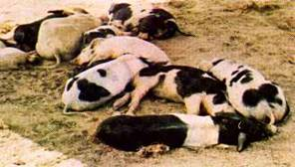
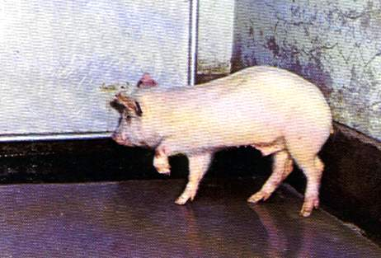
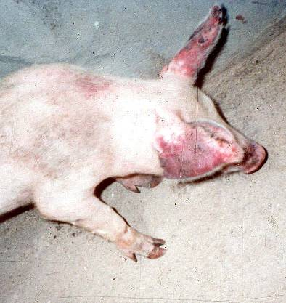
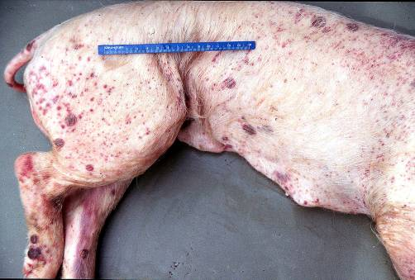
Clinical Signs

Slide 10
Necropsy findings
Spleen – Infarcts of wedge shaped, found on the
edges of the organ (browinesh in color)
Lungs – Croupous Pneumonia.
Intestine – In chronic cases, ulcers with raised edges “Button shaped ulcer” are often present in the cecum and/or colon. .
Kidney – petechiaetion on the cortex extending deeply into the parenchyma
-Turkey egg appearance.

Slide 11
Necropsy findings
Skin – Erythematous patches on the lips, vulva & edges of ears.
Brain – non – purulent meningo encephalomyelitis.
“Perivascular cuffing” - i.e – accumulation of lymphocytes, monocyes, plasma cells & local histocytes in the perivascular space
– ( Robin Virchow).

Slide 12
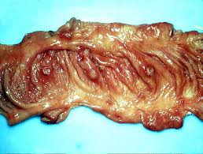
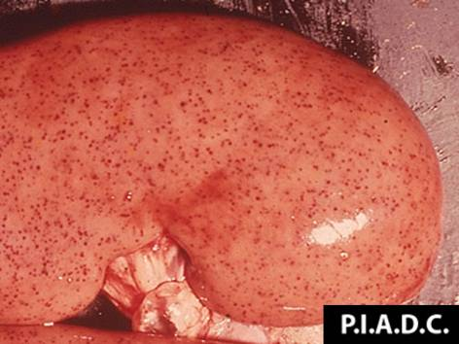
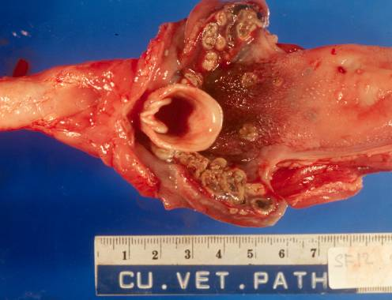
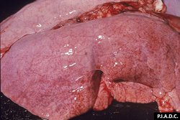
Post Mortem Lesions

Slide 13
Diagnosis
On the basis of history, clinical signs, temperatures and gross lesions.
Leucopenia in several suspected cases is suggestive of CSF.
The lesions of typical, acute cholera closely resemble and must be carefully differentiated from those of African swine fever, acute salmonellosis and acute swine erysipelas.

Slide 14
Diagnosis
Laboratory Tests
Detect virus, antigens, nucleic acids
Tissue samples (tonsils, spleen, kidneys, distal ileum)
Whole blood
ELISA or direct immunofluorescence
Serology
ELISA or virus neutralization
Comparative neutralization test
Definitive test

Slide 15
Differential Diagnosis
Diagnosis is impossible without lab testing
Porcine reproductive and respiratory syndrome (PRRS)
Porcine circovirus associated disease
Salmonellosis
Erysipelas
Leptospirosis
Aujeszky’s disease (pseudorabies)
African swine fever
Tonsil samples should be sent with every submission to your state diagnostic lab

Slide 16
Questions?
(If Any)

