Slide 1
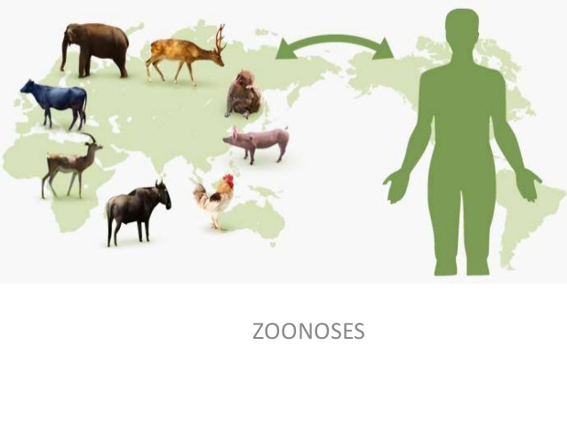
Classification of Zoonoses

Slide 2
Classification of Zoonoses
Zoonoses can be classified in many ways, the logical and scientific basis of classification of zoonoses are as follows:
On the basis of etiological agents
Based on transmission cycle
Based on reservoir hosts

Slide 3
On the basis of etiological agents
Bacterial
e.g. brucellosis, leptospirosis, listeriosis
b. Viral
e.g. rabies, Japanese encephalitis
Rickettsial and Chlamydial
e.g. Q fever, scrub typhus, ornithosis
Mycotic
e.g. dermatophytosis, cryptococcosis, histoplasmosis
e. Parasitic
e.g. toxoplasmosis, visceral larva migrans, hydatidosis

Slide 4
Based on transmission cycle (Baesd on the type of life cycle of the infective organism)
Direct zoonoses:
These zoonotic diseases are perpetuated in nature by a single vertebrate species
Infection is transmitted by direct contact- anthrax
Indirectly through food -taeniasis, air (tuberculosis) etc.
If a vector is involved in the transmission, there is no development of pathogen in the vector (mechanical transmission)
e.g. Anthrax, rabies, tuberculosis, scabies etc.
Cattle
Cattle
Cattle
Cattle
man

Slide 5
Based on transmission cycle (Based on the type of life cycle of the infective organism)
2. Cyclozoonoses
Require two or more vertebrate hosts to complete transmission cycle of an infectious agent
Classified into two sub types
(a) Obligatory cyclozoonoses
Man is must for completion of life cycle i.e. compulsory
host. e.g. Taenia solium, Taenia saginata
Man
Pig
Pig
Man

Slide 6
Based on transmission cycle (Based on the type of life cycle of the infective organism)
(b) Non-obligatory cyclozoonoses
Man is accidentally involved in transmission cycle.
Many a times, these zoonoses form cul-de-sac in man
e.g. Hydatidosis (Echinococcus granulosus)
Dog
Sheep/
Cattle
Dog
Sheep/
Cattle
man

Slide 7
Based on transmission cycle (Based on the type of life cycle of the infective organism)
3. Metazoonoses
Both vertebrate and invertebrate species are involved in the transmission of an infectious agent
In invertebrate hosts, infectious agent may multiply, develop or remain dormant
Classified into: four subgroups
(a) Metazoonoses type I :One vertebrate and one invertebrate host. e.g. Yellow fever, plague
Flea
Rat
Flea
Rat
man
(plague)

Slide 8
Based on transmission cycle (Based on the type of life cycle of the infective organism)
(b) Metazoonoses type II
One vertebrate and two invertebrate hosts
e.g. Paragonimiasis
Crab
Dog
Snail
Man
Snail
Crab
(Paragonimiasis)

Slide 9
Based on transmission cycle (Based on the type of life cycle of the infective organism)
(c) Metazoonoses type III
Two vertebrate and one invertebrate hosts
e.g. Clonorchiasis
Fish
Dog
Snail
Man
Snail
Fish
(Clonorchiasis)

Slide 10
Based on transmission cycle (Based on the type of life cycle of the infective organism)
(d) Metazoonoses type IV
Transovarian transmission
e.g. Tick-borne encephalitis
Sheep
Tick
Sheep
Tick
man

Slide 11
Based on transmission cycle (Based on the type of life cycle of the infective organism)
4. Saprozoonoses
Require a non-animate substance for completion of life cycle in addition to vertebrate or invertebrate host
i.e. food, soil, clothing, water, grass or plants
An infectious agent may multiply, develop or propogate on inanimate site may serve as reservoir or source of an infectious agent
It is subdivided into 3 types:
a. Saproanthrapozoonoses
b. Saproamphixenoses
c. Saprometanthrapozoonoses

Slide 12
Based on transmission cycle (Based on the type of life cycle of the infective organism)
Saproanthrapozoonoses
These diseases of animals are transmitted to human beings via
non-animate substance.
e.g. Cutaneous larva migrans, Ancylostomiasis
Snail
Dog
Snail
Dog
man
(Cutaneous larva migrans)

Slide 13
Based on transmission cycle (Based on the type of life cycle of the infective organism)
(b) Saproamphixenoses
These diseases are equally shared in nature by man and animals but are transmitted through inanimate objects
e.g. Histoplasmosis, fungal infections
Man
Snail
Dog
Snail
(Histoplasmosis)

Slide 14
Based on transmission cycle (Based on the type of life cycle of the infective organism)
(c) Saprometanthrapozoonoses
Require vertebrate host, invertebrate host and inanimate object
for completion of transmission cycle
e.g. Fascioliasis
Sheep
Snail
Plant
man

Slide 15
Based on reservoir hosts
Anthrapozoonoses
These are diseases of domestic and wild animals which occur in
nature independent of man
Human beings get infected from animals in unusual circumstances, through occupational contact or food
Mostly man act as cul de sac
e.g. Leptospirosis, tularemia, Rift valley fever, hydatidosis, rabies
Dog
Dog
man
(Leptospirosis)

Slide 16
Based on reservoir hosts
b) Zooanthroponoses :
These are diseases which normally pass from man to othervertebrate animals.
e.g. Tuberculosis (Human type), amoebiasis, diptheria (Human type).
Man
Man
Cattle
Tuberculosis (Human type)

Slide 17
Based on reservoir hosts
c) Amphixenoses
These are ubiquitous diseases for which man as well as vertebrate animals act as host. The agent can pass from man to animal and animal to man
e.g. Streptococcosis, non-host specific salmonellosis, staphylococcosis
Man
Man
Cattle
Cattle
(Streptococcosis)

Slide 18
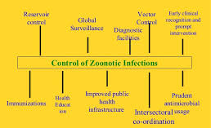
Management of Zoonoses
The control of zoonoses involves the following steps -
Reservoir Control
Vector
Control
Early clinical rcognition & prompt intervention
Global Surveillance
Diagnostic Facilities
Control of Zoonoses
Prudent antimicrobial
usage
Improved public health & infrastructure
Immunization
Health Education
Intersectoral
Co-ordination

