Slide 1
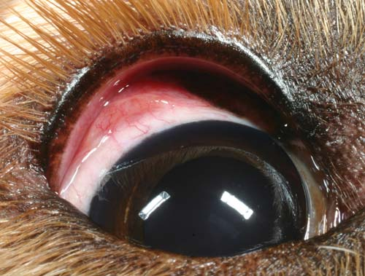
Department of Veterinary Medicine Bihar Veterinary College, Patna – 800 014 (BASU, Patna)
CONJUNCTIVITIS
UNIT -2
Dr. Ranveer Kumar Sinha Assistant Professor cum Junior Scientist
E-mail: ranveervet@rediffmail.com

Slide 2
INTRODUCTION
Conjunctivitis is a condition where the conjunctiva becomes reddened, congested and painful. It is the inflammation of the conjunctival mucous membrane
Classification according to etiology:-
1.Viral:ICH, CD, IBR
2.Bacterial:Staphylococcus,Streptococcus,Mycoplasma, Leptospira
3.Mycotic: Aspergillus, Candida
4. Parasitic: Eyeworm-Thelazia spp. Filarid worm & Setaria spp.
5.Traumatic: Thorn, Grass blade etc.
6.Chemical: Crossive agent, Tick dips
7. Allergic: Pollen, Drugs etc.

Slide 3
Etiology
Pink eye or infectious bovine Keratoconjunctivitis (IBK) is the most common ocular disease of cattle.
It is an inflammatory bacterial infection of the eye that can cause permanent blindness in severe cases.
It is a highly contagious disease, causing inflammation of the cornea and conjunctiva of the eye.
IBK is characterized by conjunctivitis, lacrimation and varying degrees of corneal opacity and ulceration.
Incidence of pinkeye increases in spring, peaks in the summer, and decreases in the autumn.

Slide 4
Predisposing Factors
Predisposing factors for IBK are
Plant pollens, ultraviolet radiations, tall grass, dry and dusty environmental conditions and transportation stress.
Flies (Musca spp.) can also serve as mechanical vectors for M. bovis.
Calves are more likely to develop the disease than adult cattle, as adult cattle appear to develop protective antibodies on the surface of the eye.
Bull calves have a higher incidence of disease than heifer calves.

Slide 5
Conjunctivitis in Dog

Slide 10
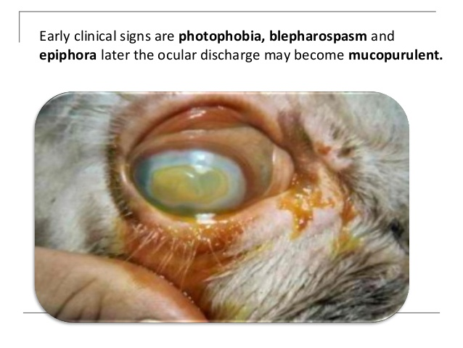
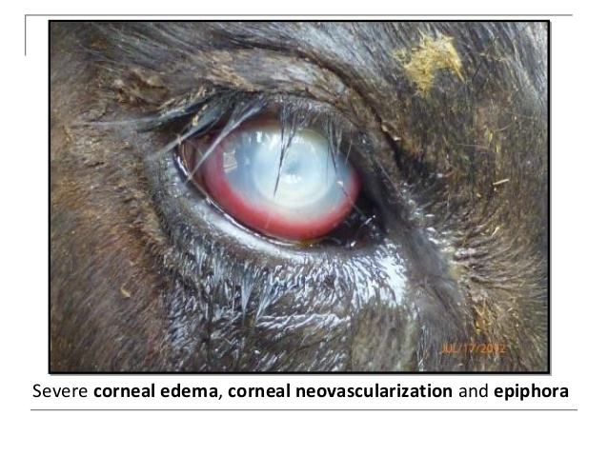

Slide 11
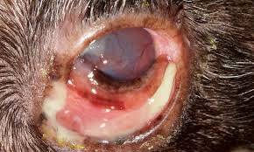
Conjunctivitis in Dog

Slide 12
Diagnosis
Presumptive diagnosis is based on ocular signs and concurrent systemic disease.
Microbial culture is important for confirmatory diagnosis.
It is important to distinguish that the lesions are not due to some other cause like some systemic disease or foreign bodies or parasites.

Slide 13
Differential Diagnosis
Traumatic conjunctivitis – evidence of physical injury or presence of foreign material in the eye.
Pasteurella multocida (capsular type A) – isolated from the eyes; outbreaks of severe keratitis with loss of corneal stroma.
Mycoplasma bovis – isolated from the eyes; outbreaks characterized by severe conjunctivitis, corneal opacity, ulceration, & swelling of eyelids.
Other diseases – Listeria monocytogenes iritis , Infectious bovine rhinotracheitis, Bovine malignant catarrh & Chalmydial Keratoconjunctivitis & Thelaziasis

Slide 14
Treatment
Ancillary therapy:
Animal should be placed in dark shelter out of direct sunlight.
Sterile NS irrigation 3-4 times a day
Antiseptic eye lotion Borozinc lotion (1-2%) may be instilled in eye
Systemic NSAID may be used to provide relief from secondary uveitis.
Animals with substantial uveitis secondary to Keratoconjunctivitis that is particularly painful may benefit from topical ophthalmic application of 1% atropine ointment 1–3 times daily.
Topical therapy:
(antibiotic solution or ointment):
Chloramphenicol, ciprofloxacin, Gatifloxacin Gentamicin, Ofloxacin Locally 2-3 times a day for 7-10 days
(antibiotic solution with cortcosteroid):
Cyprin D(Ciprofloxacin + Dexamethasone)
Genticyn B (Gentamicin + Betamethasone) etc

Slide 15
Treatment
Subconjuctival therapy:
Antibiotic & corticosteroid is given through the skin of upper eyelid or under the bulbar conjunctiva
Parental therapy:
Broad spectrum antibiotic for 3-5 days or
Long-acting oxytetracycline (2 injections @20 mg/kg, IM , at a 48- to 72-hr interval)

Slide 16
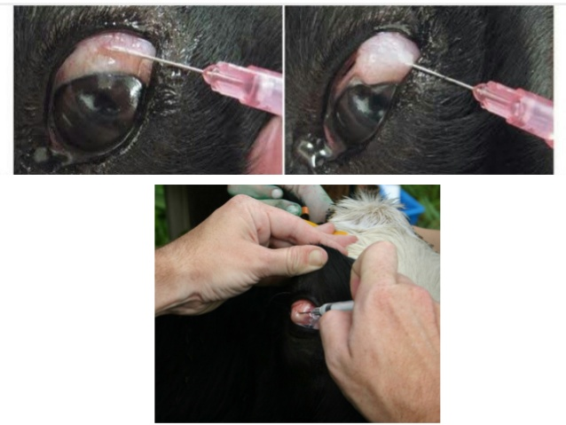

Slide 17
Prevention and control
Good management practices
Separation of infected animals
Ultraviolet radiation from sunlight may enhance the disease therefore affected animals should be provided with shade.
Reduce the incidence of flies and subsequent spreading of bacteria with the application of pour-on treatments.

Slide 18
THANKS YOU !

