Slide 1
CRYPTOCOCCUS
Dr Manoj Kumar

Slide 2
Taxonomy
Kingdom-fungi
Division- Basidiomycota
Genus: Cryptococcus
Species: Cryptococcus neoformans
Cryptococcus gatii

Slide 3
Introduction
Cryptococcus neoformans is an encapsulated yeast and an obligate aerobe that can live in both plants and animal
C. neoformans usually infects the lungs or the central nervous system (the brain and spinal cord), but it can also affect other parts of the body.

Slide 4
Cryptococcus spp. Are fungi in the division basidiomycota.
Two species – c. Neoformans and C. Gattii - commonly affect animals.
Cryptococcus spp. Are dimorphic fungi – occurs in hyphae and yeast form
Mainly occur in the yeast form
Reproduce by budding
Mating produces the perfect (mycelial) stage of the fungus.

Slide 5
Habitat
Found in soil contaminated with pigeon droppings
Cryptococcus neoformans grows easily in pigeon feces, however the birds are not naturally infected due to high body temp

Slide 6
Species:
The genus Cryptococcus includes around 37 species.
Among these, Cryptococcus neoformans and Cryptococcus gatii are the only species that is pathogenic to animals.

Slide 7
Serotypes-Cryptococcus neoformans
It has four serotypes (A to D).
Serotyping is based on capsular agglutination reactions.
All types can cause animal disease
Infection due to serotypes A and D common
Serotypes A and D found in excreta of wild and domesticated birds throughout world
Serotypes B and C found in flowers Eucalyptus camaldulensis
The two varieties, neoformans and gattii are morphologically similar, except that basidiospores of var. neoformans are round and those of var. gattii are more elliptical in shape.

Slide 8
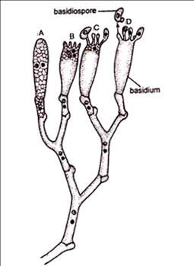
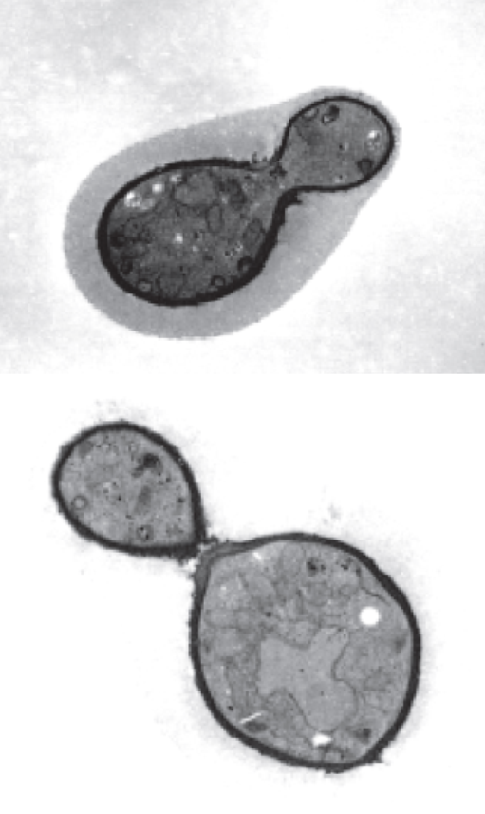
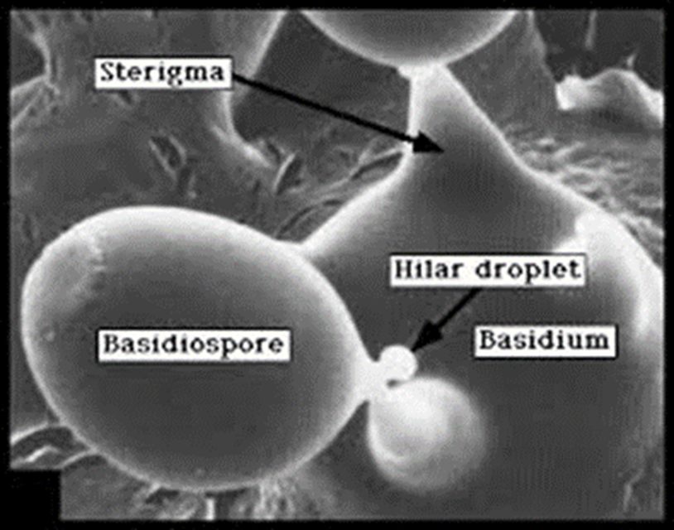
Morphology
The typical vegetative form of C. neoformans is the yeast form with a cell diameter of 2.5 μm to 10 μm.
A characteristic polysaccharide capsule of variable thickness (1-30μm) surrounds these yeasts.
In its natural environment the capsule is thinner and the yeast smaller, while thicker capsules tend to be found from infected tissues.
The capsules stain pink by the Meyer’s mucicarmine technique.

Slide 9
Virulence Factors
Virulence
The polysaccharide capsule
Melanin production
Mannitol production
Different enzymes : superoxide dismutase, proteases, phospholipase B, and lysophospholipase the phenoloxidase , urease
The organism's ability to grow at 37°C
These factors increase the degree of pathogenicity of a microbe

Slide 10
Mode of Infection:
Inhalation of the organism( basidiospores) from environment.
No animal to Animal transmission

Slide 11
Species Affected
Clinical cases found in most species of domesticated animals including:
Cattle
Sheep & goats
Buffalo
Dogs
Horses
Donkeys
Pigs

Slide 12
Birds
Clinical cases are uncommon in birds, althoughpsittacines are occasionally affected by C. neoformans var. gattii.
Cryptococcosis seems to be very rare in poultry and pigeons
C. neoformans can temporarily colonize the intestinal tract of some avian species.
This organism is especially prevalent in droppings from columbiform birds (e.g., pigeons)
Humans can be affected by both C. neoformans and C. gattii.

Slide 13
C. neoformans and C. gattii have been divided into serotypes, and also into “molecular” (genetic) types.
four serotypes, A through D, based on the capsular antigens.

Slide 14
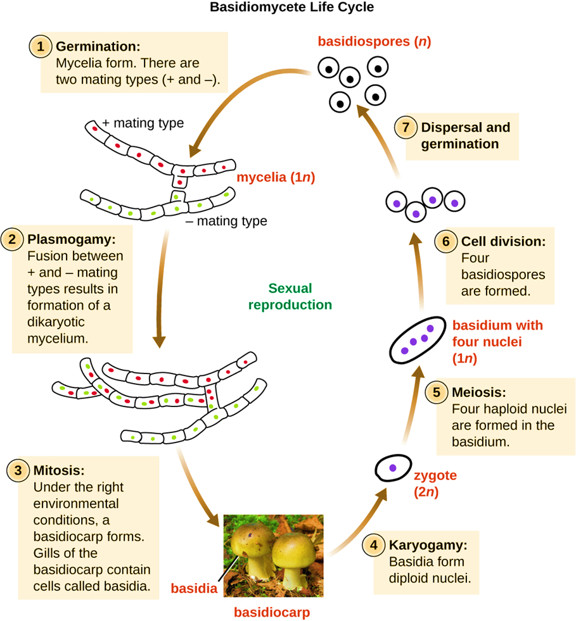
Life cycle
Life cycle
– Asexual: yeast that reproduce by budding
Animal infections
– Sexual
C. neoformans is heterothallic haploid yeasts that exist in two mating types, MATαand MATa.
MAT α strains are predominant in nature

Slide 15
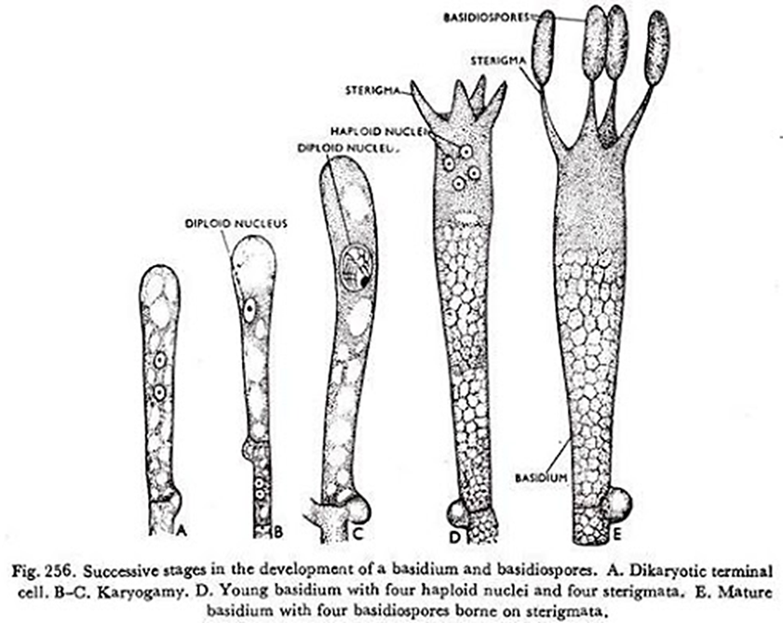
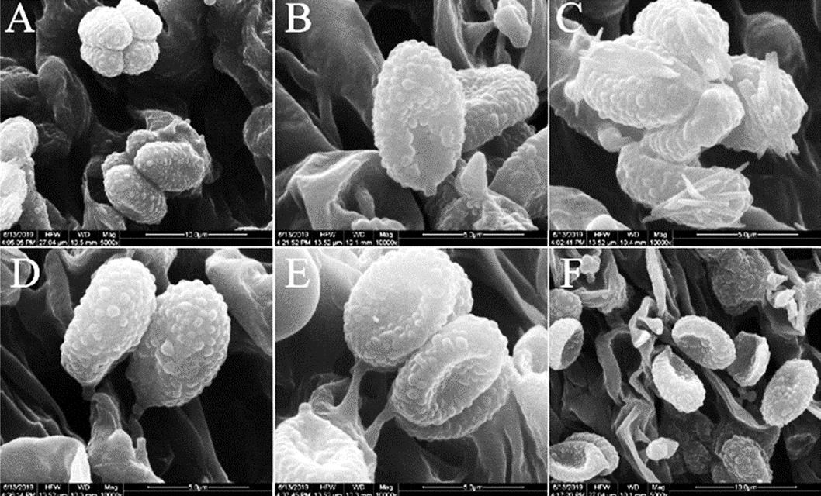
Cont…
The haploid cells propagate asexually by budding
In Sexual life cycle
strains of opposite mating type come into contact on substrates conducive for mating
In the terminal swollen part of the basidium, the two nuclei from opposite mating types fuse to form a single transient diploidnucleus
diploidnucleus undergoes one cycle of meiotic division producing four haploid nuclei

Slide 16
four haploid nuclei repeatedly undergo mitotic division
basipetally produce bud of four long chains of basidiospores (sexual spores) consisting of MATα and MATa type spores in an equal ratio
These basidiospores can cause infection

Slide 17
Life cycle

Slide 18
Pathogenesis
Cryptococcus spp. are almost always acquired from environmental sources, mainly by inhalation.
organisms usually replicate initially in the lungs
primary colonization might also occur in the nasal cavity and sinuses of some animals.
Cryptococcal organisms occasionally enter the body through breaks in the skin,
In cattle with cryptococcal mastitis, they enter the mammary gland through the teat.
Other routes (e.g., ascending infections via the urinary tract)
Latent infections occurs n animals: small numbers of viable organisms, encapsulated in granulomas in the lungs or lymph nodes
Both of these organisms grow as yeasts inside the body, and reproduce by budding.

Slide 19
Transmission
Direct transmission between animals in unusual circumstances (although infections can be acquired from bird droppings).

Slide 20
Infections in Animals
Clinical Signs
Ruminants
Pulmonary infections, CNS involvement and cryptococcal
mastitis have been reported in cattle.
Mastitis:
clinical signs may include
Anorexia
decreased milk production
enlargement of the supramammary lymph nodes
affected quarters are usually swollen and firm
milk may be viscid, mucoid and grayish-white, or it may be watery with flakes.

Slide 21
Birds
Psittacine birds have signs of an upper respiratory tract obstruction
Often have proliferative lesions, which may resemble neoplasia, around the beak or nares
Cryptococcosis - rare in pigeons

Slide 22
Diagnostic Tests
Samples
Blood, or in other samples from biopsies
Impression smears
Aspirates or swabs of affected sites
Nasal secretions
Bronchial washings
Skin exudates
Csf
Urine

Slide 23
Observation under microscope
Observation of clinical samples under microscope after staining
C. neoformans and C. gattii are round to oval yeasts, surrounded by large capsules that stain strongly with Mayer’s mucicarmine.
In an India ink preparation, the capsule appears as a clear halo around the yeast cell.
latex agglutination test can used to detect C. neoformans capsular antigens in blood, CSF or urine.

Slide 24
Confirmatory diagnosis
By culture. On fungal media such as sabouraud dextrose agar without cycloheximide.
Colonies usually appear within 2 to 5 days
The organism is identified by its appearance, ability to grow at 37°C and biochemical tests
By molecular methods such as DNA sequencing;
By commercial yeast identification systems.

Slide 25
Thanks

