Slide 1
Mechanisms & characteristics of gas-fluidization systems Application of fluidization in drying, Batch fluidization, Fluidized bed dryers.
Dr. J. Badshah
University Professor – cum - Chief Scientist
Dairy Engineering Department
Sanjay Gandhi Institute of Dairy Science & Technology, Jagdeopath, Patna
(Bihar Animal Sciences University, Patna)

Slide 2
Solid Gas Separation in spray Dryers
Importance of Separation of fine powder particles (10 -30%) from air exiting from drying chamber
Economic Reasons
Pollution Problems
Methods of powder recovery from exhaust air
1. Cyclone separators 2. Bag filters 3. Wet scrubbers
Working of Cyclone Separators
High efficiency, Easy to maintain and Easy to clean.
Vortex motion due to centrifugal force move the particles of powder towards the wall but the Drag force of the air tries to carry the particles towards axis of cyclone.
Centrifugal force predominant over drag force resulted in separation of particles towards radial direction. Powder leaves the bottom of the cyclone via a locking device. The clean air spirals upwards along the center axis of the cyclone and passes out at the top.

Slide 3
Efficiency of Cyclone separators
Optimum size and Nos. of cyclone depend upon:
Centrifugal Force = m ( v_{t} ) ²/ r
Higher mass, Higher tangential velocity and lower radial distance of particles i.e. conical shape towards exit of powder particles results in high efficiency of separation.
Residence time should be equal to the time required by the travel towards wall for smallest size of particles
Risk of air leaks through valves in multi-cyclones
Need of one valve , final cyclone and central hopper
Same pressure drop over each cyclone to avoid powder losses
Cleaning problems and large nos. of corners and crevices for bacterial growing and multiplying problem
Optimum size is not 1.0 meter dia. Of cyclone but generally 2.5 -3.0 m dia. With air handling cap. Of 25,000 to 30,000 kg/hr.

Slide 4
Efficiency of Cyclone separators
Cyclone diameter : Inlet duct diameter = 3:1
Cyclone diameter : exit duct diameter = 10:1
Air through-put velocity V₀ and increased pressure drops will also increase the efficiency, but the energy requirement will increase simultaneously.
In general the upper limit of pressure drop is 175-200 mm WG for skimmilk powder and 140-160 mm WG is the maximum for whole milk in order to avoid deposits and final blocking.
In most cases rotary valves are used as air lock and product discharge at the bottom of the cyclone

Slide 5
Terms to define efficiency of cyclone
The critical particle diameter : The particle size that will be completely removed from the air flow (100% collection efficiency).
The cut size : The size for which 50% collection is obtained
The overall cyclone efficiency : It is obtained when handling a product of definite size distribution.
Another method of learning the cyclone efficiency is by a simple powder loss measurement after the cyclone.
A very small fraction of the out-going air is passed through a high-efficient mini cyclone or through micro dust filters.

Slide 6
Bag Filters
Stack Losses Requirement: Less than 0.5 % to make ecofriendly
Bag Filters of proper fabrics material may give high efficiency with collection of particles of 1 micron size even. Fabrics filters consist of woven fabrics of tubular shape and supported over certain frames preferable.
Arrangement of multi bag filters to have equal volume of air through each filter from outside to inside
Clean air is exhausted from inner part of bags to exhaust manifolds and powder
The collected powder is automatically shaken off by blowing compressed air through the filter bags from the inner side. The powder is collected at the bottom via a rotary valve.
Continuous build up dust layer on the fabric surface results in increase in pressure drop and thus in drop of capacity.
To avoid this, the dust is continuously dislodged by mechanical sacking or by reverse air pulsations.

Slide 7
Bag Filters.. Contd.
Collection efficiency : 99 % for particles upto 1 micron
Pressure Drop : 7- 15 cm of water gauge
Dry Recovery is advantageous in comparison to wet scrubbers
No corrosion and rusting
Plugging of fabric pores need maintenance and frequent replacement due to hygrscopicity of powder
The amount of powder collected is directly proportional to the powder loss, which will mainly due to:
• Feed with low solids or feed containing air • High outlet air temperature • Low particle density due to entrapment of air • Leaking product outlet from old non-adjusted rotary valves • Blocked cyclone • Change in drying parameter resulting in decrease of mean particle size

Slide 8
Wet Scrubbers
Working of wet – scrubber:
It is based on the venturi scrubber principle with an efficiency very close to 100%.
The liquid is injected through full - cone nozzles in the ventury as driving fluid and the outlet air from the spray dryer containing powder particles is accelerated to a high velocity in the venturi inlet before mixing zone.
Due to different velocities between the air/particles and the liquid droplets, they will collide, mixed and the powder will dissolve in the liquid droplets.
Passing through the subsequent diffuser this process will continue simultaneously with a certain pressure recovery of the air/droplet mix.
Passing through the separator, air and liquid are separated again. The air leaves through the centre duct and the liquid through the bottom outlet for further processing or recycling depending on what system is selected.

Slide 9
Wet Scrubbers
Product is collected wet which subsequent drying.
Initial Cost is high.
Pressure drop is higher. Thus operating cost is more.
Large space requirement.
Sever corrosion and maintenance problem.

Slide 10
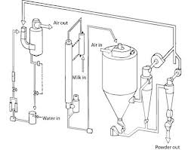
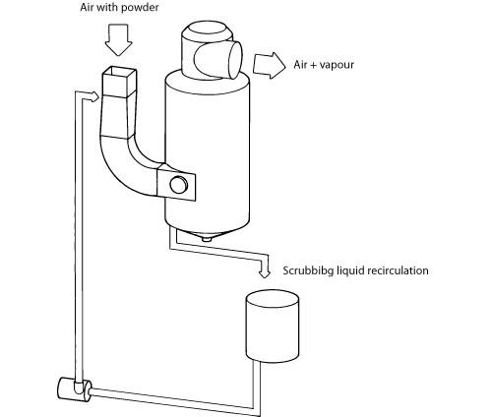
Schematic diagram of Wet scrubbers

Slide 11
Bag Filter in Niro spray Dryers
All the process air is discharged through bag filters integrated inside the drying chamber at the periphery, where they hang down from the ceiling. The separation efficiency (≤10 mg/Nm³ air) ) is the same as that known from the Niro SANICIP™ CIP‐able bag filter.
During operation the product, which is collected on the outside of the filter material, is removed by a compressed air stream blown into the inside of each bag by means of a specially designed reverse jet air nozzle (patented) positioned above each bag.
This results in a low pressure drop across the filter, i.e. reduced energy consumption and noise emission.
Another special feature (patented) in the IFDTM plant ‐ inherited from the Niro SANICIP™ bag filter ‐ is the wet cleaning of the bags from inside towards the dirty outside by means of CIP solution, which reduces the overall CIP liquid amount and thereby the effluent from the plant.

Slide 12
THANK YOU

