Slide 1
Drugs acting on Autonomic Ganglia
Dr. Nirbhay Kumar
Asstt. Professor & Head
Deptt. of Veterinary Pharmacology & Toxicology
Bihar Veterinary College, Bihar Animal Sciences University, Patna

Slide 2
Ganglionic Transmission
Acetylcholine (ACh) is the primary excitatory neurotransmitter in both sympathetic and parasympathetic ganglia.
Drugs alter the ganglionic function by either stimulating (ganglionic stimulants) or blocking (ganglionic blockers) the impulse transmission through the autonomic ganglia.
The principal pathway of impulse transmission through the ganglia involves release of ACh from the preganglionic nerve endings and the stimulation of nicotinic receptors by ACh on the post-junctional membrane (EPSP) causing rapid depolarization and subsequent propagation of the impulse through the post-ganglionic nerve fibre.

Slide 3
Diagrammatic representation of Ganglionic Transmission

Slide 4
Ganglionic Transmission contd…
ACh is discharged from the preganglionic nerve terminal and interacts with a nicotinic receptor on the ganglionic neuron to cause a rapid depolarization measured electrically as a fast excitatory post synaptic potential (EPSP).
ACh also interacts with a muscarinic receptor on the ganglionic neuron to cause a delayed depolarization measured electrically as a slow EPSP.
In addition, ACh activates nearby chromaffin cells through a muscarinic receptor, which results in a release of catecholamine (CA: dopamine or epinephrine).
CA interacts with an a receptor on the ganglionic neuron to cause an inhibitory (hyperpolarization) response measured electrically as an inhibitory post synaptic potential (IPSP).

Slide 5
Ganglionic Stimulants
[I]. Natural Alkaloids:
Nicotine:
Obtained from the leaves of Nicotiana tabacum.
Small doses stimulate the CNS. Large doses → tremors or even convulsions.
Respiratory stimulation is due to direct stimulation of medullary respiratory centre and through activation of carotid and aortic chemoreceptors. The stimulation is followed by depression of the CNS.
Nicotine can stimulate the sympathetic and parasympathetic ganglia in small doses. In large doses, it blocks ganglia.
GI tract : Due to stimulation of parasympathetic ganglia → Salivation, increase in tone and motility of GI tract and defaecation.
Nicotine toxicity may cause CNS excitation followed by marked depression and even death due to central respiratory failure and paralysis of peripheral respiratory muscles.
2. Lobeline: It is obtained from the leaves of Lobelia inflata.

Slide 6
Ganglionic Stimulants contd…
[II]. Synthetic Compounds:
(a) Trimethylammonium (TMA)
(b) Tetraethylammonium (TEA)
(c) Dimethylphenylpiperazinium (DMPP)

Slide 7
Ganglionic Blockers
These drugs competitively antagonize the action of ACh on the nicotinic receptors on the post-ganglionic membrane and thus block ganglionic transmission.
Ganglionic blockers are all synthetic compounds.
(i) Hexamethonium
(ii) Pentolinium
(iii) Trimethaphan
(iv) Mecamylamine

Slide 8
Pharmacological effects of Ganglionic Blockers
CVS: Vasodilatation, increased peripheral blood flow, venous pooling, decreased cardiac output, hypotension and tachycardia.
GI tract: Reduced tone and motility.
Eye: Mydriasis and cycloplegia.
Bladder: Relaxation and urine retention.
Sweat glands: Anhydrosis.
Salivary glands: Xerostomia (dry mouth).

Slide 9
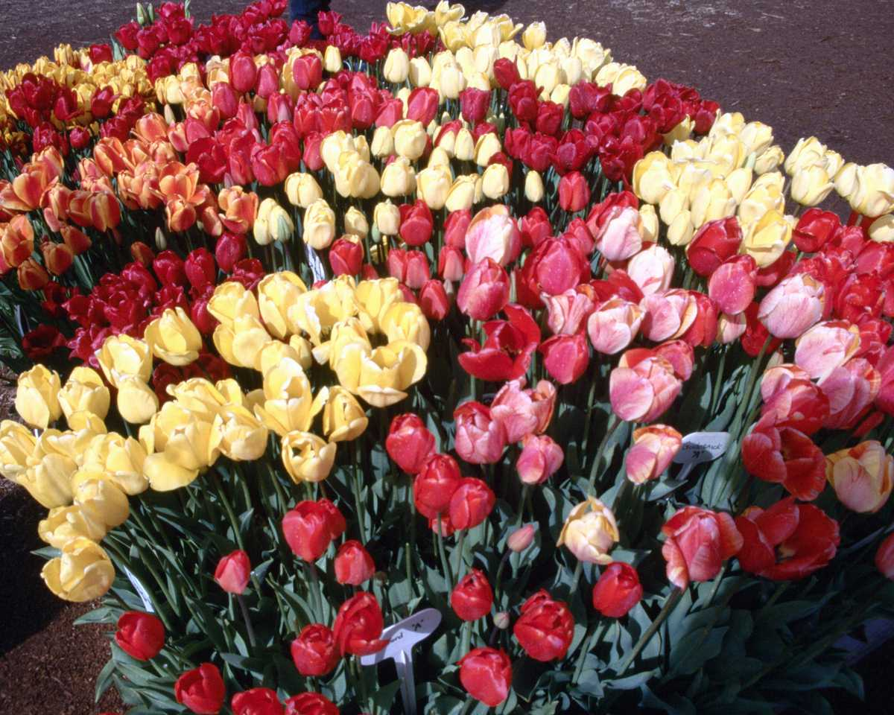
Thank You

