Slide 1
Unit-8 EMBRYOLOGY
Topic - General embryology
Development of Placenta
(EXTRAEMBRYONIC MEMBRANE)
Date of Lecture 25.04.2014
Course instructor – Dr. Manoj Kumar Sinha
Department of veterinary Anatomy

Slide 2
EXTRAEMBRYONIC MEMBRANE
During development of embryo the germ layer extends far from the embryonic area and peripheral part of the germ layer give rise to extra embryonic membrane
It is discarded at the time of birth
Four types of extra embryonic membrane:
Amnion
Yolk sac
Allantois
Chorion

Slide 3
AMNION
Develops into folds from all parts of embryo
Due to continuous growth these folds came together above the mid dorsal region of embryo and fuse with one another to form a single covering of somatopleure
The limb of somatopleure forms amnion and outer limb forms chorion (serosa)
Tracheal and oral secretion as well as urine enters into amniotic sac as pregnancy advances
The embryo remain suspended in amniotic fluid which prevent its adhesions and prevent the embryo from injury
The amniotic sac is fully formed in pig, sheep and cow in 16th 17th and 18th days of fertilization respectively
In chick it is formed in 72 hrs of incubation

Slide 4
YOLK SAC
It is the first extra embryonic membranes appear
There are three folds : cephalic, lateral, and caudal fold these folds push the somatopleure downward and affect the splanchnoplerue
Anterior part of endoderm forms-Foregut
Middle undifferentiated part forms-Hind gut
Original endodermal sac remains undifferentiated and continuous with midgut is called yolk sac
In cattle and pig it absorbed the uterine milk to provide nutrition to development embryo.
In horse & dog it develops villi.
In adult remnant of yolk sac present at the junction of ileum & jejunum as small diverticulum called Meckel’s diverticulum . It is more common in birds and ruminants.

Slide 5
ALLANTOIS
It develops from the splanchopleure .
It appear as a diverticulum from ventral wall of hindgut on its external surface.
Its narrow proximal part is called allantoic stalk & distal portion is called allantoic vesicle.
In dog & horse its completely encloses the embryo.
In pig and sheep it does not cover the dorsal aspect of embryo.
Allantoic fluid smooth discoidal rubber like brown masses make their appearance during later part of pregnancy is called Hippomanes.
In pig allantois appear on 6th day & fully formed by 28 day of post fertilization & chick appear on 3rd day & full formed 9th day.
It dispose of waste products & contributes to gas exchange.

Slide 6
CHORION
Chorion is outermost extra embryonic membrane.
It is a composite structure formed due to fusion of allantois & serosa.
It consist of four layers.
a. Trophoectoderm
b. Somatic mesoderm
c. Splanchnic mesoderm
d. Endoderm
The allantois fuses with serosa in cow, sheep, and pig on 36th day
In the mares a girdle like structure is formed in chorion, cells of this girdle migrated into endometrium and transformed into concave shaped structre called Endometrial cups
Endomerial cups are 12 in number and it secrets equine chorionic gonadotropin harmone kown as PMSG (Pregnant Mare Serum Gonadotropin)

Slide 7
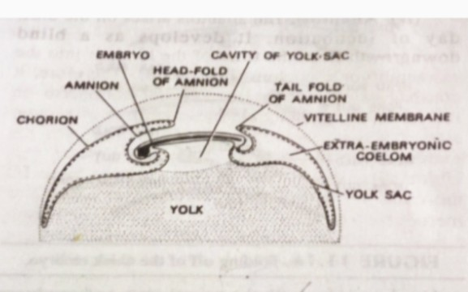
Appearance of embryonic membranes in chick embryo

Slide 8
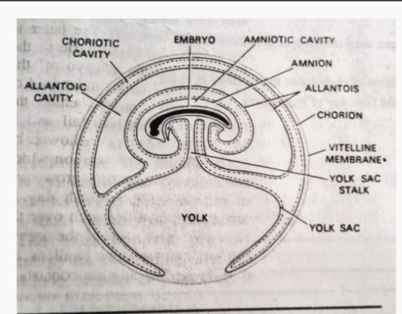
Embryonic membranes of chick- embryo almost fully develop

Slide 9
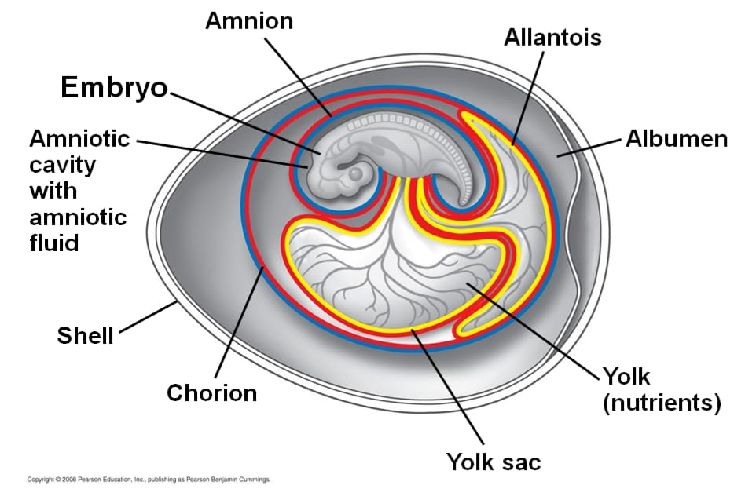
Extraembryonic Membrane in Birds

Slide 10
THANK YOU

