Slide 1
BIOCHEMISTY
Course No.-DTC-111, Credit Hours – 2 (1+1)
ELECTRON TRANSPORT CHAIN AND ATP SYNTHESIS
BINITA RANI
ASSOCIATE PROFESSOR (DAIRY CHEMISTRY)
FACULTY OF DAIRY TECHNOLOGY
S.G.I.D.T., BVC CAMPUS,
P.O.- BVC, DIST.-PATNA-800014

Slide 2
•In eukaryotes => Electron transport and oxidative phosphorylation => inner mitochondrial membrane.
• These processes => re-oxidize NADH and FADH2 <= from the citric acid cycle (mitochondrial matrix ), glycolysis (cytoplasm ) and fatty acid oxidation ( mitochondrial matrix ) and => trap the energy released as ATP.
• Oxidative phosphorylation => major source of ATP in the cell.
In prokaryotes => electron transport and oxidative phosphorylation components => in the plasma membrane.

Slide 3
Redox Potential
Oxidation => loss of electrons.
Reduction => gain of electrons.
In chemical reaction :
if one molecule is oxidized => another must be reduced
i.e. oxidation-reduction reaction => transfer of electrons.
.

Slide 4
when NADH => oxidized to NAD+ => it loses electrons.
When molecular oxygen => reduced to water => it gains electrons :

Slide 5
Oxidation-reduction potential, E, (redox potential)
a measure of affinity of a substance for electrons and
is measured relative to hydrogen.
Positive redox potential
substance => higher affinity => electrons than hydrogen
so would accept electrons from hydrogen,
e.g., Oxygen , a strong oxidizing agent

Slide 6
Negative redox potential
substance has a lower affinity for electrons than does hydrogen
would donate electrons to H+, forming hydrogen,
e.g., NADH , a strong reducing agent

Slide 7
For biological systems,
standard redox potential for a substance (E0’)
measured at pH 7 & expressed in volts.
In oxidation-reduction reaction
electron transfer is occurring
total voltage change of the reaction (change in electric potential, ΔE) => is the sum of voltage changes of individual oxidation-reduction steps.

Slide 8
Standard free energy change of a reaction at pH 7 => ΔG0’=> calculated from the change in redox potential ΔE0’ of substrates and products:
ΔG0’ = -n F ΔE0’
Where, n -- number of electrons transferred,
ΔE0’ -- in volts (V),
ΔG0’ -- in kilocalories per mole (kcal mol-1) and
F -- constant called Faraday (23.06 kcal V-1 mol-1).

Slide 9
A reaction with a positive ΔE0’ has a negative ΔG0’ (i.e., is exergonic).
Thus for the reaction:

Slide 10
Electron Transport from NADH

Slide 11
• NADH oxidation and ATP synthesis → not occur in a single step.
Electrons → not transferred from NADH → oxygen directly.
Electrons are transferred from NADH → oxygen → along a chain of electron carriers → called electron transport chain (respiratory chain).

Slide 12
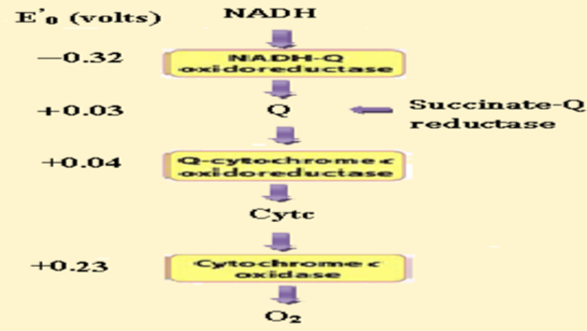
Organisation of Electron Transport Chain complexes

Slide 13
Electron Transport Chain
Consists of 3 large protein complexes embedded in inner mitochondrial membrane :
• NADH dehydrogenase complex (Complex I)
• Succinate Q reductase
• The cytochrome bc1 complex (Complex II)
• cytochrome oxidase ( Complex III)

Slide 14
Electrons flow from NADH to oxygen through these three complexes
Each complex contains → several electron carriers → work sequentially → carry electrons down the chain.
2 free electron carriers are also needed to link these large complexes:
• Ubiquinone {coenzyme Q (CoQ)}
• cytochrome c

Slide 15
ATP Synthesis (Oxidative Phosphorylation)
• NADH and FADH2 are oxidized by electron transport through → respiratory chain → Synthesis of ATP.
• Energy liberated by electron transport => used to create a proton gradient across the mitochondrial inner membrane => that is used to drive ATP synthesis (chemiosmotic hypothesis)→ in presence of ATP synthase .

Slide 16
Thus the proton gradient couples electron transport and ATP synthesis .
(not a chemical intermediate as in substrate level phosphorylation.)
(enzyme → originally → ATPase because → without input of energy from electron transport → the reaction can reverse and actually hydrolyzes ATP.)

Slide 17
Summary
• Electron transport down the respiratory chain → from NADH oxidation => causes H+ ions to be pumped out → into the inter membrane space by three H+ pumps → NADH dehydrogenase, cytochrome bc1 complex and cytochrome oxidase.
• Free energy change => in transporting an electrically charged ion => across a membrane => leads to formation of electrochemical proton gradient.

Slide 18
The pumping out of H+ ions → generates a higher concentration of H+ ions → in inter membrane space and an electrical potential →the side of the inner mitochondrial membrane facing the inter membrane space → positive.
Protons flow back → mitochondrial matrix according to electrochemical gradient through ATP synthase → drives ATP synthesis.
The ATP synthase is driven by proton-motive force → which is the sum of pH gradient (the chemical gradient of H+ ions) and membrane potential (electrical charge potential across the inner mitochondrial membrane).

Slide 19
FADH2 is re oxidized → via ubiquinone → its oxidation causes H+ ions to be pumped out only by the cytochrome bc1 complex and cytochrome oxidase → so the amount of ATP made from FADH2 is less than from NADH.
Measurements → show that 2.5 ATP molecules are synthesized per NADH oxidized whereas 1.5 ATPs are synthesized per FADH2 oxidized.

Slide 20
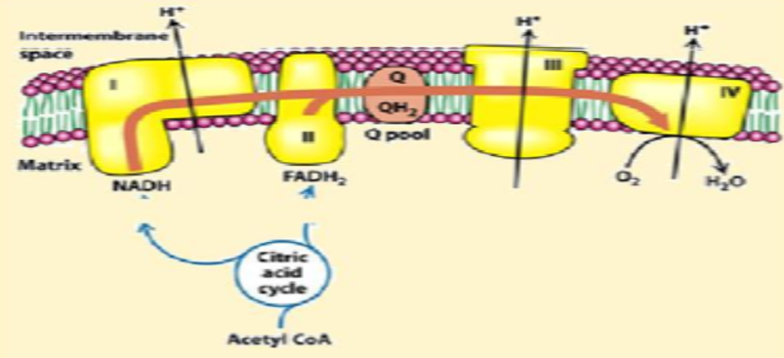
Summary of Electron Flow

