Slide 1
Unit-8 EMBRYOLOGY
Topic - General embryology
(Periods of Embryology)
Date of Lecture 07.04.2014
Course instructor – Dr. Manoj Kumar Sinha
Department of veterinary Anatomy

Slide 2
PERIODS OF EMBRYOLOGY
The changes occur during the whole gestation period are divided into three major stages:
Germinal Stage : Includes Cleavage, Formation of morula and blastocyst, implantation of blastocyst, and appearance of three germinal layer
Embrryonic Stage: Includes differentiation of three germinal layers and and formation of most of the tissues and organs
Foetal Stage: Includes growth of various system of embryo without much tissue differentiation and development of placenta

Slide 3
GESTATION PERIOD OF DIFFERENT ANIMALS
ANIMALS | PERIOD OF GESTATION (IN DAYS)
Cow | 280-290
Mare | 330-340
Dog/Cat | 60-65
Sow | 110-130
Goat/Sheep | 140-160
Human | 270-290
Elephant | 600-650
Rabbit | 30-35
Rhinoceros | 520-560
Rat | 20-25
Monkey | 160-175
Hen | 20-25 (Incubation Period)

Slide 4
GERMINAL STAGE
CLEAVAGE : Is the process of rapid successive mitotic division of an ovum immediately after its fertilization ,resulting in production of increasing number of smaller cells within the zona pellucida ,called BLASTOMERS
The rate of cleavage division = 1/Amount of yolk present in ova
TYPES OF CLEAVAGE: Vary species to species
Holoblastic/Total cleavage Meroblastic/Partial cleavage (scanty deutoplasm in ovum) (Abundant deutoplasm in ovum)
Equal Unequal Discoidal Suprrficial
Eg: Mammals Eg: Amphibians Eg: Reptiles Eg: Arthropod

Slide 5
MORULA
No. of cells (Blastomeres) 12 to 16 and remain closely packed without formation of any cavity looks like a mulberry fruit, called Morula
In chick embryo it appears as a disc shaped mass of cells
Central cell mass of the morula gives rise embryo proper and peripheral cells from protective and nutritive covering of the embryo
With the continuation of cleavage the zygote migrates from ampulla of fallopian tube and reach to the cavity of uterus either in the horn or in the body depends upon the species
Migration depends upon cilia of the mucous membrane of the tube and muscular contraction

Slide 6
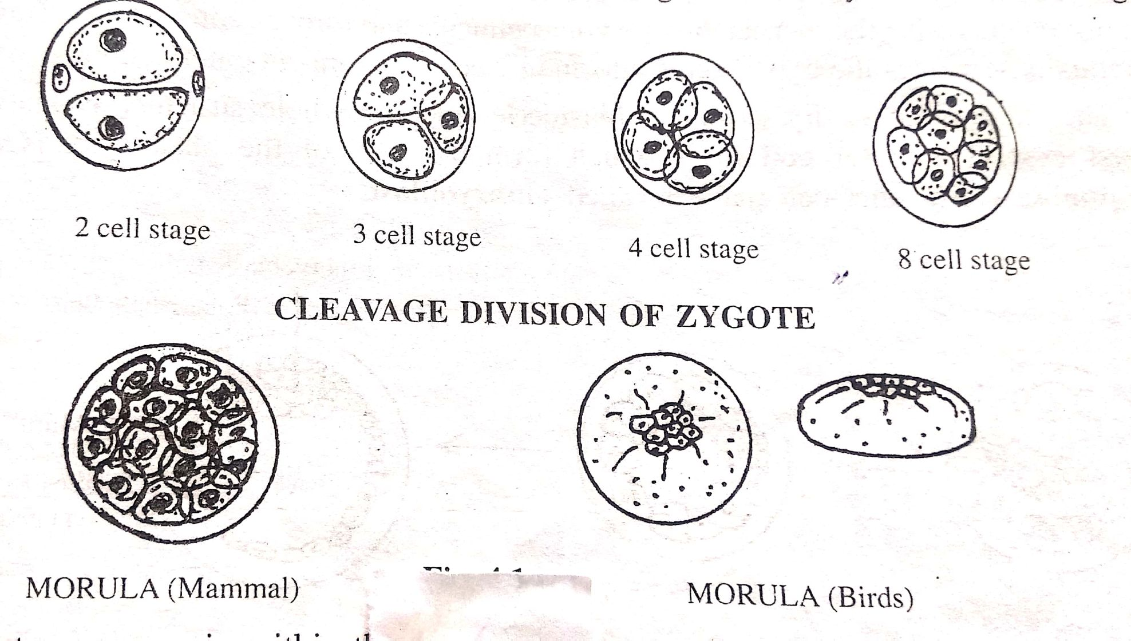

Slide 7
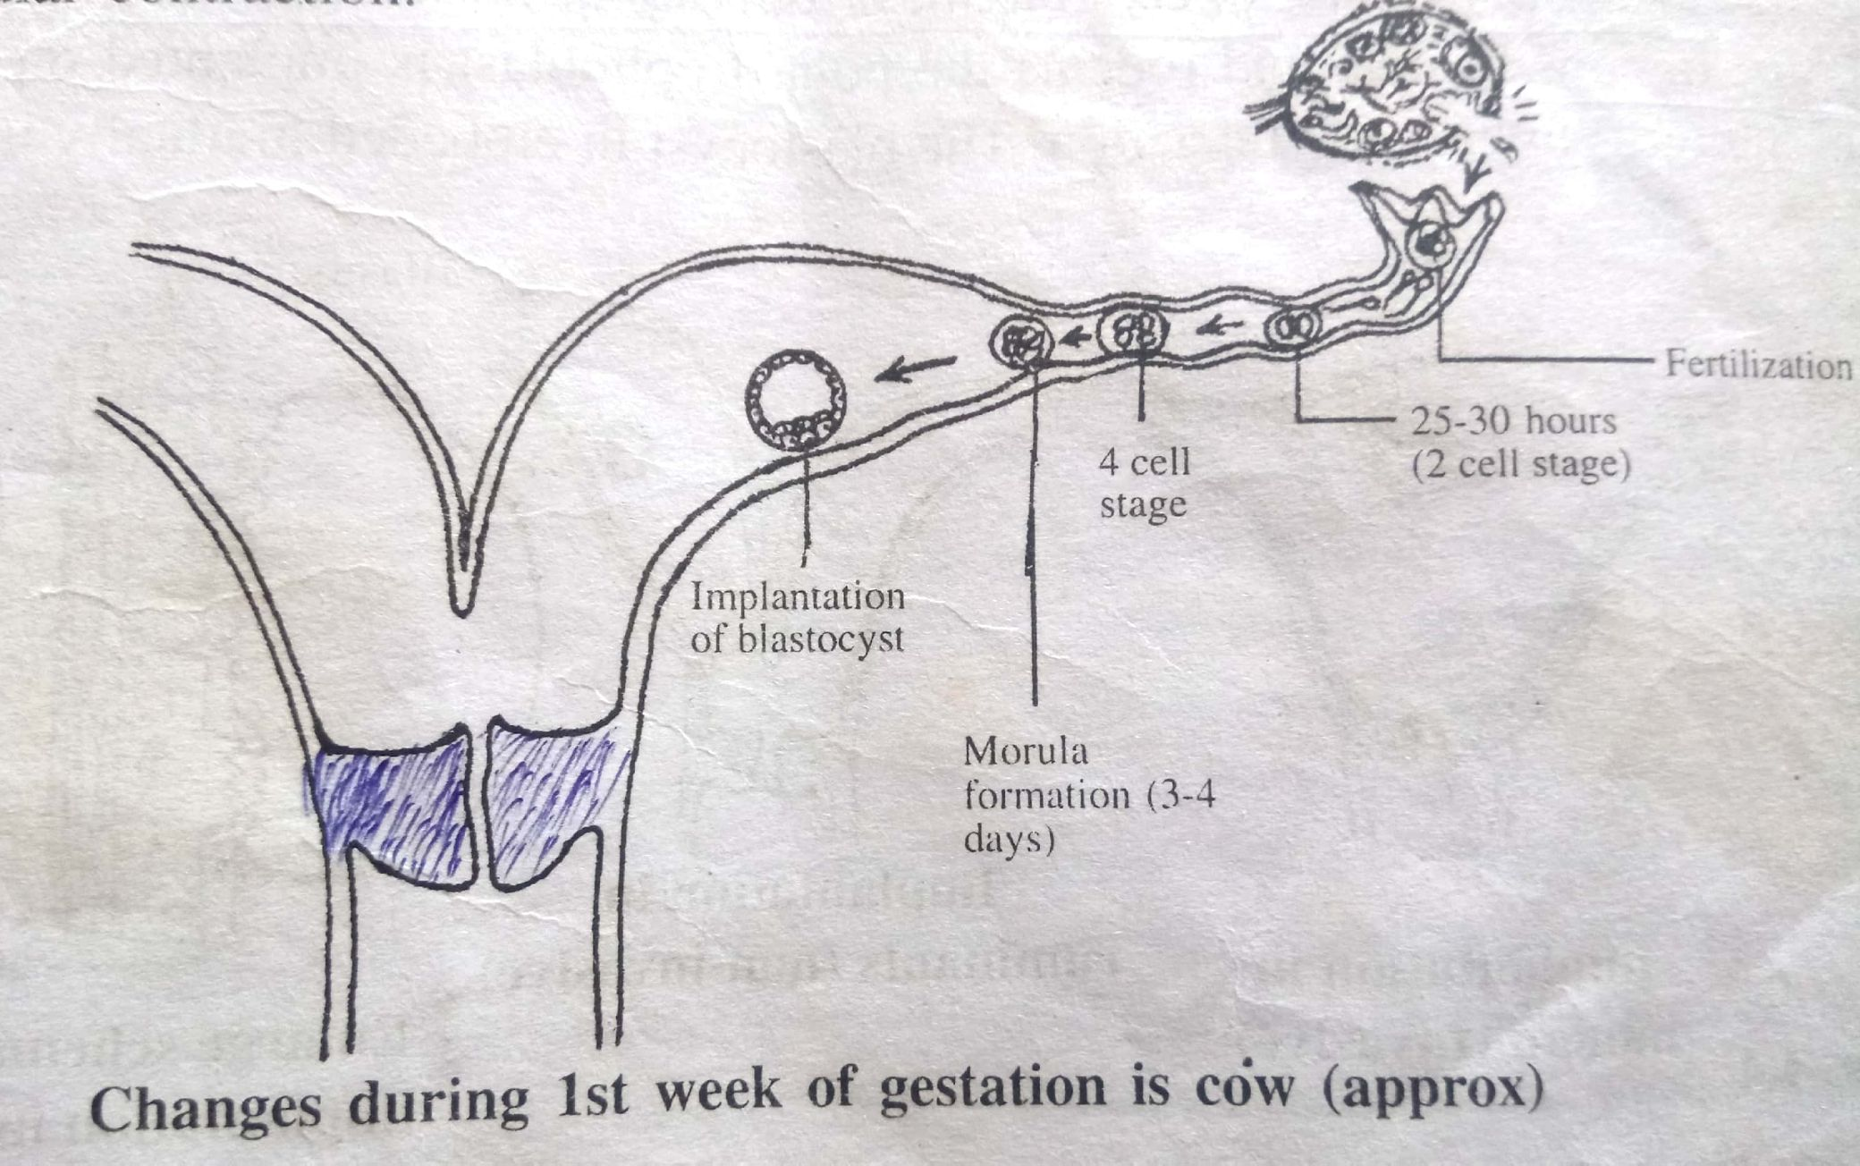

Slide 8
BLASTOCYST
Blastocyst formed b/w 4-5 day after fertilization in cow and man
In the uterine cavity the blstomers continue to divide ,fluid from the lumen of the uterus enter inside morula through zona pellucida and form central cavity
This fluid separates blstomeres into an inner cell mass and an outer cell mass
This whole structre are called blastocyst and fluid filled cavity is called Blastocele
Outer cell mass which form the wall of blastocyst is called Trophoblst and iner cell mass is called Embryoblast
The trophoblast that covers the embryonic pole of of blastocyst is k/a Polar Trophoblast and other part forming the wall of cavity is known as Mural Trophoblast

Slide 10
IMPLANTATION OF BLASTOCYST
The zona pellucida disappears on 5th or 6th day of fertilization in human and 7th to 9th day in cow
By the end of 2nd wk the blastocyst is completely embeded in the endometrial stoma in human by histolytic action of trophoblast (Invasive process)
In domestic animal it is not invasive process (except in Pig) but it occures by adesion and apposition between trophoblast and uterine epithelium . In Ruminants pacental attachments involves both caruncular and inter-caruncular area of endometrium
On 17th day of gestation uninucleate trophoblst give rise to binucleate cells it persist throughout gestation period and give rise to immunoloic protection
In Mare implantation takes place on 24-40 days
Trophoblast differentiate into inner (cytotrophoblast)
outer (syncytotrophoblast/syncytium)

Slide 11
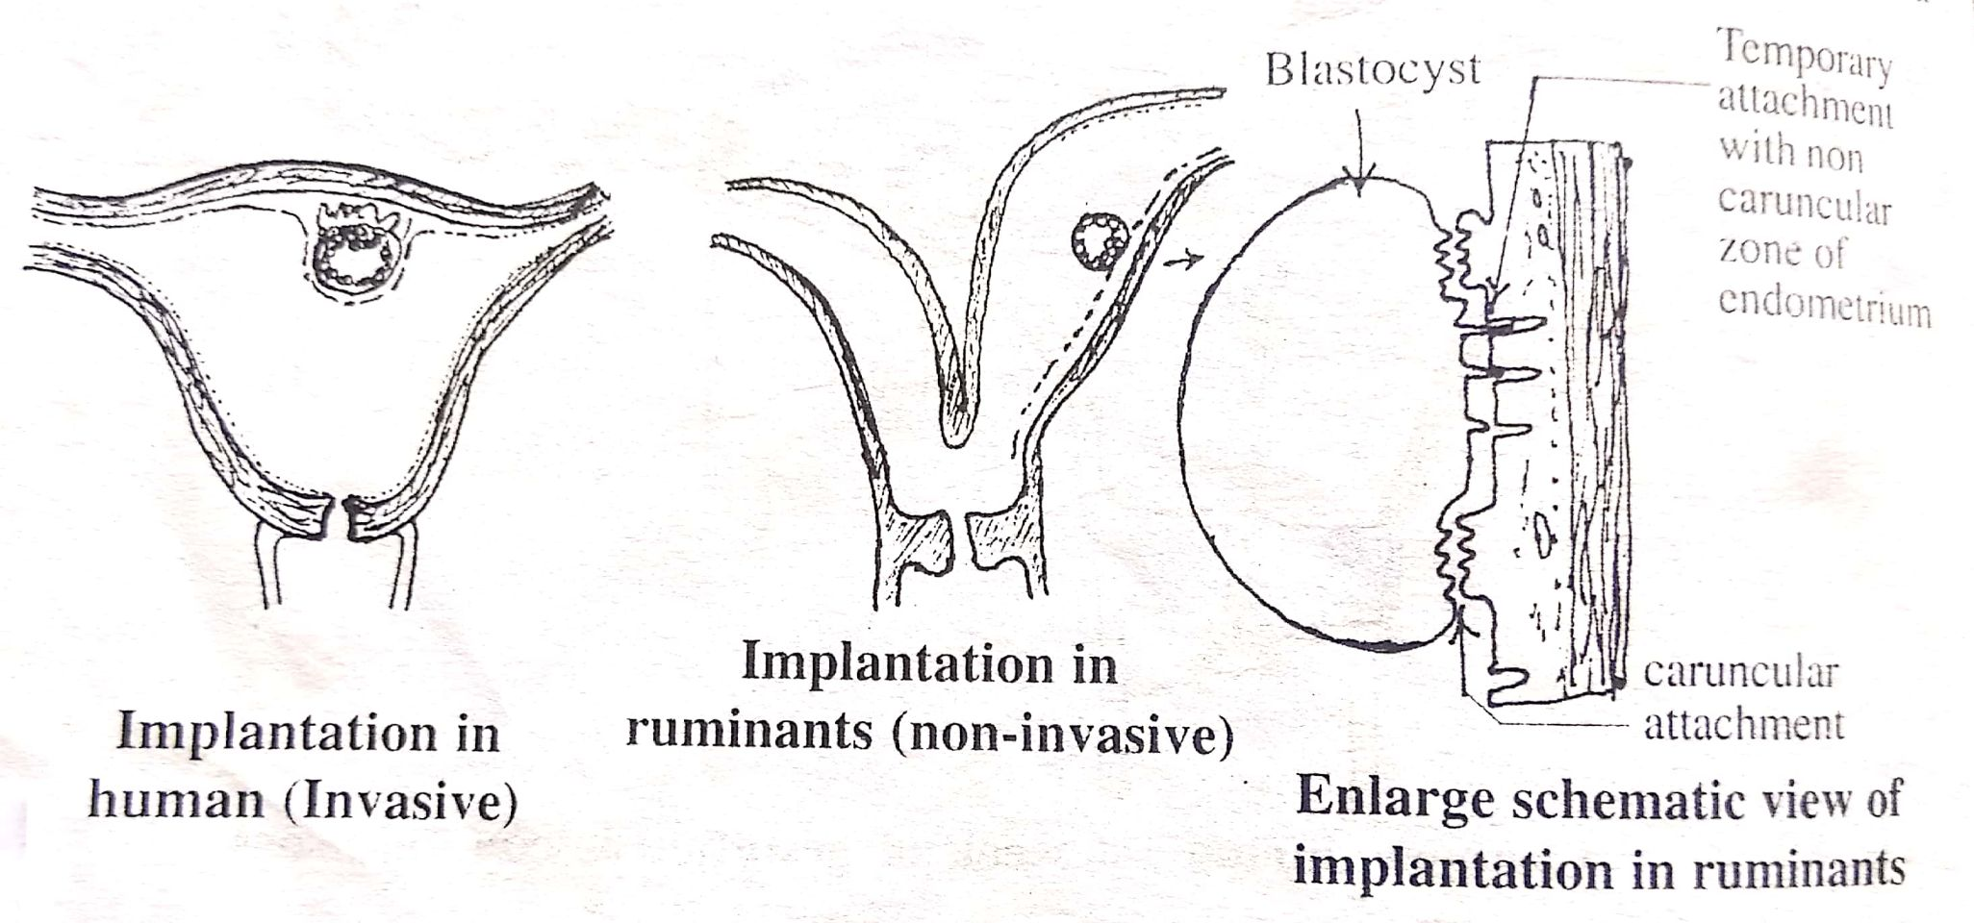

Slide 12
Continue...
The embryoblast give rise to an inner endodermic layer thus bilamilar blastocyst is formed. The endodermic layer of embryoblast is k/a Hypoblast, the cells close to polar trophoblast of embryoblast are transformed into columnar cell k/a Epiblast(Primary Ectoderm)
The primary endoderm enclose a cavity opposite to embryonic pole k/a Primary yolk Sac
The cytotrophoblast and epiblast are separated with fluid filled cavity k/a Primary Amniotic Cavity
Therefore a bilaminar plate (bilaminar germ disc) formed between primary yolk sac and primary amniotic cavity which gives rise to the development of embryo

Slide 13
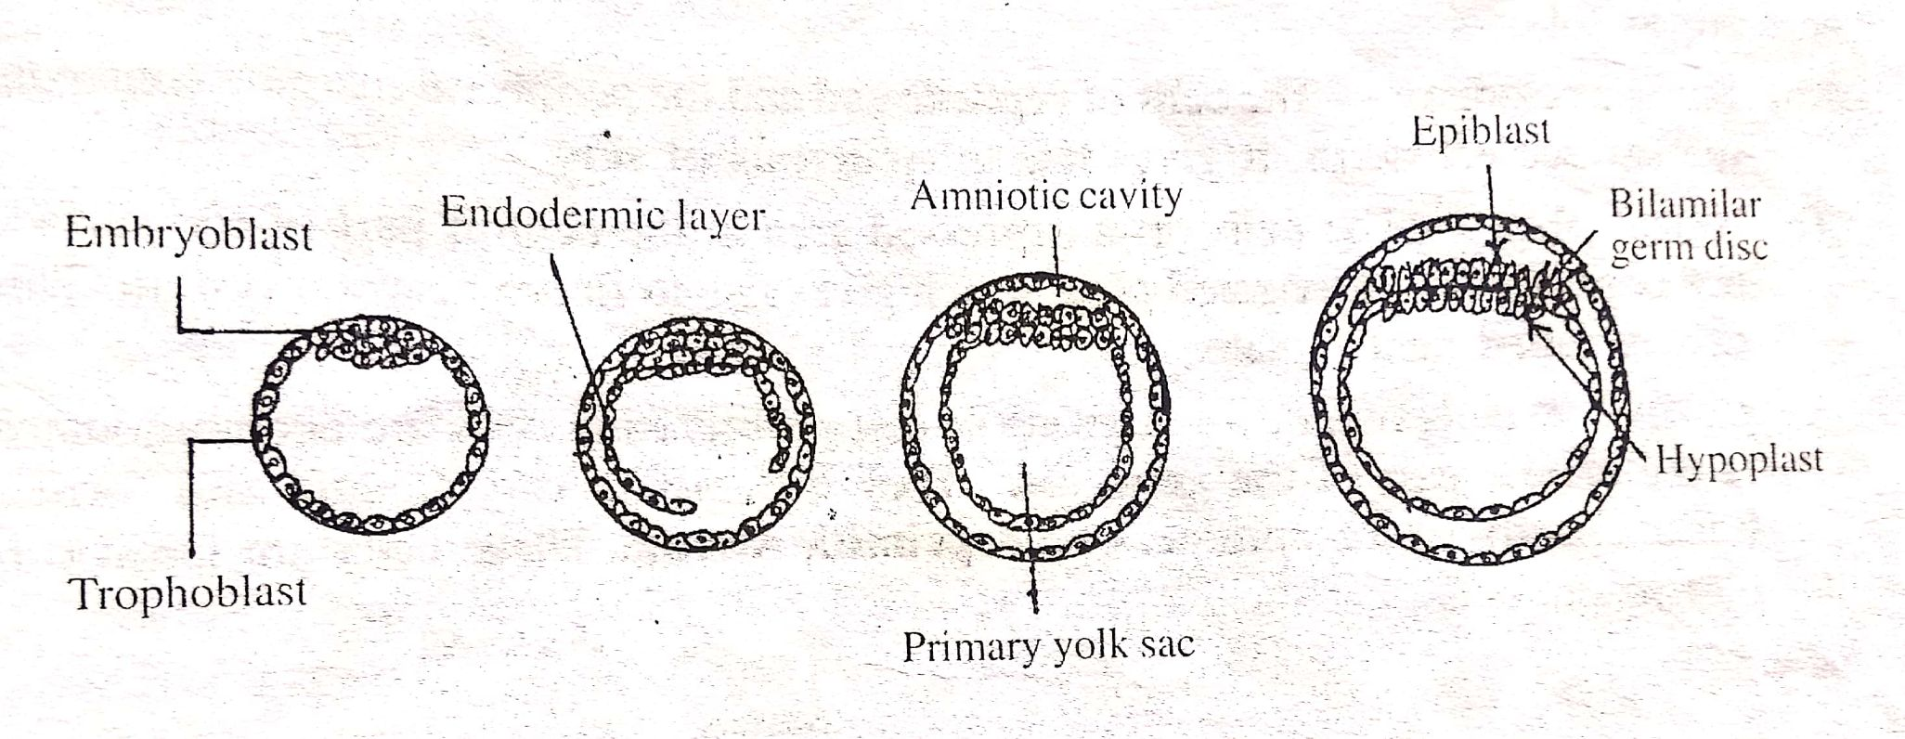

Slide 14
Appearance of Germ Layers
At first germ disc is oval and subsequently it becomes elongated in shape having broad cephalic end and other narrow caudal end
Ectodermal layer of germ disc differentiated into 3 functional zone
Surface ectoderm – It give rise to epidermis of skin
Neural plate – It gives rise to future nervous system
Pluripotent cellular zone – Fast proliferating cells and form linear opacity in the midline called Primitive Streak(Pluripotent cell)
Pluripotent cells migrate and invaginate into the space between epiblast and hypoblast k/a Gastrulation
Formation of three germ layer is necessary for organogenesis
Endoderm – formed the epiblast by invading through hypoblast
Mesoderm – cells of epiblast migrate bilaterally through primitive streak reach b/w epiblast and endoderm to form mesoderm
Ectoderm – Epiblast is called ectoderm

Slide 15
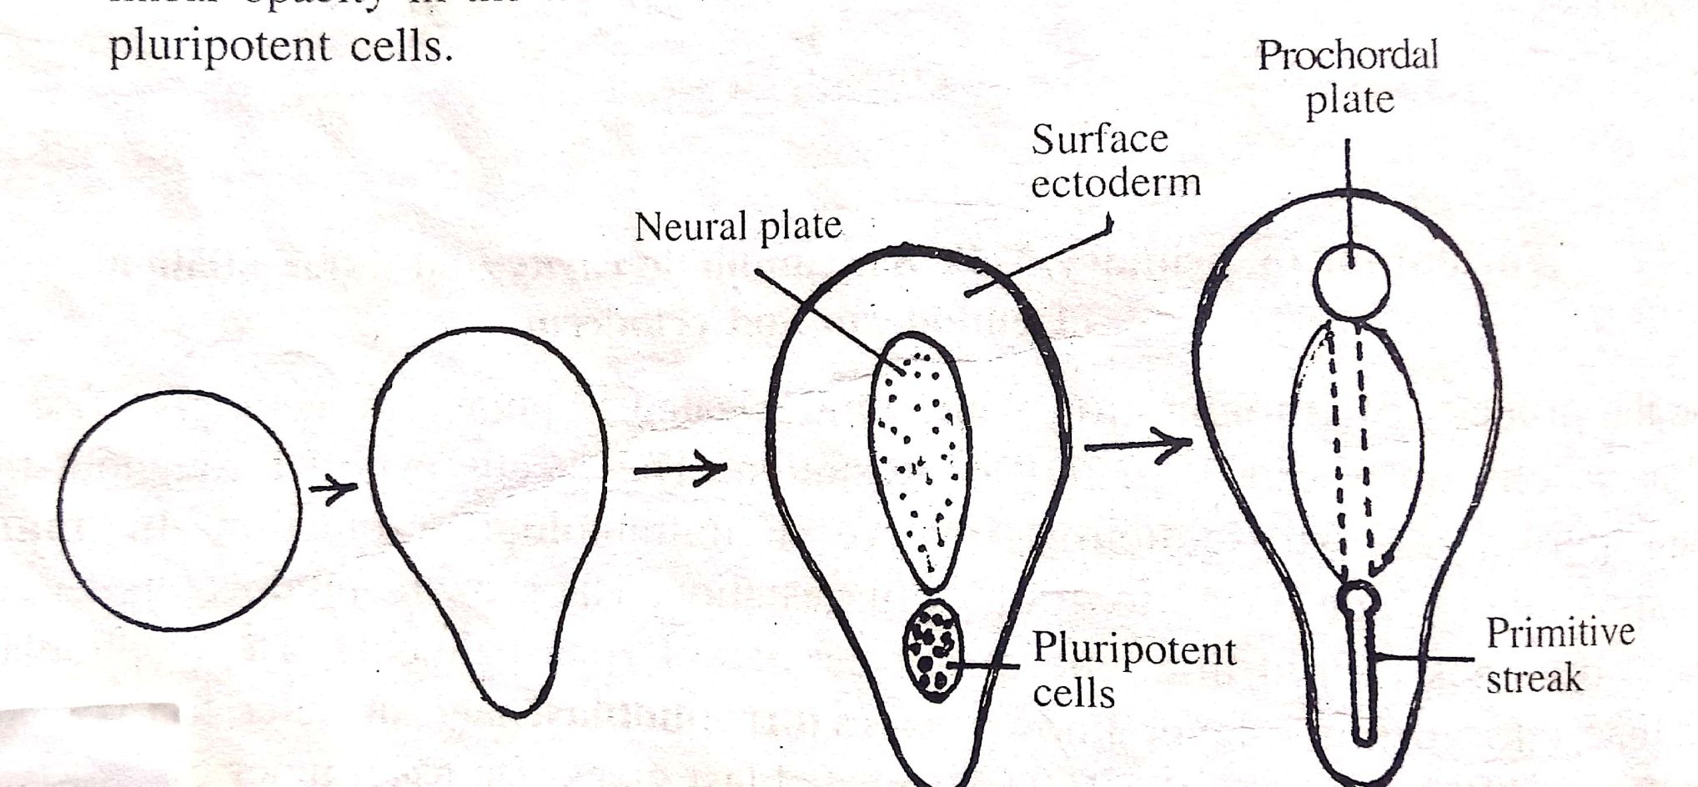

Slide 16
Formation of Notochord
The cephalic end of the primitive streak becomes swollen called Primitive Knot or Henson’s node
A central depression appears at henson’s node called Primitive pit (Blastopore)
Gradually primitive pit extend cranially and at the same time cavity of primitive pit also extend and converts it into a canal called Notochordal canal
Gradually notochordal wall becomes flat to form a notochordal plate and this plate forms a fold which becomes deep to form a tube and converted into solid cord of cells called Notochord
Notochord acts as forerunner for development of vertebral column
Later on notochord disappeared and parts of it persist as nucleus pulposus of invertibral disc

