Slide 1
Unit-8 EMBRYOLOGY
Topic - General embryology (Periods of Embryology remaining part)
Date of Lecture 14.04.2014
Course instructor – Dr. Manoj Kumar Sinha
Department of veterinary Anatomy

Slide 2
EMBRYONIC STAGE
In this period all three germinal layers form most of the organs and tissues
Ectoderm : Forms nervous system and covering of the body
Mesoderm : Forms Skeletal tissue, muscles and blood vascular system
Endoderm : Forms mucus membrane of gut
DERIVATIVES OF ECTODERM
Nervous system Epidermis Conjunctiva, lens Epithelial lining External layer of Muscles
CNS, PNS, ANS (Hair, nails, Retina, Lens, of gum, cheek, tympanic membrane of
Cranial and spinal sweat and Lacrimal gland, and enamel of tooth, and membranous Iris
Nerves and sebaceous corneal epithelium ends of natural labyrinth of
pituitary gland glands orifices internal ear

Slide 3
DERIVATIVES OF MESODERM
All connective Gonads and Teeth except All muscles Cardiovascular Urogenital
tissue and adrenal cortex Enamel except Iris and Lymphatic system (except
sclerous tissue and skin system bladder, urethra
and prostate)
DERIVATIVES OF ENDODERM
MID GUT HIND GUT
FORE GUT
Mucous membrane of alimentry canal (duodenum to colon)
Meckel’s diverticulum
Epith. Lining of Tonsil, Epith. Lining mucous membrane
Pharynx to part Thyroid, of respiratory from colon to anal Primitive Vaginal
Of deuodenum, Parathyroid, system, canal, urinary bladder, sex cell epithelium
Mucous Thymus, Eustachian urethra, prostat and
Membrane of pancreas, tube and cowpers gland
tongue and liver Tympanic cavity

Slide 4
Differentiation of Ectoderm
Ectodermal layer of embryo gives rise to whole central and peripheral nervous system including all three ganglia (cranial, spinal and autonomic ganglia)
Surface ectoderm gives rise to outer covering of embryo which develops later epidermis, hair, nail etc.
Differentiation of Mesoderm
Intraembryonic mesoderm longitudinally divided into 3 layers:
Paraxial mesoderm: Placed just at the lateral side of notochord . It is made
up of cubical tissue called somites / metameres.
These cells appear at the end of 1st month of gestation
In chick embryo these somites begin to start 22 hr. of incubation subsequently after 27 hr. 8 pair of somites appear
somites divide into two parts:
Sclerotome (ventrolateral part) – Forms primitive vertebra
Dermomyotome (Dorsolateral part) – Divided into two parts
Dermal plate Muscle plate
Forms Dermis and Forms spindlle shaped cell
subcutaneous tissue of skeletal muscle

Slide 5
Contiunue…
Intermediate cell mass : present in between para-axial mesoderm and lateral plate
It gives rise to nephric system and sex gland
iii) Lateral plate mesoderm: formation of large cavity called intraembryonic coelome forms pericardial sac, plural sac and peritonial sac
Further they divide into two parts parital layer called Somatopleure and visceral layer called Splanchopleure
At the cephalic end of embryonic area mesoderm does not split and form a plate called Septum transversum leads to formation of diaphragm

Slide 6
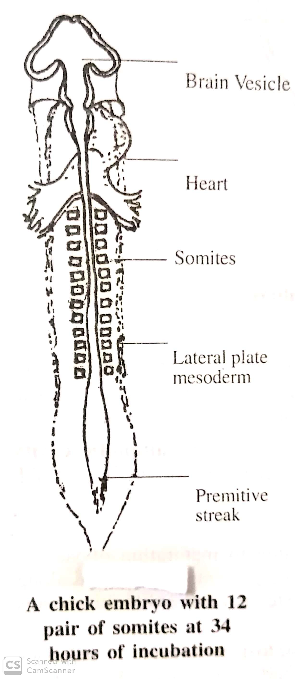

Slide 7
Folding of Embryo
The embryonic area after rapid proliferation develops a head fold, a tail fold and two lateral folds at the end of first month
At that time the shape of embryo becomes cylindrical in shape
During the folding ,growth of yolk sac slow and amniotic cavity become enlarges ,it surround the whole embryo and embryo floats in the amniotic cavity
Foetal stage
In this period growth of foetus become very rapid due to maturaton of various tissues and organs
Complete development of placenta including umblical cord and foetal membrane
Period extend from 3rd to 4th months of gestation to termination of pregnancy

Slide 8
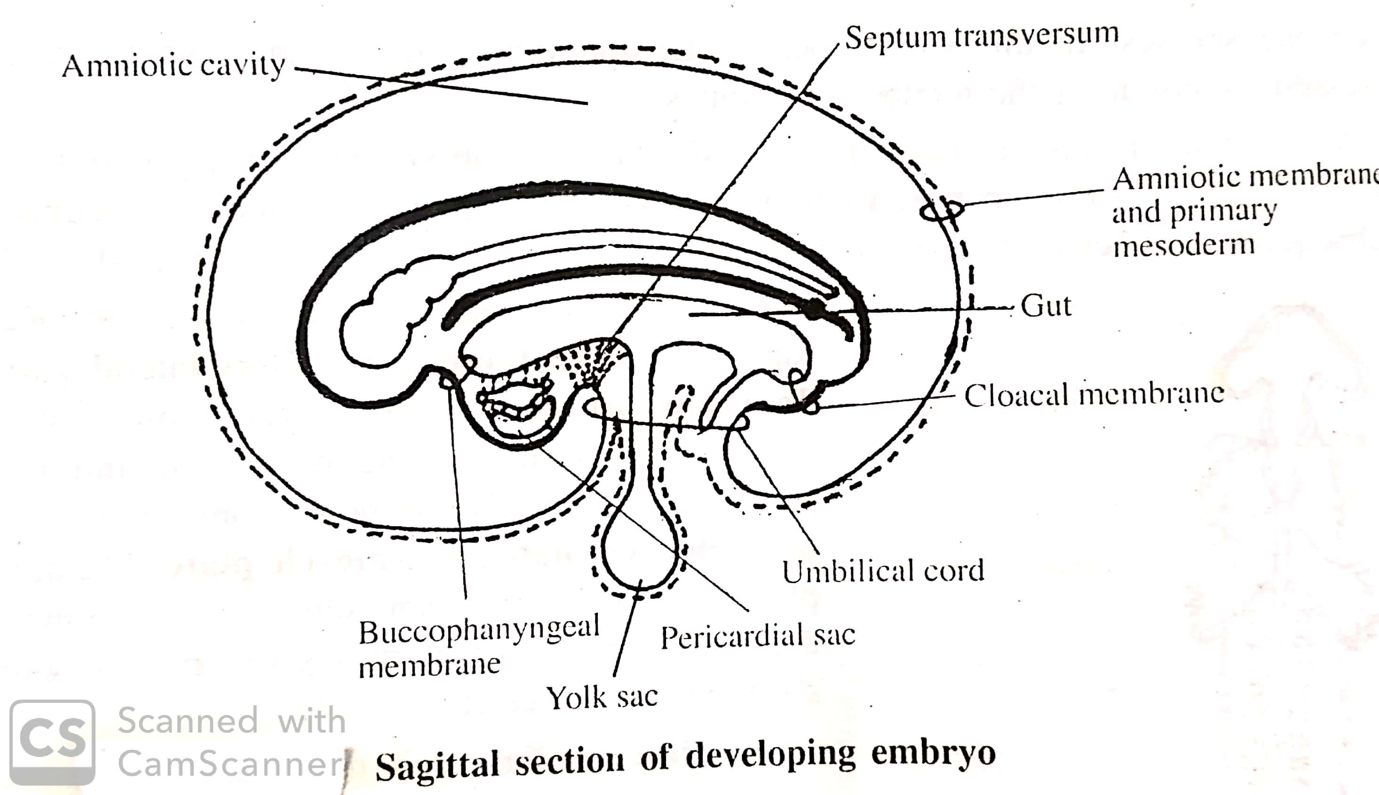

Slide 9
Continue…..
Foetus become get more weight , volume due to the deposition og more subcutaneous fat
Fat deposition occur mainly at 2nd half of pregnancy
Growth of alveoli and capillaries occur during 7th to 8th months of pregnancy
Growth is more predominant in this period
At birth at full term foetus have complete descended testis in scotum, attachment of umblical cord at the center of abdominal wall
The approx age of embryo can be determined by measuring the Crown Rump Length ( it is the distance between the fore head and sacral prominence)

