Slide 1
Emulsifier
B.K.Singh,
Dairy Technology

Slide 2
Emulsion
Emulsion is heterogeneous mixture of two immiscible liquid
Oil in water( D.Phase-oil, D.Medium-water)
Water in oil (D.Phase-water, D.Medium-oil)
Water in oil in water
Oil in water in oil

Slide 3
Emulsion
Oil-oil =cohesive force
Water-water=cohesive force
Oil-water =Adhesive force
When adding emulsifier to mix, it increases the cohesive force and stabilize the emulsion of mix

Slide 4
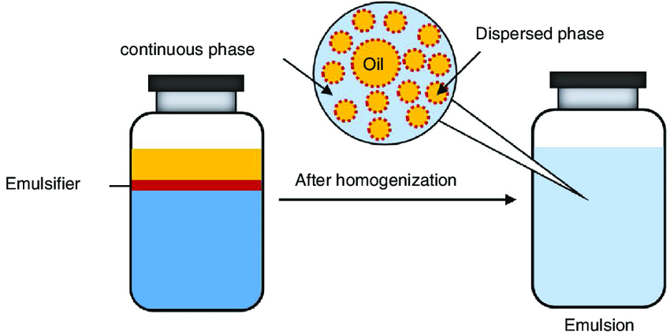

Slide 5
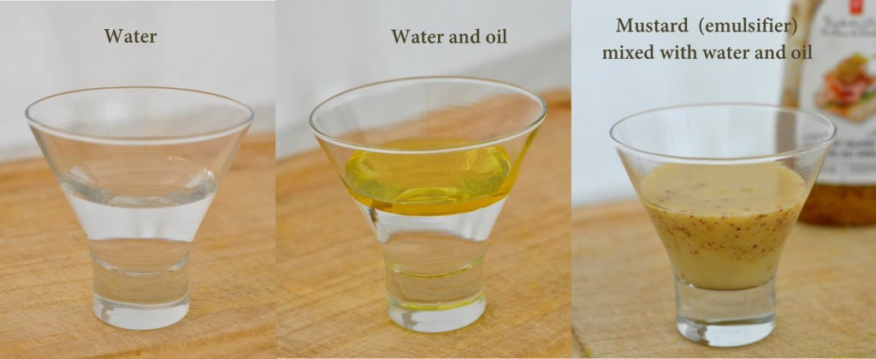

Slide 6
Emulsification
When two immiscible liquid (oil and water) are shaken together vigorously emulsion is formed. They are mixed in homogenizer or colloid mill. Oil and water produces emulsion by stirring , but starts breaking immediately . Preparation of emulsion is called emulsification. Without emulsifiers fat and water won’t mix, instead, they will split almost immediately after addition. Emulsifiers prevent this from happening. Also, emulsifiers can do a similar thing when it comes to air bubbles in the watery ice cream mixture. They will stabilize these air bubbles.
In ice cream you are also trying to mix and stabilize a mixture of fat and water: cream + milk. The emulsifiers ensure that it forms one creamy consistency instead of a watery icy phase mixed with fat globules. You might not realize, but when you’re making ice cream using a custard, you’re adding emulsifiers to your ice cream. Egg yolks contain lecithin which is an emulsifier. Also the proteins in milk can act as an emulsifier in your ice cream.

Slide 7
Emulsifier
Those substances which is added in emulsion to stabilize is called emulsifier. Emulsifiers are components that help mix water and fats together. The emulsifiers in ice cream are proteins (the original emulsifier in ice cream was egg yolk!). The ability of the protein to interact with the air and the fat phases depends on its side-chains. Changing the protein thus changing the interactions between the air and the fat phases and therefore properties of the ice cream.

Slide 9
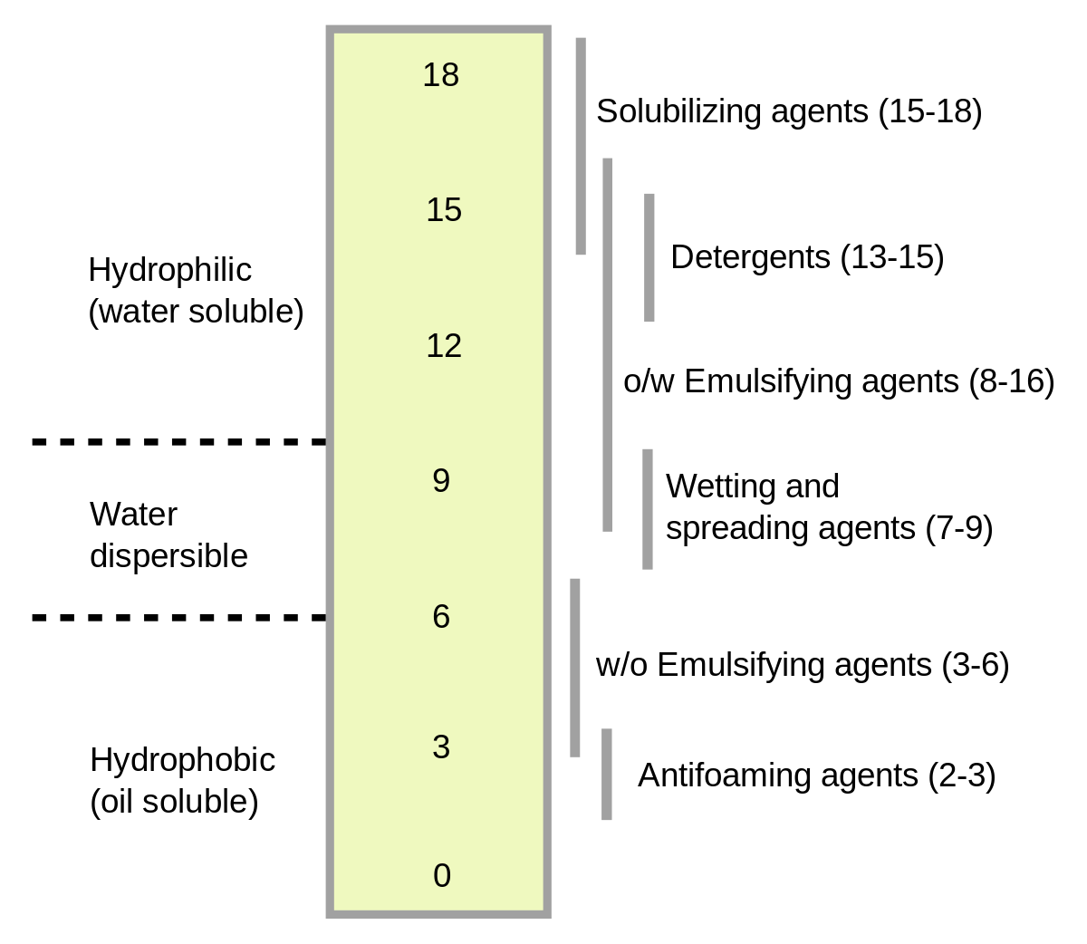

Slide 10
Emulsifier
Classified
Hydrophobic :Examples include sorbitan esters,mono- and diglycerides of fatty acids, polyglycerol polyricinoleate, highly substituted sugars, polyglycerol esters, and propylene glycol esters.
Hydrophilic : Examples include ethoxylatedsorbitan esters, monoglyceride derivatives such as lactates, tartarates,citrates, low-substituted polyglycerol esters, and monosubstituted sugaresters.

Slide 11
Selection Factors
Fat percentage of mix
Type of frozen dessert
Effect on flavour of product
Cost Composition of fat in mix
Compatibility with stabilizer used
Type of freezer used
Method of processing – homogenization
Formulation – effect of other ingredients
Legal standards

Slide 12
Role of emulsifiers in ice cream
Emulsifiers are used to:
Promote nucleation of fat during aging thus reducing aging time
Improve the whipping ability of the mix due to their function at the air interface resulting in reduced air cell sizes and homogenous distribution of air in the ice cream.
Produce a dry and stiff ice cream as they enhance fat destabilization, facilitating molding, fancy extrusion and sandwich manufacture.
Increase resistance to shrinkage and rapid melt down due to a combination of the above two factors.
Increase resistance to the development of coarse/icy texture, due to the effect of fat agglomerates, more numerous air bubbles, and thinner lamellae between adjacent air bubbles on the size and growth of ice crystals.
Provide smooth texture in the finished product, due to fat structuring and interaction of fat agglomerates within the mouth during consumption.

Slide 13
