Slide 1
Epilepsy In Canine
VCM-604
BY-Dr Nikhil Raj
M.V.Sc Scholar
Bihar Veterinary College
B.A.S.U. Patna

Slide 2
What is Epilepsy-
It is a neurological disorder marked by sudden recurrent episodes of sensory disturbance, loss of consciousness, or convulsions, associated with abnormal electrical activity in the brain.
It has been estimated to affect approximately 0.75% of the canine population³.
Idiopathic Epilepsy is most common type of seizure seen in dog.

Slide 3
Commonly Used Terminology
Automatisms – repetitive motor activity that resembles movement under voluntary control, such as lip smacking, licking or chewing.
Interictal period – the time between seizures
Postictal period – the time immediately following a seizure, where behavioral changes may be observed
Refractory epilepsy – seizures that occur even during treatment with therapeutic doses of antiepileptic medication, i.e. the medication stops being effective
Cluster seizures – a group of seizures within a shorter than normal interval; clinically defined as 2 or more seizures within a 24-hour period
Status epilepticus – a serious condition where seizures follow closely on one another without a break, or where a single seizure lasts more than 5 minutes

Slide 4
The clinical features of epileptic seizures can be separated into
four components2-
The prodrome is the time period prior to the onset of seizure activity;
2. The aura is the initial manifestation of a seizure. During this time period, animals can exhibit stereotypic sensory or motor behavior (e.g., pacing, licking), autonomic patterns (e.g., salivating, vomiting), or even unusual psychic events;
3. The ictal period is the actual seizure event manifested by involuntary muscle tone or movement and/or abnormal behavior lasting usually from seconds to minutes;
4. The postictal period occurs upon completion of the seizure and can last from minutes to hours

Slide 5
Static brain injury
Eg-Following trauma,
cerebral vascular accident
Idiopathic epilepsy
Progressive brain disease
Eg- brain tumour , inherited
disease, encephalitis
Intracranial causes
Acquired epilepsy
External
Eg- metaldehyde, permethrin ,piperazine mycotoxins, chocolate, metronidazole, bluegreen, algae, caffeine, cannabis, laburnum, lead, strychnine, organophosphates, moxidectin
Seizure
Toxins
Internal – metabolic
disease or organ failure
Eg- hepatic encephalopathy,
uraemia
Extracranial causes
(reactive causes)
Hypoglycaemia, hyperglycaemia,
hypocalcaemia, hypercalcemia hypertriglyceridaemi, hypodipsia, hypoxia, thiamine deficiency,
cobalamin deficiency
Excess/ deficit

Slide 6
Diagnosis-
CBC (complete blood count)
blood chemistry panel
urinalysis
bile acids
lead levels
testing for infectious diseases
chest x-rays ( Neoplasia)
abdominal ultrasound
magnetic resonance imaging of the brain (MRI),
computed tomography of the brain (CT), or
analysis of spinal fluid
(CSF protein elevation was found in most patients)
CSF lactate was elevated
Pleocytosis

Slide 7
Important Points-
Low Thyroid Function - Hypothyroidism & Seizures Seizures are one of the symptoms of hypothyroidism along with chronic skin disease, hair loss, weight gain, lethargy and slow metabolism, behavioral changes (aggression, hyperactivity, poor concentration, passivity, phobias, anxiety.).
Full thyroid panel of 6 different tests to determine if your dog is hypothyroid. The tests you want to have done are T3, T4, free T3, free T4, T3 and T4 Autoantibodies. Two or three thyroid tests (e.g.T4, free T4 or TSH), are not conclusive for hypothyroidism.
Preservatives such as Ethoxyquin and BHT, BHA should be avoided as they can cause seizures.

Slide 8
Types of Epilepsy-
Primary Epilepsy- epilepsy without an identifiable structural cause, typically assumed to be genetic.eg- Idiopathic epilepsy
Secondary Epilepsy- Cause by acquired brain lesions Eg-Following trauma,
cerebral vascular accident, Brain tumor etc
Cryptogenic Epilepsy- There is probably an underlying cause but ot can’t be identified by the diagnostic tests available

Slide 9
Generalized seizure –seizures originating from both hemispheres of the brain
Generalized seizure is further classified in to-
Absence seizure- (Petit-mal)
Myoclonic seizure – sudden, brief contractions of a muscle or group of muscles
Tonic seizure– a sustained increase in muscle tone (i.e. stiffening) lasting up to several minutes
Tonic-clonic seizure –(Grand-mal) a seizure where the tonic phase is followed by shorter, clonic (jerking) movements
Atonic seizure – a sudden loss of muscle tone lasting several seconds or more, not following a tonic or myoclonic event

Slide 10
Continued….

Slide 11
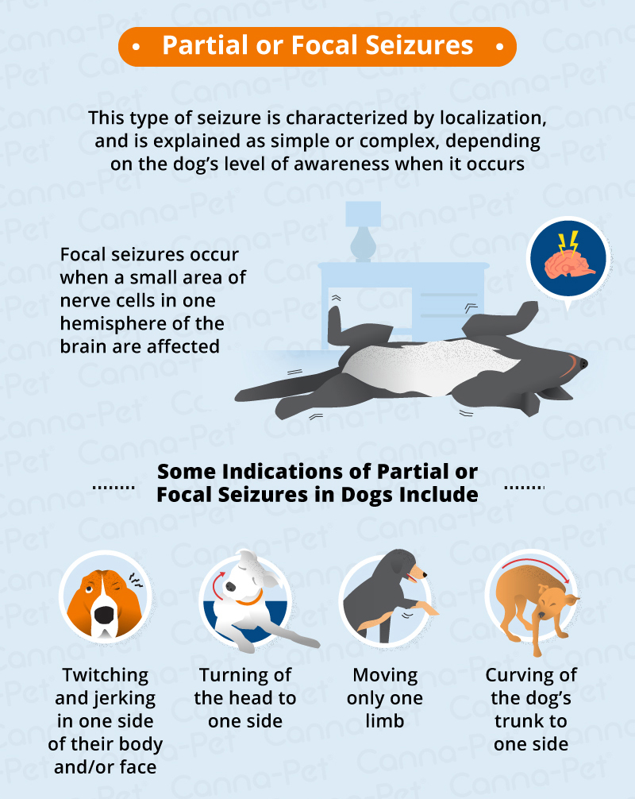
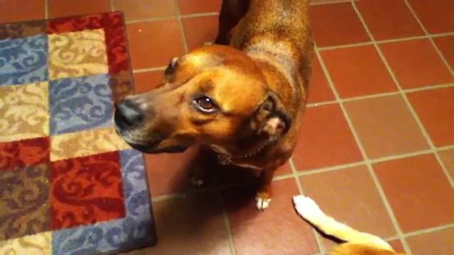
Focal seizure –
seizures originating from only part of the brain and therefore also only affecting part of the body

Slide 12
Simple Partial Seizure- dog may show symptoms such as dilated pupils or their hair standing up. Vocalizations such as growling,, and involuntary movements may occur. Specific muscles may contract and relax, and your dog may show signs of vision or hearing changes, balance problems, or even suffer from disturbances and hallucinations. Your dog may bark or growl at nothing, bite at the air (fly biting) or behave fearfully for no discernible reason. Complex Partial Seizure- dog may stare motionless, then experience a period of abnormal or bizarre behaviors right before a generalized seizure takesplace.

Slide 13
Dog Breeds That Are More Prone To Seizure-

Slide 14
Antiepileptic Drug Therapy in the Dog
Phenobarbital- @2.5 mg /b.wt q12 hr
Potassium Bromide-@ 40mg/kg/day It is used along with phenobarbital in dog when seizure is not controlled by phenobarbital alone.
Felbamate- @20mg /kg b.wt q8hr
Clonazepam- @1-2 mg/kg b.wt q12hr
Topiramate- @2-10mg/kg b.wt q12hr
Zonisamide- @ 5-10mg /kg b.wt q12hr
Levetiracetam- 10-20mg/kg b.wt18hr

Slide 15
Continued…
NOTE
Most dogs can be controlled by using Phenobarbital and/or Phenobarbital and Potassium Bromide. Potassium Bromide is used alone if the dog's liver has become damaged
IMPORTANT: Dogs on Phenobarbital need to have their liver enzymes tested every few months using the following tests ALT (SGPT), AST (SGOT), GGT ALKALINE PHOSPHATASE.
Primidone, once commonly used, metabolizes to Phenobarbital in the liver. With prolonged treatment it can also cause liver damage.
Single needle ear acupuncture for treatment of epilepsy in the dog
(Luc A.A. Janssens, DMV – CVA - Ph.D.)

Slide 16
References
Jokinen TS, Metsähonkala L, Bergamasco L, Viitmaa R, Syrjä P, Lohi H, et al.
Seppala EH, Jokinen TS, Fukata M, Fukata Y, Webster MT, Karlsson EK, et al.
.
Seppala EH, Koskinen LLE, Gulløv CH, Jokinen P, Karlskov-Mortensen P,Bergamasco L, et al.
Stassen W, van Steenbeek F, van Rhijn N, Tenwolde R, Leegwater P.
. Kearsley-Fleet L, O’Neill DG, Volk HA, Church DB, Brodbelt DC. Prevalence
Heske L, Nodtvedt A, Jaderlund KH, Berendt M, Egenvall A
Famula TR, Oberbauer AM, Brown KN
Jaggy A, Faissler D, Gaillard C, Srenk P, Graber H. Geneti idiopathic epilepsy in Labrador retrievers. J Small Anim Pract.
Kathmann I, Jaggy A, Busato A, Bartschi M, Gaillard C. Clinical
investigations of idiopathic epilepsy in the Bernese mountain dog. J Small
Nielen AL, Knol BW, van Hagen MA, van der Gaag I. 12. Berendt M, Gredal H, Pedersen LG, Alban L, Alving J

Slide 17
Thank You

