Slide 1
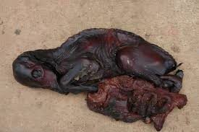
Fetal Mummification
Dr. Bhavna
Assistant Professor
Deptt. of Veterinary Gynaecology and Obstetrics

Slide 2
Introduction
Failure of pregnancy is usually divided into stages based on the fetus’s development and potential viability: embryonic mortality and fetal mortality.
The exact outcome of early fetal mortality is unpredictable and influenced by several factors:
cause of the fetal mortality
species differences
stage of gestation at fetal death
number of fetuses

Slide 3
Fetal death in domestic animals occuring during the middle or last third of gestation that does not result in involution of the corpus luteum and is followed by:
autolytic changes in the fetus,
absorption of placental and fetal fluids,
involution of the maternal placenta, and
mummification of the fetus.

Slide 4
Autolysis involves two steps:
the release of digestive enzymes normally present in organs like the intestine and liver, and
the breakdown of organic matter by bacteria, or putrefaction.

Slide 5
Mummification stops autolysis/ decomposition.
Dry conditions (tissue water decreases)
low oxygen conc.
Inhibits bacterial putrefaction
Tissue becomes dessicated
Body shrivels to a dry, leathery mass of skin, tendons and bones

Slide 6
Events that must be present for fetal mummification
The fetus must die after the development of bones is complete.
Uterine and fetal fluids must be resorbed relatively rapidly.
There must be no oxygen in the uterus until the mummification process is complete.
There must be no bacteria in the uterus.

Slide 7
Occasionally diagnosed in many domestic species, including the cow, sheep, goat, horse, swine, dog, and cat, with the highest prevalence occurring in the swine.
Swine ˃ Small ruminants (Goats and Sheep) ˃ Cattle ˃ Cats and Dogs ˃ Horses

Slide 8
Two types:
The hematic or chocolate mummification (in cattle)
The papyraceous (in other species)
Produces a dry, stiff fetoplacental unit with no exudate.

Slide 9
Hematic Mummification
Involution of maternal caruncles
Haemorrhage between endometrium and fetal membranes
Plasma gets absorbed
Reddish-brown gummy, tenacious mass of autolysed red cells, clots and mucus
Imparts reddish-brown colour to the fetus and fetal membranes

Slide 10
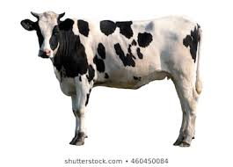
Cattle
Approx. 0.13-1.8% incidence.
High incidence in Guernsey and Jersey breeds.
Higher risk of recurrence (30%) in cows that have experienced previously.
Occurs after 70 days of gestation.
Most often between 3rd and 8th month of pregnancy.
The longer the fetus is retained, the dryer, firmer and more leathery it becomes.

Slide 11
Causes
Bovine viral diarrhea (BVD)
Leptospirosis
Mould (Neospora caninum)
Compression/torsion of umbilical cord
Uterine torsion
Defective placentation
Genetic anomalies
Abnormal hormonal profile
Chromosomal abnormalities

Slide 12
Clinical findings and Diagnosis
Cow’s abdomen to be unusually small for the given stage of pregnancy.
Body changes incident to parturition and calving fail to occur.
Transrectal palpation – compact, firm and immobile mass without placental fluid or placentomes and no fremitus.
USG – absence of heartbeat and fetal fluids.

Slide 13
Treatment
Prostaglandins (PGF_{2α}) are the primary and most effective treatment (25 mg, dinoprost tromethamine or 500μg, Cloprostenol Sodium).
Estradiol benzoate @ 20mg i/m
Epidosin @ 20mg/100kg body weight i/m (10 ml)
Uterine lavage
Hysterotomy, if fetus fails to be expelled.
Prognosis
Both medical and surgical approaches result in normal pregnancy rates.

Slide 14
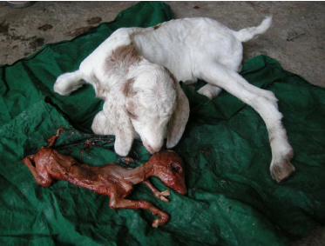
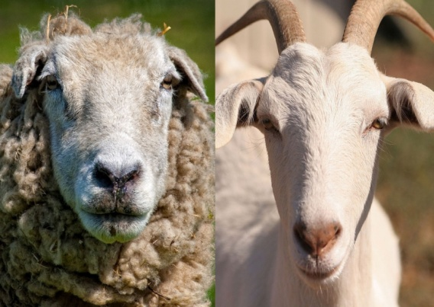
Goats and Sheep
Uncommon but may affect one or both fetuses.
Associated with 4 major infections:
Toxoplasma gondii
Chlamydiphtla abortus
Border / hairy shaker disease
Coxtella burnett
(PoxChBCox)

Slide 15
Energy and protein deficiencies, particularly on days 90 – 120 of gestation.
Mummified fetuses are spontaneously aborted.

Slide 16
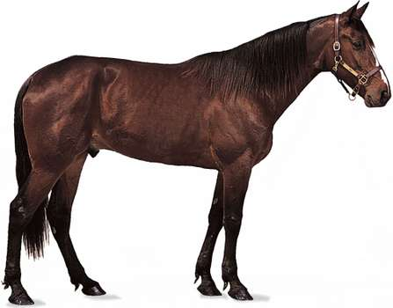
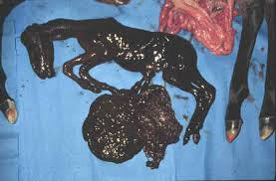
Horses
Very rare, associated with the death of a twin fetus.
The majority of surviving twin pregnancies abort at 9–11 months of gestation.
Ultrasonography-guided twin reduction via a transvaginal (vesicular aspiration or fetal injection) or transabdominal (fetal cardiac injection) approach may result in mummification of the dead fetus.

Slide 17
Clinical findings
Mummified fetuses are found unexpectedly during a normal pregnancy, dystocia during foaling or prolonged pregnancy.
Diagnosis
Uncomplicated
Transrectal palpation and ultrasonography show a hard and bony structure without fluid in the uterine lumen.

Slide 18
Treatment
Where elevated progesterone is associated with a CL, PGF_{2α} (25 mg dinoprost tromethamine IM) is indicated.
In the absence of a CL, 17β-estradiol (5 mg IM) or PGE₁ (200 μg Misoprostol) administered locally on or in the cervix 24 hours before oxytocin is administered.
Caesarean section, if large in size.
Uterine lavage to remove debris is indicated.

Slide 19
Prevention
Close monitoring to determine time of ovulation and so enable the diagnosis of double ovulation and confirm a twin pregnancy early (on day 14) is recommended.
Allows for early twin reduction in order to optimize success, and minimizes the risk of fetal mummification, reduces the risk of twins, and optimizes the future fertility of the mare.

Slide 20
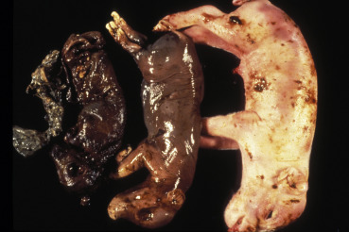
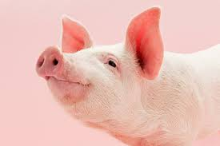
Swine
Overall prevalence is 1.5%.
Possible after 35-40 days of pregnancy.
Has been linked to
Parity
Litter size
Uterine capacity
Environmental temperature
Presence of mycotoxins
Infectious diseases

Slide 21
Presence of one mummy in an otherwise normal litter may indicate physiological death, whereas the presence of multiple mummified fetuses indicates an infectious cause.

Slide 22
Infectious agents potentially associated with fetal mummification in swine :
1. Porcine parvovirus (PPV)
2. Aujeszky’s disease / pseudorabies virus (AD/PRV)
3. Encephalomyocarditis virus (EMCV)
4. Erysipelas (bacteria)
5. Japanese encephalitis virus (JEV)
6. Porcine circovirus 2 (PCV2)
7. Porcine reproductive and respiratory syndrome virus (PRRSV)
8. Swine fever virus (SFV; African and classical)
9. Swine influenza virus (SIV)
10. Teschovirus

Slide 23
Clinical findings
Infection during early gestation (˂40 days) causes absorption of the infected fetuses, and the dam returns to estrus in a regular (18–24 days after heat) or irregular (25–38 days after heat) manner or fails to farrow.
Infection between 40 and 70 days of pregnancy, causes infection to fetuses, resulting in the mummification of fetuses of different sizes at birth, alongside the healthy piglets.

Slide 24
Diagnosis
The number of mummified fetuses relative to litter size and age at which death occurs is an indication of the potential etiologic agent.
Insufficient space or a large litter - mummified fetuses associated with a normal litter size.
Infectious agent - the litter size will be normal, but more mummified fetuses and less live piglets will be observed.

Slide 25
Prevention
Proper care/comfort
Optimal nutrition
Effective stress management
Rigorous sanitary protocols
Vaccination

Slide 26
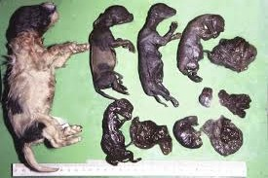
Dogs
Most common cause is canine herpesvirus (CHV).
Difficult to diagnose esp. if bitch consumes or hides the fetus.
Proper vaccination may prevent.

Slide 27
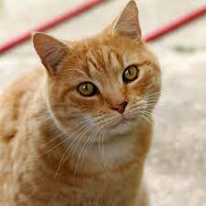
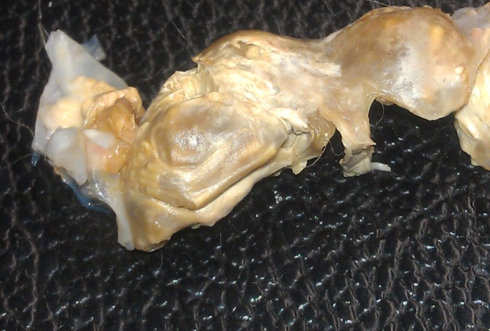
Cats
Mostly due to Feline panleukopenia virus infection.
Accidently found during abdominal surgery and appear encapsulated within uterine tissue, wrapped in omental adhesions, or free in the peritoneal cavity beyond the normal time of parturition following normal birth or dystocia.

