Slide 1

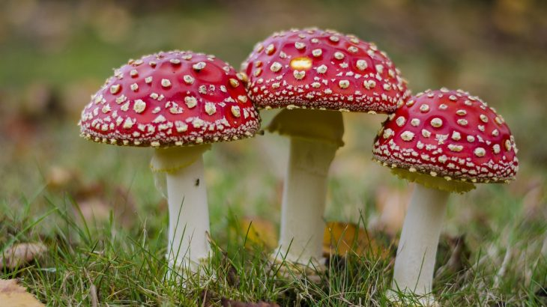

Topic :
Introduction, classification & general properties of fungi
2nd Professional (Veterinary Microbiology)
Earth.com
Dr MANOJ KUMAR

Slide 2
Importance of Fungi
Fungi - most important groups of organisms on the planet.
Important in an enormous variety of ways.
  Recycling
  Mycorrhizae and plant growth
  Food
  Medicines
  Biocontrol
  Crop Diseases
  Animal Disease
  Food Spoilage

Slide 3

What are fungi?
Fungi - ubiquitous and diverse group of organisms
Main purpose - to degrade organic matter.
All fungi lead a heterotrophic existence as
    Saprobes
    Symbionts
    Commensals
    Parasites

Slide 4
Fungi - characteristics
Habitat - Ubiquitous in terrestrial and freshwater
Distribution – Cosmopolitan
Ecology - Important ecological roles as saprotrophs, mutualistic symbionts, parasites
Nutrition - Heterotrophic
Vegetative state – Non motile mycelium
Cell wall - glucans and chitin

Slide 5
Cont.…
Nuclear status - Eukaryotic, uni- or multinucleate, the thallus being homo- or heterokaryotic, haploid, dikaryotic or diploid
Reproduction –
      Sexual (i.e. Nuclear fusion and meiosis) and/or parasexual (i.e. Involving nuclear fusion followed by gradual de-diploidization)
      Asexual

Slide 6
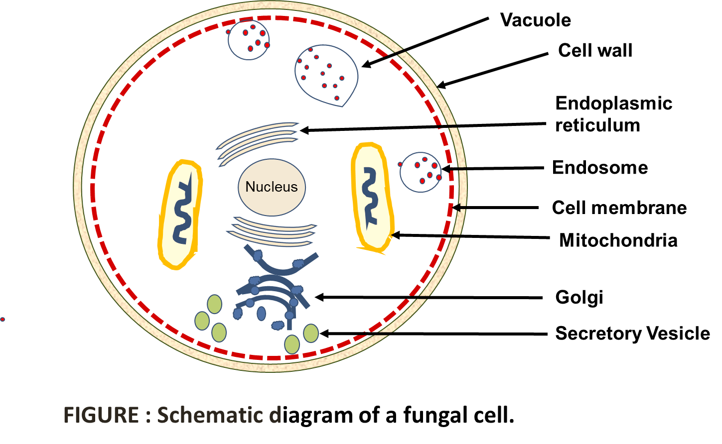
Fungus cell

Slide 7
Morphology
Fungi may be unicellular or multicellular.
Morphology of fungi are either yeasts or moulds.
      Yeasts are usually unicellular
      Molds: multicellular organisms consisting of threadlike tubular structures called hyphae

Slide 8
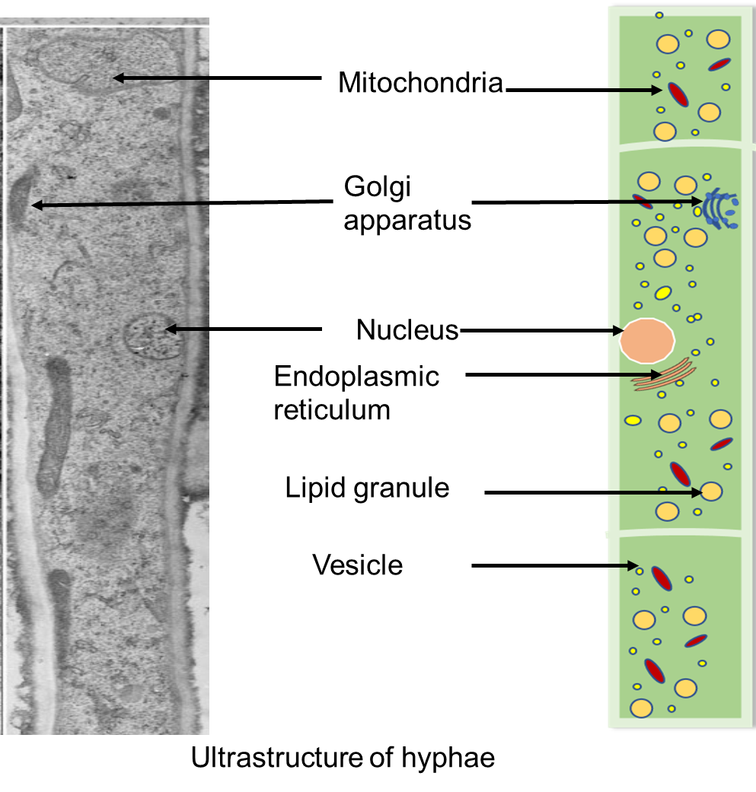
Hyphae
Hyphae are either coenocytic (hollow and multinucleate) or septate (divided by partitions or crosswalls) .
The hyphae form together to produce a mat-like structure called a mycelium.
Two form of hyphae are:
  vegetative hyphae
  reproductive hyphae.

Slide 9
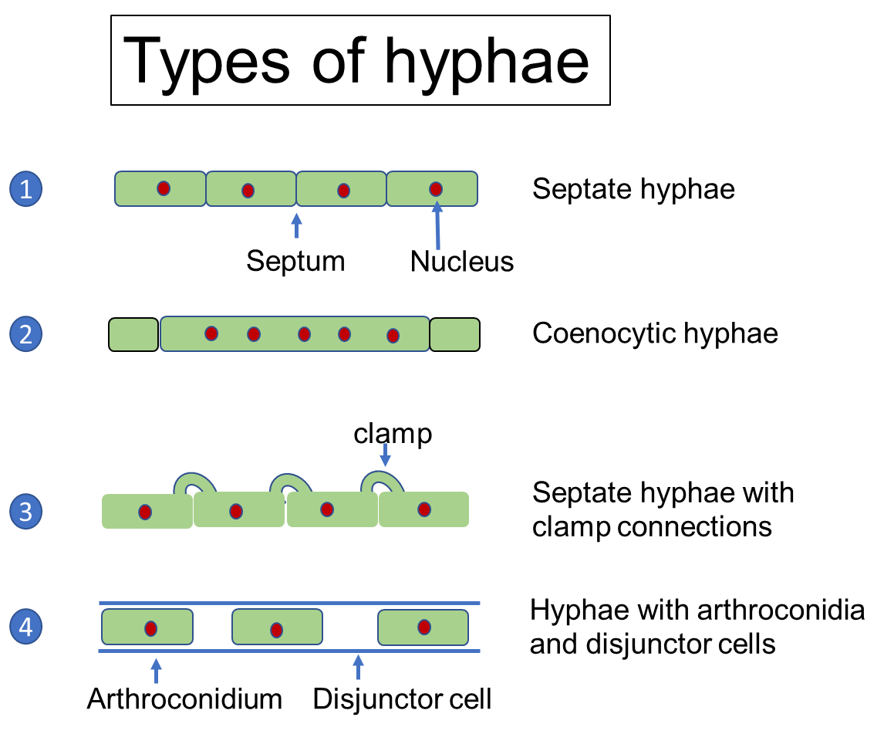
Types of hyphae
Septate hyphae (divided by partitions or crosswalls)
Coeocytic hyphae (without septum; hollow and multinucleate)
Septate hyphae with clamp connection (hyphal outgrowths form (clamp) - bypass around the septum to facilitate the migration of a nucleus).
Hyphae with arthroconidia (conidia produced by either a blastic (budding) process or a thallic process; hyphal segments fragment into individual cells or arthroconidia).

Slide 10
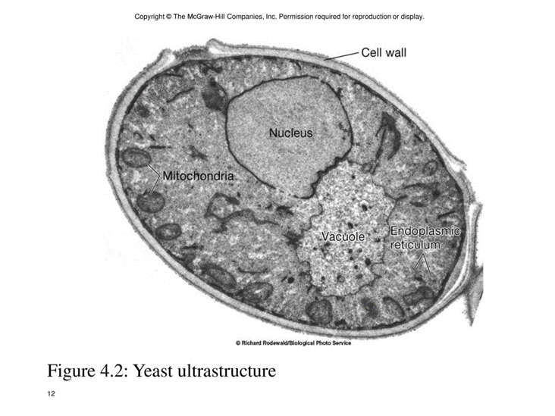
Yeast cell
These are large (5 to 8 μ), single-celled organisms that
Rarely form filaments (some reveal pseuodohyphae).
Most yeasts reproduce by the asexual process of budding.
www.buffalobrewingstl.com
Source: http://istudy.pk/

Slide 11
CLASSIFICATION OF FUNGI
Species
Genus
Family
Order
Class
Subphyla
Phyla/phylum
Subkingdom
Kingdom
Classical classification of fungi proceeds in this fashion

Slide 12
Based on sexual reproduction and the other based on Morphology of the thallus (vegetative structure)
Fungi of veterinary importance are classified into
Four classes

Slide 13
CLASSIFICATION OF FUNGI
Class Ascomycetes
Sexual reproduction in a sack called an ascus with the production of ascospores e.g. Aspergillus
Class
Basidiomycetes
Sexual reproduction in a sac called basidium with the production of basidiospores e.g. Cryptococcus
Class
Phycomycetes
Sexual reproduction by gametes and asexual reproduction with formation of zygospores or Oospore.
Asexual reproduction with production of sporangiospore
Class
Deutromycetes (Fungi imperfecti)
No recognizable form of sexual reproduction, includes most pathogenic fungi. e.g. Candida

Slide 14
Characteristics of Fungi
Taxonomic class of Fungi | Hypha | Type of Reproduction | Characteristic spore | Origin of spore | Examples of fungi | Pathogenicity
Ascomycetes | Septate | Asexually | Blastospore Conidium | Budding Conidiophore | Aspergillus Penicillium | Maduromcosis Aspergillosis
Basidiomycetes | Septate | Sexually | Basidiospore | Basidium | Cryptococcus | Cryptococosis
Deuteromycetes | Septate | Asexually | Thallospore Conidium | Thallus(hypha) Conidiphore | Candida | Most Mycoses {fungi and pathogens in medical imperfecti)
Phycomycetes | Aseptate | Asexually Sexually | Sporangiospore Zygospore or oospore | Sporangiophore Fussion of nuclei | Mucor Rhizopus | Mucormycosis

Slide 15
THANKS

