Slide 1
Government initiatives and Support for Enterpreneurship Among Agri-graduates
Naresh Chandra
Pr. Scientist (Agril. Economics)
ICAR Research Complex for Eastern Region, Patna

Slide 2
Introduction
Every year, almost 17000 agri. Graduates pass from different SAUs and other recognised Universities.
Out of these, nearly half get employed/goes for higher education and rest remain unemployed.
To tap this potential trained manpower for providing quality extension services to farmers as well as providing them gainful employment opportunities, (Agriclinic) & (Agribusiness centre) schemes were launched by MoAFW in collaboration with NABARD on 9th April, 2002.

Slide 3
Basic concept
Agriclinic: provides expert services and advice to farmers on cropping practices, technology dissemination, crop protection from pests & diseases, market trends and prices of various crops in the markets and also clinical services for animal health etc. which would enhance productivity of crops / animals.
Agribusiness Centres: provides input supply, farm equipments on hire and other services. In order to enhance viability of the ventures, Agriculture Graduates may also take up in agriculture and allied areas along with the Agriclinics/ Agribusiness Centres.

Slide 4
Objectives of the scheme
To supplement efforts of public extension by necessarily providing extension and other services to the farmers on payment basis or free of cost as per business model of agri-preneur, local needs and affordability of target group of farmers.
To support agricultural development; and
To create gainful self-employment opportunities to unemployed agricultural graduates, agricultural diploma holders, intermediate in agriculture and biological science graduates with PG in agri-related courses.

Slide 5
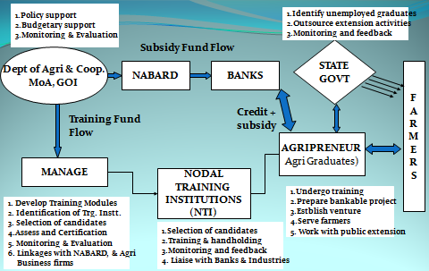
Agriclinic and Agribusiness centre Model

Slide 6
Centre for Agricultural Extension Innovations , Reforms & Agripreneurship (CEIRA)
To effectively implement and monitor AC & ABC scheme, a separate Centre called CEIRA established at MANAGE from October 2009.
Major functions of this centre is to improve quality and quantity of the training programmes, handholding activities and resolving problems of Agri Entrepreneurs.
Centre is headed by The Director and assisted by Six Consultants to look after five geographic areas of the country

Slide 7
Major tasks of CEIRA
General awareness, coordination, monitoring and overall implementation in liasoning with other stakeholders
Selection of Nodal Training Institutes
Selection of Candidates for Training
Monitoring of the Training programmes during and after the Training
Guiding the Nodal Institutes in Hand holding
Funding of Training and Handholding activities
Documenting the Success Stories
Taking measures for replicating success models.

Slide 8
Nodal Training Institutes (NTIs)
MoU finalized with 98 Nodal Training Institutions
1. State Agriculture Universities - 16
2. State Government Institutes - 08
3. NGOs - 36
4. Agribusiness Companies - 17
5. Institutes of Co-operative Management- 11
6. Krishi Vigyan Kendras - 10

Slide 9
Nodal Training Institutes: Bihar
Development Management Institute, Patna
Dr Amrita Dhiman, Nodal Officer, Mobile: 7091496209, e-Mail: adhiman@dmi.ac.in
Institute of Environment & Eco Development (IEED), Shri. I. N. Jha, Managing Director, Mob:09472919160, 09472919161, e-Mail: ieedindia2@gmail.com, ieedindia@yahoo.co.in
SRISTI Foundation, Sri. Ashok Kumar Thakur, Executive Chairman / Nodal Officer, (Mobile:94310 72233) sristi_foundation@rediffmail.com

Slide 10
Nodal training Institutes: Jharkhand
Mobile Agricultural School & Services (MASS), Ranchi, Shri. Vijay Bharat, Nodal Officer, Mob: 09431588284, 07033698070, vijmassmoon@yahoo.com
Tribal Welfare Society, Ranchi, Shri.Baidyanath Yadav,Secretary/Nodal Officer, Mobile: 07061261449,e-Mail tswspanchwati@gmail.com

Slide 11
Loan and Subsidy
Project Cost:
Individual Projects : Rs.20.00 lakhs
Group Projects : Rs.100.00 lakhs (5 member group)
An additional limit of Rs.5.00 lakhs subsidy is also provided for extremely successful ventures
Margin Money : 10 –15 % or as decided by individual banks
Bank Loans:
Type of Loan - Composite Term Loan (fixed cost + cost for one operative cycle)- At least 10% of the project cost should be in the form of capital investment
Security :
Hypothecation of assets, mortgage of lands or third party guarantee.
Collateral Security is waived up to Rs.5.00 lakhs loan.

Slide 12
Repayment Period:
5 – 10 years depending upon the project.
Gestation period – Maximum two years as per the nature of the project
Rate of Interest :
As determined by Bank (Commercial / Private Bank / RRB / State Co-operative Bank).
Composite Subsidy:
Subsidy will be released by NABARD to the Banks up-front

Slide 13
36% Subsidy on a maximum Project Cost of Rs. 20.00 lakhs (Rs.100.00 lakhs for Group) for general category, and 44% for SC, ST, women, Hilly States (NE States, J&k, H.P and Uttaranchal).
The benefit of subsidy will be extended maximum twice to a candidate under the Scheme within the prescribed loan limits
Project Activities:
32 activities/ventures mentioned (only illustrative).
Any Project which provide services to the farmers.
Hand Holding by Nodal Training Institutions:
Up to one year

Slide 14
State wise progress report (Till 29/10/2018)
S. No. | State | Trained | Ventures established | Success %
1 | Andhra Pradesh | 994 | 321 | 32.29
2 | Arunachal Pradesh | 35 | 3 | 8.57
3 | Assam | 735 | 227 | 30.88
4 | Bihar | 3836 | 1390 | 36.24
5 | Chandigarh | 3 | 1 | 33.33
6 | Chattisgarh | 716 | 332 | 46.37
7 | Delhi | 31 | 5 | 16.13
8 | Goa | 12 | 7 | 58.33
9 | Gujarat | 1785 | 682 | 38.21
10 | Haryana | 683 | 236 | 34.55
11 | Himachal Pradesh | 420 | 108 | 25.71
12 | Jammu and Kashmir | 1456 | 191 | 13.12
13 | Jharkhand | 747 | 186 | 24.90
14 | Karnataka | 3805 | 1560 | 41.00
15 | Kerala | 199 | 51 | 25.63
16 | Madhya Pradesh | 2732 | 1205 | 44.11

Slide 15
S.No. | State | Trained | Ventures Established | Success %
17 | Maharashtra | 14492 | 7094 | 48.95
18 | Manipur | 438 | 128 | 29.22
19 | Meghalaya | 35 | 3 | 8.57
20 | Mizoram | 34 | 0 | 0.00
21 | Nagaland | 184 | 21 | 11.41
22 | Orissa | 582 | 114 | 19.59
23 | Pondicherry | 133 | 84 | 63.16
24 | Punjab | 649 | 218 | 33.59
25 | Rajasthan | 3237 | 1214 | 37.50
26 | Sikkim | 9 | 1 | 11.11
27 | Telengana | 1385 | 407 | 29.39
28 | Tamil Nadu | 6835 | 3523 | 51.54
29 | Tripura | 4 | 1 | 25.00
30 | Uttar Pradesh | 13303 | 6419 | 48.25
31 | Uttaranchal | 469 | 155 | 33.05
32 | West Bengal | 1120 | 296 | 26.43
 | Total | 61098 | 26183 | 42.85

Slide 16
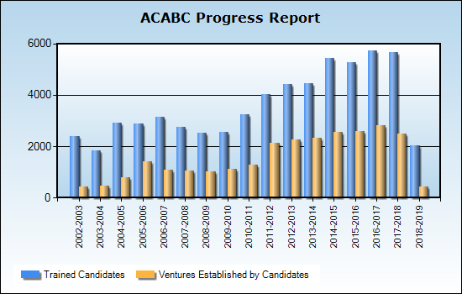
Source: http://www.agriclinics.net

Slide 17
Agro ventures established (Till 14/11/17)
Sl.No | Name of the Activity | No. of Agri-ventures Established
1 | Agri-Clinics | 4353
2 | Agri-Clinics and Agribusiness Centres | 7279
3 | Agro-Eco Tourism | 16
4 | Animal Feed Unit | 59
5 | Bio-fertilizer production and Marketing | 133
6 | Contract Farming | 111
7 | Cultivation of Medicinal Plants | 114
8 | Direct Marketing | 171
9 | Farm Machinery Unit | 791
10 | Fisheries Development | 384

Slide 18
Sl.No | Name of the Activity | No. of Agriventures Established
11 | Floriculture | 109
12 | Horticulture Clinic | 178
13 | Landscape + Nursery | 114
14 | Nursery | 569
15 | Organic Farming | 97
16 | Pesticides Production and Marketing | 56
17 | value addition | 333
18 | Fisheries clinic | 16
19 | Seed Processing and & Agri-business | 377
20 | Soil Testing Laboratory | 107

Slide 19
Sl.No | Name of the Activity | No. of Agriventures Established
21 | Tissue culture unit | 28
22 | Vegetable production & Marketing | 350
23 | Vermi Composting / Organic manure | 521
24 | Veterinary Clinics | 923
25 | Crop production | 302
26 | Dairy/Poultry/Piggery/Goat etc | 8303
27 | Rural Godowns | 58
28 | Production & Marketing of Bio-Control Agents | 30
29 | Agriculture Journalism | 16
30 | Sericulture | 56
31 | Mushroom Cultivation | 125
32 | Apiary | 104
 | Total | 26183

Slide 20
Major banks through which projects sanctioned
under ACABC
Sl No. | Name of the Bank | No. Of projects sanctioned
 | SBI | 476
2. | Union Bank of India | 190
3. | Bank of India | 151
4. | PNB | 148
5. | Canara Bank | 141
6. | Central Bank of India | 124
7. | Bank of Baroda | 115
8. | Oriental Bank of Commerce | 87
9. | Bank of Maharashtra | 80
10. | Prathma Bank | 74
11. | Indian Overseas Bank | 69
12. | Syndicate Bank | 66
13. | Corporation Bank | 65
14. | Indian Bank | 62

Slide 21
Success stories
Dr. Gajendra K. Bamania, Veterinary Doctor with MBA Xcell Breeding & Livestock services Pvt. Ltd, Godhara, Gujarat; Ph: 096274-89580
Trained at International School for Public Leadership,
Ahmedabad under AC&ABC Scheme
Developed Software for monitoring breeding services
through AI and maintained database of villages, Dairy
farmers and cattle.
Extension Service – Providing extension services in the areas cattle AI Programme, Herd testing, sale of semen of
Murrah, Sahiwal and HF, Consultancy Services to farmers .
Farmers Covered – 30000 farmers
Direct Employment for 300 persons as AI Technicians.
Annual Turnover – Around Rs. 2.0 crores

Slide 22
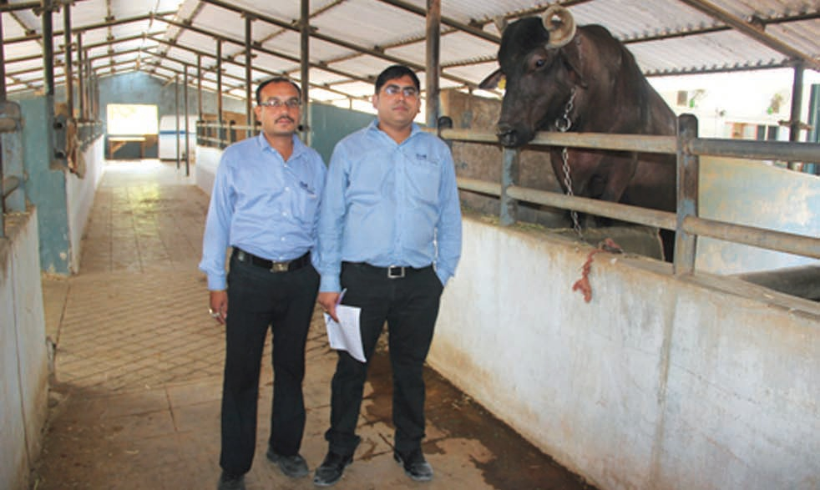

Slide 23
Dr. (Mrs) Nilbahar Begum, B.V.Sc. (AAU, Jorhat) Vet Care Veterinary Clinic, North Bogaigaon, Assam;
Ph: 09678315183
Trained at Indian Society of Agribusiness Professionals,
Guwahati, Assam under AC&ABC Scheme
Started Vet. Clinic for cattles, pets and birds. Later on opened
Dairy farm with 5 cows which has increased to 100 cows with
milk production of 500 litres/day.
Extension Service – Providing extension services in the areas of Dairy farm management and animal health care and
Consultancy Services to farmers.
Farmers Covered – 200 farmers
Direct Employment for 15 persons.
Annual Turnover – Around Rs. 25 lakhs.

Slide 24
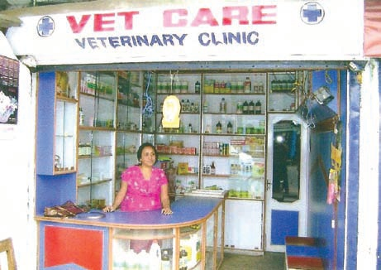
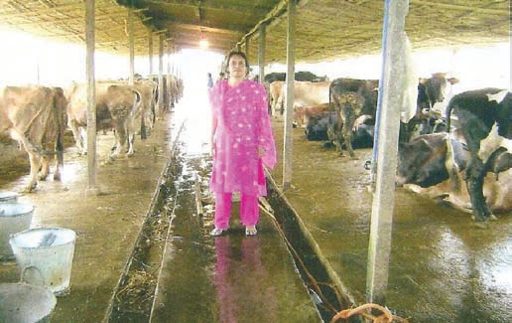

Slide 25
Dr. R Ukani Jenish, M.V.Sc. (NAU, Navsari) Krishna Veterinary Hospital, Rajkot, Gujarat;
Ph: 09712857771
Trained at International School for Public Leadership,
Ahmedabad under AC&ABC Scheme. Saw opportunities for
medical treatment of 400 horses.
Started Krishna Veterinary Hospital at Rajkot, Gujarat for Dogs
& Equines. Later on he started mobile Clinic with Doctor,
Medicine and Diagnostic kit for door to door extension service.
Extension Service – Advisory to pet breeders and health care services for pets and horses.
Farmers Covered – 500 farmers
Direct Employment for 15 persons.
Annual Turnover – Around Rs. 60 lakhs.

Slide 26
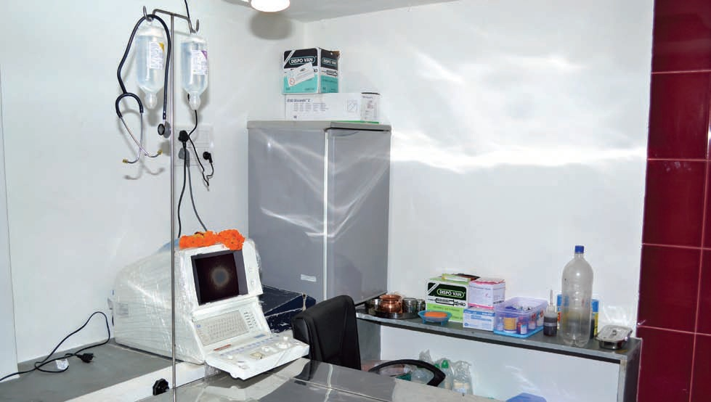
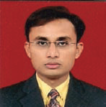

Slide 27
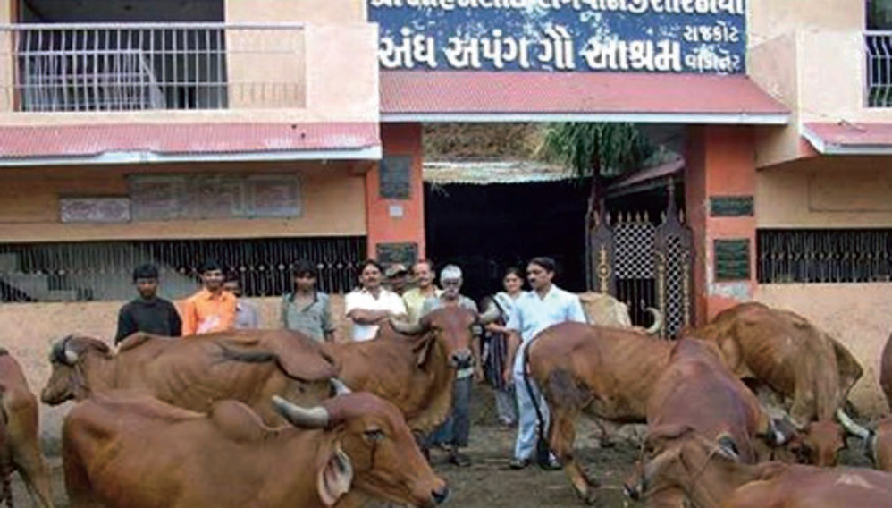
Dr. Nareshkumar K. Savsani, B.V.Sc Hindustan Trading, Rajkot, Gujarat; Ph: 9825599004
Trained at Shree Vivekanand Research and Training Institute,
Mandavi, Gujarat under AC&ABC Scheme.
Established a cattle feed supply Unit and Veterinary Clinic
named “Hindustan Trading”.
Extension Service – Providing extension services in the areas veterinary and AI services.
Farmers Covered – 4000 farmers from 50 villages
Annual Turnover – Around Rs. 50 lakh.

Slide 28
INFORMATION SUPPORT SERVICE
Website: http://www.agriclinics.net
Helpline no.
Toll Free Helpline: 1800 425 1556
9.00 AM to 5.30 PM Helpline: - 9951851556
Agripreneur – Monthly E-Bulletin

Slide 29
General facts of Entrepreneurship
There are many characteristics of an entrepreneur, which are certainly not that easy to inculcate and possess.
However, if one wants to earn money and improve livelihood, one has to be loaded with entrepreneurial characteristics, as much as possible .
In fact, a number of characteristics of a good entrepreneur are those of a good progressive human being.
In other words, if an individual is not filled with characteristics of a good human being, he cannot think of becoming a good entrepreneur

Slide 30
General facts of Entrepreneurship
Although achieving perfection in entrepreneurship is a myth, one should try to imbibe those characteristics of agri-entrepreneurship as far as possible in order to bring about prosperity.
Even partial inculcation and application of these characteristics can be of much help in bringing about farm prosperity.

Slide 31
Characteristics of an entrepreneur(1)
Health conscious (Health is wealth)
Goal setter, and goal commitment (goal always on the mind)
Right user of time, money and energy (TME)
Hard and smart working, no gain without pain/sacrifice
Risk bearer, courageous (Take risk in life. If you win, you can lead; If you lose, you can guide: Swami Vivekanand)
Work is worship (No work is small, if it is beneficial; work more, talk less), willing to work, work enjoyer, enthusiastic, motivated
Sense of service to society/community (service mindset and generous); service : profit:: 50:50
Focused and committed (do not go after attractions and get misled by distractions)

Slide 32
Characteristics of an entrepreneur(2)
Self confident (have faith on yourself)
Market led
Determined
Well behaved
Non-aggressive in nature, but aggressive in work
Innovative
Aware
Active
Opportunity seeker

Slide 33
Characteristics of an entrepreneur(3)
Passionate, persistent, persevering, patient, polite, punctual, Progressive, pluralistic, pragmatic, positive, planner, professional
Far-sighted (Dreamer)
Optimistic
Disciplined
Honest
Competitive, but non-quarrelsome
Frugal, but not miser, saver investor, good fund manager
Non-superstitious

Slide 34
Characteristics of an entrepreneur(4)
Tolerant
Open minded with sharing attitude
Help seeker and giver
Non-blaming: do not blame non-helpers
Tendency to learn (knowledge and skill, etc) and implement it in life profitably
Occupationally, spatially and attitudinally mobile; (fixity of place, occupation and attitude is regressive)
Temperamentally flexible, receptive and adjusting/accommodative

Slide 35
Characteristics of an entrepreneur(5)
Non-defeatist: Not afraid of failure/hurdle and loss (failures are the pillars of success)
Belief in and capable of team work
Social ( but not over-emotional, over- social and over-religious)
No intoxication habit, which is time and money consuming, infectious, debilitating, health damaging, socially and environmentally unfriendly
No hesitation in borrowing for undertaking gainful enterprise, but also a sincere loan repayer (non-defaulter)
Harnesser of women power
Always thinking about the enterprise/goal for money multiplication (money on the mind), but never at the cost of service delivery

Slide 36
Characteristics of an entrepreneur(6)
Family planner:
Short family (two children only irrespective of sex, proper spacing between children, marriage at appropriate age i.e. after 25 or attaining economic independence)
Good family manager:
Ensure that family aspirations are also taken care of, and it remains free from conflict.

Slide 37
Barriers to entrepreneurship development
Physical: farmers’ health and rural infrastructure
Individual/personal : Laziness, unwillingness to do unconventional work of profit, lack of risk bearing ability
Family: Lack of support from family
Social: Lack of support from society
Educational: Lack of education reduces risk and responsibility bearing capacity, self-confidence to take up some enterprise
Economic: Lack of capital for initial fixed investment and operational expenditure
Religious/cultural: Religious/cultural restriction to take up some enterprise

Slide 38
Thank You

