Slide 1
Haemonchosis of small Ruminants
Dr. Pallav Shekhar
Asstt. Professor
Veterinary Medicine
UNIT-6

Slide 2
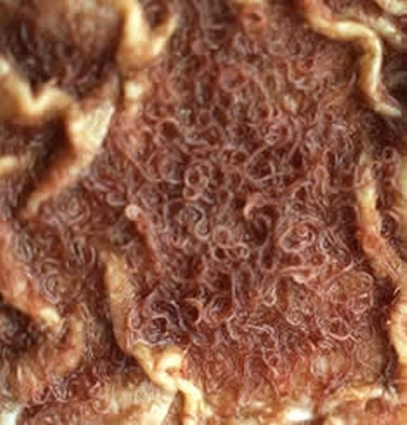
Haemonchosis
Large stomach worm
Twisted worm
Wire worm
Barbers pole worm
Lancet worm

Slide 3
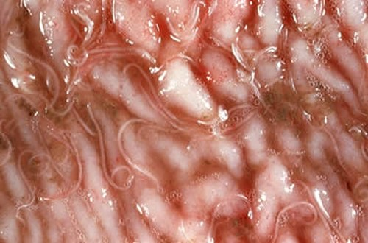
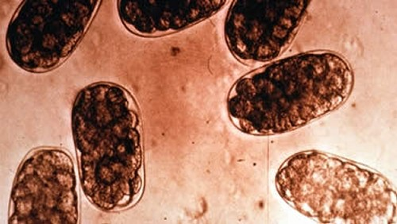
Haemonchus spp adult worm and Eggs

Slide 4
Introduction
It is mainly a disease of sheep and goat
It is a blood sucking parasite of cattle, sheep and goat.
It is characterized by anaemia, anasarca, debility and pain.

Slide 5
Etiology
H. Contortus- Sheep and Goat
H. placei- Cattle
H. bubalis- Buffalo
H. longistipes- Camel

Slide 6
Small Ruminants
Cattle
Graze together
Cross infection

Slide 7
Life cycle
Haemonchus
(1-1.25cm, red and red white)
Abomasum
Egg laying
(10,000eggs/day)
L1 stage
L2 stage
Embryonationation in environment
L3 stage
(Infective)
Ingestion by host
Ex-sheathment in the rumen
Emergence of L4 stage
Affect Abomasal gland
Adult worm emerge
EGG LAYING

Slide 8
Characteristic of L3
The larvae (L3) migrate away from the faecal pellets and some may travells 90 cm within 24 hrs. But majority of them are found within 10cm of the faecal mass.
The motility of the L3 stage larva is maximum in the hot and moist condition. It is susceptible to cold and dessication.

Slide 9
Pathogenesis
The histology and biochemical changes associated with Ostertagia spp. also occurs with Haemonchosis.
But the Vigorous blood sucking by the 4th larval stage (L4) and adult worm in the abomasum differentiate the pathogenesis of haemonchosis from that of Ostertagiosis

Slide 10
As a result of daily loss of whole blood about 0.05ml blood/worm/day. There is Haemorrhagic anaemia & due to continuing loss of R.B.C and compensatory erythropoiesis there is depletion of Fe from Fe store.
Death of Animal occurs from blood loss or from anaemia accompanied by hypoproteinemia.

Slide 11
Clinical Findings
Sudden Death
Blenched mucous membrane
Bottle Jaw
Melena
Recumbency

Slide 12
Predisposing factor
Hot and humid climate
Low plane of nutrition
Over Crowding
Lush green pasture

Slide 13
Clinical Pathology
EPG> 10,000
High plasma pepsinogen level and gastrin level
Low protein and Hb
High pH of Abomasum

Slide 14
Necropsy findings
Presence of large no. of readily visible H. Contortus in abomasum
Hyperplastic gastritis
Hydrothorax and ascites

Slide 15
Diagnosis
Epidemiological study and clinical signs.
EPG
Low Hb
Presence of barbers poles appearance of female worm as diagnostic appearance of Haemonchosis.
FAMACHA technique

Slide 16
FAMACHA
FAMACHA (FAffa MAlan CHArt) is a method whereby only certain sheep or goats in a flock are selected for treatment against wireworm (also known as barbers pole worm, Haemonchus contortus).
Sheep/goats are selected for treatment based on the degree of anaemia they are displaying in their mucous membranes.
In turn, the degree of anaemia is assessed through a colour guided chart.

Slide 17
Objectives
Use as guide to determine which animals to treat.
Significantly reduces number of treatments given when compared with conventional drenching practices.
Should significantly decrease the rate of development of anthelmintic resistance.

Slide 18
Since primary impact of H. contortus is anemia, one can indirectly measure parasite burden (and need for treatment) by measuring anemia.
Only useful where H. contortus is the primary parasite species.

Slide 19
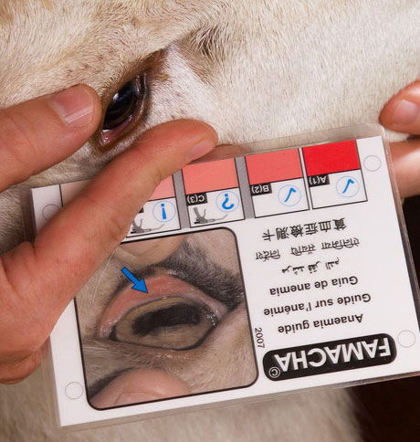
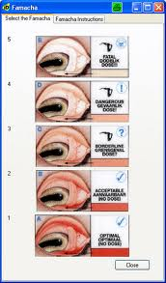

Slide 20
Eye color chart with five colour categories
Compare chart with colour of mucous membranes of sheep or goat.
Classification into one of five
colour categories:
• 1 – not anemic
• 5 -- severely anemic

Slide 21
Differential Diagnosis
Snake bite
Lightening strike
Enterotoxaemia
Coccidiosis

Slide 22
Differential diagnosis
Ostertagia & Trichostrongylus
Mild anaemia
Profuse watery diarrhoea and faeces are dark green to yellow in colour
Heamonchosis
Severe anaemia
Dark tarry coloured faeces

Slide 23
Prevention and Control
Closantel-
7.5-10mg/kg orally
Benzimidazole-
5-10mg/kg
Morantel (Banminth)-
5-7mg/kg
Late winter treatment remove Hypobiotic larva so reduces the parasite burden.
Alternate grazing
Spray of Urea soln. to kill the larvae
Vaccination by irradiated L3 and its sheathing fluid.
Self cure phenomenon.

