Slide 1
Histology of pancreas and liver
Pancreas
It is a compound tubulo acinar gland of serous secreting nature
The capsule is made up of connective tissue which divides the gland through its trabeculi into several lobes and lobules
The glandular adenomeres are made up of Pyramidal cells with parabasally placed spherical nucleus
The cytoplasm presents eosinophilic cytoplasmic granules containing enzymes

Slide 2
The acinar cell rests over the basement membrane and the duct system presents intercalated,intralobularduct,interlobular duct,lobar duct and main excretory duct
The main excretory duct is lined with simple columnar epithelium
The central lumen of the acini presents centroacinar cells which are extended epithelial cells of intercalated ducts
Myoepithelial cells are absent

Slide 3
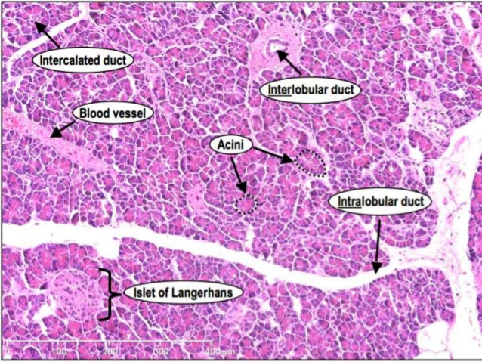
Structure of pancreas

Slide 4
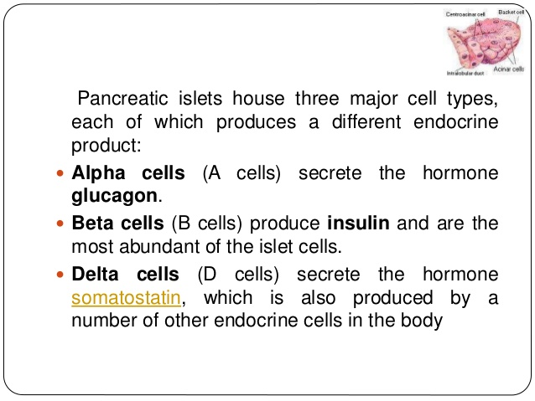
Islets of langerhan’s of pancreas

Slide 5
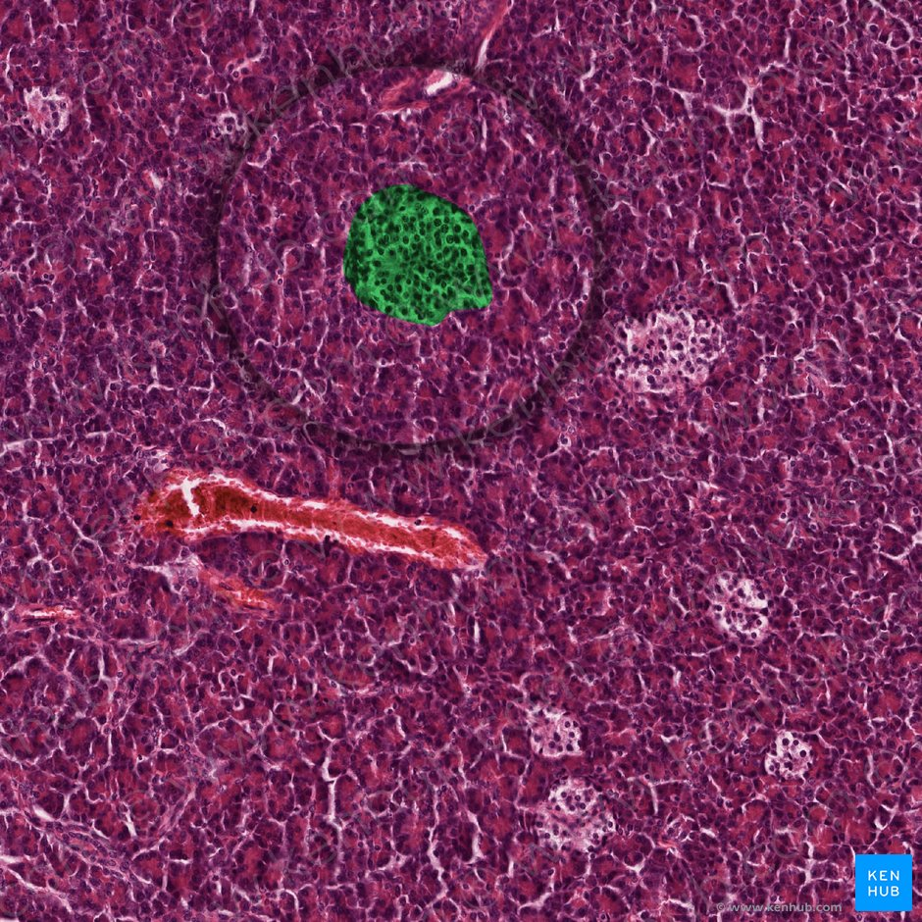
Islets of Langerhan’s

Slide 6
Liver
Irregular connective tissue known as Glisson’s capsule is covered to its maximum extent by peritoneum
From this capsule the CT descends towards the center of the gland which are predominated with reticular fiber
These septations divide the parenchyma into roughly hexagonal lobules
The interlobular septations are quite prominent in pig and made up of collagen fibers and are least developed in other animals

Slide 7
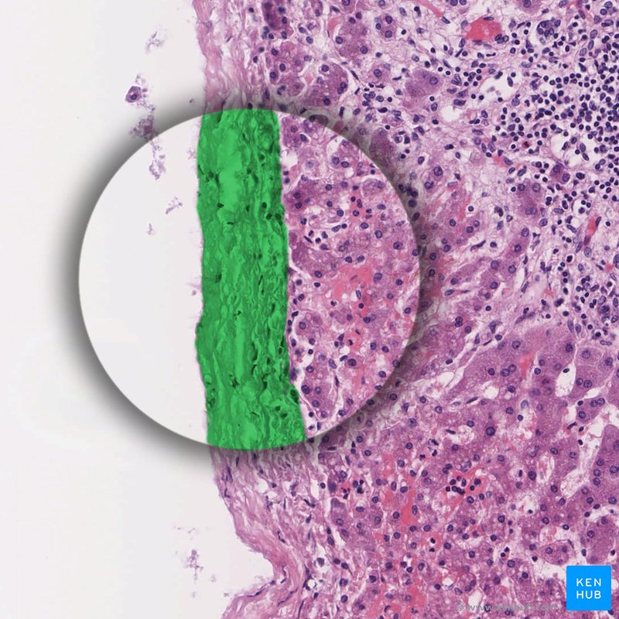
Glisson”s capsule

Slide 8
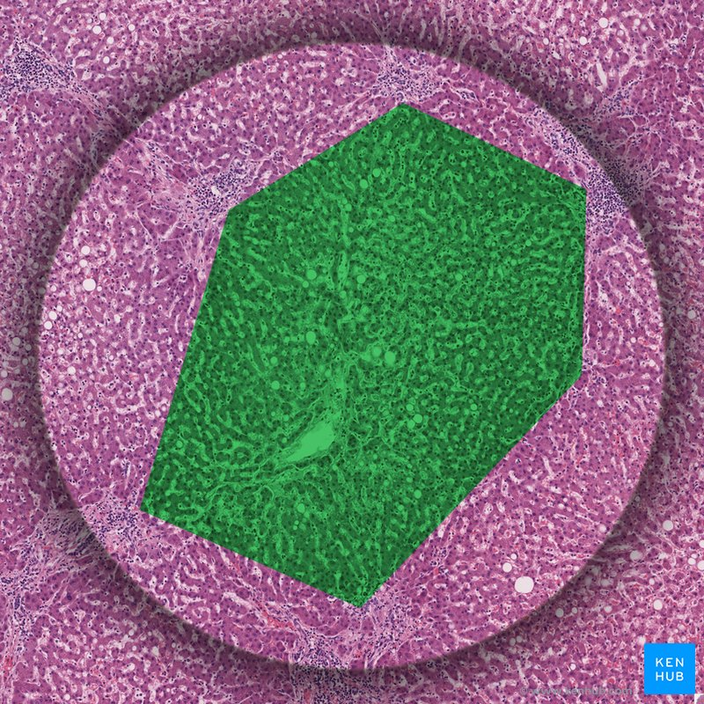
Hepatic lobule

Slide 9
The interlobular septations around hepatic lobule form six angle out of which the three angles contain portal vein,hepatic artery and bile duct.These areas are called portal areas or portal canal
The cells of the liver are known as hepatocytes which are arranged in radiating columns from outer margin of central vein towards the periphery of the lobule
The hepatic cell column are separated from each other by sinusoids which start from periphery and opens in the central vein
The hepatocytes are usually mononucleated cells and nucleus is spherical and cytoplasm rich in mitochondria,polyribosomes,ribosomes,lysosomes,SER,lipid and glycogen granules

Slide 10
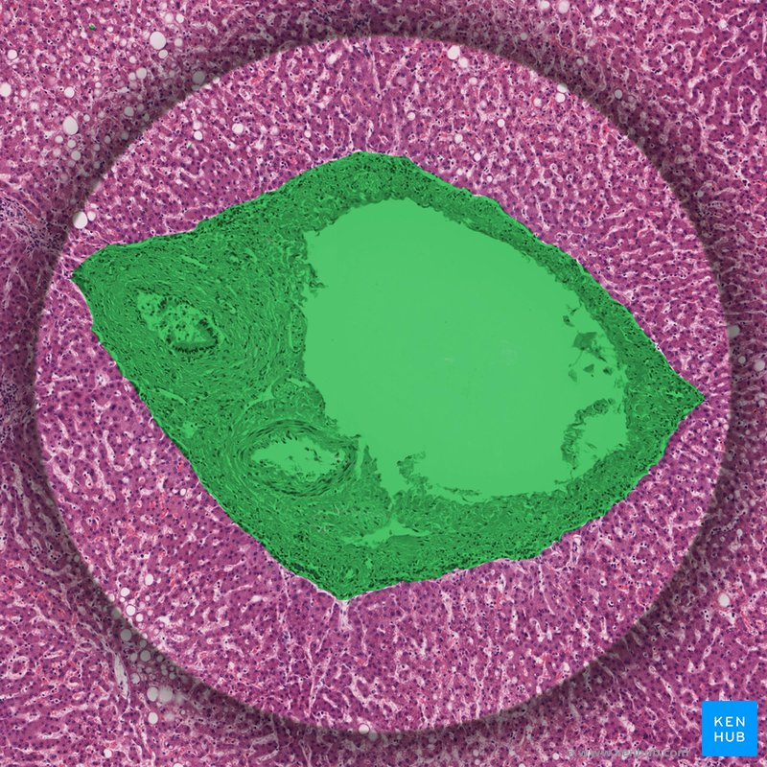
Portal triad

Slide 11
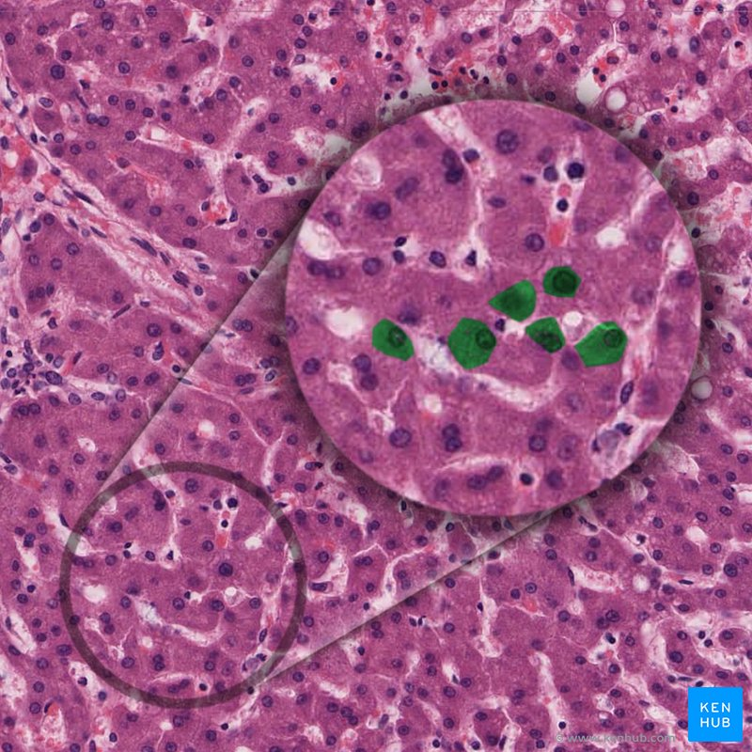
Hepatocytes

Slide 12
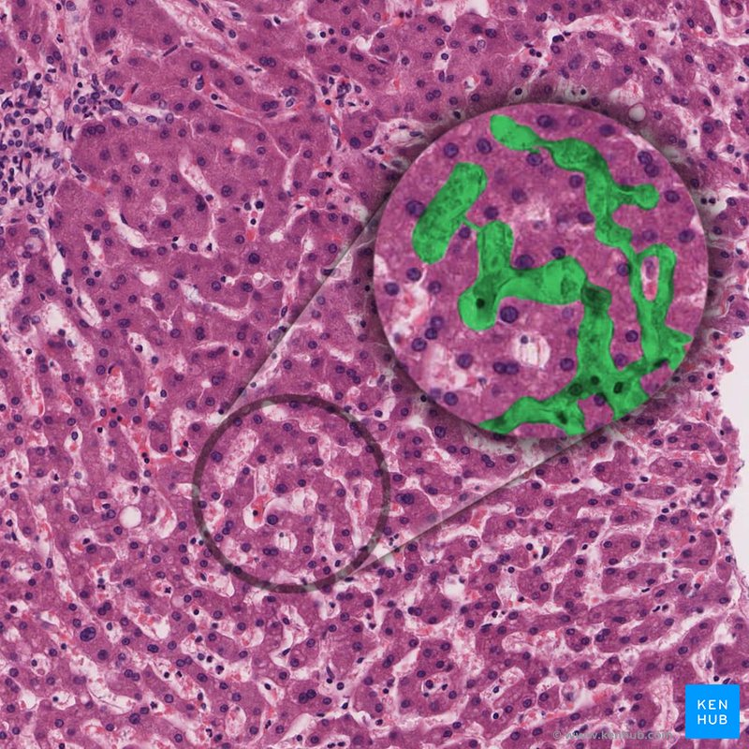
Sinusoids

Slide 13
The lining epithelium of sinusoids presents pores for transfer of macro and micro molecules of the nutrients carried through interlobular branch of portal vein
The sinusoidal wall is associated with large stellate shaped phagocytic cells popularly known as Kuffer’s cells
The space between the sinusoids and hepatocyte is called space of Disse

Slide 14
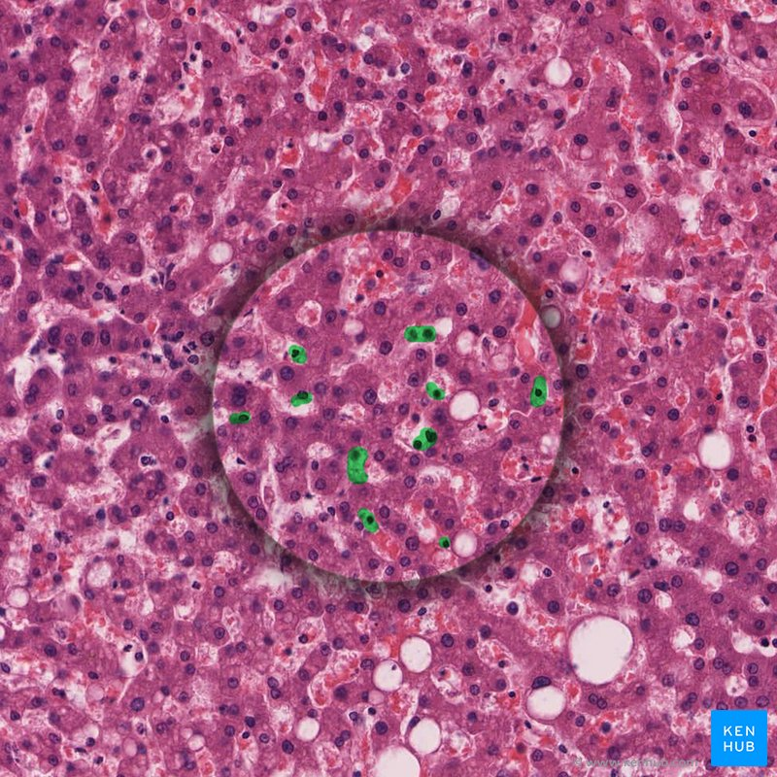
Kuffer’s cell

Slide 15
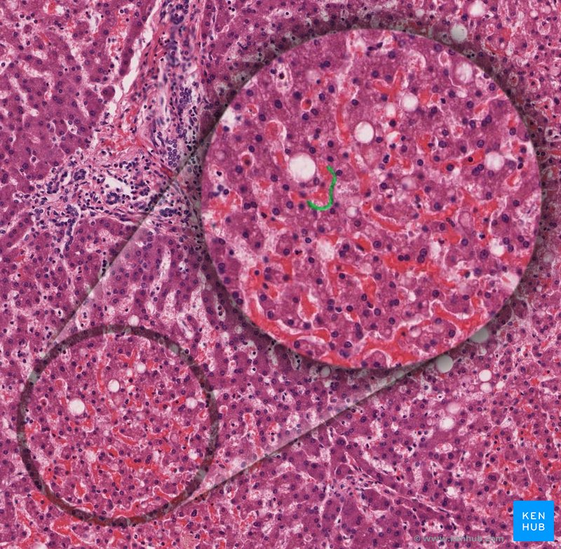
Space of Disse

