Slide 1
Light microscopy of Salivary glands
Parotid
A compound tubulo acinar gland
Serous type of gland
Myoepithelial cells present
Intraepithelial glands found in main excretory ducts
The opening of the duct into the mouth cavity is lined with stratified squamous cells

Slide 2
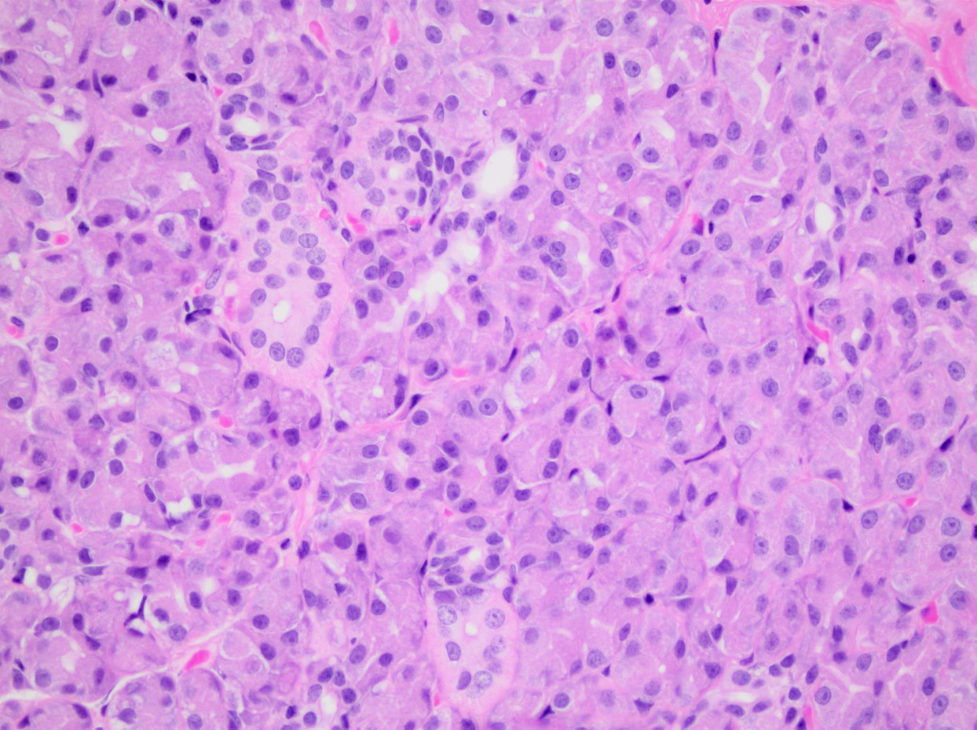
Section of parotid salivary gland

Slide 3
Mandibular salivary gland
Compound tubulo acinar gland
Seromucous
Myoepithelial cells present
Near opening the main duct is lined with Stratified squamous
Sublingual salivary gland
Seromucous gland
Compound tubulo acinar
Myoepithelial cells preesent
Main duct is lined with stratified cuboidal epithelium

Slide 4
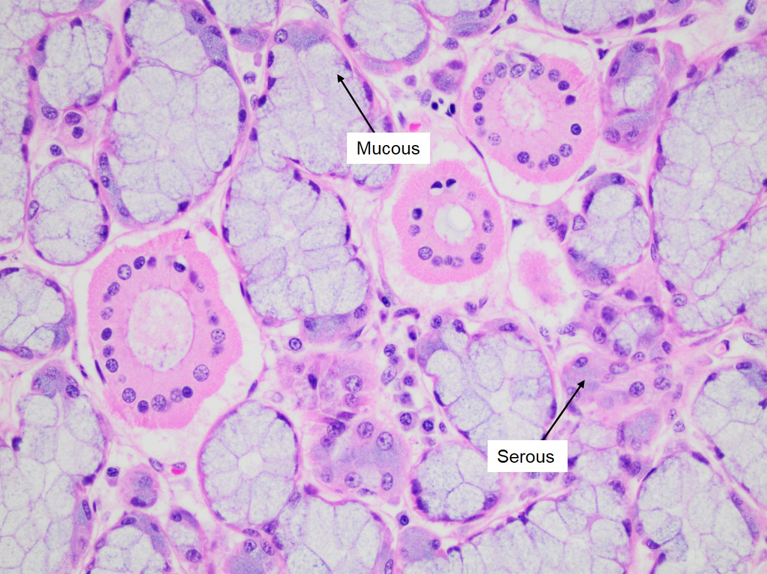
Section of mandibular salivary gland

Slide 5
Zygomatic salivary gland
Found in carnivores
Tubuloacinar gland
Mucous gland
Intercalated and striated ducts are lacking
Minor salivary glands
Simple tubulo or tubulo alveolar glands
May be serous ,mucous or seromucous glands
Distributed in surface of tongue,vestibular face of lips and cheek areas

Slide 6
Pharynx
Lamina epithelialis is formed by stratified squamous epithelium which may be keratinized or non keratinized depending upon the species
Lamina propria submucosae is made up of fibroelastic tissue
Laminae muscularis mucosae is absent
Tuica muscularis is formed by pharyngeal muscles
Tunica adventitia comprised of fibroelastic connective tissue

Slide 7
Oesophagus
Laminae epithelialis is made up of stratified squamous epi and is highly keratinized in ruminants,least in pigs and non keratinized in carnivores
Laminae propria is made up of dense fibro elastic connective tissue
Laminae muscularis is made up of longitudinally placed smooth muscles
Tela submucosa is made up of loose connective tissue and presents seromucous glands

Slide 8
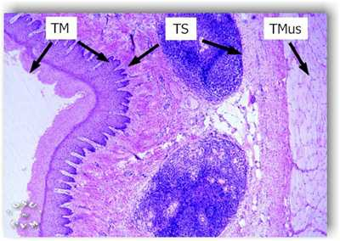
Section of oesophagus

Slide 9
The tunica muscularis in ruminants is entirly made up of striated muscles
In horse the cranial and middle third is made up of striated muscle fiber whereas caudal third is made up of smooth muscle fibers
In case of pig the cranial one third is made up of striated muscles,middle part is made up of striated and smooth muscles and caudal part with smooth muscles
Tunica adventitia is made up of loose connective tissue containing blood vessels and lymphatics

Slide 10
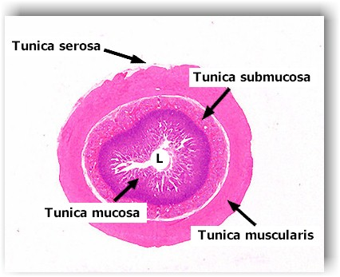
Structure of general tubular organ

Slide 11
Histology of stomach
Non glandular part of non ruminants
Tunica mucosae is lined with SSE which is non keratinized in dog
Lamina propria made up of loose connective tissue
Laminae muscularis mucosae made up of smooth muscles
Tela submucosae made up of loose C.T containing submucosal plexus
Tunica muscularis made up of smooth muscles
Tunica serosa lined with mesothelial cells

Slide 12
Non glandular part of ruminants
Rumen
Lamina epithelialis is formed by SSE of keratinized variety containing S.corneum,S granulosum,S.spinosum and stratum basale
Lamina propria is loose and lamina muscularis mucosae is absent
Tela submucosa is made up of loose connective tissue and tunica muscularis is made up of smooth muscles

Slide 13
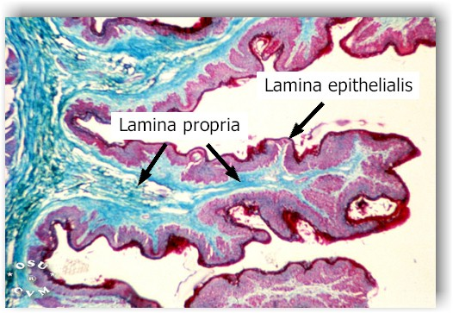
Section of rumen

Slide 14
Reticulum
Structures are similar to rumen except the lamina muscularis mucosae which is present at the tip
Omasum
The omasal laminae presents distinct laminae muscularis mucosae extending from the base to the central core

Slide 15
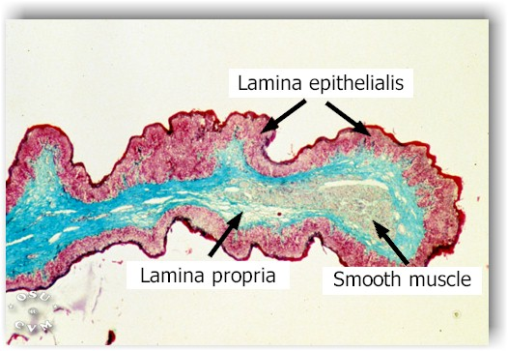
Section of reticulum

Slide 16
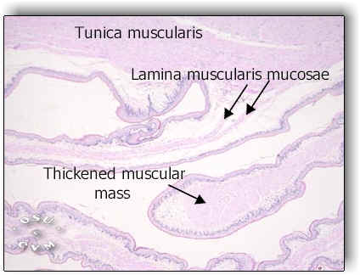
Structure of omasum

