Slide 1
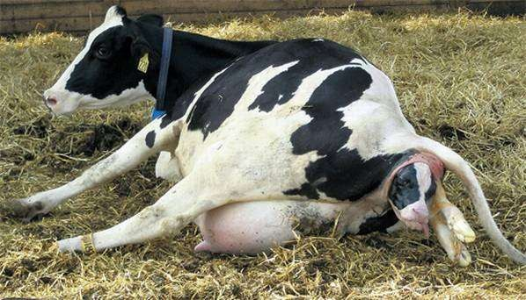
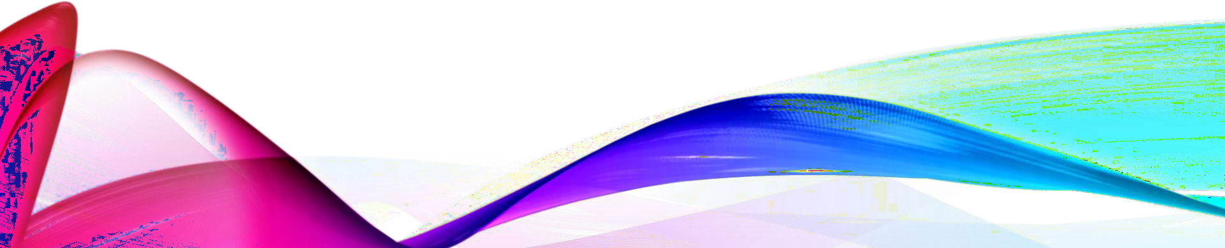
INDUCTION OF PARTURITION & ELECTIVE TERMINATION OF PREGNANCY IN ANIMALS

Slide 2







PARTURITION
Fetal Nutritional Demands
CRH
ACTH
Hypothalamus
Anterior
Pituitary
Adrenal
Cortex
Placental
Insufficiency
Fetal Corticosteroids (Cortisol)

Slide 3








PARTURITION
Fetal Nutritional Demands
CRH
ACTH
Hypothalamus
Anterior
Pituitary
Adrenal
Cortex
Placental
Insufficiency
Fetal Corticosteroids (Cortisol)
Lung (surfactant)
Liver (glycogen)
Thyroid (metabolism)
Placentome
Progesterone
Estrogen
PGF_{2α}

Slide 4




PARTURITION
Fetal Nutritional Demands
CRH
ACTH
Hypothalamus
Anterior
Pituitary
Adrenal
Cortex
Placental
Insufficiency
Fetal Corticosteroids (Cortisol)
Lung (surfactant)
Liver (glycogen)
Thyroid (metabolism)
Placentome
Progesterone
Estrogen
PGF_{2α}
Uterine Myometrium
» Gap junctions
Uterine Endometrium
» Oxytocin receptors
Cow,Sow Triggers CL
Regression
PGF_{2α}
Oxytocin
Ovary (CL)
Uterine Contractions
Cervical
Ripening
Relaxin

Slide 5

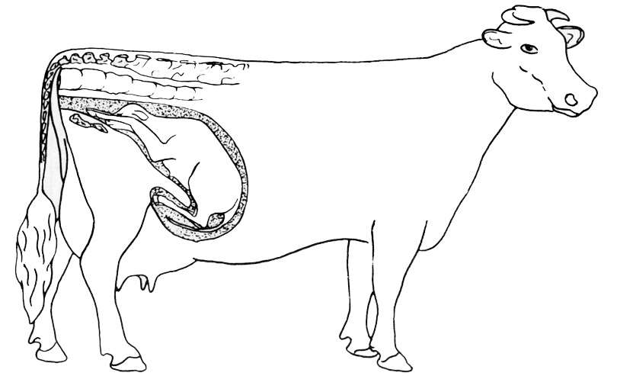


FINAL ROLE OF OXYTOCIN
Sensory Neurons in Cervix
Oxytocin from Posterior Pituitary
Myometrial Contractions

Slide 6
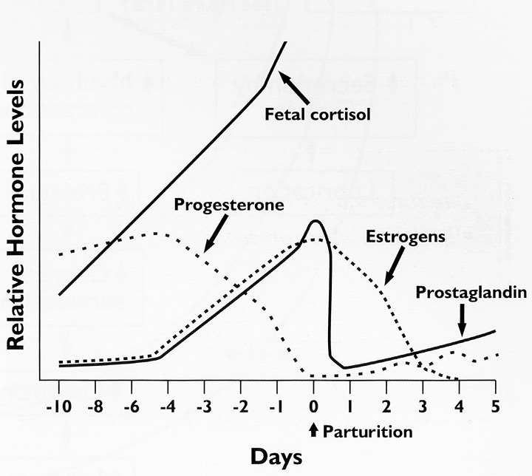
HORMONAL CHANGES ASSOCIATED WITH PARTURITION

Slide 7
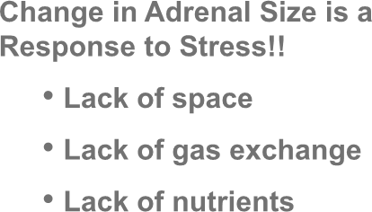

FETAL ADRENAL CHANGES WITH
AGE
Adrenal Gland Weight
Change in Adrenal Size is a
Response to Stress!!
Lack of space
Lack of gas exchange
Lack of nutrients
Parturition
Fetal Age

Slide 8
INDICATIONS
During normal gestation
Misidentification of a breeding female
Accidental breeding of a very young heifer, and
Unwanted pregnancy in feedlot heifers.
During abnormal gestation
Fetal maceration,
Fetal mummification
Hydramnios, and hydrallantois.

Slide 9
INDUCTION OF PARTURITION
Dexamethazone
  Potent synthetic cortisol
  Works in all species
  Takes 2 to 3 days
PGF_{2a}
  Swine, cattle and sheep
Oxytocin
  Human, horse

Slide 10
PGF₂α results in luteolysis at any stage of pregnancy;
PGF₂α treatment alone induces abortion only up to 5 months of gestation.
Rarely, luteolysis is incomplete, (luteal progesterone remains above the threshold), and partial cervical dilation and abdominal straining may occur before the cow resumes normal gestation.

Slide 11
GLUCOCORTICOIDS
Reduce placental progesterone secretion from 150 days of gestation.
Luteal progesterone level is unaffected, induces abortion the last month of gestation.
During the final month of gestation, glucocorticoids act at the feto-placental unit to increase the production of oestradiol and PGF₂α, resulting in induced parturition.
A combination of PG and glucocorticoids will induce abortion from 150 days of gestation.

Slide 12
OESTROGENS
During the first 2 to 3 days after ovulation, administration of E2 alters oviductal
transport of the bovine embryo and terminates pregnancy.
After corpus luteum formation, estrogens cause luteolysis by inducing the endogenous PGF₂α luteolytic cascade from the endometrium.
abortion can be induced reliably at up to 150 days of gestation.
30mg estradiol valerate, alone or in combination with dexamethasone in cows between 200 and 220 days of gestation has not been shown to decrease serum progesterone or result in abortion.

Slide 13
INDUCTION OF PARTURITION IN
COW
Caution:
Do not induce before day 269 of gestation
Methods
  Dexamethasone
oparturition in 48 hours
oDexa. + PGF induces within 35±2 hrs oHigh incidence of retained placenta Estrogen given before Dexa. eases parturition.
PGF
oWorks near term but may require long acting or 2 doses
oUsed to remove mumified fetus.

Slide 14
INDUCTION OF PARTURITION IN
EWE
Dexamethasone
  Parturition within 24 – 72 hrs
  No retained placenta problem.
PGF_{2a}
  Lutalyse
    works best to abort prior to day 50
    multiple injections will work to induce parturition near term

Slide 15
INDUCTION OF PARTURITION IN
THE SOW
Survival only after day 111 of gestation
PGF_{2a}
  Parturition within 24 – 48 hrs
  PGF at 8 AM followed by oxytocin 24 hrs latter
    Sows farrow between 8 AM and 5 PM following oxytocin
  Farrowing:1 to 8 hrs. with 15 min interval b/w piglets.
  Oxytocin can be given if delay in expulsion of subsequent piglet is noticed.
  decrease stillbirth – occurs in large litters or after extended parturition

Slide 16
INDUCTION OF PARTURITION IN THE
MARE
Do not do this unless absolute need!!!
  Variable length of gestation in mare
  Not sure of foal maturity
Oxytocin after day 320
  Problems
    Foal may require extensive veterinary care in first few weeks of life – impact on social maturity of foal
    Colostrum in mare
    Lung maturity in foal

Slide 17
INDICATIONS
Mismating
Change in ownership
Age or health of dam
Abnormal gestation, and
Twin pregnancy.

Slide 18
TERMINATION OF PREGNANCY UP TO 150
DAYS
Prostaglandins
Upto 5 months of pregnancy.
PGF₂α or an analogue
  PGF₂α : 25 mg IM
  Cloprostenol: 500 µg IM
  Fenprostalene: 1 mg SC

Slide 19
Intrauterine infusion of irritating solutions
Between days 5 and 10 after ovulation, prevents the establishment of pregnancy and may cause luteolysis and early return to oestrus.
Later than 11 days after ovulation occasionally lengthens the oestrous cycle.
Up to 90 days of gestation, causes embryonic death necessitating manual evacuation of uterine contents.
Suitable solutions
  Aqueous iodine 0.5%
  Tetracycline 2 Gm in saline.

Slide 20
Oxytocin
First few days after ovulation may prevent the establishment of pregnancy
Oestrogens
Administration within 72 h of ovulation impedes oviductal transit of embryos.
Up to 5 months of gestation, administration of an oestradiol ester, such as oestradiol valerate, results in abortion within 7 days. Occasional abortions occur up to 14 days after treatment.
Oestradiol should be administered every 4 days until abortion.
  Diethylstilesterol: 40-80 mg IM
  Oestradiol ester: 4-8 mg IM

Slide 21
MANUAL TECHNIQUES
1.Manual enucleation of the CL
By transrectal manipulation manual enucleation of CL removes progesterone support for pregnancy and results in abortion at up to 150 days.
Conceptus will be aborted in 2-5 days late or resorbed.
Limitations
  Induce adhesions of the ovary and ovarian bursa
  Occasionally, severe hemorrhage, sometimes fatal.

Slide 22
2.Manual rupture of the amniotic vesicle
By transrectal manipulation it is possible to manually rupture once the vesicle can be palpated at 30 to 35 days of gestation.
After 60 days and up to 120 days of gestation, it is possible to terminate pregnancy
by manual decapitation of the fetus.
The mean time to abortion is 25 days, but abortion may occur up to 8 weeks after treatment.

Slide 23
IN HYDRALLANTOIS AND HYDRAMNIOS
Pregnancy can be terminated within 48 h in cows with simultaneous administration of PGF₂α and dexamethasone.
Supportive treatment is necessary to compensate fluid loss.
Parturition usually is abnormal.
C-section may be an alternative to induced parturition.

Slide 24
IN FETAL MUMMIFICATION
PGF₂α or an analogue
  Therapeutic agent of choice.
  Expulsion of the fetus : 24-72 h.
  return to fertility within 1-3 months.
  Retreatment occationally
Oestrogens
  Luteolytic doses of estrogen also results in expulsion of mummified fetuses.
  Repeated treatments may be necessary at 48 h intervals.
  After treatment, the mummified fetus may become lodged in the vagina, requiring lubrication and manual removal.

Slide 25
MTP
Mismated dogs that may be too young or small for breeding, may be held in reserve for breeding at some future date, or scheduled to be bred to a different stud.
Injury or disease that may compromise the life

Slide 26
DURING PRE-OSSIFICATION PERIOD IN CANINE ( Days 20-22 through 40 -42 after LH peak )
Drugs | Dose | Route | Frequency
PGF2 alpha | 0.1-0.25 mg/kg | SC | BID for 4-6 days
Cloprostenol | 1.0-2.5 µg/kg | SC | Once a day for 5 days
Cabergoline Plus Cloprostenol | 5 µg/kg 1 µg/kg | Oral SC | Once a day for 5 days Once in 48 h
Bromocriptine Plus Cloprostenol | 30 µg/kg 1 µg/kg | Oral SC | TID On days 28 and 32 after LH peak
Bromocriptine PlusPGF2 alpha | 10 µg/kg 100 µg/kg | Oral SC | TID TID
Aglepristone | 10 mg/kg | SC | Once a day for 2 days

Slide 27
DURING PREATTACHMENT PERIOD IN
CANINE
DURING PRE-ATTACHMENT PERIOD IN CANINE (Fertilization to days 20-22 after LH peak)
Drugs | Dose | Route | Frequency
Aglepristone | 10 mg/kg | SC | Once a day for 2 days
Oestradiol Benzoate | 10 µg/kg (max 1 µg) | SC | Divided in to 2-3 injections / once in 48 h. Begin 2-4 days after mating
Cloprostenol | 1.0-2.5 µg/kg | SC | BID to QID for 5 days begining of day 5 of diestrus
Natural PGF2 alpha | 10-250 µg/kg | SC | BID to QID, days 5-11 of diestrus

Slide 28
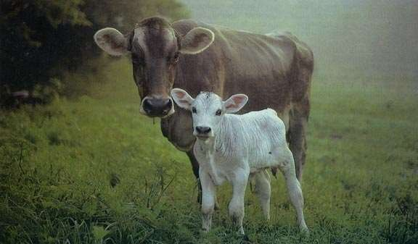
THANK YOU

