Slide 1
LAYOUTS OF LIVESTOCK FARM
DR. S. P. SAHU
Assistant Professor
Livestock Production Management
Bihar Veterinary College, Patna - 14

Slide 2
LAYOUTS OF LIVESTOCK FARM
It includes:
Location and grouping of farm buildings.
Location of pathways and roads.
Division of farm land into plots.
The layouts are intended to show the size, numbers and locations of different functional units.
Each lay out can be planned based on the size of the farm and the economic returns.
A dairy farm should preferably start with a small herd and increase the herd strength later on.
Farmer may modify layout suitable to his location, personal likes and dislikes.

Slide 3
Factors for Planning a Good Layout of Dairy Farm:
1. Topography of the land.
2. Capital availability.
3. Size of herd and level of milk yield.
4. Stock density and feeding policy.
5. Effective supervision of farm operation.
6. Use of labor saving devices.
7. Strength of herd in relation to land under forages.
8. Fodder conservation.
9. Other resources of fodder.
10. Type of farm buildings.

Slide 4
A suitable distribution of 100 acres of land for proper of dairy farm may be made as follows:
Land under Buildings, Paddocks and roads: 8 acres
(b) Land under fodder cultivation: 80 acres
(c) Land under permanent pasture: 8 acres
(d) Land under cash crops: 4 acres
Total: 100 acres

Slide 5
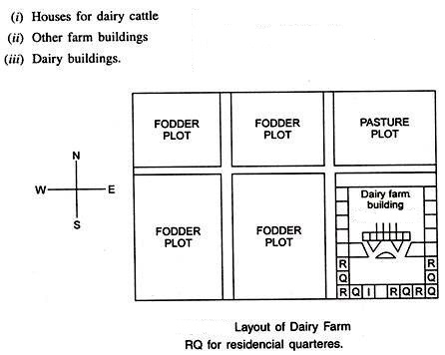
Dairy farm building:

Slide 6
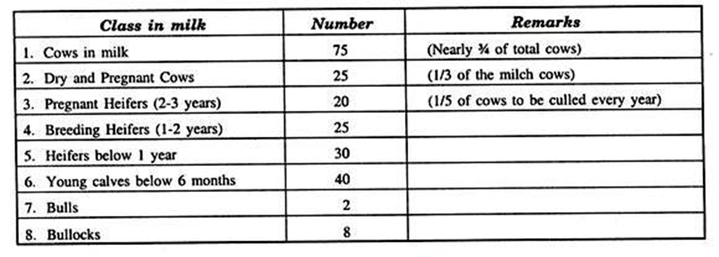
Housing requirement/animal:
Strength of herd for 100 milk animals and followers:

Slide 7
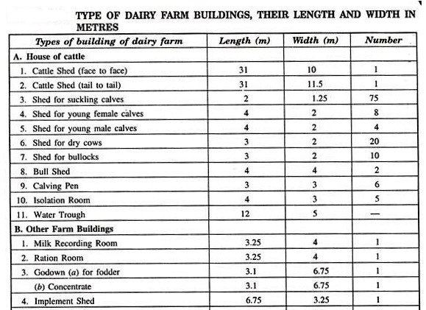

Slide 8
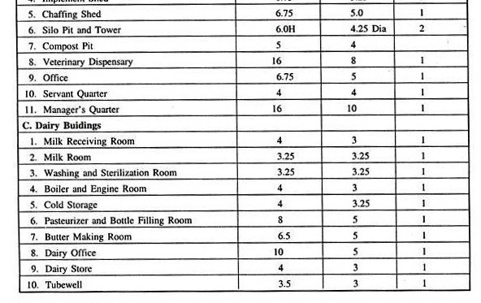

Slide 9
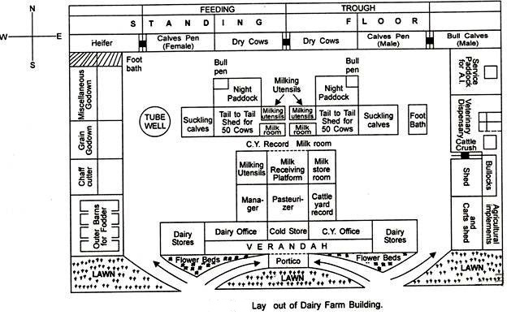

Slide 11
Housing requirement per animal for crossbred cattle

Slide 12
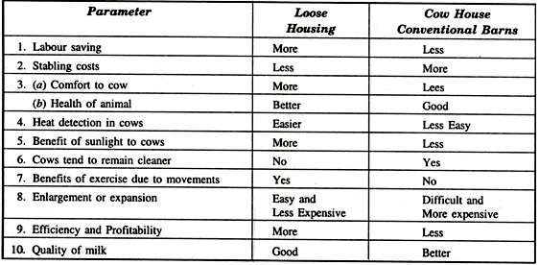
Comparative Merits of Loose Housing and Conventional Barn System:

Slide 13
(b) Pathways and roads:
Following are the key points in layout of roads on farms:
Pathways must connect each building of cattle yard, offices, residential quarters etc.
Roads must be well graveled for quick transport.
As far as possible roads must be straight for easy economic haulage.
Layout of roads must be such which requires minimum wastage of land.

Slide 14
(c) Fodder fields and Pastures:
Operation on farm must be easy and economic to carry out.
Number and size of plots must be according to cropping rotations/plan.
All plots must be well connected to roads and irrigation channels.
Layout of plots must be such that it is easy to irrigate without soil erosion.

Slide 15
Loose Housing System:
It consists of four units for a successful layout as follows:
1. Feeding area and feed storage.
2. The bedded area, pen space and bedding storage.
3. The paved area.
4. The milking plant (milking parlor, milk house, feed storage and
utility room.

Slide 16
1. Feeding Area
Covered shed where cows are fed dry feed.
Close and convenient to milking parlour because it can serve as a holding area for the cows during milking.
The floor should have slope of 3.0 cm/m from the manger to the back of paved area.
Feed manger should be so constructed that dry fodders cannot be spilled over on the floor.
Space required for manger per cow is 50-60 cm.

Slide 17
2. Bedded Area
Responsible for favorable health condition in loose housing system.
Provides comfort and keeps cows clean.
About 5.5 to 6 kg of bedding material/cow is needed/day.
Bedding area must provide 5.6 sq. m per cow.
Bedding area must be located at the opposite end of the building from the milking parlour.

Slide 18
3. Paved Area
The place cows use for fresh air and sunshine.
Paved area required/cow is 9.3 sq. m.
A pavement consisting of 4″ of good concrete placed over 6″ gravel.
Provided with a row of trees to provide shade and stop wind.
Its floor should have a slope of 3 cm. per 10 m. away from buildings.

Slide 19
4. Milking Parlour
To keep milked cows separated from the rest of the herd, a partly covered clean paved area just outside of milking parlor is required.
Best to feed concentrates in hopper bins conveniently set above the ground floor level during milking of cows in the parlor.
Contain 2 to 8 or even more stalls depending upon size of herd.
Here cows stand in stalls and milked by operator standing at the same level as cow.
Cows are milked in a continuous operation, rather than milking one group then replacing these with another group.

Slide 21
Conventional Barn System:
(a) Two Storey Barns:
The storey on upstairs of double storey barns is used for storage of feed, concentrates and bedding material.
Ground floor is used for housing the dairy animals.
(b) Single Storey Barns:
Such barns are common in use.
Sufficient light and ventilation provision and bring saving in labor.
Standard stanchion barn.

Slide 22
(c) Round barns:
Such barns consist of a silo tower in the center and manger around it.
Animals stand around the manger facing the silo tower.
(d) Pen type barn:
one of the loose housing systems.
Pen type housing system consists of 3 m. wide shed covered area for feeding purposes and protection from inclement weathers.
Animals here move about freely.
(e) Basement barn:
Such houses for animals are made after cutting the basements of hills and rocks in hilly areas.

Slide 30
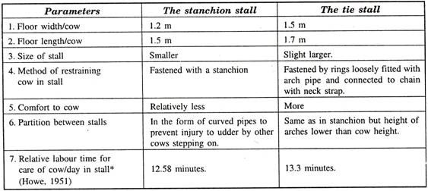
Types of Stalls:
(i) Stanchion stalls
(ii) Tie stalls
Comparative Merits of Types of Stall:

Slide 31
Grouping of Buildings:
1 . Location:
According to land under fodder, farm houses, roads and pasture area.
2. Farm house and office/buildings:
Near the main road.
3. Animals barns:
30 m away from main road and farm house.
4. Silos, balance room, calving pen and feed room:
Near the barns
5. Isolation room:
Away from barns and near dispensary
6. Calf pen houses for young stock:
Near the paddocks

Slide 38
Factors Affecting Cost of Livestock Housing :
Housing cost varies from 25-90% of the total initial investment.
1. Site.
2. Housing system.
3. Type of barn.
4. Size of buildings.
5. Number of buildings.
6. Placement/arrangement of buildings.
7. Building material used for the construction.
8. Methods of cladding and masonry charges.

Slide 39
1. Site Selection:
The site of the building bears a relation with the useful life of the building.
Mainly affected by the climate, soil type, topography and available basic facilities.
2. Housing System:
Adoption of loose and open housing of the livestock for a maximum period of comfortable weather conditions.
Open houses are cheap, easy to construct, expand and alter.
Open houses offer less protection and require more space.
3. Type of Barn:
Decide to go in for adjustable form of barns, where in an emergency; a variety of different categories of animals may be housed together. Loose boxes are therefore the assets of any farm.

Slide 40
4. Size and Number of Buildings:
The size and number of building will vary according to the type of the livestock farming, number of animals to be housed together, entire herd strength and amount of produce dealt with.
Advisable to build a barn for 20 cattle or buffaloes in a single row system and for about 50 animals in double row system.
5. Placement/Arrangement of Buildings:
Properly constructed and well-arranged buildings, optimally utilized equipment, machinery and animals are the assets of a livestock farm.
They make the labor more efficient, reduce cost of production and provide opportunities to utilize crops and manures more efficiently.

Slide 41
Suppose a farmer has 10,000 sq/m areas for accommodating five buildings:
One office, three animal sheds and one store, each with a similar area i.e., 100 sq/m. Then he has options to place these buildings in three ways: circular, square and rectangular forms.
(A) Placing Buildings in Circular Form:
Assume placement of four buildings equidistantly on the periphery and one in the center. The distance to be covered during movement of men and materials on taking the circular route can be deduced in the following manner.
(i) Distance from centre to any other building in the periphery:
This will be equal to the radius, ‘r’ of the circle, whose area ‘A’ is 10,000 m².
R = (A/π) = (10,000 X 7/22) m = 56 m.
(ii) Peripheral distance among four buildings:
This will be equal to the circumference of the circle ‘C whose area ‘A’ is 10,000 m².
C= 2πr = 2 x 3.14 x 56 = 356 m.

Slide 42
(B) Placing Buildings in Square Form:
Assume placement of one building in the centre and the remaining four equidistantly on the periphery in ‘2a’ or ‘2b’ form (either on the corners or on mid line of the square path).
The distance to be covered during movement of materials and men on taking square route can be deduced as follows:
(i) Distance from centre to any other building on the periphery:
‘2a’ form of square layout
1/2 (bd or ac) = ½ x (ab² + ad²)= 1/2 X (100² + 100²) = 71 m
‘2b’ form
1/2 (ab or ad or be or cd) = 50 m.
(ii) Peripheral distance among four building:
This will be equal to the circumference, ‘C of the square whose area is 10,000 m².
C = ab + bc + cd + ad = 100 + 100 + 100 + 100 = 400 m.

Slide 43
(C) Placing Buildings in Rectangular Form:
Assume placement of one building in the centre and the remaining four equidistantly on the periphery of the rectangle with 50 and 200 m sides in ‘3a’ or ‘3b’ form (either on the corners or on mid line of the rectangular path).
(i) Distance from centre to any other building on the periphery
‘3a’ form: 1/2 (bd or ae) = 1/2 x (ab² + ad²) = 1/2 (200²+ 50²) = 103 m
‘3b’ form: 1/2 (ab OT cd) = 100 m and 1/2 (ad or be) = 25 m.
(ii) Peripheral distance among four buildings:
This will be equal to the circumference ‘C of the rectangle whose area is 10,000 m²
C = ab + bc + cd + ad = 200 + 50 + 200 + 50 = 500 m.
Adoption of circular form of placement of buildings in a given area will permit minimum distance for approach roads, and thereby cut down on the cost of their construction.
It would also give faster coverage of all buildings during the movement of men, vehicles and materials leading to efficient managerial operations all around.
Simply put, placing the building in different layout increases the cost of construction from 4 to 58%.

Slide 46
6. Design of Buildings:
Internal design of barns also affects the cost of construction. In case of commercial livestock production, animals may be kept in single row or double row styles with or without provision of feeding passages.
Such arrangements give rise to the following alternatives:
1. Single row with feed passage.
2. Single row without feed passage.
3. Double rows – tail to tail with feed passage.
4. Double rows – Tail to tail without feed passage.
5. Double rows – Face to face with feed passage.
6. Double rows – Face to face without feed passage.
(A) Width of Shed (feeding passage optional):
1. Single row:
= wall + feeding passage + manger + standing + channel + cleaning passage + wall

Slide 47
2. Double rows:
(a) Face to face (feeding passage optional):
= wall + cleaning passage + channel + standing + manger + feeding passage + manger + standing + channel + cleaning passage + wall
(b) Tail to tail (feeding passage optional):
= wall + feeding passage + manger + standing + channel + cleaning passage + channel + standing + manger + feeding passage + wall
(B) Length of Shed = Area + width, or (Number of cows + 2) x 1.2 + 0.3 x 2 m
(C) Length of Manger:
I. Single row = Length of shed
II. Double rows = Length of shed x 2
(D) Number of Animals to be accommodated:
= (Length of Standing floor + 1.2) x 2
(E) Air Space Available per Animal:
= Air space/no. of animals housed

Slide 48
7. Building Materials:
Building materials differ from region to region according to soil types and topography.
These materials are usually substances that remain unaffected/reasonably slowly affected by the stress of climatic variables.
It is noted that certain materials are predominantly available in particular areas (e.g., coconut and bamboo in coastal areas).
Be liberal in using locally available materials to cut down on cost on their procurement.
The roofing materials: Lighter and weather proof.
Corrugated iron roofs are suitable for open cattle courts, manure pits, cart sheds etc.

Slide 49
8. Method of Cladding and Masonry:
A smooth and unbroken surface is necessary in buildings where cracks and crevices may harbor insects and pests.
Brickwork or concrete jointed to a regular face and color washed is suitable.
The wall should be smooth finished in cement rendering to prevent lodging of dirt and dust and will satisfy hygienic requirements.
Ideally, livestock houses should be constructed by experienced masons to avoid unnecessary masonry work.

Slide 50
THANKS

