Slide 1
POULTRY MANAGEMENT (LPM-608)
Dr. S. P. Sahu
Department of LPM
Bihar Veterinary College, Patna- 800 014
Email: spsahuj@rediffmail.com

Slide 2
POULTRY MANAGEMENT
Husbandry practices to maximize the efficiency of production by satisfying the basic needs of the birds.
Management practices for commercial broilers and layers: Entirely different.
Management practices for breeder broilers and layers: Same as the ultimate objective is to maximize baby chicks production.

Slide 3
Successful poultry management depends on:
Judicious implementation of scientific practices
Personal discretion
Personal experience

Slide 4
BROODING MANAGEMENT OF CHICKS
Chicks transferred to brooder house just after hatching and reared there for 6-8 weeks.
Most critical period of life of birds.
Best time to procure replacement stock or starting of layer farm: January-April (hens are in high production during winter months fetching higher prices).

Slide 5
Broiler farm: Started any time of the year as it is a continuous process.
Comfort of chicks in brooder house depends on ventilation, sanitation and hygiene, litter, temperature, brooder space, brooder guard, floor space, water space and feeder space.

Slide 6
Ventilation:
Adequately ventilated and free from draft.
For removal of Co₂, heat, healthy environment, dryness in brooder.
Avoid too dusty environment which irritates the respiratory tract and transmits diseases.
Optimum Co₂ concentration: 0.3-0.5%.

Slide 7
Ventilation …………….
At 1% concentration of Co₂: increased mortality.
5% Co₂: completely lethal
O2 concentration: Not less than 21%.
Avoid too much moisture causing ammonia fumes which irritating the respiratory tract and eyes.

Slide 8
Sanitation and Hygiene:
Brooder house properly cleaned and disinfected with disinfectant solution before placing the chicks.
All movable equipments (feeders, waterers, hovers): cleaned and disinfected.
Litter: scraped and removed.
Interior and exterior of brooder house: cleaned under pressure.

Slide 9
Sanitation and Hygiene …………
Malathion spray/blow lamp: to control ticks and mites.
Insecticides: mixed with litter at recommended doses.
Adopt “all in all out” system to control and prevent diseases.
Restrict the movement of workers and equipments.
Foot bath at entrance of each building.

Slide 10
Litter:
Suitable litter materials like sawdust, paddy husk, chaffed paddy straw, shredded papers etc. locally available.
Thickness: 5 cm at the starting and increased upto 7-10 cm in course of time by gradual addition.
Never use mouldy litter materials.
Litter stirred at frequent intervals to prevent caking.

Slide 11
Litter …………….
Wet litter must be replaced by dry litter immediately to prevent ammoniacal odour.
Moisture content of litter: 20-25%
Low moisture: dustiness
High moisture: hot and caked litter, high ammonia production.

Slide 12
Temperature:
Maintain right temperature in brooder house.
Too high and low temperature: Slow growth and high mortality..
Temp. recording: 5 cm above the floor and 5-7.5 cm inside the edge of warm portion of the brooder.

Slide 13
Temperature ……………
During first week, start with 95ºF which is reduced 5ºF per week during successive weeks till it reaches to 70ºF.
Brooders: switched on atleast 24 hours before chicks arrival.
Temperature under brooder house: 10ºC below the brooder temperature.
Control temp. by using max.-min. thermometer.

Slide 14
Chicks behaviour: Getting desired amount of heat.
Less temp.: close to heat source and huddling.
High temp.: away from heat source and panting/gasping.
Optimum temp.: evenly scattered.
Hover type electric brooder: thermostatic control.

Slide 15
Minimum clearance space of 12-15 cm above the chicks is recommended in hover brooder.
More hover height: excessively heating and high fuel cost.
Electric bulbs: temp. control is difficult but not impossible.
Infra-red lamp: very good for brooding

Slide 16
Brooder Space:
45-65 sq. cm per chick.
Hover with 1.8 m diameter: 500 chicks.
Avoid overcrowding as it results into starve-out, culls and increase in disease problems.

Slide 17
Brooder Guard:
To prevent straying of baby chicks from heat source and to prevent floor drafts.
Placed 0.9-1.2 m away from the edge of hover.
This distance is increased slowly each day to a max. of 1.5 m.
Not required after 7-14 days.

Slide 18
Floor Space:
At start: 0.05 sq. m per chick and increased by 0.15 sq. m every 4 weeks till pullets are of 20 weeks age.
Female broiler: 0.1 sq. m.
Male broiler: 0.15 sq. m. till 8 weeks of age.
Rear broiler pullets and cockerels in separate pens.
Avoid overcrowding: Uneven and poor growth, high incidence of cannibalism and diseases

Slide 19
Water Space:
Plenty of clean and fresh water.
50 linear cm per 100 chicks for first 2 weeks.
100-150 cm: 3-12 weeks.
250 cm: after 12 weeks of age.
Water should be provided through fountain initially.

Slide 20
Water Space ……………
By trough: 2.5 cm above the height of the chicks to reduce spillage.
Add antibiotics and stress medication whenever needed.
All waterers cleaned daily.
teach new chicks to drink water by holding a few chicks at a time.
Provide sugared and electrolyted water after 12-48 hours of hatch.

Slide 21
Feeder Space:
0-8 weeks: 2.50-6.75 cm per bird.
Chicks should be fed 3-4 hours after arrival at the brooder house.
Chick feed: spread on papers for few days.
Feeder should be filled one-third only at any time to avoid feed waste.

Slide 22
Feeder Space …………..
Feeders and waterers: arranged around the hover like spoke of a wheel – to offer all chicks equal opportunity of warmth, feed and water.
Layers: uniform distribution of night-light upto 8 weeks of age.
Broilers: all nigh dim light for max. feed intake.
For max. wt. gain: intermittent light as 1 hr light- 3 hrs darkness or 2 hrs light- 2 hrs darkness.

Slide 23
GROWER MANAGEMENT
Pullet quality: Important for optimum exploitation of genetic potential of layers.
Prime objective of growing programme: Produce pullets which start laying around 20 weeks of age with av. B. Wt. of 1.2-1.4 kg.
At same age: Male broiler parents : 2.5 kg
Female broiler parents: 2.0 kg.

Slide 24
Floor space: 800-1000 cm² /bird
Feeder space: 6.5-10.0 linear cm.
Waterer space: 1.5-2.5 cm
Water consumption depends on Temp., Humidity, Age, Dietary Constituents, Activity and Air movement.

Slide 25
Water consumption increases rapidly when temp. exceeds above 30ºC/85ºF.
Deworming: Once bimonthly to reduce parasitic diseases: Evening or Early Morning.
Top 0.5 cm of litter is scraped and removed to prevent reinfection.
Lighting schedule: decreasing till 20 weeks age.
Debeaking: between 12-16 weeks of age.

Slide 26
Feed restriction for broiler breeders to control B. Wt. and maturity otherwise results in higher feed cost, lower egg production and hatchability.
B. Wt.: Recorded weekly/fortnightly for uniformity of birds and regulating feeding programme.

Slide 27
Feed grower ration: 15% CP, 2600 calorie ME and 5-10% fibre with proper vitamins and minerals.
Grower feeds: contains Coccidiostat for development of immunity against coccidiosis.
Culling of underdeveloped, diseased type of undesirable pullets as early as possible.

Slide 28
LAYER MANAGEMENT
Transfer pullets to layer house at 18-20 weeks of age a/c to size and growth.
Floor space: 1800-2000 cm²/bird in DLS.
Feeder space: 14 cm/bird in DLS.
Waterer space: 2.5 cm/bird in Deep Litter syst.
Floor space: 450-600 cm² in cage system

Slide 29
Lighting: from 21 weeks gradually increase till it reaches to 16-17 hours/day.
Correct lighting boosts up egg production by 5-10%.
Irregular light drops in egg production.
Correct light: 1 foot candle/bird at eye level (one 40 watt bulb with reflector hung at 2.1 m above the floor for each 9 m² of floor space).

Slide 30
Breeder males: Provided diet with extra calcium, mangnese and vit. E for proper fertility.
Males & females reared separately to increase uniformity, reduce culling, even growth and better production.

Slide 31
Age Light Light intensity Light intensity
(weeks) (hours) (lux) (foot candles)
1 to 3 24 hrs- 8 hrs 20 2.0
3 - 20 8 5 - 10 0.5-1.0
20 - 21 11 40 - 60 4.0-6.0
21 - 22 13 40 - 60 4.0-6.0
22 - 23 14 40 - 60 4.0-6.0
23 - 60 15 40 - 60 4.0-6.0

Slide 32
Stress:
Vaccination, medication, disease outbreak, improper and restricted feeding, weather inclement, starvation, dehydration and shifting of birds
Checked by antibiotics, vitamins, minerals supplementation.

Slide 33
Housing:
Open-sided poultry houses, well ventilated, cool in summer and hot in winter and free from drafts.
Long axis of shed: East-West direction in hotter areas and facing north to south.
Distance between 2 houses: 20 m for proper ventilation.
Young stock sheds should be 50-100 m away from adult stock to prevent disease transmission.
Width of open sided house: max. 9 m for proper ventilation.

Slide 34
Poultry houses: Cheap, durable, comfortable and safe.
Floor: Moisture proof, free from cracks, easily cleanable and rat proof.
Walls & partitions: solid enough to support the roof and withstand heavy winds. Moisture and draft proof
Insulation of roof to maintain temperature during winter and summer.

Slide 35
Roof painted with aluminium white to reduce room temperature by reflection.
Overhangs: 1m to check rain water.
In open-sided house: 2/3 of area of wall remains open and fitted with wire mesh for proper ventilation.

Slide 36
Poultry houses: located on well drained ground, safe from flood and easy access to road.
Height of poultry shed: 2.6-3.3 meter from the foundation to roof line.
Optimum temperature of layer house: 55-75ºF.

Slide 37
Feeding: actual feed consumption depends on
Body weight of hen
Rate of egg production
Season and weather condition
Health and physical condition of hen
Feed quality in terms of protein and energy content.

Slide 38
Feed intake increases as the pullets/hens increases their egg production.
Feed should be uniformly distributed so that all hens get their share easily.
One feeder for shell grit/oyster shell for every 250 pullets @1.5kg per 100 birds/week from 22nd weeks of age.
Hen needs less feed in summer and more feed in winter.
During extreme hot months, stimulate feed intake by changing ration containing higher protein and other nutrients.

Slide 39
Weak, non-layers and poor layers should be culled regularly.
Eggs -- collected 3 to 4 times daily.
During storage, temperature should be 50-55ºF and relative humidity 75-80 per cent.
Birds should be protected from extreme hot and cold climate.

Slide 40
Proper hygienic condition should be maintained in the shed.
If there is problem of ticks and lice, then dusting or spraying should be done to control the external parasites.
Clean and fresh water should be provided daily.
Height of feeder should be adjusted according to the height of birds.

Slide 41
SELECTION IN POULTRY
Selection is the process of selecting the best to be the parents of the next generation. There are two methods.
1. Individual or mass selection: It is based on the performance of an individual bird. It is very effective system of improvement of traits which are highly heritable and expressed in both the sexes.
2. Family selection: In family selection, the entire group of individuals is either selected or rejected as a whole, based on mean performance of individuals in the group.
It is practiced for traits of low heritability and has two phases.

Slide 42
Progeny testing: Progeny testing attempts to evaluate animals on the basis of performance of their progenies.
Sib Testing: To overcome the problem of time consuming in progeny testing, breeders largely use sib testing.
First, selection based on mean performance of sibs kept in groups of unrelated individuals.
Second, selection based on mean performance of sibs kept in family groups.
The most successful breeding programme will include the combination of individual selection and family selection.

Slide 43
METHODS OF MATING
Flock mating: A number of males and females are bred together.
Pedigree records are not maintained.
Pen mating: One male is bred with a number of females. Pedigree records are maintained by use of trapnests.
Artificial insemination: For the birds housed in a cage.

Slide 44
CULLING OF POULTRY
Culling is a procedure to separate uneconomical and diseased birds from the layer flock.
Natural phenomenon that there will some birds, which will not grow well and ultimately will become poor layers and uneconomic.
Culling should be done during night hour to avoid undue stress on birds due to excitement and handling.

Slide 45
1. Condition of bird: It includes health of the bird such as tight feathering with tail and wing feather, bright expression and alertness.
Lack of condition is exhibited by the appearance of comb and eye.
Birds showing pale and shrunken comb, emaciated face, thin breast, drooping wings and tail feathers should be culled.

Slide 46
Characteristics of good and poor layers
Character | Good layer | Poor layer
Head and nature | Strong, Square and broad at the top. All parts well- proportionate. Feminine in female and Masculine in male | Coarse, crow headed, narrow, tendency to masculine in female and feminine in male
Comb and wattle | Full, red, waxy and warm | Dry, scaly and cold
Beak | Short and solid well curved | Narrow, very long, thin sharp and pointed.
Earlobes | Full, waxy, colour as per breed specification | Shrunken, wrinkled, off colour than breed.
Eye | Bright, alert and well set | Dull, sleepy
Ear lobes | Bleached, thin and flat Bleached | Yellow
Neck | Stocky and rather short | Long and thin
Body | Capacious, broad and straight | Limited capacity, Narrow not Straight
Back | Deep and straight | Shallow, Barrel shaped
Pubic bone | Wide apart, thin soft and pliable Distance in between more than 2-3 fingers. | Closer to each other, thick and Stiff, distance in between loss than 2-3 fingers.
Distance between keel and pubic bones | More than 4-5 fingers | Less than 2-3 fingers.

Slide 47
Character | Good layer | Poor layer
Skin | Thin, Soft, oily and silky | Thick, dry rough and under laid with fat.
Abdomen | Large, soft and moist. Free from fat | Small, hard and fat deposits
Vent (for females) | Large, oval and moist | Small dry and round
Plumage | Tight, compact colour specific for breed | Loose, scattered off colour from breed
Legs | Thin, soft and curved at back | Thick, hard and rounded at back
Shank | Dry, old bristle, soiled | yellowish, round, full
Toe nails | Stocky well curved | Long, thin and sharp – pointed
Temperament | Friendly and always happy | Shy, nervous frighten when caught
Appetite | Heavy eater and crop always nearly full | Poor eater, crop is near to empty
Pigmentation | Pigment disappears from beak skin, vent shank and wings as laying advance and they will appear faint in colour | Pigmented beak, skin and wings are brightly coloured.
Vent | Bleached, large oval and moist | Yellow round small
Time of moulting | Late and quick | Early and slow

Slide 48
2. Moulting patterns: Moulting is a natural physiological process to shed old feathers with new feathers at the end of first year of laying.
Early moulters (Before 72 weeks of age) are usually poor layers.
Such birds start moulting at early age and take unusual long time (24 weeks time) to complete moulting.
Often these birds stop laying during moulting periods.
They shed only on primary feathers, complete the moulting quickly by shedding two or more primary feathers together and complete the moulting with 4-8 weeks period.

Slide 49
3. Depigmentation: There is abundance of yellow pigments in the different parts of body of pullets.
This is due to the deposition of carotenoid pigment mainly xanthophyll which comes from feed.
As the pullets come in egg production, these pigments are transferred from body to eggs.
The depigmentation in good layer follows a particular pattern depending upon the blood circulation.
The order in which it disappears first from vent – eye ring- ear lobes- beak (beginning at the base and extends towards tip)- shank (first at the front and then at rear side).

Slide 50
4. Sexual Maturity:
The duration between the date a pullet hatched and the date she lays first egg.
Good layers mature earlier within 18-20 weeks.
The birds which mature after 22 weeks should be culled out.

Slide 51
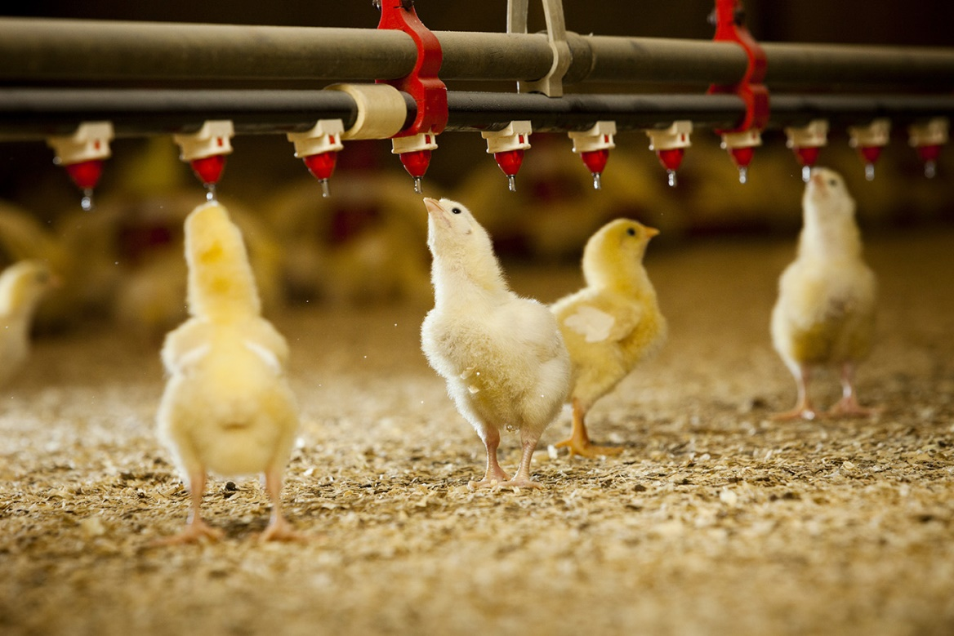
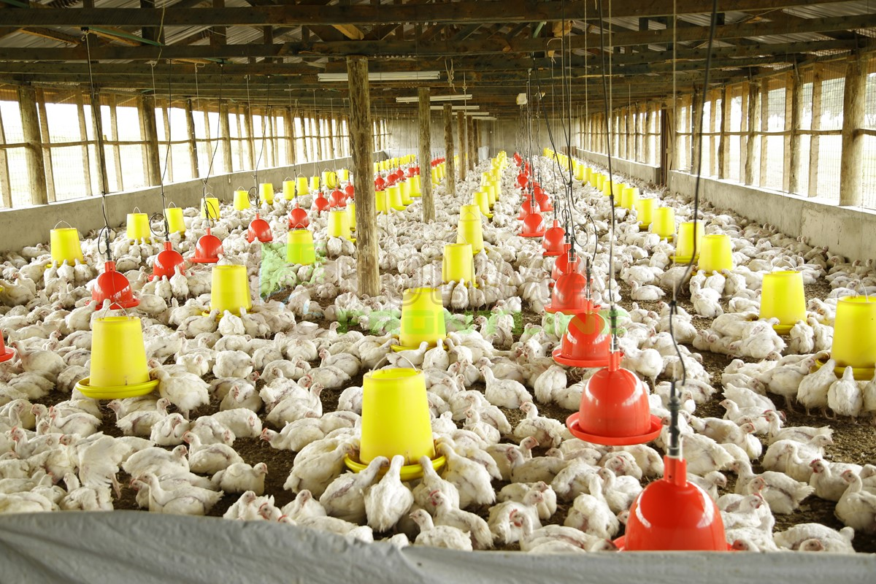
THANKS

