Slide 1
Lipid biosynthesis
Ajeet kumar

Slide 2
Lipid Biosynthesis
Key topics:
Biosynthesis of fatty acids and eicosanoids
Biosynthesis of isoprenes and cholesterol
Cholesterol regulation
Biosynthesis of triacylglycerols, and membrane lipids

Slide 3
Energy is stored in the form of lipid. But energy is consumed mostly in the form of carbohydrate. Therefore, mechanism for the conversion of carbohydrate to fat is required.
2. Fatty acid synthase a multi enzyme complex is responsible for the formation of fatty acids.
3. acetyl-CoA derived from pyruvate is substrate for this complex and palmitate is end product.
4. Fatty acids are formed by the condensation of two carbon units.
5. Existence of two separate sets of enzymes for synthesis and degradation of fatty acids allows reciprocal regulation and prevents simultaneous operation of these pathways
6. NADPH required for the formation
7. Fatty acid synthesis occurs in the cytosol of liver, kidneys, brain, lung, adipose tissue and mammary gland

Slide 4
Medical Importance
1. Few of the drugs used in the treatment of obesity work by inhibiting fatty acid synthesis.
e.g. Hydroxy citrate -ATP citrate lyase is the target.
In presence of hydroxy citrate, the enzyme can not act on citrate. As a result, availability of acetyl-CoA for fatty acid synthesis is impaired.
2. In malarial parasite, fatty acid synthesis is brought about by fatty acid synthesis system type-II. This is different from that of host fatty acid synthase system type-I.
Triclosan and cerulenin are inhibitors of enoyl reductase and ketoacyl synthase, respectively. They are effective in killing malarial parasite in in vitro and in vivo.

Slide 5
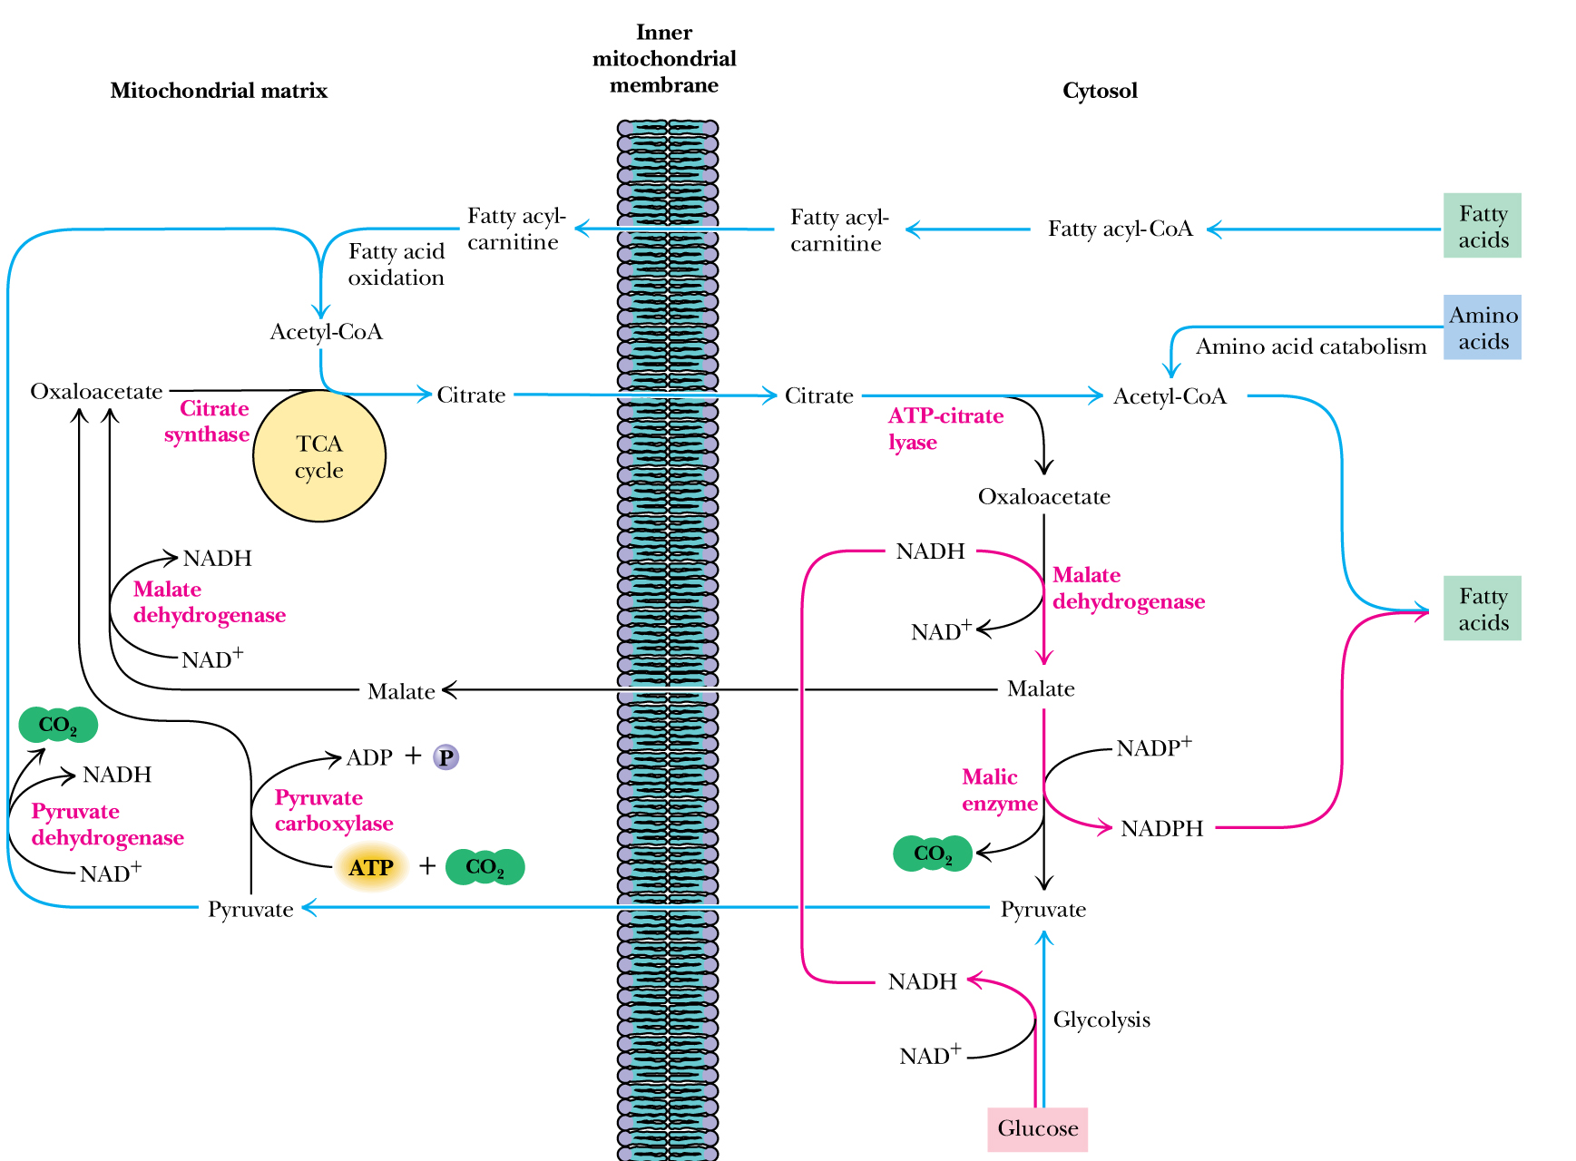
Transport of Acetyl CoA

Slide 6
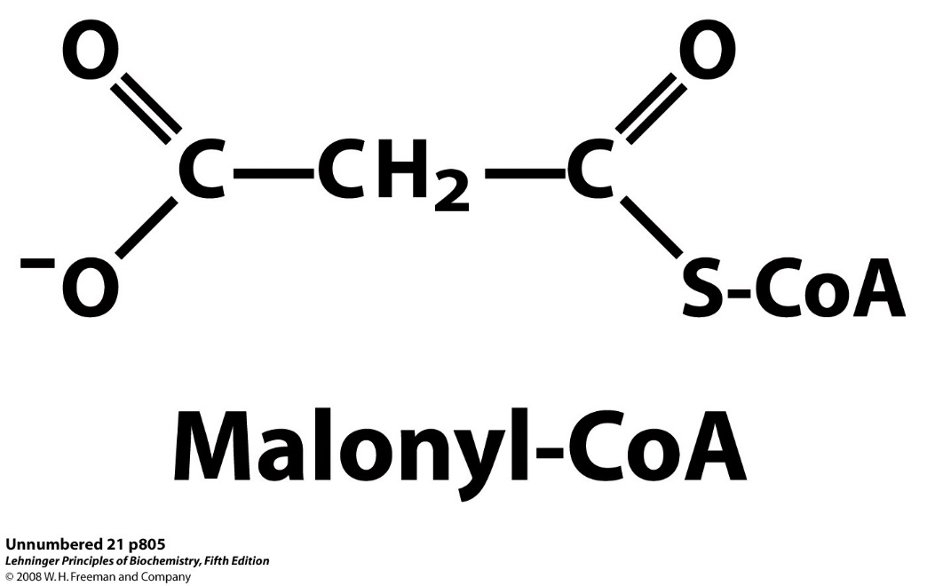
Overview of Fatty Acid Synthesis
Fatty acids are built in several passes processing one acetate unit at a time
Acetate from activated malonate in the form of malonyl-CoA
In each pass involves reduction of a carbonyl carbon to a methylene carbon

Slide 7
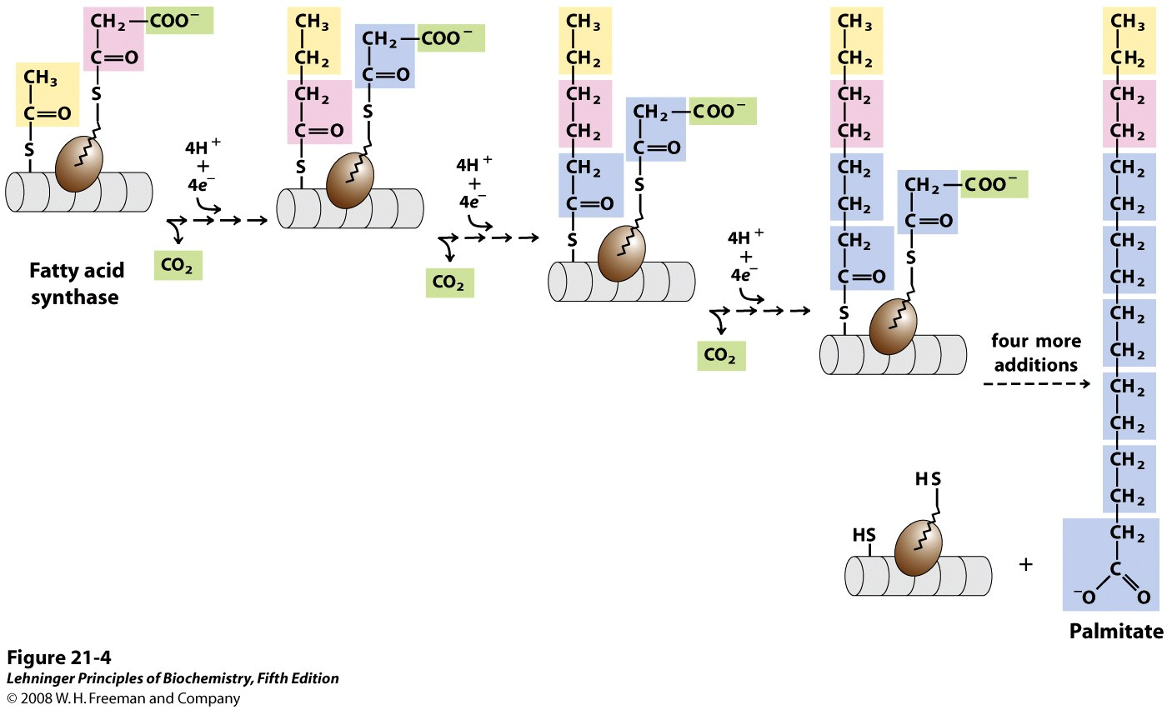
Overview of Fatty Acid Synthesis

Slide 8
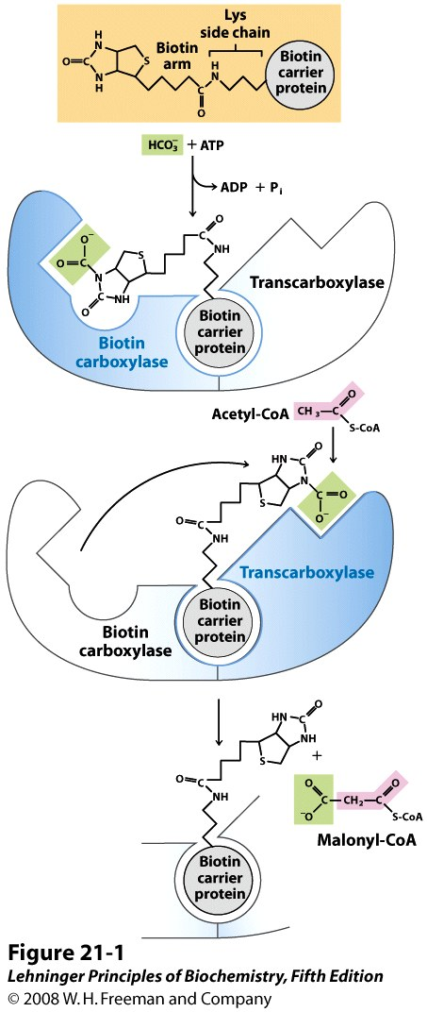
Synthesis of Malonyl-CoA (1)
The three-carbon precursor for fatty acid synthesis is made from acetyl-CoA and CO₂
The reaction is catalyzed by acetyl-CoA carboxylase (ACC)
ACC is a bifunctional enzyme
Biotin carboxylase
Transcarboxylase
ACC contains biotin, nature’s carrier of CO₂
Biotin shuttles between the two active sites

Slide 9
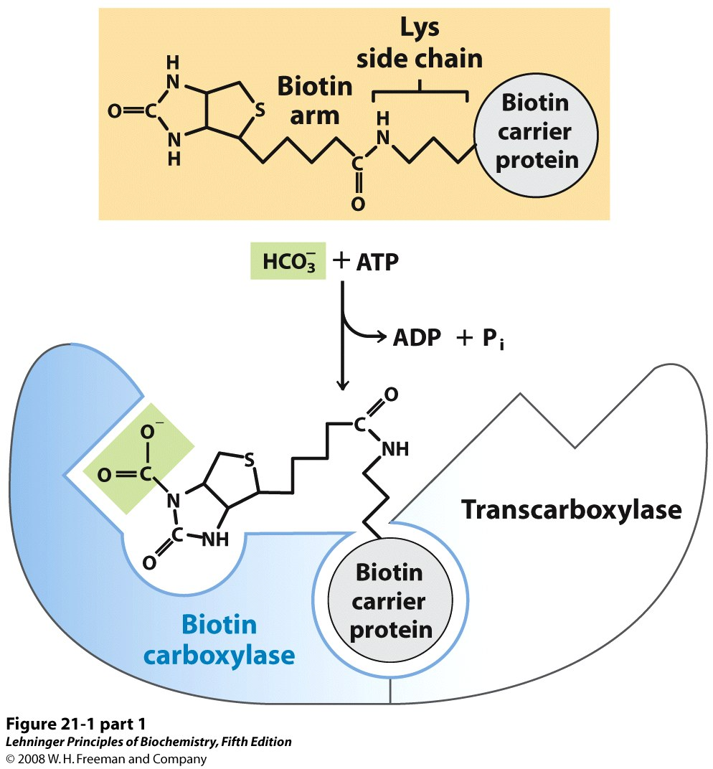
Synthesis of Malonyl-CoA (2)
Bicarbonate reacts with the terminal phosphate of ATP to give carbamoyl phosphate
Biotin carries out a nucleophilic attack to carbamoyl phosphate
The product is a good donor of a carboxylate group

Slide 10
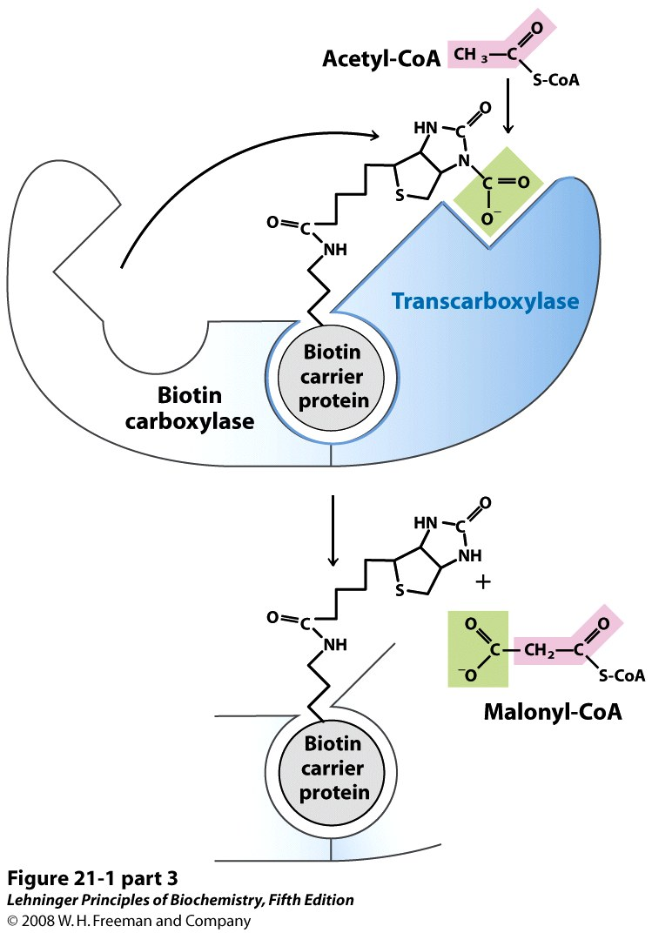
Synthesis of Malonyl-CoA (3)
The arm swing moves carboxybiotin to the transcarboxylase site
The carbanion picks up the carboxylate moiety from biotin
Notes:
FIGURE 21-1 (part 2) The acetyl-CoA carboxylase reaction. Acetyl-CoA carboxylase has three functional regions: biotin carrier protein (gray); biotin carboxylase, which activates CO₂ by attaching it to a nitrogen in the biotin ring in an ATP-dependent reaction (see Figure 16-16); and transcarboxylase, which transfers activated CO₂ (shaded green) from biotin to acetyl-CoA, producing malonyl-CoA. The long, flexible biotin arm carries the activated CO₂ from the biotin carboxylase region to the transcarboxylase active site. The active enzyme in each step is shaded blue.

Slide 11
Fatty Acid Synthesis
Overall goal is to attach a two-carbon acetate unit from malonyl-CoA to a growing chain and then reduce it
Reaction involves cycles of four enzyme-catalyzed steps
Condensation of the growing chain with activated acetate
Reduction of carbonyl to hydroxyl
Dehydration of alcohol to trans-alkene
Reduction of alkene to alkane
The growing chain is initially attached to the enzyme via a thioester linkage
During condensation, the growing chain is transferred to the acyl carrier protein
After the second reduction step, the elongated chain is transferred back to fatty acid synthase

Slide 12
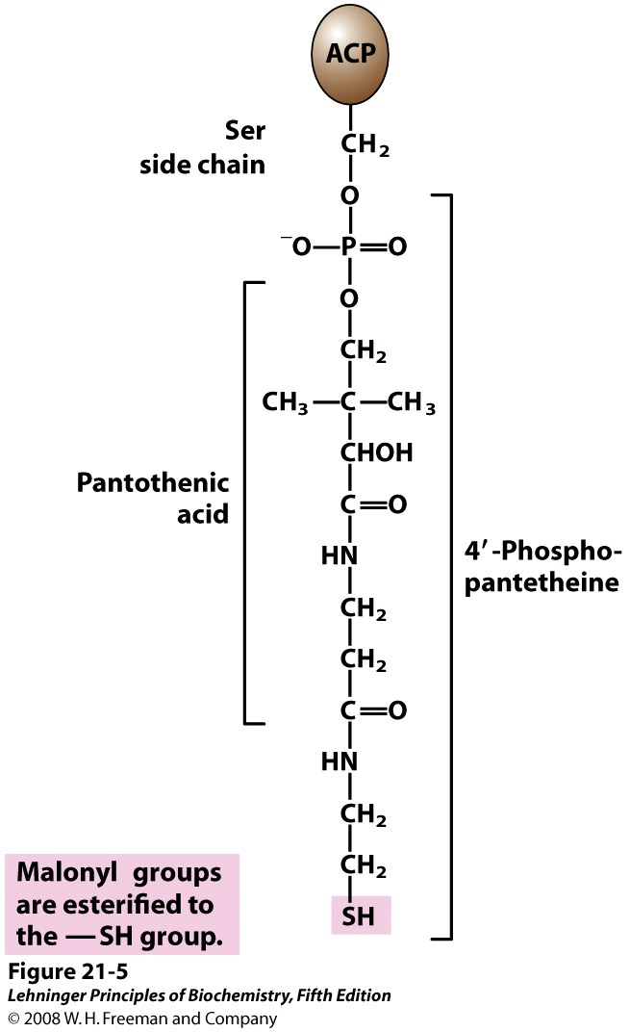
Acyl Carrier Protein
Contains a covalently attached prothetic group 4’-phospho-pantethiene
The acyl carrier protein delivers acetate (in the first step) or malonate (in all the next steps) to the fatty acid synthase
The acyl carrier protein shuttles the growing chain from one active site to another during the four-step reaction
Notes:
FIGURE 21-5 Acyl carrier protein (ACP). The prosthetic group is 4′-phosphopantetheine, which is covalently attached to the hydroxyl group of a Ser residue in ACP. Phosphopantetheine contains the B vitamin pantothenic acid, also found in the coenzyme A molecule. Its —SH group is the site of entry of malonyl groups during fatty acid synthesis.

Slide 13
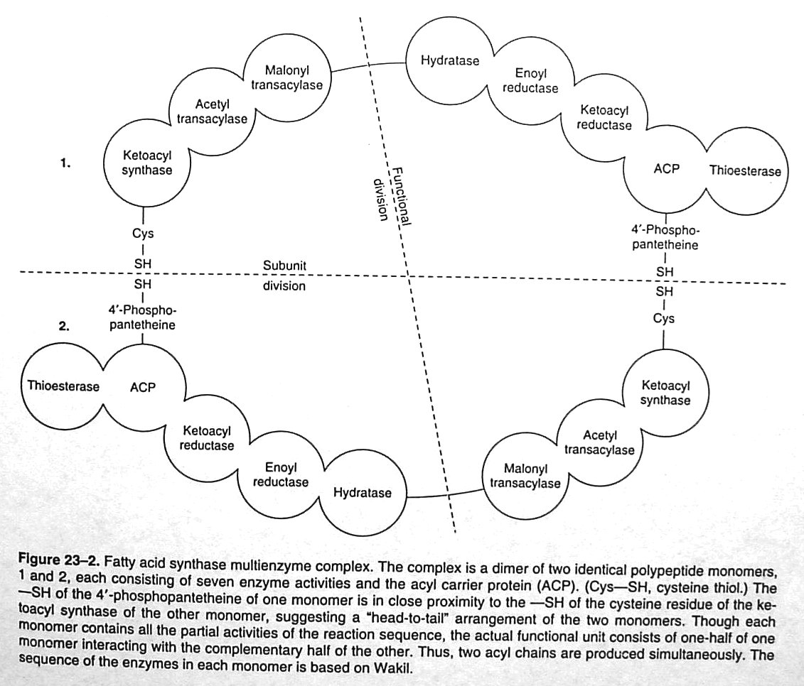

Slide 14
Charging the Acyl Carrier Protein and Fatty Acid Synthase
Two thiols participate in the fatty acid synthesis
Thiol from 4-phosphopantethine in acyl carrier protein
Thiol from cysteine in fatty acid synthase
Both thiols must be charged for the condensation reaction to occur
In the first step, acetyl from acetyl-CoA is transferred to acyl carrier protein
Acyl carrier protein passes this acetate to fatty acid synthase
Acyl carrier protein is then re-charged with malonyl from malonyl-CoA

Slide 15
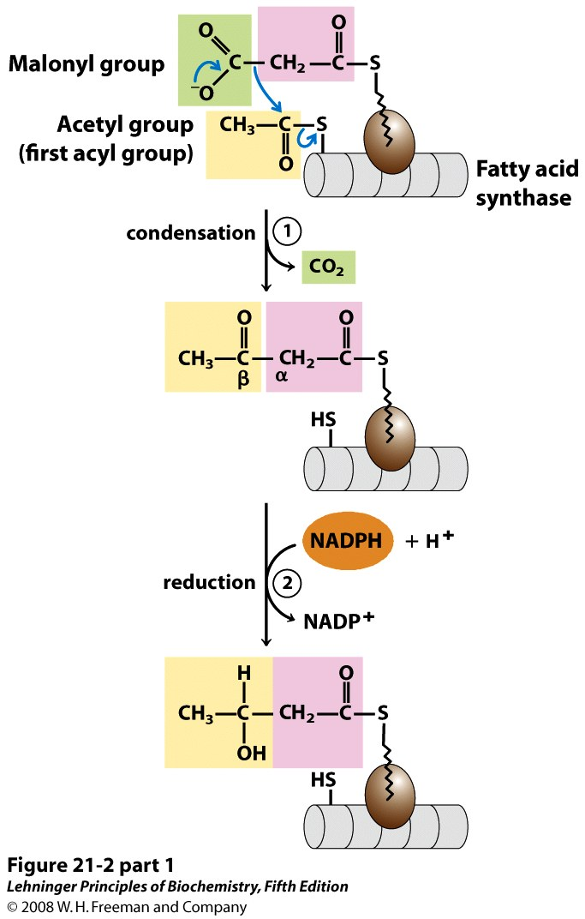
Assimilation of Two-Carbon Units Condensation and First Reduction
1 Condensation of an activated acyl group
2 the β-keto group is reduced to an alcohol
Notes:
FIGURE 21-2 (part 1) Addition of two carbons to a growing fatty acyl chain: a four-step sequence. Each malonyl group and acetyl (or longer acyl) group is activated by a thioester that links it to fatty acid synthase, a multienzyme system described later in the text. 1 Condensation of an activated acyl group (an acetyl group from acetyl-CoA is the first acyl group) and two carbons derived from malonyl-CoA, with elimination of CO₂ from the malonyl group, extends the acyl chain by two carbons. The mechanism of the first step of this reaction is given to illustrate the role of decarboxylation in facilitating condensation. The β-keto product of this condensation is then reduced in three more steps nearly identical to the reactions of β oxidation, but in the reverse sequence: 2 the β-keto group is reduced to an alcohol, 3 elimination of H₂O creates a double bond, and 4 the double bond is reduced to form the corresponding saturated fatty acyl group.

Slide 16
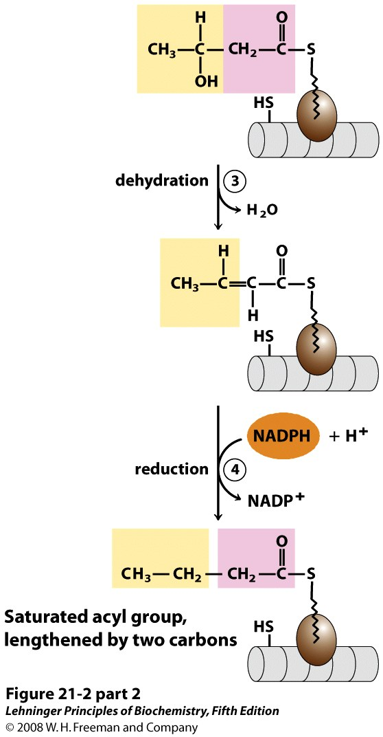
Assimilation of Two-Carbon Units Dehydration and Second Reduction
3 elimination of H₂O creates a double bond, and
4 the double bond is reduced
Notes:
FIGURE 21-2 (part 2) Addition of two carbons to a growing fatty acyl chain: a four-step sequence. Each malonyl group and acetyl (or longer acyl) group is activated by a thioester that links it to fatty acid synthase, a multienzyme system described later in the text. 1 Condensation of an activated acyl group (an acetyl group from acetyl-CoA is the first acyl group) and two carbons derived from malonyl-CoA, with elimination of CO₂ from the malonyl group, extends the acyl chain by two carbons. The mechanism of the first step of this reaction is given to illustrate the role of decarboxylation in facilitating condensation. The β-keto product of this condensation is then reduced in three more steps nearly identical to the reactions of β oxidation, but in the reverse sequence: 2 the β-keto group is reduced to an alcohol, 3 elimination of H₂O creates a double bond, and 4 the double bond is reduced to form the corresponding saturated fatty acyl group.

Slide 17
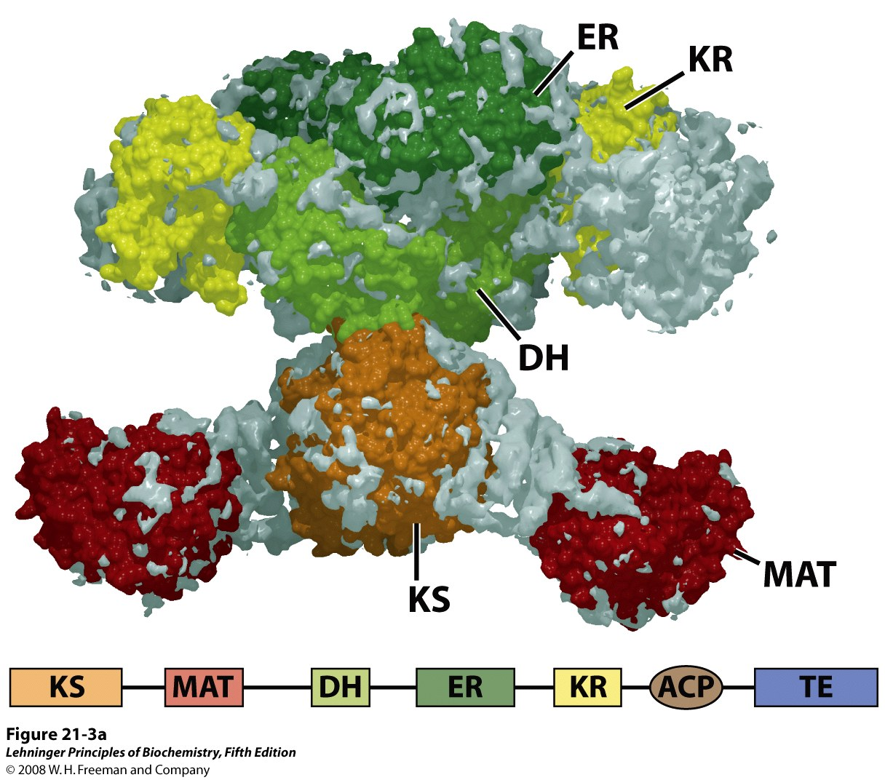
Enzymatic Activities in Fatty Acid Synthase
Condensation with acetate
β-ketoacyl-ACP synthase (KS)
Reduction of carbonyl to hydroxyl
β-ketoacyl-ACP reductase (KR)
Dehydration of alcohol to alkene
β-hydroxyacyl-ACP dehydratase (DH)
Reduction of alkene to alkane
enoyl-ACP reductase (ER)
Chain transfer
Malonyl/acetyl-CoA ACP transferase

Slide 18
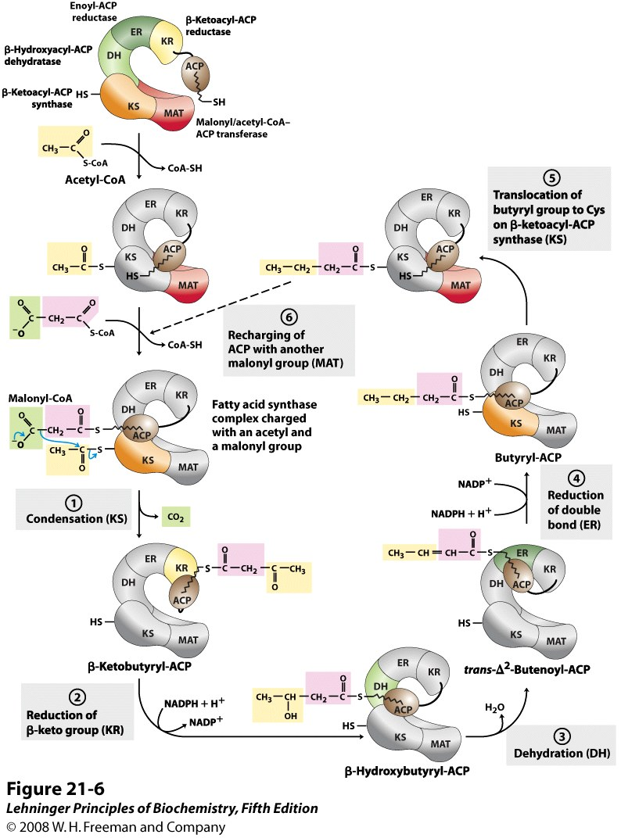
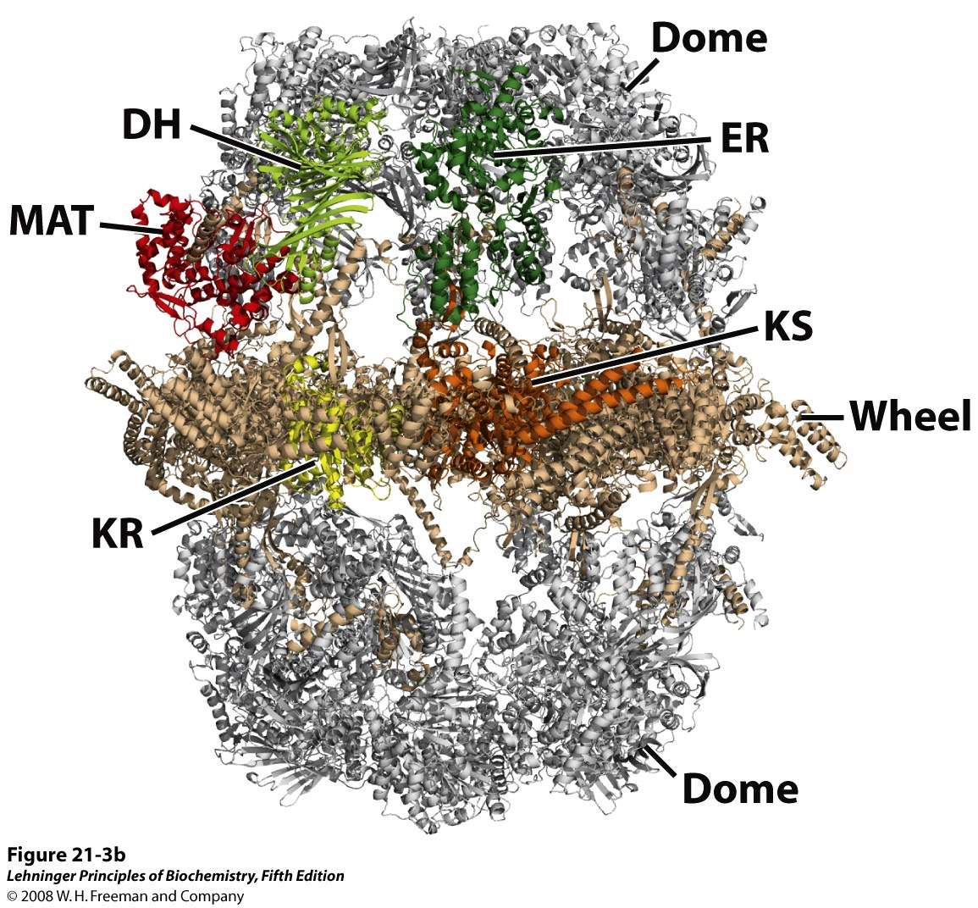
Sequence of Events in Synthesis of Fatty Acids

Slide 19
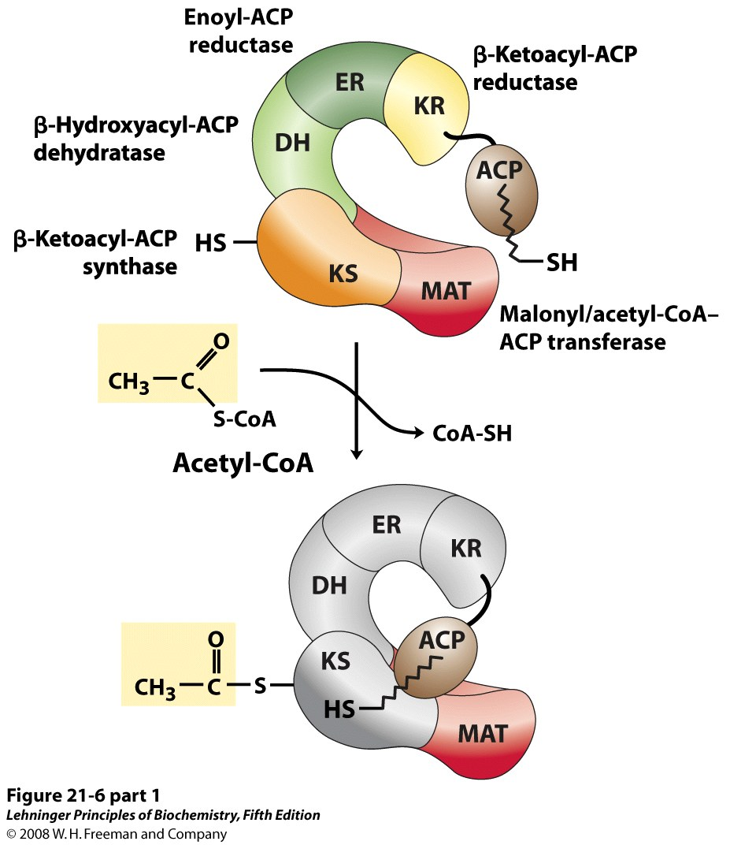
Notes:
FIGURE 21-6 (part 1) Sequence of events during synthesis of a fatty acid. The mammalian FAS I complex is shown schematically, with catalytic domains colored as in Figure 21-3. Each domain of the larger polypeptide represents one of the six enzymatic activities of the complex, arranged in a large, tight "S" shape. The acyl carrier protein (ACP) is not resolved in the crystal structure shown in Figure 21-3, but is attached to the KS domain. The phosphopantetheine arm of ACP ends in an —SH. After the first panel, the enzyme shown in color is the one that will act in the next step. As in Figure 21-4, the initial acetyl group is shaded yellow, C-1 and C-2 of malonate are shaded pink, and the carbon released as CO₂ is shaded green. Steps 1 to 4 are described in the text.

Slide 20
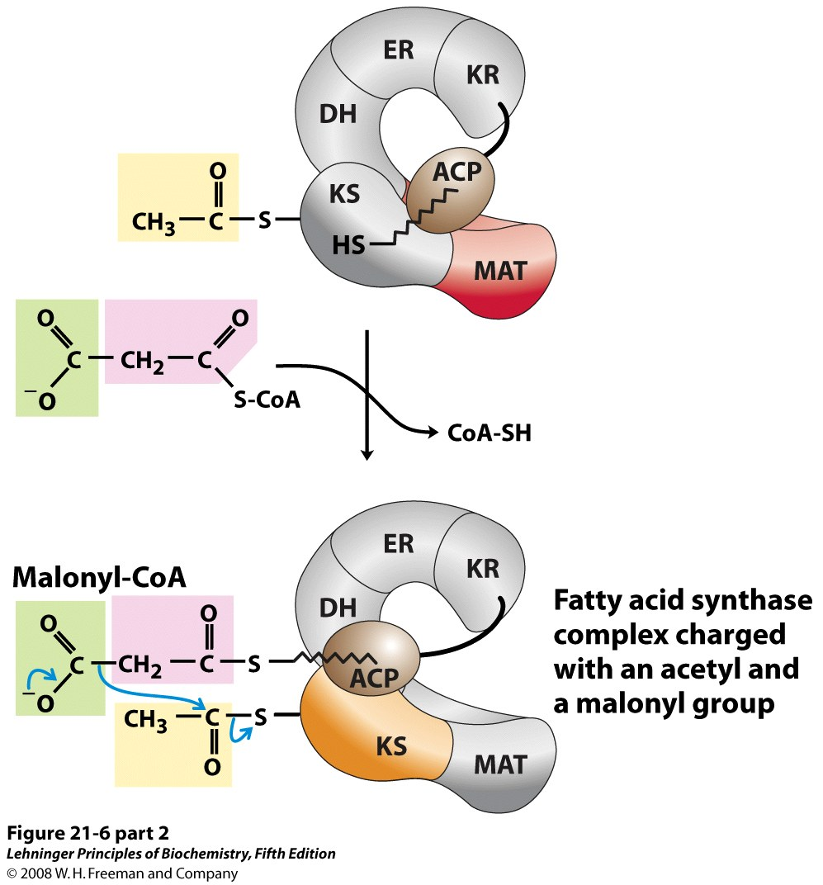
Notes:
FIGURE 21-6 (part 2) Sequence of events during synthesis of a fatty acid. The mammalian FAS I complex is shown schematically, with catalytic domains colored as in Figure 21-3. Each domain of the larger polypeptide represents one of the six enzymatic activities of the complex, arranged in a large, tight "S" shape. The acyl carrier protein (ACP) is not resolved in the crystal structure shown in Figure 21-3, but is attached to the KS domain. The phosphopantetheine arm of ACP ends in an —SH. After the first panel, the enzyme shown in color is the one that will act in the next step. As in Figure 21-4, the initial acetyl group is shaded yellow, C-1 and C-2 of malonate are shaded pink, and the carbon released as CO₂ is shaded green. Steps 1 to 4 are described in the text.

Slide 21
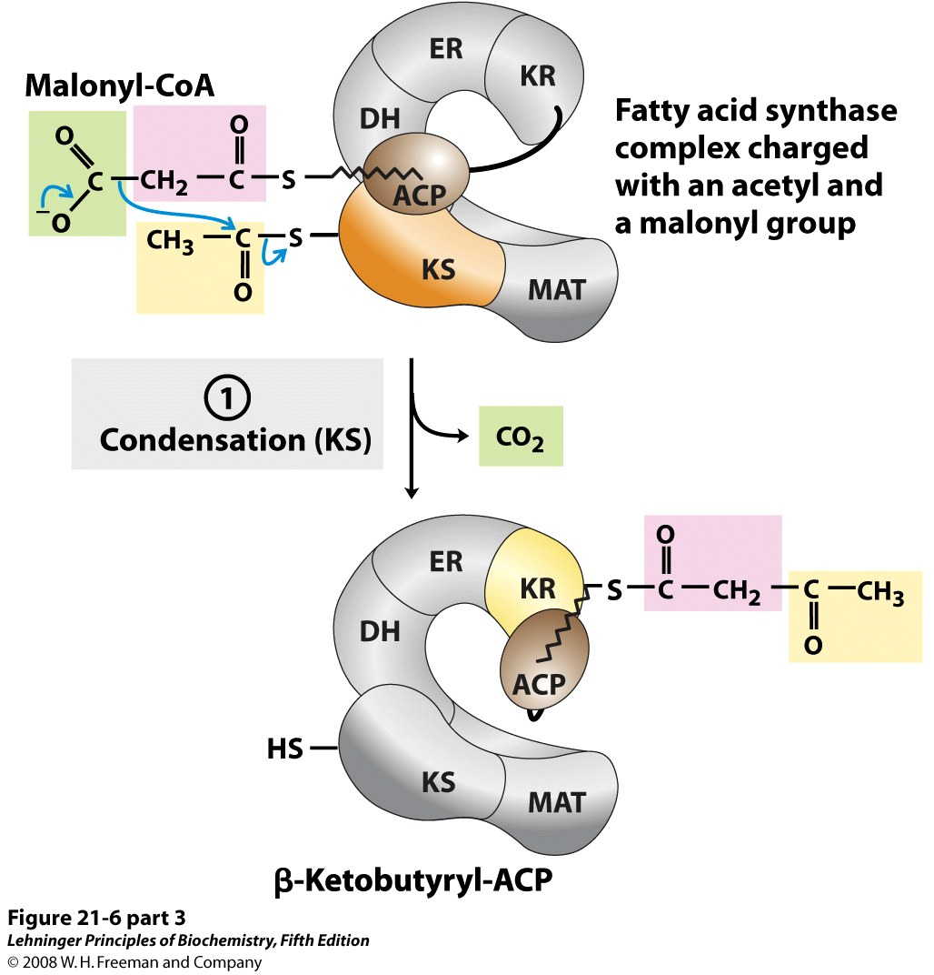
Notes:
FIGURE 21-6 (part 3) Sequence of events during synthesis of a fatty acid. The mammalian FAS I complex is shown schematically, with catalytic domains colored as in Figure 21-3. Each domain of the larger polypeptide represents one of the six enzymatic activities of the complex, arranged in a large, tight "S" shape. The acyl carrier protein (ACP) is not resolved in the crystal structure shown in Figure 21-3, but is attached to the KS domain. The phosphopantetheine arm of ACP ends in an —SH. After the first panel, the enzyme shown in color is the one that will act in the next step. As in Figure 21-4, the initial acetyl group is shaded yellow, C-1 and C-2 of malonate are shaded pink, and the carbon released as CO₂ is shaded green. Steps 1 to 4 are described in the text.

Slide 22
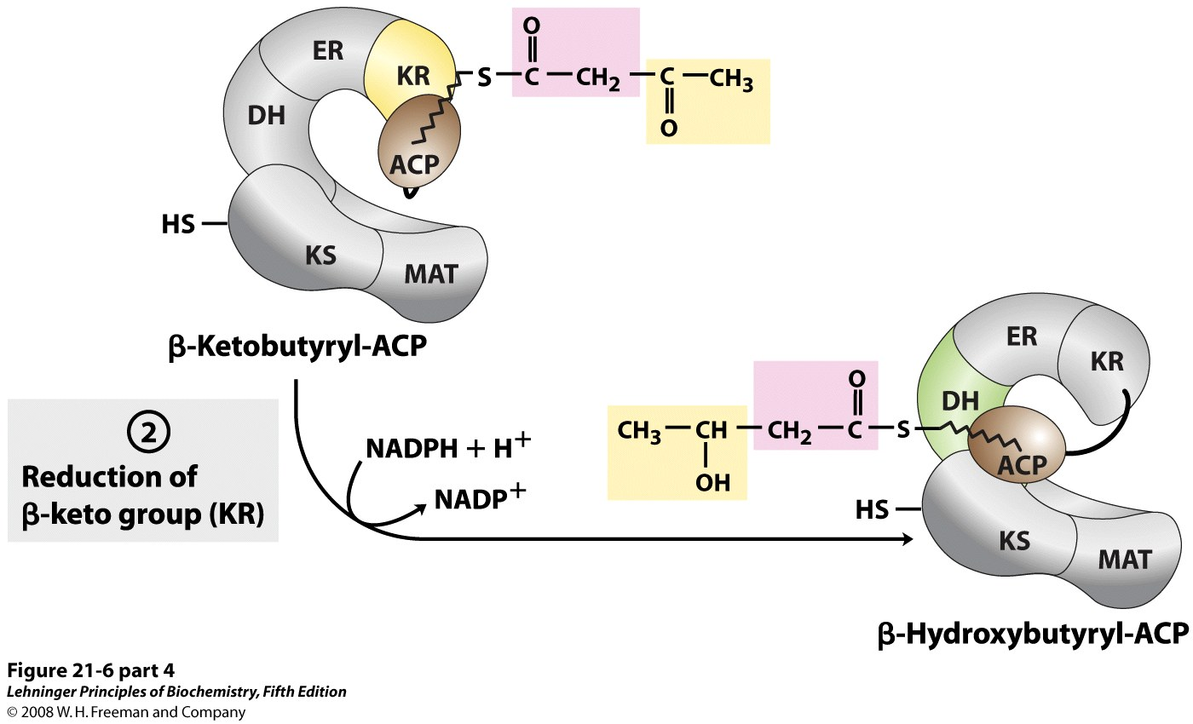
Notes:
FIGURE 21-6 (part 4) Sequence of events during synthesis of a fatty acid. The mammalian FAS I complex is shown schematically, with catalytic domains colored as in Figure 21-3. Each domain of the larger polypeptide represents one of the six enzymatic activities of the complex, arranged in a large, tight "S" shape. The acyl carrier protein (ACP) is not resolved in the crystal structure shown in Figure 21-3, but is attached to the KS domain. The phosphopantetheine arm of ACP ends in an —SH. After the first panel, the enzyme shown in color is the one that will act in the next step. As in Figure 21-4, the initial acetyl group is shaded yellow, C-1 and C-2 of malonate are shaded pink, and the carbon released as CO₂ is shaded green. Steps 1 to 4 are described in the text.

Slide 23
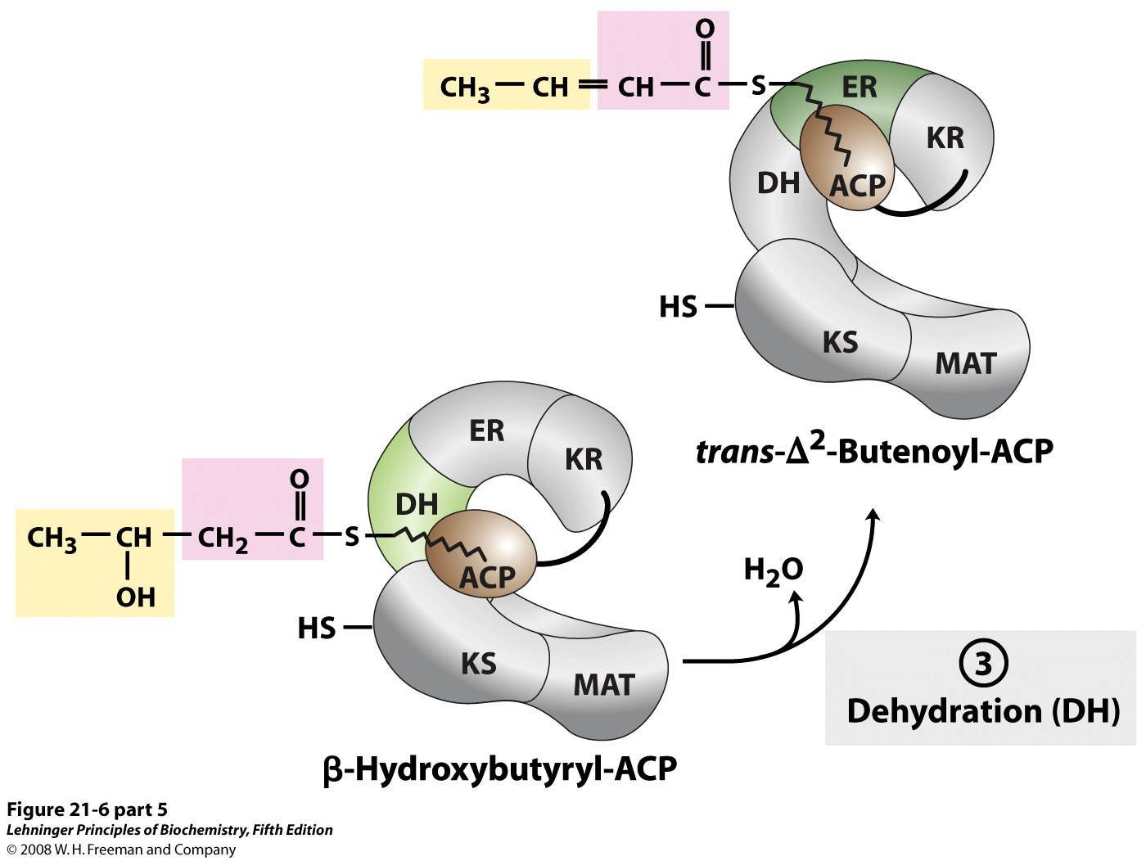
Notes:
FIGURE 21-6 (part 5) Sequence of events during synthesis of a fatty acid. The mammalian FAS I complex is shown schematically, with catalytic domains colored as in Figure 21-3. Each domain of the larger polypeptide represents one of the six enzymatic activities of the complex, arranged in a large, tight "S" shape. The acyl carrier protein (ACP) is not resolved in the crystal structure shown in Figure 21-3, but is attached to the KS domain. The phosphopantetheine arm of ACP ends in an —SH. After the first panel, the enzyme shown in color is the one that will act in the next step. As in Figure 21-4, the initial acetyl group is shaded yellow, C-1 and C-2 of malonate are shaded pink, and the carbon released as CO₂ is shaded green. Steps 1 to 4 are described in the text.

Slide 24
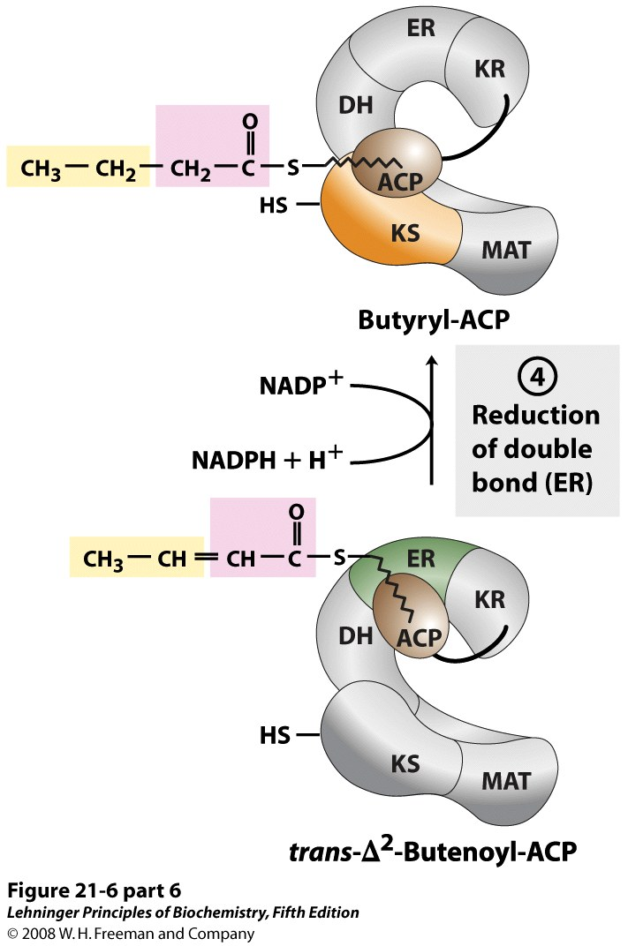
Notes:
FIGURE 21-6 (part 6) Sequence of events during synthesis of a fatty acid. The mammalian FAS I complex is shown schematically, with catalytic domains colored as in Figure 21-3. Each domain of the larger polypeptide represents one of the six enzymatic activities of the complex, arranged in a large, tight "S" shape. The acyl carrier protein (ACP) is not resolved in the crystal structure shown in Figure 21-3, but is attached to the KS domain. The phosphopantetheine arm of ACP ends in an —SH. After the first panel, the enzyme shown in color is the one that will act in the next step. As in Figure 21-4, the initial acetyl group is shaded yellow, C-1 and C-2 of malonate are shaded pink, and the carbon released as CO₂ is shaded green. Steps 1 to 4 are described in the text.

Slide 25
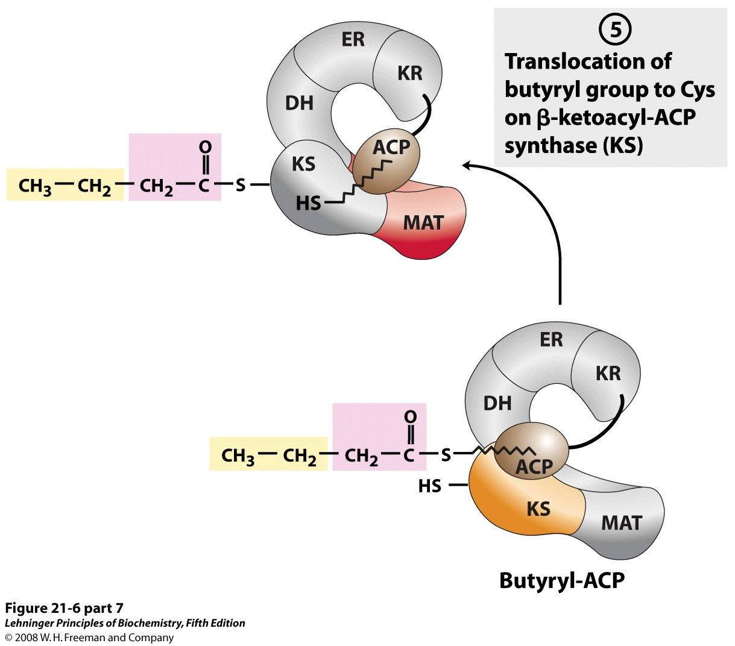
Notes:
FIGURE 21-6 (part 7) Sequence of events during synthesis of a fatty acid. The mammalian FAS I complex is shown schematically, with catalytic domains colored as in Figure 21-3. Each domain of the larger polypeptide represents one of the six enzymatic activities of the complex, arranged in a large, tight "S" shape. The acyl carrier protein (ACP) is not resolved in the crystal structure shown in Figure 21-3, but is attached to the KS domain. The phosphopantetheine arm of ACP ends in an —SH. After the first panel, the enzyme shown in color is the one that will act in the next step. As in Figure 21-4, the initial acetyl group is shaded yellow, C-1 and C-2 of malonate are shaded pink, and the carbon released as CO₂ is shaded green. Steps 1 to 4 are described in the text.

Slide 26
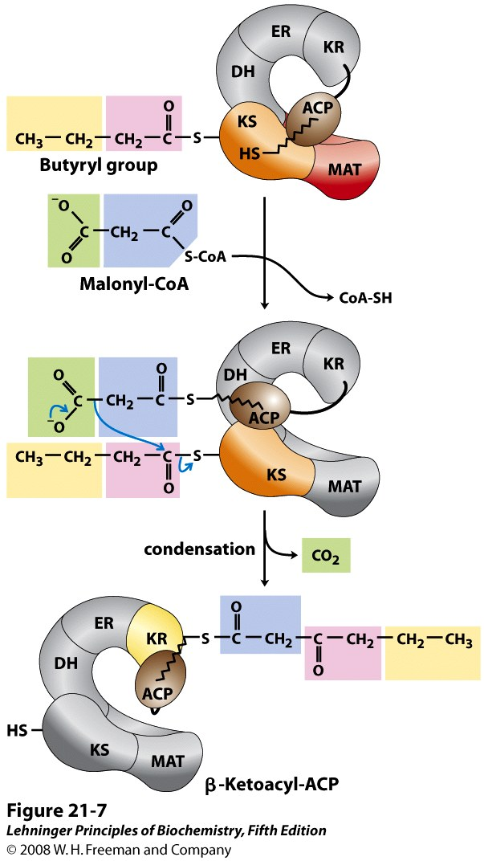
Notes:
FIGURE 21-7 Beginning of the second round of the fatty acid synthesis cycle. The butyryl group is on the Cys —SH group. The incoming malonyl group is first attached to the phosphopantetheine ﾑSH group. Then, in the condensation step, the entire butyryl group on the Cys —SH is exchanged for the carboxyl group of the malonyl residue, which is lost as CO₂ (green). This step is analogous to step 1 in Figure 21-6. The product, a six-carbon β-ketoacyl group, now contains four carbons derived from malonyl-CoA and two derived from the acetyl-CoA that started the reaction. The β-ketoacyl group then undergoes steps 2 through 4, as in Figure 21-6.

Slide 27
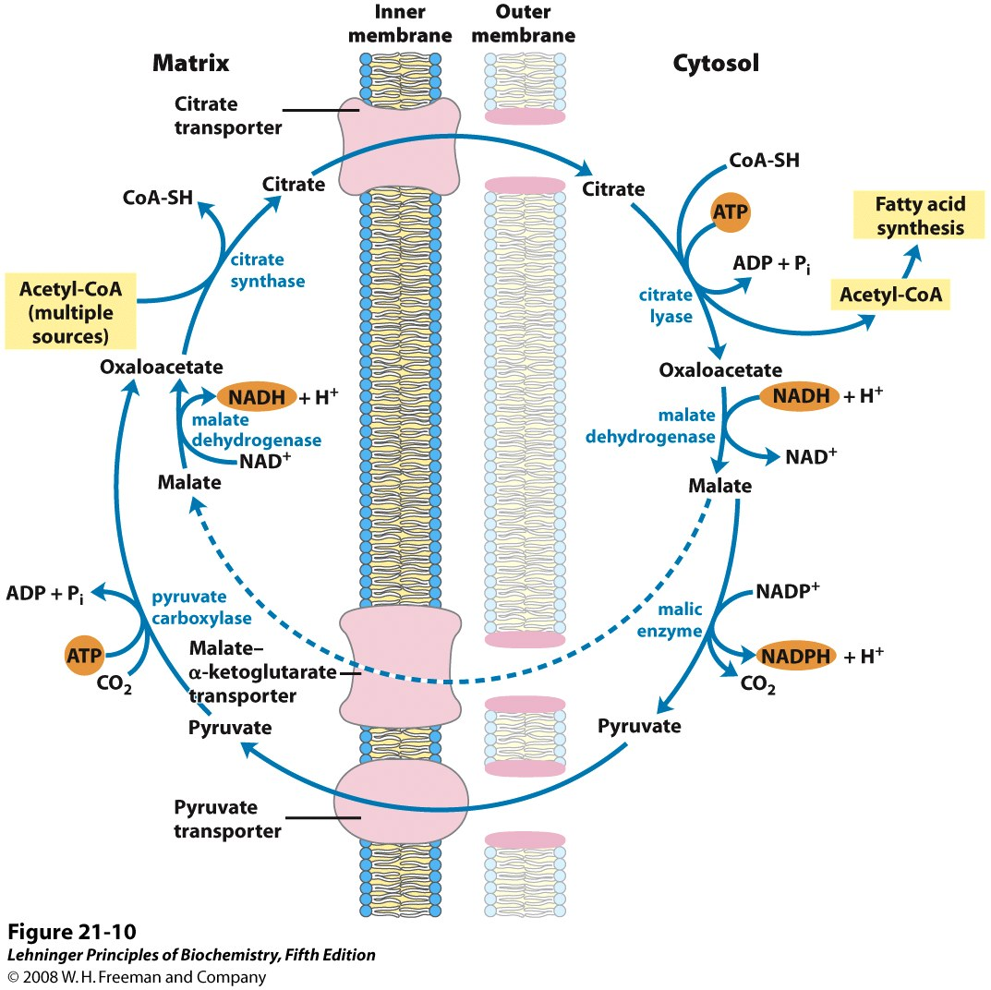
Notes:
FIGURE 21-10 Shuttle for transfer of acetyl groups from mitochondria to the cytosol. The mitochondrial outer membrane is freely permeable to all these compounds. Pyruvate derived from amino acid catabolism in the mitochondrial matrix, or from glucose by glycolysis in the cytosol, is converted to acetyl-CoA in the matrix. Acetyl groups pass out of the mitochondrion as citrate; in the cytosol they are delivered as acetyl-CoA for fatty acid synthesis. Oxaloacetate is reduced to malate, which can return to the mitochondrial matrix and is converted to oxaloacetate. The major fate for cytosolic malate is oxidation by malic enzyme to generate cytosolic NADPH; the pyruvate produced returns to the mitochondrial matrix.

Slide 28
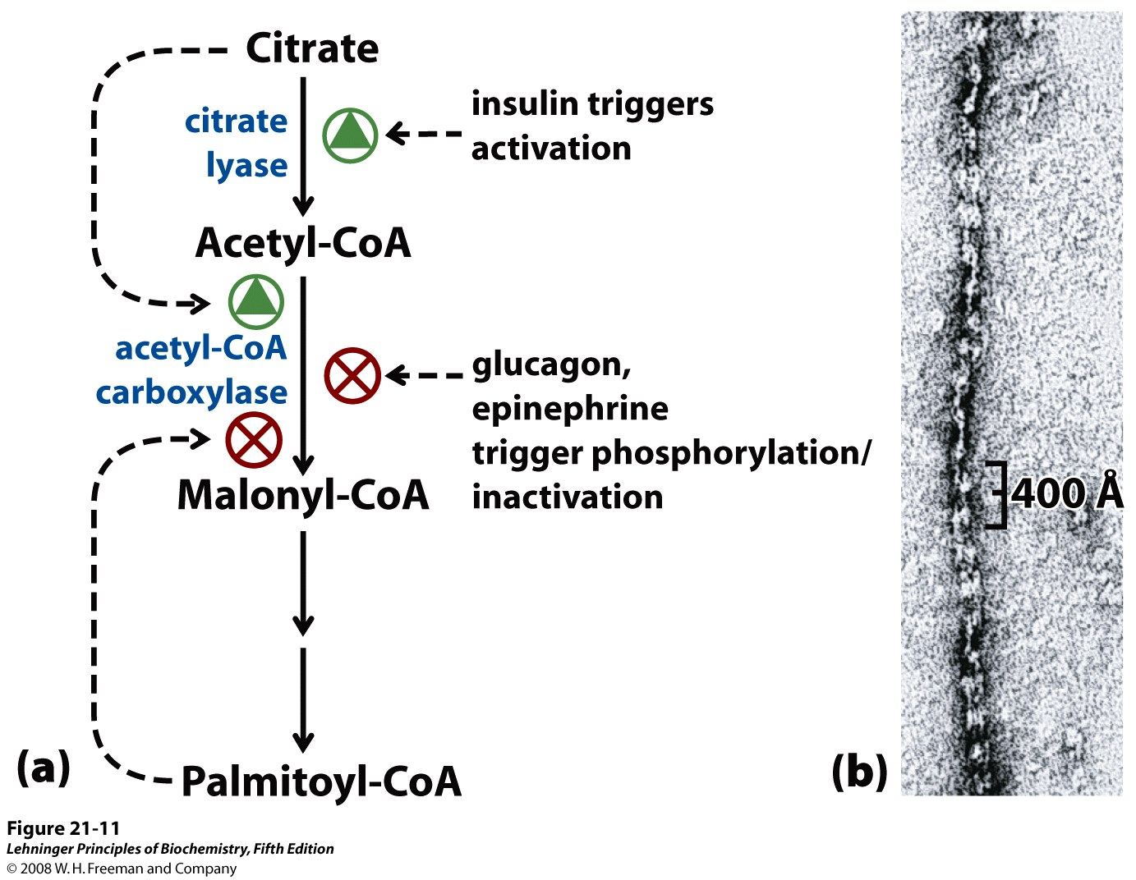
Regulation of Fatty Acid Synthesis in Vertebrates
Notes:
FIGURE 21-11 Regulation of fatty acid synthesis. (a) In the cells of vertebrates, both allosteric regulation and hormone-dependent covalent modification influence the flow of precursors into malonyl-CoA. In plants, acetyl-CoA carboxylase is activated by the changes in [Mg²⁺] and pH that accompany illumination (not shown here). (b) Filaments of acetyl-CoA carboxylase (the active, dephosphorylated form) as seen with the electron microscope.

Slide 29
Desaturation
Rules:
The fatty acid desaturation system is
in the smooth membranes of the endoplasmic
reticulum
There are 4 fatty acyl desaturase enzymes in
mammals designated Δ⁹ , Δ^{6,} Δ^{5,} and Δ⁴ fatty
acyl-CoA desaturase
Mammals cannot incorporate a double bond
beyond Δ⁹; plants can.
Mammals can synthesize long chain unsaturated
fatty acids using desaturation and elongation

Slide 30
Rule:
The Desaturase System requires O₂ and
resembles an electron transport system
Cyt b₅
reductase
NADPH
Cyt b₅
O₂
2
(FAD)
3
Saturated FA-CoA
1
2
NOTE:
1. System is in ER membrane
2. Both NADPH and the fatty acid contribute
electrons
3. Fatty acyl desaturase is considered a mixed
function oxidase

Slide 31
Fatty acid desaturation system
C₁₈-stearoly-CoA
+ O₂ + 2H⁺
C₁₈ Δ⁹-oleyl-CoA
+ 2H₂O
Desaturase
Desaturase
2 cyt b₅ Fe²⁺
2 cyt b₅ Fe²⁺
Cyt b₅
2H⁺ + cyt b₅ reductase
FAD
cyt b₅ reductase
FADH₂
Cyt b₅
reductase
NADPH + H⁺
NADP⁺

Slide 32
Palmitate
Desaturase
16:0
Elongase
Palmitoleate
Stearate
16:1(Δ⁹)
18:0
Desaturase
Permitted
transitions
in mammals
Oleate
Essential
fatty acid
18:1(Δ⁹)
Desaturase
Linoleate
Desaturase
18:2(Δ^{9,12})
γ-Linolenate
Desaturase
α-Linolenate
18:3(Δ^{6,9,12})
18:3(Δ^{9,12,15})
Elongase
Eicosatrienoate
20:3(Δ^{8,11,14})
Other lipids
Desaturase
Arachidonate
20:4(Δ^{5,8,11,14})

Slide 33
Differences in synthesis and catabolism of Fat
 | Fatty acid Synthesis | Catabolism
Intermediates are bound | Acyl Carrier Protein | Bound to CoenzymeA
Site | In cytosol | In Mitochondria
Tissue | Liver, Adipose Tissue | Muscles, Liver
Precursor | Acetyl Co A | Acyl CoA
Units added | MalonylCoA | AcetylCoA
Transport System | Citrate | Carnitine
Enzyme | Multifunctional Enzyme complex | Individual Enzyme
Endproduct | Palmitate | Acetyl CoA
e⁺ donor/acceptor | FAD/NAD⁺ | NADP⁺

Slide 34
Palmitate, a 16-C saturated fatty acid, is the final product of the Fatty Acid Synthase reactions.
1. a. How many acetyl-CoA used for initial priming of enzyme? _____
b. How many acetyl-CoA used for synthesis of each malonate? ____
c. How many malonate used (how many reaction cycles) per
synthesis of one 16-C palminate? ________
d. Total acetyl-CoA used for priming & for syntheisis of malonate,
: ________
2. a. How many ~P bonds of ATP used for synthesis of each
malonate? ________
b. Total ~P bonds of ATP used for synthesis of one 16-C palmitate,
: ________
3. a. How many NADPH used per reaction cycle? __________
b. Total NADPH used per synthesis of one 16-C palmitate, :
_________
1
1
7
8
1
7
2
14

