Slide 1
FOOD CHEMISTRY DTC-321 Credit hours- 3(2+1)
BINITA RANI
ASSOCIATE PROFESSOR (DAIRY CHEMISTRY)
FACULTY OF DAIRY TECHNOLOGY
S.G.I.D.T., BVC CAMPUS,
P.O.- BVC, DIST.-PATNA-800014
Minerals in Foods

Slide 2
Term mineral → elements other than C, H, O, and N → present in foods.
No universally accepted definition of “mineral”
Four non mineral elements (C, H, O, and N) → present in organic molecules and water → constitute 99% → total number of atoms in living systems.
Minerals → remain as ash → combustion of plant and animal tissues.
Present → relatively low conc in foods → key functional roles .

Slide 3
Mineral supply depends → intake → bioavailability → related to composition of food.
Food constituents, e. g., amino acids, proteins, peptides, sugars, polysaccharides, phytin, lignin, and organic acids → bind minerals → enhance / inhibit → absorption.
affect → texture of food.
contribute → food flavor.
activate / inhibit → enzyme-catalyzed and other reactions

Slide 4
Three classes:
MAIN ELEMENTS:
human beings in amounts > 50 mg/day
e.g., Ca, Cl, K, Mg, Na, P, S .
TRACE ELEMENTS:
concentrations < 50 mg/day
e.g.,Fe, F, Co, Cu, Cr, I, Zn, Se, Mn, Mo, Ni.
ULTRA-TRACE ELEMENTS:
vital elements
e.g.,Al, As, B, Ba, Bi, Br, Cs, Cd, Ge, Hg, Li, Pb, Rb, Si, Sn, Sb, Sr, Ti, W.

Slide 5
NUTRITIONAL AND FUNCTIONAL ROLES
Minerals have important nutritional and physiological functions .
MAIN ELEMENTS
Sodium:
Sodium absorption is rapid.
activates → some enzymes, such as amylase.
excessive intake → hypertension.
low intake of sodium → a non-salty diet or by using diet salt (common salt substitutes).

Slide 6
Potassium:
regulates osmotic pressure within the cell.
involved in cell membrane transport.
deficiency ← potassium-deficient foods, e.g., white bread, fat or oil.
Potatoes and molasses → sources.

Slide 7
Magnesium:
constituent and activator → many enzymes.
associated → conversion of energy-rich phosphate compounds
Stabilizer → plasma membranes, intracellular membranes, and nucleic acids.

Slide 8
Calcium:
skeleton and in some body tissues.
controls essential processes → activity of brain cells and cell growth, blood clotting, muscle contraction (heartbeat).
source → milk and milk products, fruit and vegetables, cereal products, meat, fish and eggs.

Slide 9
Chloride:
serves as counter ion for sodium in extracellular fluid and
for hydrogen ions in gastric juice.
absorption is as rapid as its excretion → urine.
Phosphorus:
essential nutrient.
in the form of phosphate, free or bound as an ester or present as an anhydride, plays imp role → metabolism

Slide 10
TRACE ELEMENTS
Iron:
essential ingredient of daily diet
present → hemoglobin (blood) and myoglobin (muscle tissue) pigments.
present → enzymes (peroxidase, catalase, hydroxylases and flavine enzymes)
Two food processing problems → iron fortification :
1. increased probability → oxidation
2. wheat flour → decreased baking quality.
undesirable element → food processing
catalyzes oxidation of fat / oil,
increases turbidity of wine,
supports growth of iron-requiring bacteria.

Slide 11
Copper:
component of oxidoreductase enzymes (amine oxidase, cytochrome oxidase, superoxide dismutase, tyrosinase, uricase ).
less desirable than iron → food processing and storage → catalyzes many unwanted reactions.
Cu2+-Ions are taste bearing.
Threshold value 2.4 – 3.8mg/l was determined with aqueous solutions of CuSO4 or CuCl2.

Slide 12
Zinc:
component → enzymes (e.g., alcohol dehydrogenase, carbonic anhydrase, carboxypeptidases A and B, glutamate dehydrogenase, lactate dehydrogenase and malate dehydrogenase,,).
Other enzymes, e.g., alkaline phosphatase, dipeptidases, enolase and lecithinase are activated by zinc.
deficiency in animals → serious disorders.
high zinc intake → toxic.

Slide 13
Manganese:
metal activator for pyruvate carboxylase .
activates various enzymes → alkaline phosphatase, amino peptidase, arginase, lecithinase or enolase.
even in higher amounts → relatively nontoxic.

Slide 14
Cobalt:
Essential element → Vitamin B12 contains cobalt as its central atom.
Its requirement → met by normal nutrition.

Slide 15
Chromium:
important → utilization of glucose.
activates → enzyme phosphoglucomutase and increases → activity of insulin
deficiency → a decrease in glucose tolerance.

Slide 16
Selenium:
vary greatly → varying content of selenium in the soil → depending on the region.
antioxidant and can enhance tocopherol activity.
Enzyme glutathione peroxidase contains selenium.

Slide 17
Molybdenum:
component of aldehyde oxidase and xanthine oxidase.
bacterial nitrate reductase involved in meat curing and pickling processes contains molybdenum

Slide 18
Nickel:
activator of enzymes, e.g., alkaline phosphatase and oxaloacetate decarboxylase, which can also be activated by other divalent metal ions.
enhances insulin activity.

Slide 19
Fluorine:
Addition → drinking water 0.5–1.5 ppm fluorine in the form of NaF → inhibits tooth decay.
beneficial effect → retarding solubilization of tooth enamel and inhibiting the enzymes involved → development of caries.
Toxic effects → at a level of 2 ppm.
beneficial effects of fluoridating drinking water → disputed by some and → controversial topic of mineral nutrition.

Slide 20
Iodine:
absorption → as iodide .
utilized in thyroid gland → biosynthesis of → hormone thyroxine (tetraiodothyronine) and its less iodized form, triiodothyronine.
deficiency → enlargement of the thyroid gland (iodine-deficiency induced goiter).
most food → little iodine.
Good sources → milk, eggs and seafood.
Drinking water → little iodine supply.
To avoid deficiency diseases → iodization of common salt is done in which potassium iodate, with 100 μg iodine added to 1–10 g NaCl..
Higher amounts of iodine → toxic.

Slide 21
ULTRA-TRACE ELEMENTS
Tin:
natural level of tin in food → very low.
can be increased → foods canned in tinplate cans.
Very acidic foods → dissolve substantial amounts of tin.
concentration of tin in pineapple and grapefruit juice transported in poorly tin plated cans → 2 g/l.
tin content of foods in tinplate cans → generally below 50mg/kg and
should not exceed 250 mg/kg.

Slide 22
Aluminum:
resorbed in only negligible amounts by gastrointestinal tract.
largest portion is eliminated in feces.
not secreted in milk.

Slide 23
Boron:
essential nutrient.
promotes bone formation by interaction with calcium, magnesium and vitamin D.
involved in hydroxylation of steroids, e.g., in the synthesis testosterone.
sources include wine and water.

Slide 24
Silicon:
rapidly absorbed as soluble silicic acid.
source is cereal products.
promotes growth and thus has a biological role.
toxicity of silicic acid is apparent only at concentrations ≥ 100 mg/kg.

Slide 25
Arsenic:
main source is fish.
metabolic role is not yet understood.
appears to be involved in the metabolism of methionine.
Choline can be replaced by arseno choline in some of its functions.

Slide 26
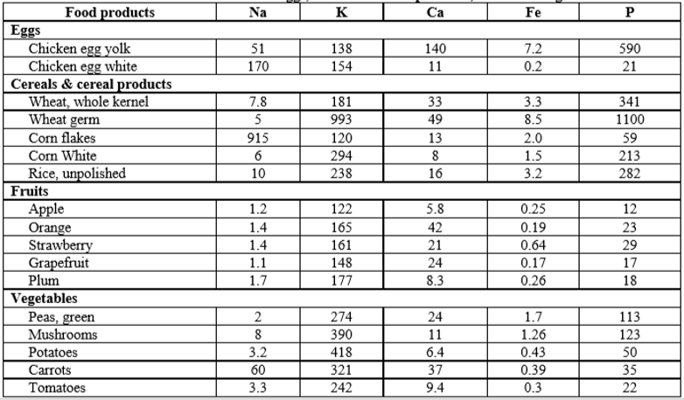
MINERAL CONTENT OF EGGS , CEREALS AND CEREAL PRODUCTS, FRUITS AND VEGETABLES

Slide 27
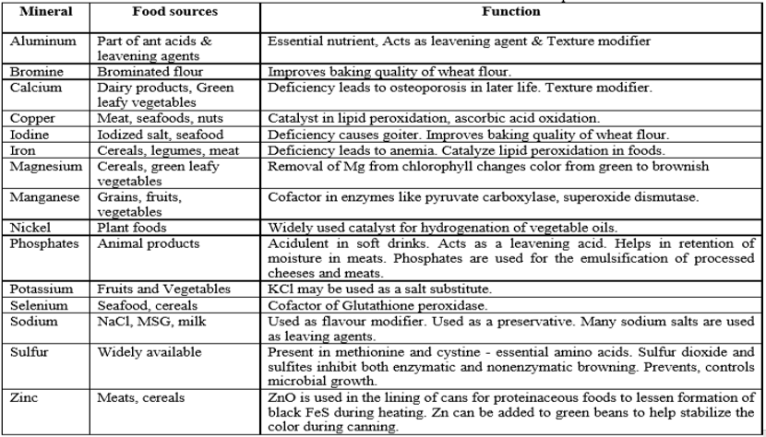
NUTRITIONAL AND FUNCTIONAL ROLE OF MINERALS AND MINERAL SALTS IN FOODS

