Slide 1
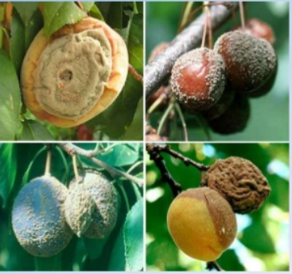
Course Title: Food and Industrial Microbiology Course No. - DTM-321: Credit Hrs-3 (2+1)
Microbiology of Fruit and vegetables
RAKESH KUMAR
ASSOCIATE PROFESSOR (DAIRY MICROBIOLOGY)
FACULTY OF DAIRY TECHNOLOGY
S.G.I.D.T., BVC CAMPUS,
P.O.- BVC, DIST.-PATNA-800014

Slide 2
Vegetables form an integral part of diet due to their role in providing various types of vital nutrients such as carbohydrates, minerals, vitamins, roughage etc. Vegetables being a part of fresh produce, contain high moisture which makes them highly perishable foods and hence more prone to spoilage. Microorganisms gain entry into vegetables from various sources. These sources include:
Soil
Water
Diseased plant
Harvesting and processing equipments
Handlers
Packaging and packing material
Contact with spoiled vegetables
The conditions in which vegetables are stored and transported after harvesting also contribute to rate of spoilage. Other than microbial, sources, the spoilage of vegetables can also occur due to the activity of native enzymes.

Slide 4
Spoilage in vegetables is mainly affected by composition of vegetable. The non acidic foods are thus spoiled by bacterial rot while acidic foods with dry surfaces are more prone to mold spoilage. The product on which organism grows and types of organisms growing largely determine the character of spoilage.
Bacterial Soft Rot Caused by Erwinia carotovora and Pseudomonas such as Psedomonas. marginalis.
Breaks down pectin, giving rise to a soft, mushy consistency, sometimes a bad odour and water soaked appearance. Vegetables affected onions, garlic, beans, carrot, beets, lettuce, spinach, potatoes, cabbage, cauliflower, radishes, tomatoes, cucumbers, watermelons.
Soft rot in tomato caused by Erwinia carotovora. Blue mould rot in tomato caused by Penicillium spp. Penicillium, Cladosporium, Rhizopus, Aspergillus spp. are responsible for various defects in vegetables. Gray mold rot – caused by Botrytis cinera in vegetables. Favoured by high humidity and warm temperature

Slide 6
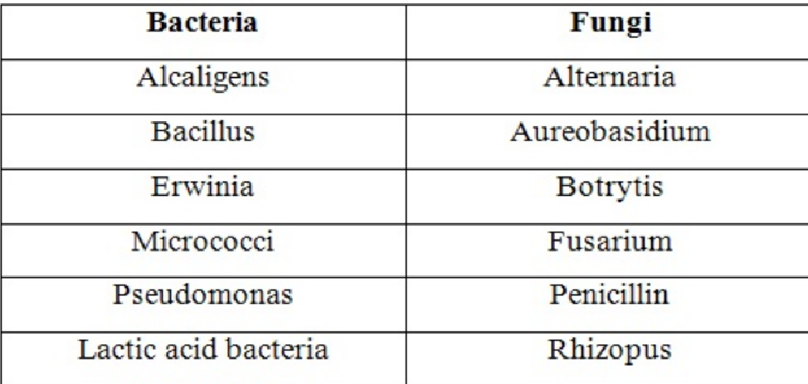
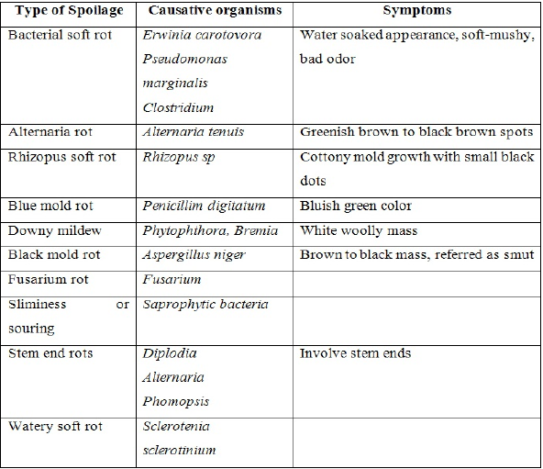
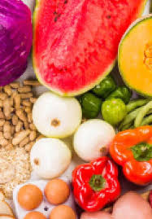
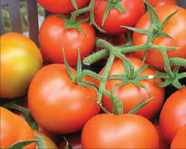
Normal microflora of vegetables
The major types of spoilages by pathogens in vegetables

Slide 8
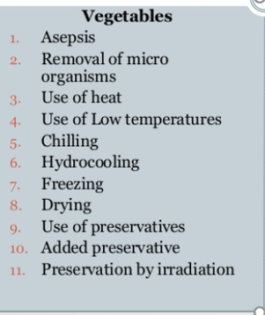
Method of Preservation

Slide 9
Fruits are natural sources of minerals, vitamins besides carbohydrates and other essential substances. Naturally fresh fruits and juices made out of them contain high amount of water thereby making them highly prone to attack by microorganisms. While most of the fruits are naturally provided with coatings and coverings in the form of skins, but these are fragile enough to be easily disturbed by various biological and mechanical factors. Like vegetables, fruits being produce of plants get contaminated through different sources by a variety of microorganisms which may play significant role in their spoilage. These are soil, water, diseased plant, harvesting and processing equipments, handlers, packaging and packing material and contact with spoiled fruits.

Slide 10
Microorganisms Associated with Spoilage in Fruits and Juices
The microorganisms associated with fruits depend on the structure of fruit. The fruits contain different organic acids in varying amounts. The types of acids which are predominately found are citric acid, malic acid and tartaric acid. The low pH of fruits restricts the proliferation of various types of organisms. Due to the low pH, a large number of microorganisms are restricted to grow on fruits. Fungi are most dominating organisms to grow on fruits because of the ability of yeasts and molds to grow under acidic conditions. A small number of bacteria which are aciduric (ability to resist acidic conditions) also grow. Also the dry conditions prevailing on the skin and surface do not allow the growth of certain microorganisms. Besides, these plants also produce certain antimicrobial components too. Despite the high water activity of most fruits, the low pH leads to their spoilage being dominated by fungi, both yeasts and molds but especially the latter.

Slide 11
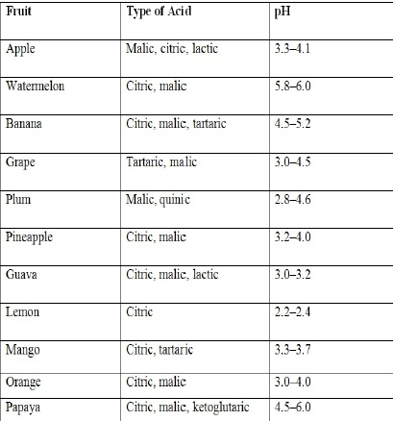
Type of acid associated with fruits and their pH

Slide 12
Yeasts
Yeasts are unicellular fungi which normally reproduce by budding. Of the 215 species important in foods, about 32 genera are associated with fruits and fruit products . Only a few species of yeasts are pathogenic for man and other animals. None of the pathogenic species are common contaminants of fruits and fruit products. Fruit that has been damaged by birds, insects, or pathogenic fungi usually contain very high yeast populations. The yeasts are introduced into the exposed tissue, often via insects and are able to use the sugars and other nutrients to support their growth. Types of yeasts growing in fruits depend upon the nature of the fruit and the strain of yeast.
While carbon dioxide and ethanol are the predominant metabolic products of yeasts, other products such as glycerol, acetaldehyde, pyruvic acid, and a keto glutaric acid are also formed. Oxidative yeasts such as species of Brettanomyces produce acetic acid in wines and other fruit products.

Slide 13
Molds
These are filamentous fungi which are important group of microflora of fruit products due to following reasons
1. Some of the members are xerophilic, thereby having potential to spoil foods of low water activity such as dried fruits and fruit juice concentrates.
2. Some of the species have heat resistant spores such as ascospores which can survive the commercial pasteurization treatments that are given to most fruit products.
3. Growth of molds on processing equipment such as wooden tanks can result in the generation of off flavors in wines, juices, and other fruit products.
4. Mold infected raw fruit may become soft after processing because pectinases were not inactivated by the thermal treatment.
5. The metabolic products of many molds are toxic to humans. Of these toxins, mycotoxins are important components. Molds are aerobic microorganisms, but many of them are very efficient scavengers of oxygen. Due to this property of molds, processed fruits, including those hermetically sealed in cans or glass, are susceptible to spoilage. Penicillium italicum (blue mold) and Penicillium digitatum (green mold) seen in oranges, lemons and citrus fruits.

Slide 14
Bacteria
Various groups of bacteria have ability to grow on fruits and its juices. These bacteria by virtue of their diversity in metabolism row on fruits and produce different types of compounds. The major group of bacteria which are involved are:
Lactic acid bacteria
Acetic acid bacteria
Spore formers
Lactic acid bacteria
The lactic acid bacteria are Gram positive, catalase negative organisms which can grow under anaerobic conditions. These are rod shaped (lactobacilli), or cocci (pediococci and leuconostocs). The homo fermentative species produce mainly lactic acid from hexose sugars. The heterofermenters produce one molecule of lactic acid, one molecule of carbon dioxide, and a two carbon compound, which is usually acetic acid or ethanol or a combination of the two.
Growth of lactic acid bacteria in juices and other fruit products cause the formation of haze, gas, acid, and a number of other changes.

Slide 15
Acetic acid bacteria
These are Gram negative, aerobic rods having two genera, viz. Acetobacter and Gluconobacter. Both of these species oxidize ethanol to acetic acid under acidic condition, Acetobacter species can oxidize acetic acid to carbon dioxide thus, the genus is called as over oxidizer. Because the bacteria are obligate aerobes, juices, wines, and cider are most susceptible to spoilage while held in tanks prior to bottling. Some strains of Acetobacter pasteurianus and Gluconobacter oxydans produce microfibrils composed of cellulose, which leads to formation of flocs in different fruit juice beverages.
Spore formers
Spores are heat resistant, so role of organisms producing spores is important in heat treated juices and beverages. Variuos spore formers such as Bacillus coagulans, B. subtilis, B. macerans, B. pumilis, B. sphaericus , and B. pantothenticus have been found to grow in different types of wines. Some of these organisms have also been involved in canned fruits. Spore forming bacilli that actually prefer a low pH have been responsible for spoilage of apple juice and a blend of fruit juices.

Slide 18
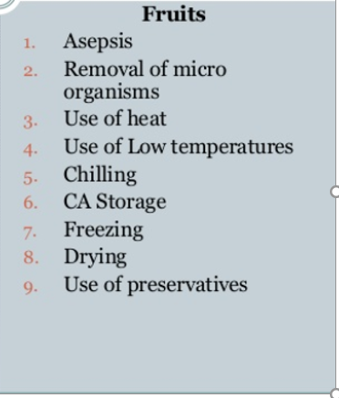
Method of Preservation

