Slide 1
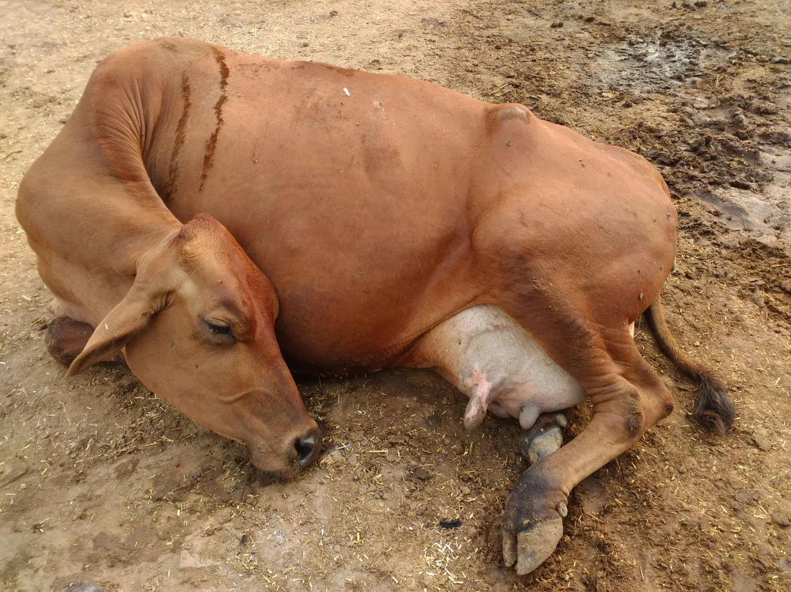
Department of Veterinary Medicine Bihar Veterinary College, Patna – 800 014
MILK FEVER
Dr. Ranveer Kumar Sinha Assistant Professor cum Junior Scientist

Slide 2
MILK FEVER (Parturient paresis, Hypocalcaemia, Calving paralysis)
Introduction
Disease of female
Occurs in cattle, Buffalo, sheep and goats at or within 72 hrs. of parturition, caused by hypocalcaemia and characterized by weakness, recumbency, and ultimately shock and death
“Fever” is a misnomer
Sometime it is associated with low level of Ca, P & Mg, it is k.a. “Milk Fever Complex”

Slide 3
EPIDEMIOLOGY
Species:- Cows & Buffaloes
Breed:- Jersey cows & Jaffarabadi buffaloes
Age/Lactation:- 5-10 years/third and greater lactations
Season:- Late winter & Spring
Milk Yield:- High Yielding animals
Predisposing factors
Cold climate
Long distance transport
Digestive disturbance

Slide 4
Calcium Homeostasis

Slide 5
Aetiology
Excessive Loss of ca through colostrum:-
Blood plasma 8.5-10.4 mg/dl
(cow suffered with milk fever = 2-6mg/dl)
Colostrum 2.3g Ca/ kg
Milk 1.2g Ca/kg
Decreased absorption of ca
Reduced feed intake results in atony of gut
Indigestion
Def. of vit. D:-
Vit.D3(cholecalciferol) is first converted to 25 hydroxy cholecalciferol by the enzymes of liver & again converted to 1,25 dihydroxy cholecalciferol by the enzymes of kidney. This help in absorption of ca ion from intestine & resorption of ca ion from bone.

Slide 6
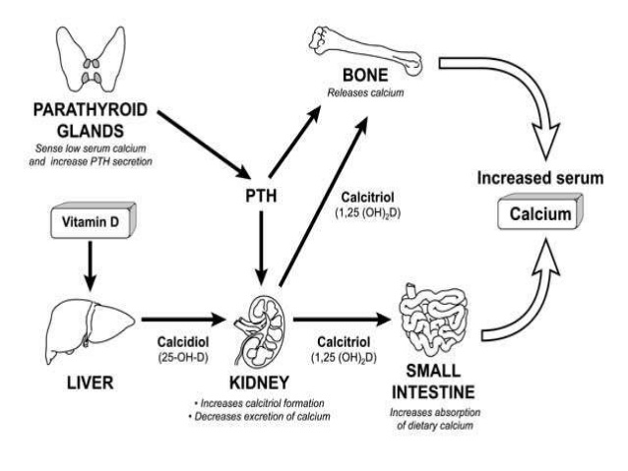

Slide 7
Aetiology
Improper Ca:P ratio in diet (N.L. in blood 2.3:1)
Disease of intestine
Slow mobilization of Ca from bone
Parathormone(PTH) def.
High calcitonin
Excessive ca intake(over 100-125g/cow/day) during dry period

Slide 9
Clinical findings
Stage I/Stage of excitment:-
Tem. Normal
Hypersensitiveness
Tremor of the muscle of the hind limb
Hind limb become rigid & thereby ataxic for which animal is prone to fall

Slide 10
Stage II/ sternal recumbency
Sub normal temp.
Cold skin & extremities
Loss of anal reflex
Low venous pressure(Difficult to raise the jugular vein
Suspended defecation & urination

Slide 11
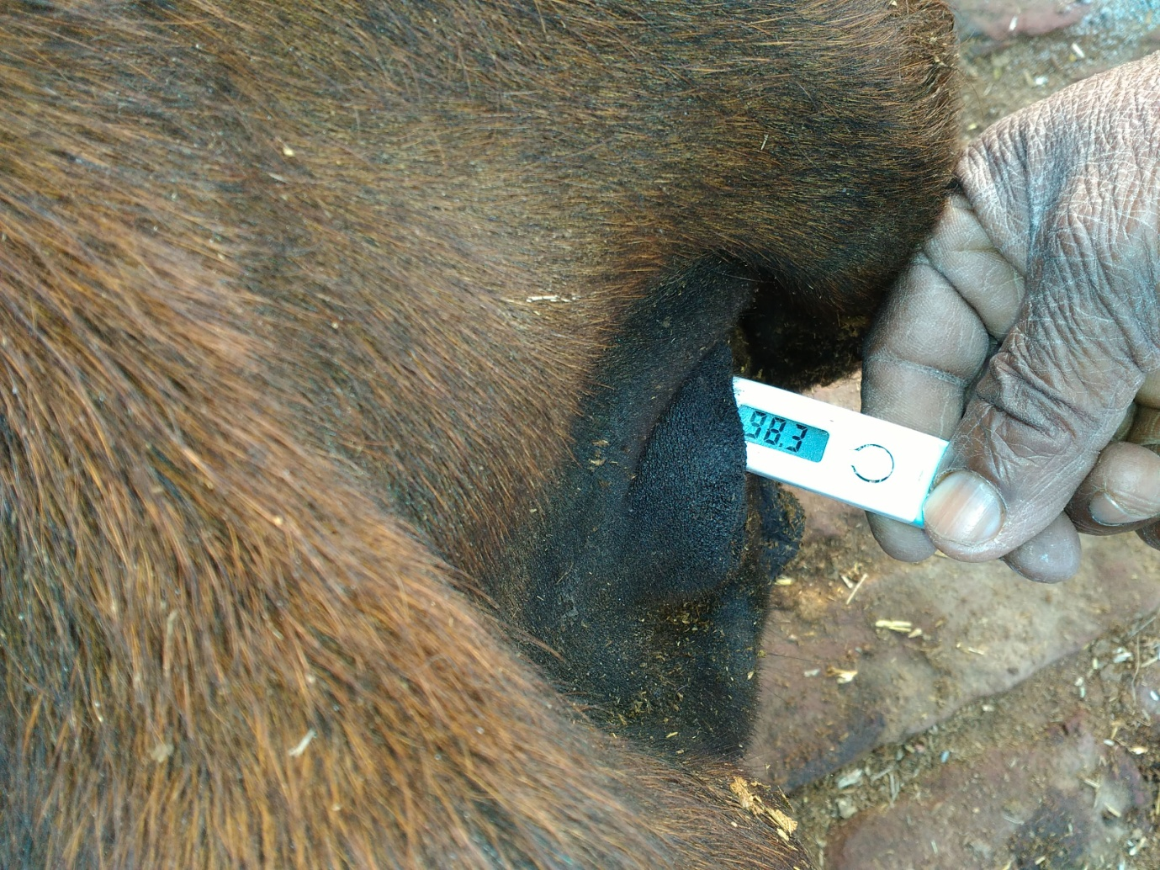

Slide 12
Stage III/ lateral recumbency
Markedly sub normal temp.
Extremely cold skin & extremities
Bloat
Difficult/Impossible to raise the jugular vein
Suspended defecation & urination

Slide 13
Clinical Pathology
Ca level= 5.5 – 6.5mg/100ml
(N.L. = 8.5 – 11.5mg/100ml)
Mg level= 0.8 – 1.2mg/100ml
(N.L. = 1.8 – 3.2mg/100ml)
P level= 2.3 – 2.8mg/100ml
(N.L. = 3.5 – 6.0mg/100ml)

Slide 14
Diagnosis
History of parturition
High milk yield
Typical clinical signs viz. sternal or lateral recumbency with subnormal body temperature
Clinical pathology viz. Low serum Ca level
Clinical response to calcium therapy

Slide 15
Treatment
Calcium borogluconate (25%) @ 400-800 ml or 1 gm/45 kg body weight slow IV
(Av. 450ml bottle contain 8-11g Ca)
When hypocalcaemia are associated with hypomagnesaemia & hypophosphatemia then use Mifex 200-450 ml slow IV
Antihistaminic like Avil 10 ml IM in L.A.
Ca, Vit.D3 & Vit.B12 inj (Caldee-12 inj.) 10-15 ml IM in
Unusal reaction to Ca therapy can be treated with:-
Atropine sulphate can be used to overcome cardiac arrhythmia
Magnesium sulphate 10% solution @100-400ml IV to antagonize cardio-excitatory effects of calcium

Slide 16
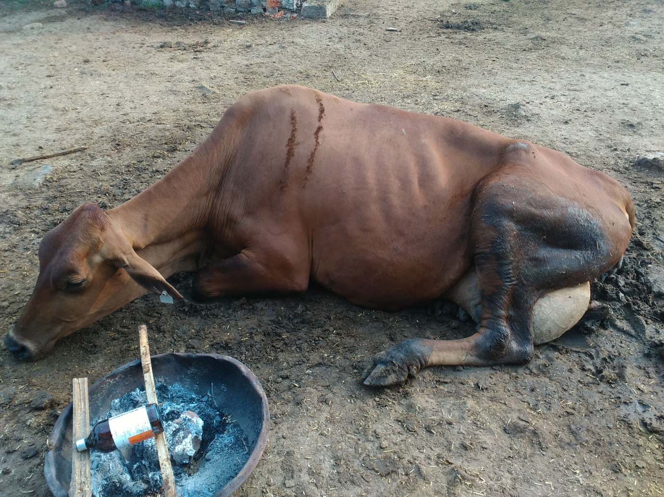

Slide 17
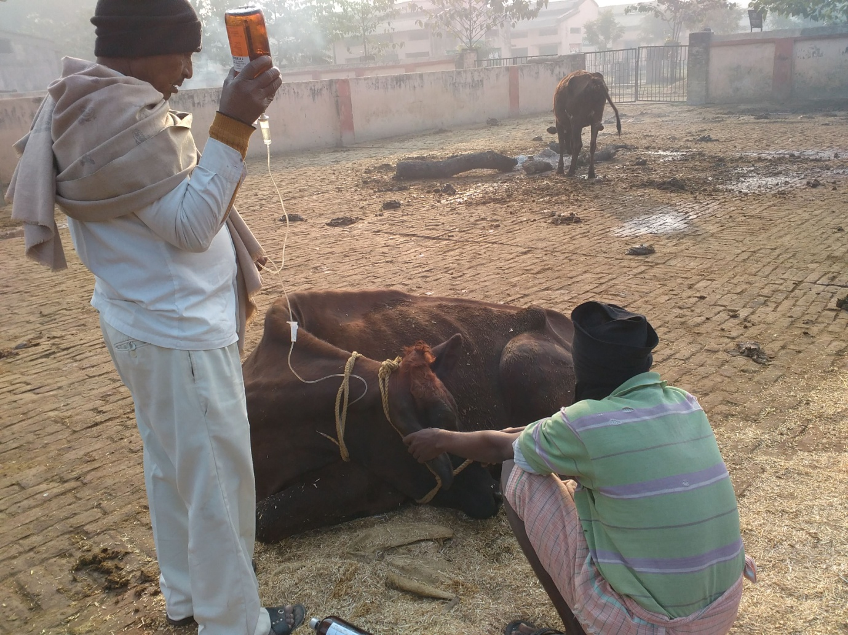

Slide 18
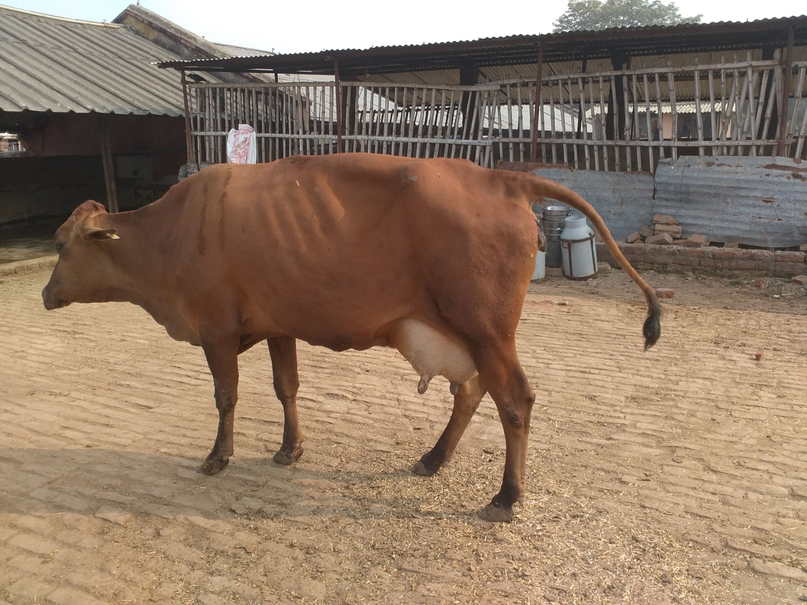

Slide 19
After Treatment

Slide 20
Prevention & Control
Feeding of low Ca diet(8 g/day/450 kg b.wt.) during last 2 week of gestation
Incomplete milking after calving
Protect from cold stress & transportation stress
Use of dietary straw to stimulate rumen function
Oral Ca supplement, one at calving and a second dose the next day
A single dose of Vit D3 @ 10 million unit i.e. 1 million units/ 45 kg body weight IM one week before calving has been reported to be effective
calcium-binding agents such as zeolite, zinc oxide e.t.c

Slide 21
THANKS YOU !

