Slide 1
UNIT-3
‘Zoonotic disease’
(Credit Hours-3+1)

Slide 2
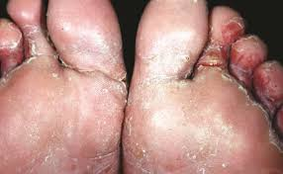
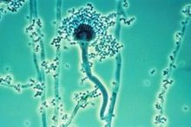
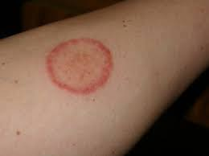
Superficial and Systemic mycoses

Slide 3
Features of Fungi
Eukaryotic cell/ Prokaryotic cells?
Autophagy/hetrophagy ?
Unicelluler/Multicelluler?
Are they motile/non motile?
They multiply by mitotic/meiotic division?
Classification- Depending on cell morphology
Yeasts eg. Yeast, Cryptococcus neoformans
Yeast like fungi eg. Candida albicans
Molds eg. Dermatophytes
Dimorphic fungi eg. Histoplasma capsulatum
Blastomyces dermatidis

Slide 4
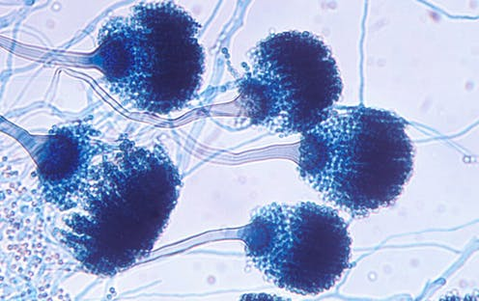
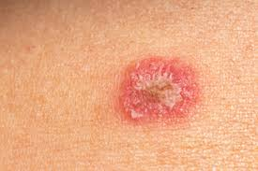
Introduction:
Fungus are:
Normal skin microbiota
Opportunistic infection: Entry through a wound
Immunocompromised patients
Causes a variety of disease conditions: Animals & man
Infections, also K/ as mycoses
Most of mycoses: zoonotic in nature
Effect all organs & structures of the body
Moist environment: Promote growth & transmission
(sweaty shoes, communal showers, and locker rooms)

Slide 5
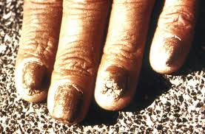
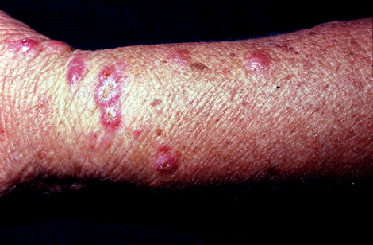
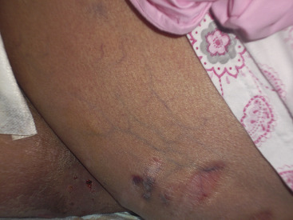
Types of Mycoses
Mycoses: 3 types (Based on their invasiveness)
1. Cutaneous mycoses
Infections of the epidermis, hair, & nail
Ex. Tinea
2. Subcutaneous mycoses
Penetrates epidermis/dermis to infect deeper tissues
Ex. Sporotrichosis
3. Systemic mycoses
Spreads throughout body
Ex. Aspergillosis

Slide 6
Cutaneous Mycoses

Slide 7
Cutaneous Mycoses
Caused by Dermatophytes (fungal molds)
Keratinophilic - "keratin loving” (keratin of horns, hooves, nails, hair and skin
Commonly found : Environment & soils
Frequently transferred to the skin via contact
There are three genera of dermatophytes:
Epidermophyton: Infects skin, nails but never hair
Trichophyton: Infects hair, skin and nails
Microsporum: Infects hair and skin, rare cases of nail
Several species of Microsporum & Trichophyton causes zoonotic ring worm infection
*A group of cutaneous mycoses called tineas*

Slide 8
Cutaneous Mycoses
These genera have been categorized into three groups
(On the basis of their host preferences)
(i) Zoophilic dermatophytes:
Primarily parasites of animals but mostly are also pathogenic for man
(ii) Geophilic dermatophytes:
Inhabitants of soil and rarely infect man & animals
(iii) Anthropophilic dermatophytes:
Primarily parasites of man but cause disease in animals

Slide 9
Cutaneous Mycoses
Based on hosts affected by different dermatophytes
Fungus | Hosts
Zoophilic dermatophyte Trichophyton equinum T. mentagrophytes T. verrucosum T. gallinae Microsporum equinum M. canis M. distortum | Horse, mule, monkey, and man Horse, donkey, cattle, pig, sheep, dog, rabbit, mouse, rat, & man Cattle, buffalo, horse, donkey, pig, sheep, goat, & man Bird, dog, cat, & man Horse and man Cat, dog, sheep, horse, cattle, monkey & man Cat, dog, monkey and man
(B) Geophilic dermatophytes M. nanum M. gypseum | Pig and rarely man Dog, horse and rarely man
(C) Anthropophilic dermatophytes T. rubrum M. audouinii | Man, rarely animals Man, rarely animals

Slide 10
Cutaneous Mycoses
Tinea’s on most areas of the body are generally called ringworm
Some Common Tineas and Location on the Body
Tinea corporis (ringworm) | Body
Tinea capitis (ringworm) | Scalp
Tinea pedis (athlete’s foot) | Feet
Tinea barbae (barber’s itch) | Beard
Tinea cruris (jock itch) | Groin
Tinea unguium (onychomycosis) | Toenails, fingernails

Slide 11
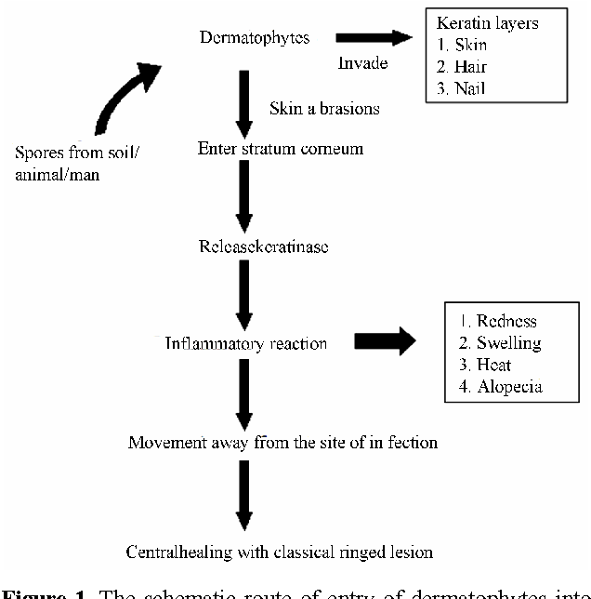
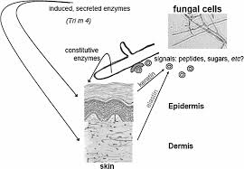
Epidemiology
Direct contact; infected host
Contact with Inanimate objects; carrying fungal spores
More prevalent in animals, kept confined i.e. in winter season
High humidity in the environment; favorable for multiplication
Young animals ; most susceptible
Notes:
The fungus attacks mainly keratinized tissues. Stratum corneum and hair fibers are particularly affected resulting in alopecia. Exudation from invaded epithelial layers, epithelial debris and fungal hyphae produces dry crusts in the centre of the lesions which is a typical feature of the disease. The lesions grow centrifugally, where the periphery is active, leading to the development of the characteristic ring form of the lesions. Secondary bacterial infection of hair follicles is also common.

Slide 12
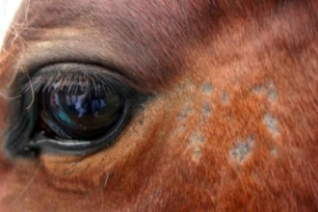
Disease in animals
Common in: Cattle, horse, pig & many other species
Rare in: Sheep & very rare in goats
In cattle:
Calves are more susceptible
Effected parts: Neck, head & perineum sometimes other parts
Lesions: Grey-white crust followed by alopecia
In horses
Lesions: Axillary girth area & later spread over the trunk & rump, and to the neck, head and limbs
Lesions with scabs followed by alopecia appear which vary in size with the species of fungus involved
In Pigs
Similar lesions on the back and sides
In sheep
lesions consist of round, bald patches covered with greyish crust, in head
In goats
Similar lesions are observed generally all over the body

Slide 13
Disease in human
Human being can contract ringworm infection from animals
In rural areas: 80% of human cases are of animal origin
In urban areas:10% of human cases are of animal origin
Horses and cattle: Trichophyton spp. infection
Dogs: M. canis infection
Infected pet animals (Guinea pigs/hamsters/cats/rabbits) to farmers, zoo-keepers, veterinarians & children
Children are particularly susceptible
M. canis (microsporia): Develop single/ multiple, round, oval or polycyclic reddened scaly lesions, primarily on face, neck, & arms
M. distortum: lesions on scalp, neck, face, trunk &
other parts of the body
T. rubrum: Superficial mycosis of feet, toe-webs, & hands
T. mentagrophytes/T. verrucosum/M. gypseum: Hairy skin on the scalp, neck, face and rarely on extremities

Slide 14
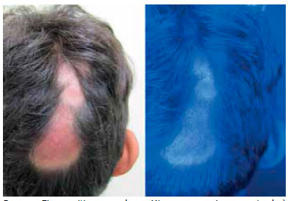
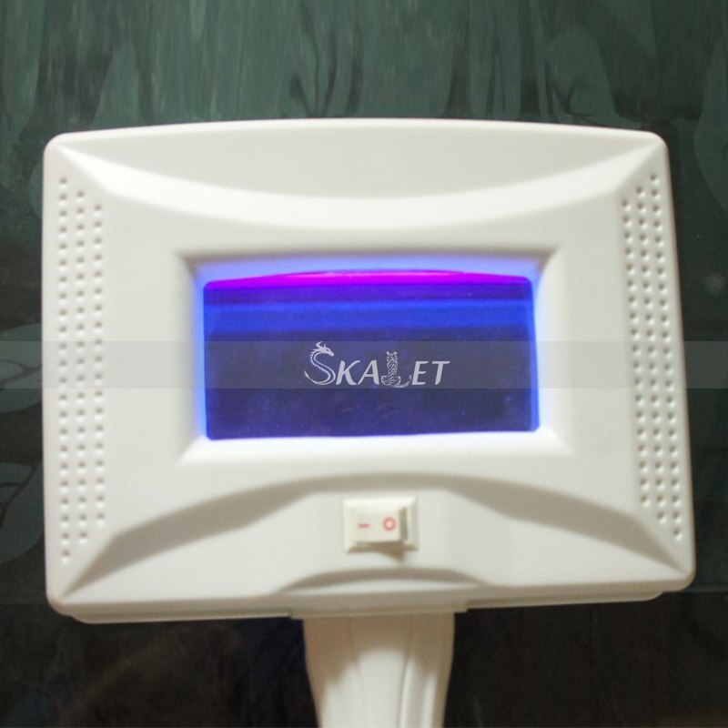
Diagnosis
By characteristic lesion: Ring like lesion
Wood’s lamp (also called a black lamp) examination
UV Wavelength - 365 nm
Used to examine dermatophyte infections of M. canis, M. distortum and M. equinum
Fungal elements (spores and hyphae) show greenish fluorescence
Wood’s lamp

Slide 15
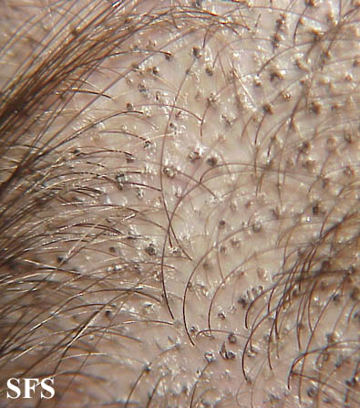
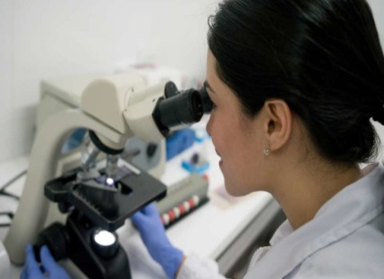
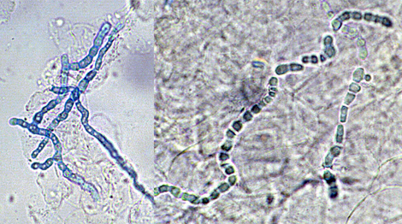
Diagnosis
Direct microscopic evaluation:
Specimens: Skin scrapings, hair, or nails
Preparation of specimens: Wet mount slide
Skin/Hair
10%–20% aqueous KOH
Dissolves keratin
Dissolves keratin
visualization of the hyphae & fungal spores

Slide 16
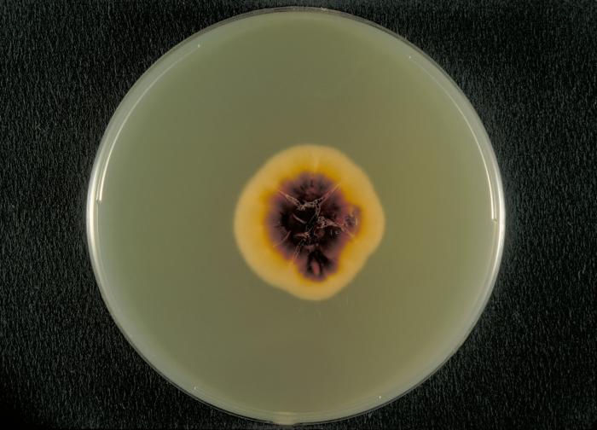
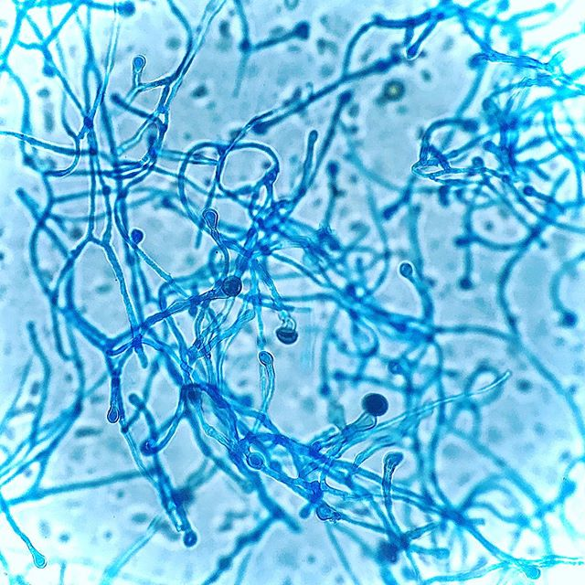
Diagnosis
Culture examination:
Media: Sabouraud dextrose CC (chloramphenicol/cyclohexamide)
Inhibiting the growth of bacteria/ saprophytic fungi
Macroscopic colony morphology
Identification can be further confirmed by visualizing the
Microscopic morphology using either a slide culture /a sticky tape
prep stained with lactophenol cotton blue
Tinae growth on a Sabouraud dextrose CC agar plate.
Lactophenol Cotton blue staining

Slide 17
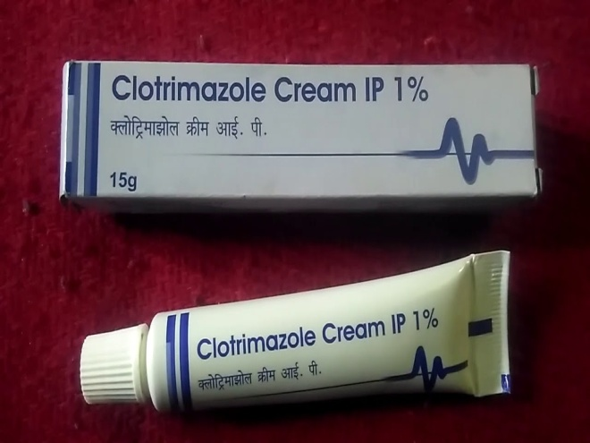
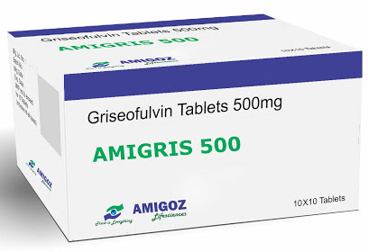
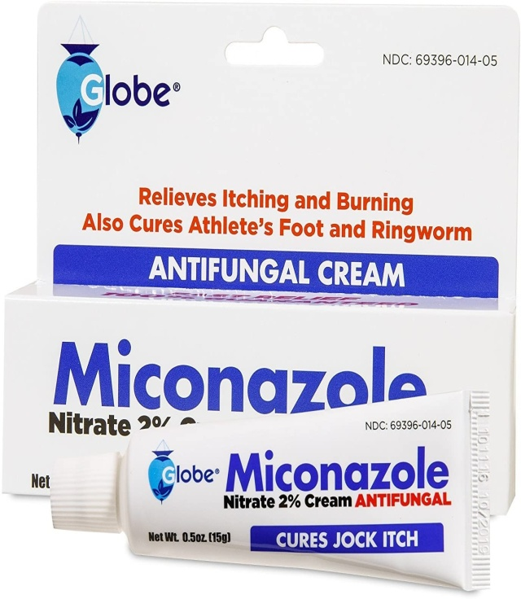
Treatment
Various antifungal treatments can be effective against tineas
Depending upon the extent of lesions: local/ systemic treatments
Topical application:
First removal of the crust and application of weak solution of
Iodine, Whitfield's ointment, 10% ammoniated mercury ointment,
Ointments containing propionic and undecylenic acids,
Hexetidine etc.
Natamycin and nanomycin weak solution of iodine
Allylamine (Contais terbinafine)
Miconazole
Clotrimazole
Orally: Griseofulvin
Systemic application: Inj. of Sodium Iodide

Slide 18
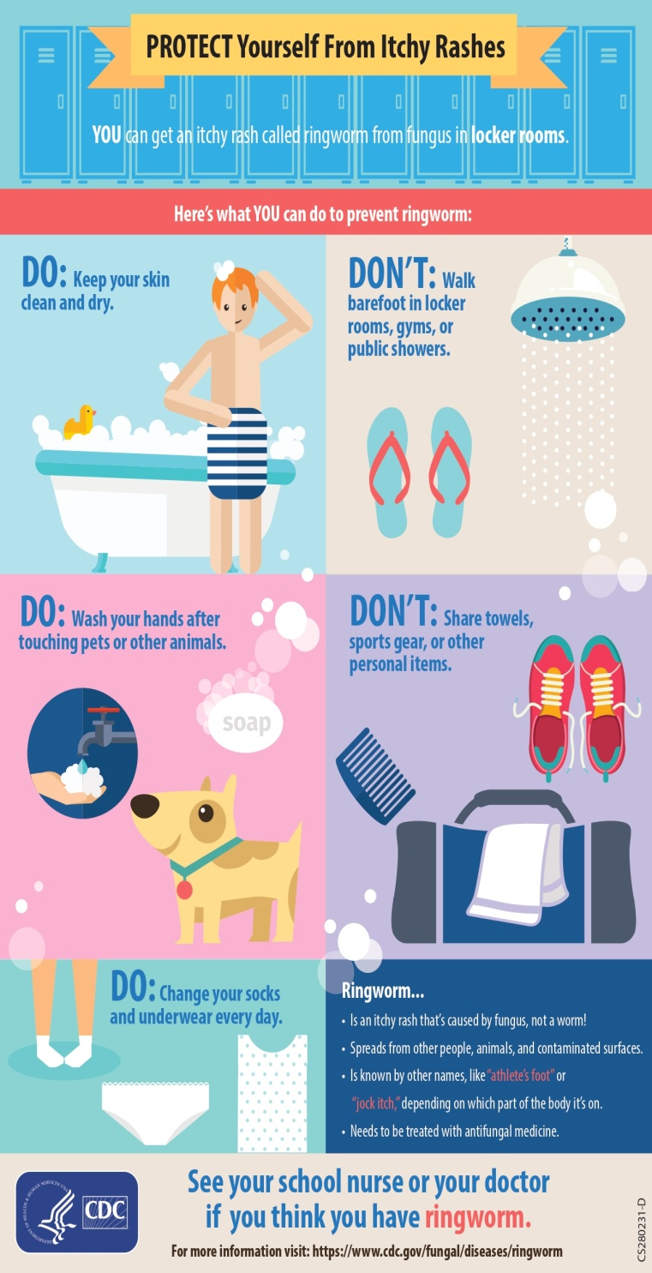
Prevention and control
Maintain General hygienic measures
Isolation and treatment of infected animals
Disinfection of contaminated equipment and premises
Oral administration of griseofulvin also has protective effect
Proper diet with vitamin A supplementation is considered desirable
A vaccine against ringworm, containing the inactivated Trichophyton verrucosum strain

Slide 19
Questions?
1. ________ is a superficial fungal infection found on the head.
Tinea cruris
Tinea capitis
Tinea pedis
Tinea corporis
2. Sabouraud dextrose agar CC is selective for ________.
All fungi
Non-saprophytic fungi
Bacteria
Viruses
3. ___________Dermatophytes effect the skin, hair and nails
Epidermaphyton
Microsporum
Trichophyton
All

