Slide 1
Neurohumoural Transmission
Dr. Nirbhay Kumar
Asstt. Professor & Head
Deptt. of Veterinary Pharmacology & Toxicology
Bihar Veterinary College, Bihar Animal Sciences University, Patna

Slide 2
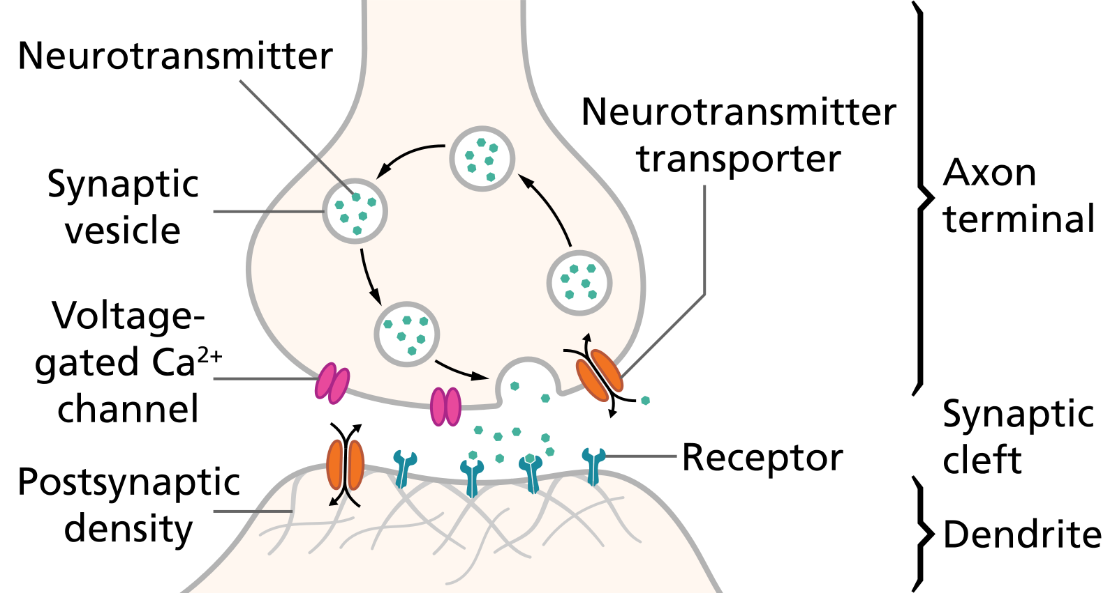
Neurohumoural Transmission
Neurohumoural transmission implies that nerves transmit their message across synapses and neuroeffector junctions by the release of humoural (chemical) messengers.
Steps involved:
1. Axonal conduction
2. Junctional Transmission

Slide 3
Historical aspects
1857, Dubois Raymond : Observed similarity between transmission of nerve impulse produced electrically as well as by chemical substances such as NH₃, lactic acid etc.
1901, Lewandowsky & Langley : Noted independently the similarity between the effects of injection of extracts of the adrenal gland and stimulation of sympathetic nerves.
1910, Berger & Dale : Noted that the effect of sympathetic nerve stimulation were more closely produced by primary sympathomimetic amines, then by secondary sympathomimetic amines.
1914, Sir Henry Dale : Thoroughly investigated the pharmacological properties of ACh which produced responses exactly similar to parasympathetic nerve stimulation and he introduced the term “parasympathomimetic” to characterize the effects of ACh.

Slide 4
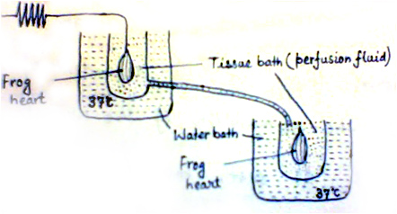
Historical aspects continued ….
1921, Otto Loewi : He provided the first direct evidence for the chemical mediation of nerve impulses by peripheral release of specific chemical agents.
Otto Loewi Experiment ⇨
1946, Von Euler : He showed that the sympathetic transmitter is noradrenaline.

Slide 5
Criteria for being a Neurohumoural Transmitter
To be considered as a post-junctionally acting neurohumoural transmitter a substance must fulfill the following criteria –
It should be present in the presynaptic neurone (usually along with the enzymes synthesizing it).
It should be released in the medium following nerve stimulation.
Its application should produce responses identical to those produced by nerve stimulation.
Its effects should be antagonized or potentiated by other substances which similarly alter effects of nerve stimulation.

Slide 6
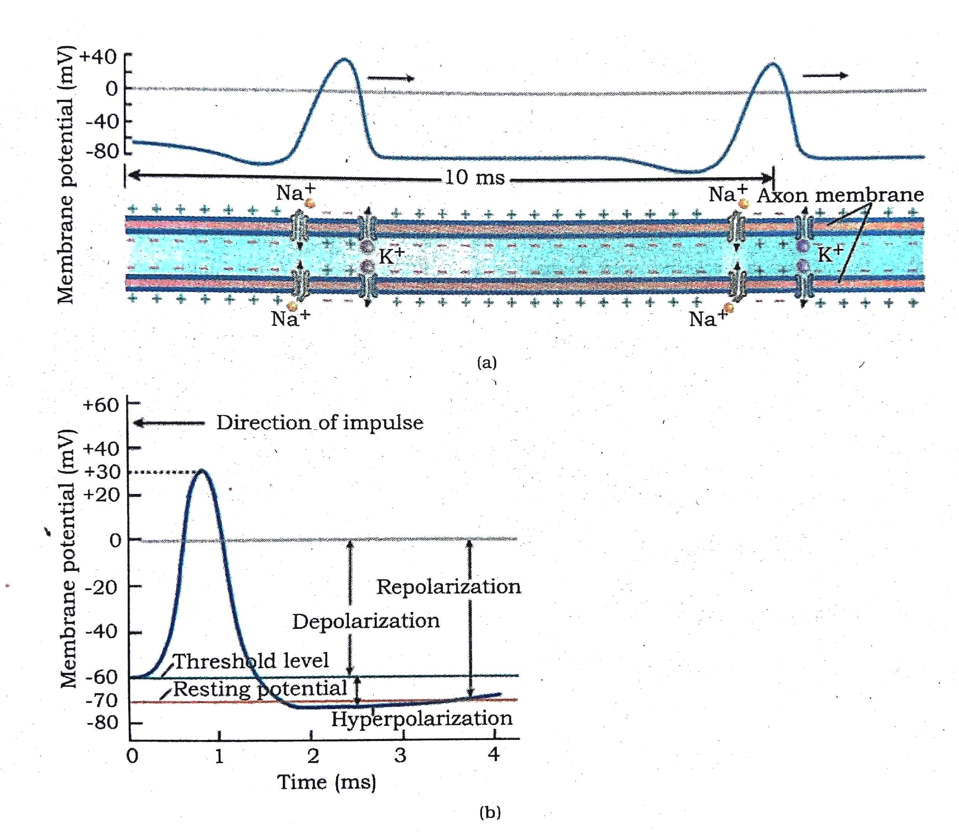
Steps involved in Neurohumoural Transmission
[I]. Axonal Conduction:
Figure : A typical action potential in an axon.
(a) Potential distribution across the axonal membrane
(b) Relationship between membrane potentials.

Slide 7
Steps involved in Neurohumoural Transmission continued…..
Drugs/ Toxins that interfere Axonal Conduction:
The axonal conduction is blocked by certain toxins such as Tetradotoxin (puffer fish poison) and Saxitoxin (shell fish toxin), which interfere with the Na⁺ entry across the neuronal membrane during depolarization.
Batrachotoxin, a steroidal alkaloidal toxin elaborated by a type of South American frogs, paralyses the nerves by persistent depolarization as a result of increase in Na⁺ influx.
Local anaesthetics act by preventing the Na⁺ influx and depolarization of the nerve.

Slide 8
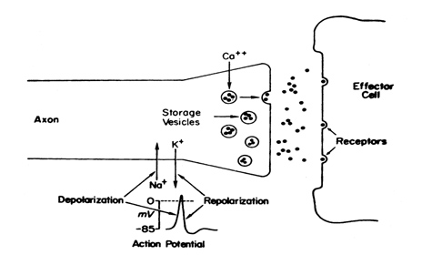
Steps involved in Neurohumoural Transmission continued…..
[II]. Junctional Transmission:
Storage and release of the transmitter:
The non-peptide neurotransmitters are largely synthesized in the region of axonal terminals and stored there in synaptic vesicles.
Peptide neurotransmitters are found in large dense-core vesicles which are transported down the axon from their site of synthesis in the cell body.

Slide 9
Steps involved in Neurohumoural Transmission continued…..
(ii) Combination of the transmitter with post-junctional receptors and production of the post-junctional potential:
EPSP : Increase in permeability to all cations causes Na⁺ or Ca²⁺ influx (through fast or slow channels) which cause depolarization followed by K⁺ efflux (repolarization).
IPSP : Increase in permeability to smaller ions, i.e. K⁺ and Cl⁻ (hydrated K⁺ ion is smaller than hydrated Na⁺ ion) only, so that K⁺ moves out and Cl⁻ moves in (in the direction of their concentration gradients).

Slide 10
Steps involved in Neurohumoural Transmission continued…..
(iii) Initiation of post-junctional activity:
EPSP ⇨ Initiates a propagated action potential in the post-synaptic neurone or skeletal or cardiac muscle. In smooth muscles, enhance muscle tone and in gland cells, initiates secretion through Ca²⁺ mobilization.
IPSP ⇨ Found in neurons and smooth muscles but not in skeletal muscles, will tend to oppose excitatory potentials simultaneously initiated by other neuronal sources.
(iv) Destruction or dissipation of the transmitter:
Following its combination with the receptor, the transmitter is either locally degraded (e.g. ACh) or is taken back into the pre-junctional neurone by active uptake or diffuses away (e.g. NE, GABA).
Rate of termination of transmitter action governs the rate at which responses can be transmitted across a junction (1 to 1000/ second).

Slide 11
Thank You

