Slide 1


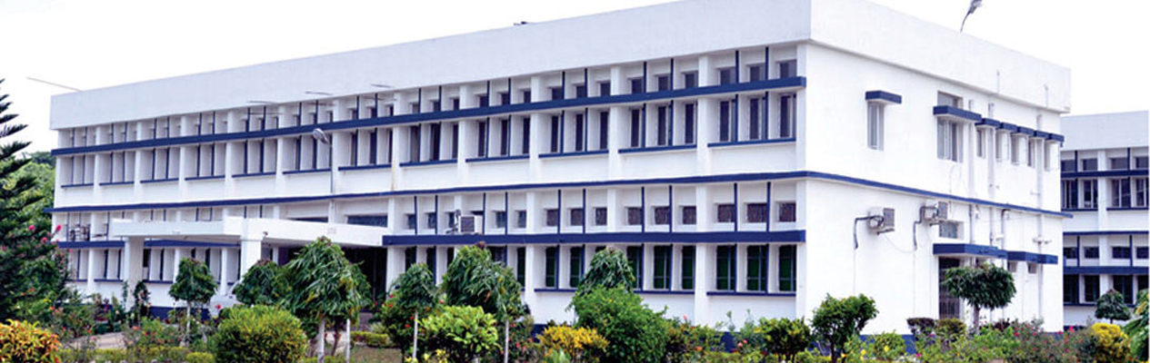
Course Title: Microbiology of Milk Product
Course No. - DTM-222: Credit Hrs-2 (1+1)
Microbiology of Butter
RAKESH KUMAR
ASSOCIATE PROFESSOR (DAIRY MICROBIOLOGY)
FACULTY OF DAIRY TECHNOLOGY
S.G.I.D.T., BVC CAMPUS,
P.O.- BVC, DIST.-PATNA-800014

Slide 2
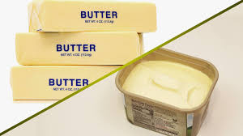
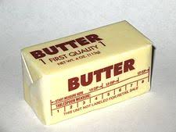
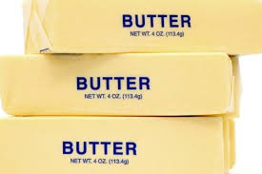
Microbiology of Butter
Definition
Butter is a smoothy fatty food made from milk or cream, or both, with or without common salt, and with or without additional coloring matter, and containing not less than 80% by weight of milk fat.
Butter Characteristics
Butter with a firm waxy body has an attractive appearance, has granules that are close knit, cuts clean when sliced, and has good spreadability. The trier sample from such butter will show this clean cut smooth, waxy appearance. The temperature of the butter at the time of grading is important in determining the true characteristics of body and should be between 45oF and 50oF.

Slide 3
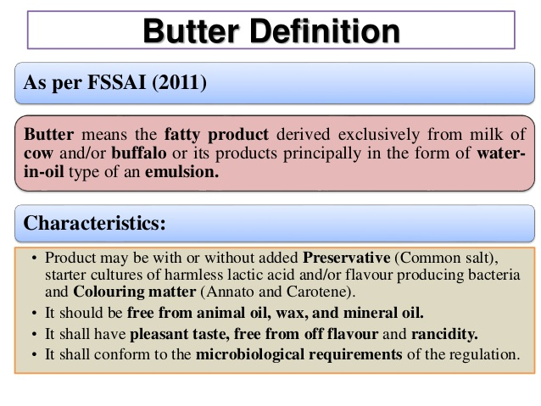

Slide 4
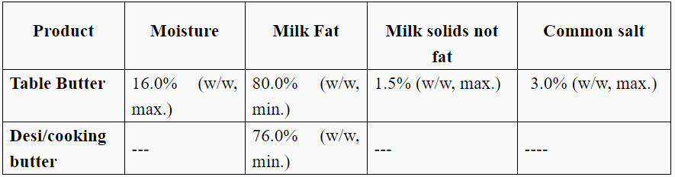
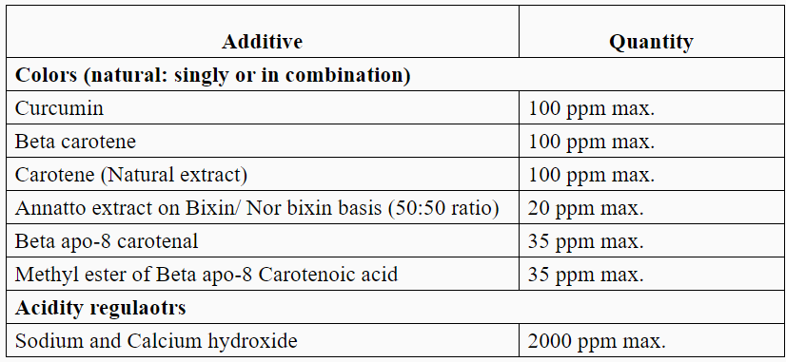
FSSAI standards for butter
Permitted food additives in butter as per FSSR
Food Safety and Standards. Regulations, 2010

Slide 5
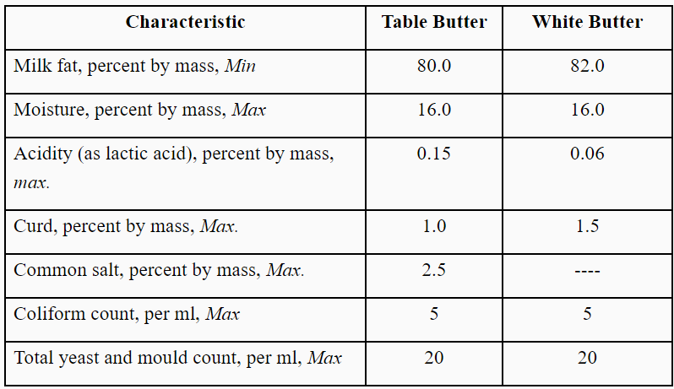
BIS standards for pasteurized butter

Slide 6
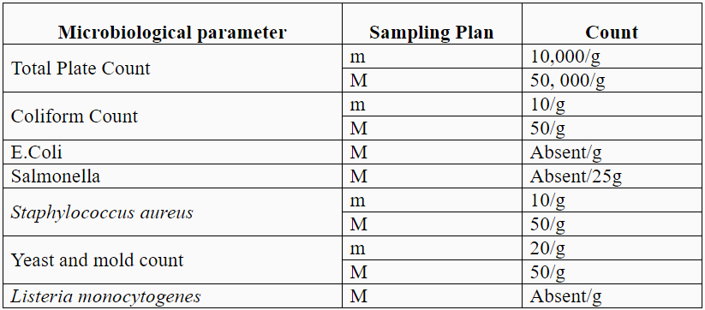
Microbiological requirements of pasteurized butter (FSSAI, 2011)
Note: m, M denotes standard sampling procedure as given by FSSAI, 2011
m= Represents an acceptable level and values above it are marginally acceptable in terms of the sampling plan.
M= A microbiological criterion which indicate unsatisfactory or potentially hazardous quality. Values above M are unacceptable in terms of the sampling plan and detection of one or more samples exceeding this level would be cause for rejection of the lot and will attract prosecution by the concerned food safety authorities.

Slide 7
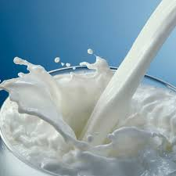
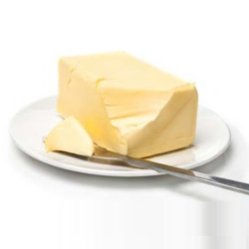
Microbiological Significance
Milk and dairy products constitute an important item of our food. These products are very suitable for microbial growth. It thus becomes necessary to know the microbiology of milk, its spoilage, method of preservation, and different dairy products where microbes play a positive rather than negative role. Milk is considered as a complete food and it contains proteins, fat, carbohydrates, minerals, vitamins and water. It is also a good medium for the growth of microorganisms. It is therefore, important to know the types of microorganisms present in milk, their control and use for beneficial purposes.
Milk contains relatively few bacteria when it is secreted from the udder of an healthy animal. However, during milking operations it gets contaminated from the exterior of the upper and the adjacent areas, dairy untensils, milking machines, the hands of the milkers from the soil and dust. In this way bacteria, yeasts and molds got into the milk and constitute the normal flora of milk. The number of contaminants added from various sources depends on the care taken to avoid contamination.

Slide 8
Manufacture of Butter The raw milk is separated into skim milk and cream. The principle behind this step is to increase the efficiency of the production process by increasing the yield of butter and reducing the yield of buttermilk. The cream, after pasteurization and standardization, could be marketed as different consumer products such as single / double cream, whipping cream and / or coffee cream. The cream to be used in the production of the butter is pasteurized, with the purpose of eliminating spoilage and pathogenic microorganism, inactivating enzymes and to make the butter less susceptible to oxidative degradation. The pasteurized cream (with a fat content of at least 35%) is inoculated with 1–2% starter culture in the production of ripened cream butter to ferment the citrate in the cream to yield acetoin and diacetyl with the latter responsible for the characteristic flavor of the cream butter.
Chemistry of Butter manufacture- When cream foams, fat globules come to the air--a serum interface of air bubbles. Liquid fat from the globules spreads at the interface along with material of fat globule membranes. The film of liquid fat cements globules into clumps. On repeated formation and destruction of foam bubbles, clumps grow to butter granules that contain modified serum (buttermilk) in the interstices between the fat globules. During working of the mass, some fat globules are crushed, and their contents are added to liquid fat. Also, moisture droplets are subdivided and air is entrapped

Slide 9
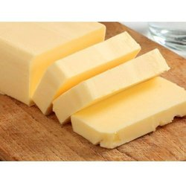
Manufacture of butter
Cream, the starting material for making butter, is an oil-in-water (o/w) emulsion which is through emulsion inversion phase that occurs during butter-making process makes butter which is a water-in-oil (w/o) emulsion, wherein milk fat globules are suspended in an aqueous phase.
Two typical types of butter are sweet butter (made from unfermented sweet cream) and cultured / fermented butter, a flavor intense type made from fermented/ripened cream by lactic acid bacteria. The fermentation process reduces the pH from typical 6.5 in sweet butter to around 5.0.
Butter is typically composed of 80–81% milk fat, 16–17% moisture, 1% carbohydrates and protein, and 1.2–1.5% sodium chloride. Butter with no added salt contains 82–83% milk fat. With many developments in dairy industries including butter manufacturing to widen the choices available to the consumers, different types of spreadable butters are now available: dairy spread (40% fat), blended spread (40% fat) and blended spread with high fat (70–80% fat)

Slide 10
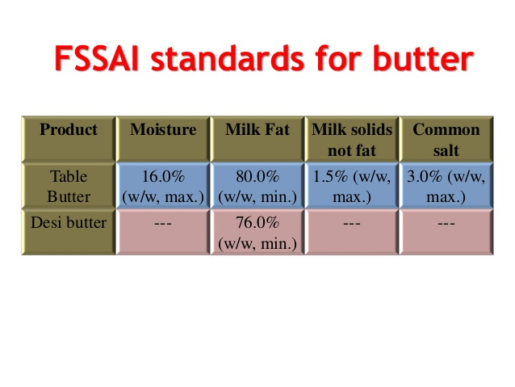
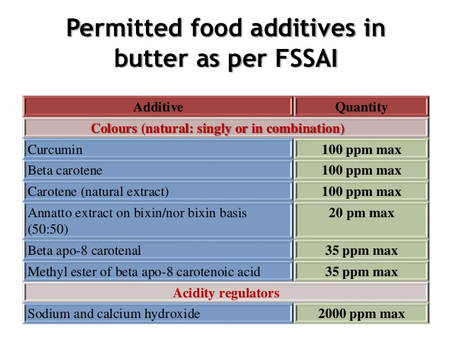
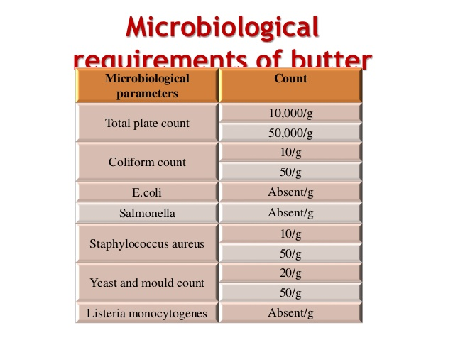

Slide 11
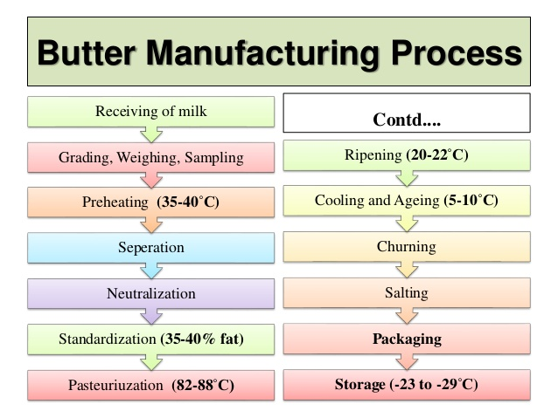

Slide 12
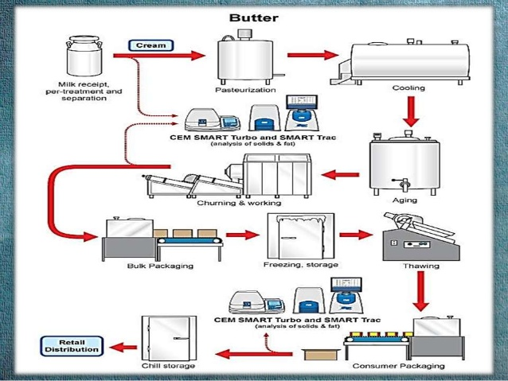

Slide 13
Batch Method - A huge metal cylinder that turns around a horizontal axis is most often used for churning butter by the conventional batch method. As the churn rotates, the cream is agitated, and butter can be manufactured after churning process.
Flow Diagram-
The following steps are usually followed in batch churning: 1) prepare the churn by cleaning and sanitizing 2) pump cream of 30-33% fat at 9ºC in summer or 13ºC in winter into a churn 3) add coloring 4) rotate the churn until butter granules are formed (breaking point) and become the size of peas or popcorn 5) drain buttermilk 6) rinse buttermilk from interior surfaces of the churn with clean, cold water, wash butter with sufficient water to bring total volume to that of original cream (water colder than butter firms, where as water warmer than butter softens) 8) drain wash water 9) add salt 10)work butter sufficiently to bring granules and water into compact mass, 11)sample and test for moisture 12)add water if insufficient (below about 16%) or permit to escape from the churn if the test shows high moisture 13)work butter until it has a firm, waxy body 14)sample and test for moisture, salt and curd 15)remove butter from the churn. • Butter is then packaged in automated printer-wrapper machines, being cut into one-quarter or 1-lb prints (sticks), wrapped in foil or parchment, and then stored at -18o to -29oC.

Slide 14
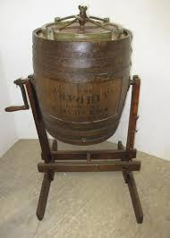

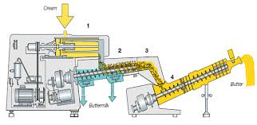
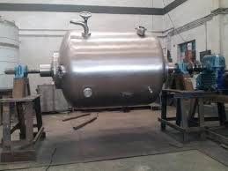
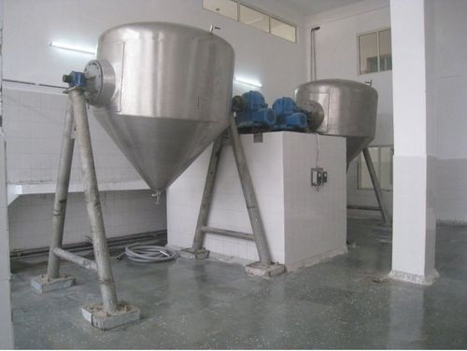
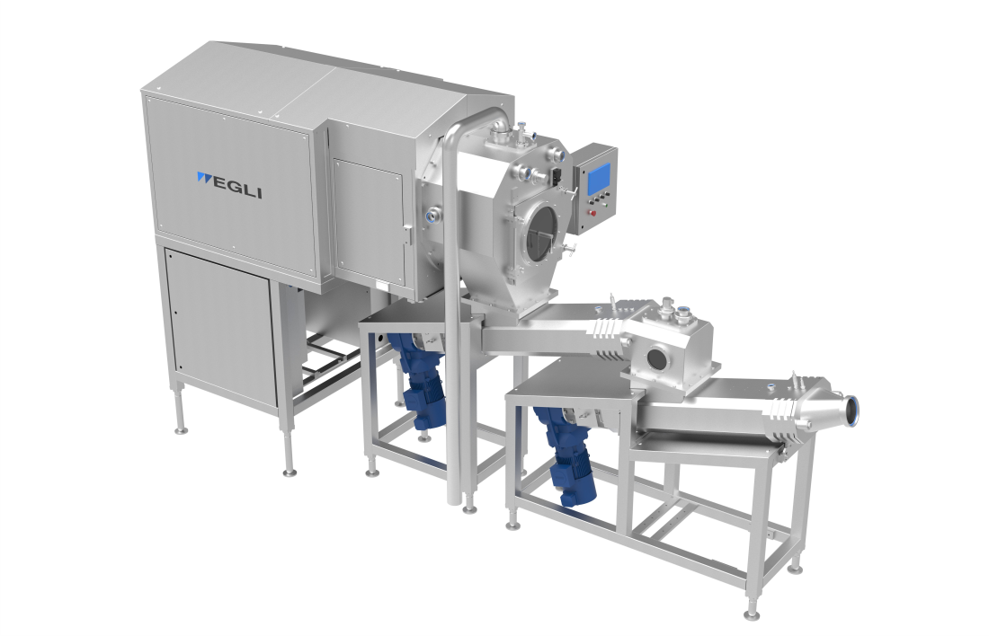

Slide 15
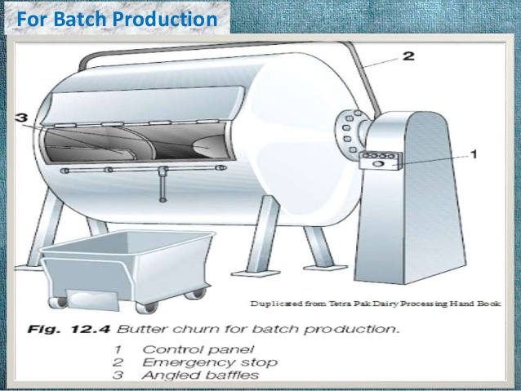

Slide 16
Continuous butter churn.
(1) Churning cylinder containing beaters to break emulsion.
(2) Separation section where buttermilk is drained.
(3) Squeeze-drying section where initial working begins and where salt is added as a slurry.
(4) Second working section where uniform moisture and salt dispersion occur and texture is finalized.
(Courtesy of Dairy Processing Handbook. Tetra Pak Processing Systems AB, Lund, Sweden.)

Slide 17
Microbiology of Butter
Milk, Cream and Butter constitute an important item of our food. These products are very suitable for microbial growth. It is important to know the initial quality of milk, type of spoilage, method of preservation, method of preparation of different dairy products.
Milk is considered as a complete food and it contains proteins, fat , carbohydrates, minerals, vitamins and water. It is also a good medium for the growth of microorganisms. It is therefore, important to know the types of microorganisms present in milk, their control and use for selected microorganism for beneficial purposes.
Milk contains relatively few bacteria when it is secreted from the udder of an healthy animal. However, during milking operations it gets contaminated from the exterior of the upper and the surrounding condition, dairy untensils, milking machines, the hinds of the milkers from the soil and dust. In this way bacteria, yeasts and molds got into the milk and constitute the normal flora of milk. The number of contaminants added from various sources depends on the care taken to avoid contamination. The presence of these nonpathogenic organisms in milk is not serious but if these organisms multiply quickly, They can cause spoilage of milk, such as souring or putrefaction and develop undesirable odours. So, the control of their multiplication in milk is very essential.

Slide 18
Micro-Environment of Butter
Micro-environment of Butter is unfavorable for growth of Microorganisms compared because of the following compositional and structural differences.
Structural differences
The nature of distribution of water and fat in cream and butter makes their microenvironment different. In cream water is in continuous phase and fat is in discontinuous phase, where are the reverse in case of butter where water is discontinuous phase present as drops dispersed in fat. A large number of water droplets are more than the number of Microorganisms in butter. Moreover, unlike that in cream, Microorganisms cannot proliferate easily and spread in butter because of the following reasons.
a) Water phase is separated by relatively resistant fat phase in butter. Molds and Psuedomycelia forming yeast are able to grow and penetrate through the fat phase of butter.
b) Limited supply of nutrients in the H₂O droplet in butter while in cream microorganisms can grow in the continuous H₂O phase having dissolved nutrients and migrate one portion to the other.

Slide 19
Microflora of Butter
In spite of unfavorable conditions in butter for microbiological growth; since cream utilized for butter making is pasteurized, the bulk of Microbial population in the final packet is contributed by post pasteurization contamination during butter making. Microorganisms of the post pasteurization contamination from utensils, H₂O, air etc and belong to different groups of bacteria such as psychrophilic / psychrotropic (proteolytic/Lipolytic), Mesophilic (Lactic and non lactic acid) and spore forming bacteria. In case of yeast and molds, they may enter through aerial route.
These are a need for adopting the following measures to maintain the quality standards of butter.
1) Hygiene production of milk and cream
2) Proper quality control of cream before butter making
3) Avoiding accumulation and high temperature

Slide 20
Butter is made as a means of extracting and preserving milk fat. It can be made directly from milk or by separation of milk and subsequent churning of the cream.
Sources of contamination
• In addition to bacteria present in the milk other sources of bacteria in butter are
Equipment
(2) wash water
(3) air contamination
(4) packing materials and
(5) personnel.
• Equipment -- In smallholder butter-making, bacterial contamination can come from unclean surfaces, the butter maker and wash water. Packaging materials, cups and leaves are also sources of contaminants. Washing and smoking the churn reduces bacterial numbers. But traditional equipment is often porous and is therefore a reservoir for many organisms. • When butter is made on a larger processing scale, bacterial contamination can come from holding-tank surfaces, the churn and butter-handling equipment.

Slide 21
The following test may be carried out for quality control of cream for butter making:-
a) Organoleptic test
b) Acidity
c) Sediment test
d) MBR test
e) Total bacterial count
f) Yeast and Mold count
Pretreatment of Cream Much research has been conducted over the past forty years to improve the consistency of butter through temperature pre treatment of the cream before churning. Such treatment results in controlled crystallization of the milk fat. Quick cooling of the cream to a low temperature results in the rapid formation of many small fat crystals. However, the ratio of liquid to solid fat would be low and would result in a hard butter. Heating such cooled cream to a higher temperature melts the higher- melting -point triglycerides from the crystals. Recrystallization of the melted fat at a lower temperature results in a higher liquid/solids ratio, yielding a softer butter.

Slide 22
In fresh cream, the predominating organisms vary depending on the temperatures of storage. While Pseudomonas, Alcaligenes, Acinetobacter, Aeromonas and Achromobacter are dominant in cream kept at 5ºC, Corynebacterium, Bacillus, Micrococcus, Lactobacillus and Staphylococcus constitute the majority of the cream microflora stored at 30ºC. Since milk is emulsified in cream, and, therefore, the surface area of cream is extremely large, cream easily absorbs the odors from the environment, leading to quality losses.
Ripening of cream
This step is applicable for making ripened cream butter. Ripening of cream affects the microbiological quality of butter in the following ways.
a) There is considerable increase in the total bacterial count in butter involves direct addition and multiplication of the added organism.
b) If the cultures used are contaminated, the considerable organism can also enter the product.
c) In general, the acid production by butter cultures during ripening suppresses the growth of spoilage causing organisms. (Eg. proteolytic and lipolytic pseudomonades).

Slide 23
Use of Ripened Butter Starter
The ripened butter starters usually consist of
-----acid-producers (e.g., Lactococcus lactis subsp. lactis and L. lactis subsp. cremoris) and
-----aroma producers (e.g., Leuconostoc mesenteroides subsp. cremoris and Lactococcus lactis biovar. diacetylactis).
In case of Whipped or whipping cream, it is more likely to be spoiled by the microorganisms than the liquid cream since the introduction of air into the cream during whipping creates a suitable environment for the growth of most microorganisms. If nitrogen is used as whipping agent, this problem is largely avoided. Products prepared or filled with cream are more likely to cause outbreaks than the cream consumption.

Slide 24
Neutralization of cream
The sour cream is neutralized before heat processing. The neutralization step may affect the microbiological quality in the following manner. The contaminated neutralization solution as a result of poor quality water used for dissolving neutralizers may add microorganisms in cream. However, the contaminants entering at this step may get killed during subsequent pasteurization of the neutralized cream.
Factors affecting neutralization • Accurate neutralization of sour cream is important to get a desired quality product. a. Accuracy in sampling. b. Accuracy in testing. c. Accuracy in estimation of amounts of cream and neutralizer. d. Careful weighing the quantity of neutralizer. e. Thorough mixing of neutralizer in cream prior to pasteurization.
Lime Neutralizers • The neutralizers used for reducing acidity in cream. • Types: 1. Low magnesium limes (<5% Lime) 2. Medium magnesium limes (30-35%) 3. High magnesium limes (45 to 55% ) Soda Neutralizers • Bicarbonate of soda or baking soda are used.

Slide 25
Standardization of Cream
• Adjustment of fat to desired level. • Pearson square method is used. • Done by adding calculated quantity of skim milk or butter milk. • Desired level of fat in cream for butter making is 33 to 40% • Standardization to both higher and lower level leads to higher fat loss in butter milk.
Pasteurization of Cream
• Adjustment every particle of cream to a temperature not less that 71°C and holding it at that temperature for at least 20 min or any suitable temperature-time combination using properly operated equipment. • A number of equipment can be employed for this purpose. • More severe heat treatment of cream should be avoided • Pasteurization of cream for making ripened cream butter is commonly carried out at higher temperature than for sweet cream butter e.g. 90-95ºC for 15 or 105-110ºC with no holding.

Slide 26
Churning
Churning during conventional batch method of butter making involves vigorous agitation of cream at 10C. This step affects the microbiological quality butter in the following ways.
a) This process causes quantitative changes in microflora by breaking the bacterial clumps and consequently increasing the total bacterial count.
b) Contamination of butter churn from extraneous sources may further add to the microbial load in butter.
c) Major part of bacterial population goes to butter milk instead of butter during churning, whereas rivers are true for molts due to this bigger size.
A wooden churn can be a source of serious bacterial, yeast and mould contamination since these organisms can penetrate the wood, where they can be destroyed only by extreme heat. If a wooden churn has loose bands, cream can enter the crevices between the staves, where it provides a growth medium for bacteria which contaminate subsequent batches of butter. However, if care is taken in cleaning a wooden churn this source of contamination can be controlled. Similar care is required with scotch hands and butter-working equipment.

Slide 27
Concentrated diacetyl permeate and lactic starter permeate containing lactic acid and flavor-enhancing lactic acid bacteria are added to the butter after churning (NIZO process). Diacetyl is primarily responsible for the development of characteristic butter flavor and inhibits Gram-negative bacteria. In the manufacture of sweet cream butter, the fat phase of the cream is crystallized while the pasteurized cream is tempered at a low temperature of around 10ºC.
Treatment of Butter Working of butter accomplishes two purposes: first, even distribution of moisture and salt in tiny droplets, and second, to allow for fat crystal growth to increase spreadability and to minimize brittleness of the product. Although treatment of cream before churning is considered the most feasible means of improving the spreadability of butter, attempts have been make to work butter after churning to improve it. One of the most interesting properties of butter is its tendency to soften during working. The greater part of softening occurs instantaneously, and the properties of the butter determine the amount of the breakdown rather than the intensity of working. It is observed that holding freshly churned butter at 5oC for a few hours, then working it in a compact mixer will result in improved spreadability at refrigeration temperature.

Slide 28
Effect of process for moisture distribution (working, printing and reworking)
The distribution of moisture droplet in butter is directly affected by working; printing and reworking process the working of butter breaks the bigger droplets and brings about a uniform distribution of tiny droplets, printing of butter, however, leads to aggregators of water into bigger droplets and loss of free water from butter. Reworking of butter needed where moisture content of lot of more and needs removal or when two or more lots of butter are to be mined. This is preserved to have the same effect as the Working and process on moisture distribution.
The nature of moisture distribution in turn affects the microflora of butter. The microbial growth is restricted only infected droplets and a large number of tiny droplets in properly worked butter remain sterile since migrations of bacteria through the resistant fat mass is difficult the proliferation of organism in the infected droplet is restricted due to limited availability of nutrients. On the other hand, in under worked or unworked butter, the bigger water droplets support greater proliferation of microorganisms, thereby leading to butter spoilage. Based on this mechanism, working of butter discourages microbial growth due to fines and uniform moisture distribution whereas printing encourages microbial multiplication by creating bigger droplets. Reworking has been observed to cause rapid deterioration of butter samples stores for long time probably by renewed microbial activity.

Slide 29
Washing and salting Wash water can be a source of contamination with both coliform bacteria and bacteria associated with defects in butter. Polluted water supplies can also be a source of pathogens. Butter granules may be washed to remove excess buttermilk however, this is not often done now a days. Salt added to butter inhibits microbial growth. However, salt must be distributed evenly in the moisture phase of butter effectively to inhibit microbial growth in water droplets. Insufficient working results in a nonhomogeneous distribution of salt in the water droplets. Salt creates an osmotic gradient between salt granules and buttermilk during working. This tends to cause aggregation of water droplets and can lead to free moisture (‘‘leaky’’ butter) and a color defect called ‘‘mottling.’’ Adequate working and use of finely ground salt or salt flour can minimize this defect.
The microbiological quality of water used for washing or for brines is critical to production of a safe and stable product. Water with less than 100 cfu/mL total aerobic count when plates are incubated at 22°C and less than 10 cfu/mL total aerobic count when plates are incubated at 37°C has been deemed to be acceptable. Formerly, wash water was chilled and chlorinated at 10 ppm 2 h before use to control microflora. Little if any butter washing is done today.

Slide 30
Effect / Mode of Action on Microorganisms by salting
Salt, generally added to butter, is inhibitory to the growth of microorganisms. However, its action is influenced by its concentration and its uniform distribution in water droplet which in turn in dependent if butter is worked efficiently. The salted tiny droplets will contain high concentration (>15% salt and hence prevent bacterial growth). If salt is not is uniformly distributed, the bacteria will grow in regions where the salt concentration in moisture is low or absent. Therefore, microbial growth is checked in the infected droplet in droplets in salted butter and as a result microorganisms are more active in can worked or under worked salted butter than in properly salted butter.
However some salt tolerant organisms for example particularly fluorescent pseudomonades can grow in 3% salt concentration very few can grow in 5% salt and none can grow in 6% salt concentration certain molds can also tolerate high slat concentration and grow on the butter surface.

Slide 31
Microbiological significance of washing and salting
Listeria survive in a saturated brine solution held at 4°C for 132 days. Thus, brines used to salt butter must be free of Listeria. Water is frequently contaminated with pseudomonads, and consequently care must be taken to insure water and brines used are free of these bacteria. The most common form of spoilage in butter occurs with species of Pseudomonas.
Addition of salt to butter lowers the freezing point so that psychrotrophic microorganisms present may be able to grow at less than 0°C. Some psychrotrophic organisms multiply in salted butter stored as low as 6°C. Distribution of salt in the moisture phase of butter has less impact on growth of yeasts and molds on the surface of butter as compared to Humid conditions appear to have a greater impact on mold growth than does the material on which they grow. Bacterial spoilage may occur in areas of butter with low salt in large droplets of moisture (poor working).
So, salting effectively controls bacterial growth in butter. The salt must be evenly dispersed and worked in well. Salt concentration of 2% adequately dispersed in butter of 16% moisture will result in a 12.5% salt solution throughout the water-in-oil emulsion.

Slide 32
Air
Air is comparatively important source of contamination a butter plant than any other during product plant. All plants don’t have a separate packing room or don’t maintain a high standard of hygiene in butter packing room or don’t maintain a high standard of hygiene in butter packing and printing room. Thus butter often gets exposed to air for long periods prior to or during packing and get contaminated bacteria are the most predominant sources of aerial contamination followed by yeast and molds. Suggested standard reported Bacterial counts of air ranging from 11-132/ft³ & yeast & mold count of 4-26/ft³ during butter packing and printing operations. Psychrotrophs are also encountered in the air of dairy plants. Molds spores remain suspended in air and contaminant walls or wooden structures in the packing room, which can serve as growth centres for molds. The main sources of aerial contamination in dairy plant appear to be announcement of workers, fans, drains and dust from the surrounding areas.

Slide 33
Microbiological significance of Air
In batch operations, butter is loaded directly from the churn into hoppers and transferred to packaging machines. Handling butter this way exposes it to air, workers, plant environment and ambient temperatures that may accelerate spoilage. Contamination from the air can introduce spoilage organisms, mould spores, bacteria and yeasts which can fall on the butter if it is left exposed to the air. Moulds grow rapidly on butter exposed to air. Control of the microbiological quality of air in the packaging room is therefore important. HEPA (High Efficiency Particulate Arrester) quality air with the filtration after temperature modification is desired. Practices that result in standing water on the floor or residual and spilled product facilitate growth of environmental contaminants. Thus, maintaining dry conditions in the plant is preferred.
A number of approaches can be taken to monitor microbiological air quality, which include sedimentation, impaction on solid surfaces, impingement in liquids, centrifugation, and filtration. Air quality is particularly important in butter produced from continuous-type churns that may incorporate up to 5% air into the product. Gases used in processing room must be of acceptable microbiological quality.

Slide 34
So, the necessity for milk, cream, and wash water should be of high microbial quality and the importance of pasteurization is very important for public health. Yeasts and molds are particularly resistant to dry conditions when compared to bacteria. Unlike bacteria, many of these fungi can grow at water activities (aw) below 0.84. A few can grow below an aw of 0.65. A study was reported in which molds would not grow on butter held at or below 70% humidity. Therefore, to prevent growth of osmotolerant yeasts and molds, a humidity of 60% or less should be maintained in the processing environment.
Packaging
Normally, parchment paper is used for packing butter. This paper is usually received in a satisfactory condition from the manufacturer but it may get contaminated especially with molds. Subsequently during transportation or storage use of dry parchment and or air treatment of parchment with hot brine or antifungal chemicals like sorbic acid/ potassium sorbate, Propionic acid/ calcium or sodium propionate or benzoic acid/ Sodium benzoate may reduce the mold contamination. Normally, a combined treatment of hot brine and sorbic acid (0.5%) for 24 hrs is recommended. Care is required in the storage and preparation of packaging material. Careless handling of packaging material can be a source of mould contamination.

Slide 35
Personnel
The persons involved in the manufacture and handling butter may introduce Microorganisms to butter through contaminated hands, clothing, mouth, nasal discharge, sneezing etc particularly doing packaging stage unhealthy persons, particularly those suffering from respiratory disorders should not be allowed to handle butter. The personnel engaged in the packaging room should follow the hygiene measures and a very high standard of personal hygiene is required from people engaged in butter-making. For example, in New Zealand the 1938 dairy produce regulations stated "no person shall permit his bare hands to be brought in contact with any butter at any time immediately following manufacture or during the wrapping, packaging, storage and transport of such butter". Personnel pass organisms to butter via the hands, mouth, nasal passage and clothing. Suitable arrangements for disinfecting hands should be provided, and clean working garments should not have contact with other clothes.

Slide 36
Control of micro-organisms in butter • Washing butter does little to reduce microbiological counts. It may be desirable not to wash butter, since washing reduces yield. The acid pH of serum in butter made from ripened cream or sour milk may control the growth of acid-sensitive organisms. • Microbiological analysis of butter usually includes some of the following tests: total bacterial count, yeasts and moulds, coliform estimation and estimation of lipolytic bacteria. • Yeast, mould and coliform estimations are useful for evaluating sanitary practices. The presence of defect producing types can be indicated by estimating the presence of lipolytic organisms. • All butter contains some micro-organisms. However, proper control at every stage of the process can minimize the harmful effects of these organisms
Butter defects Five classes of defects in quality i. Flavor ii. Body iii. Color iv. Salt v. Package
There are eight major defects considered in this evaluation: 1) Crumbly (lacks cohesion) 2) Gummy (sticky mouthfeel) 3) Leaky (free moisture on the butter surface) 4) Mealy or grainy (a grainy feel on the tongue similar to cornmeal) 5) Ragged boring (unable to draw a smooth full trier of butter) 6) Short (lacks plasticity and tends toward brittleness) 7) Sticky (butter sticks to trier as a smear) 8) Weak (lacks firmness).

Slide 37
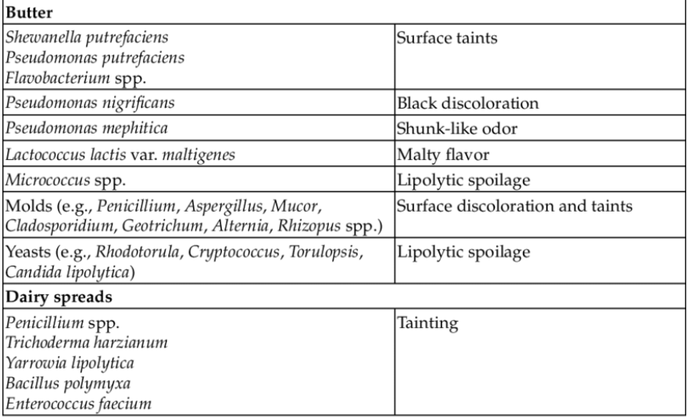
Butter defects

Slide 38
Bacterial Discoloration
Black discoloration (like grease smudge) causative organisms : Ps. nigrificans.
Due to butter stored at low temperature (optimum for pigmentation is 4ºC i.e. 15-20% salt concentration in the moisture droplets.
b) Fungal Discoloration: Butter gets discolored due to surface growth of molds and the defect is also described as moldy butter. This is a major defect commonly occurred in India since the ambient temperature storage condition encourages the growth of Fungi in butter. Fungi growth also favored by higher moisture content and acidity. Some psychotropic molds like Alternaria, Harmodendrum, phoma and stamphylium have been appear to grow in butter ( unsalted) at low temperature (5ºC) slightly growth @ -4º to -6ºC but not @ -7º to -9ºC. Some common fungal discoloration frequently occurred in butter areas follows
Mold discoloration
i. Black Cladosporium, Aspergillus, Hasmodendrum,Alternaria, Mucor, Rhizopus, and Stamphylium
ii. Brown Aspergillus spp, and Phoma spp (muddy brown)
iii. Green & blue green Penicillium spp and Aspergillus app
iv. Orange & yellow Geotrichum candidum
v. Reddish pink Fusarium

Slide 39
Flavour defects of butter
• Butter can taste a bit malty (like “Grape Nuts”), or sour if bacterial had a chance to grow in the milk. The cause is usually due to Streptococcus lactis in poorly cooled milk. Bacterial degradation results from bacteria that get into the milk upon contact with improperly washed or sanitized equipment, from external contamination, and is made worse by improper cooling. Milk is an excellent growth medium for bacteria. It provides the nutrients and moisture and has a near neutral pH. Off- flavors are the results of bacterial growth psychrotrophs).
• Chemical flavors can be cowy (ketosis), rancid, oxidized, sunlight, and medicinal. The cowy or ketone flavor is the result of the animal suffering from ketosis. A foreign flavor can be caused by medications, a reaction to pesticides, disinfectants, or any number of contaminants. Rancidity and oxidation result from the degradation of milk fat. This is the most common. Many of the oxidation pathways are not entirely understood. Salted butter was developed to prevent spoilage, and to mask the taste of rancid butter.

Slide 40
Rancidity
• A sour-bitter taste is identifiable with rancidity (i.e. soapy, baby-vomit, blue cheese). Rancid butter becomes yellow to brown and the flavor becomes harsh. There appears to be a seasonal effect, with the months between July and September having the highest occurrences, and is also caused by stressed cows, and plumbing issued with the processing tanks. Rancidity is caused by a chemical development, which continues until the milk is pasteurized. It often occurs if the membranes around milk fat globules are weakened or broken. When butter becomes rancid, the enzyme lipase breaks it down into glycerol and fatty acids. Hydrolytic rancidity results in the formation of free fatty acids and soaps (salts of free fatty acids) and is caused by either the reaction of lipid and water in the presence of a catalyst or by the action of lipase enzymes. Low levels of free fatty acids are not objectionable if they are sixteen or eighteen carbon fatty acids as commonly found in soybeans, corn or animal fat. However, in butter fat (and coconut oil), low levels of shorter carbon chain fatty acids may be quite objectionable. The worst offender being butyric acid (butanoic acid).

Slide 41
Rancid flavor: -
Butter gets rancid due to microbial, enzymatic or chemical degradation of fat constituents. The fat hydrolysis in butter mainly due to the activity of microbial lipases. Many of the lipolytic microorganisms are psychotropic and are able to grow @ temperature slightly under 0ºC and survive cold storage @ -10ºC. Some of the lipase producing organisms which can grow on butter is as follows.
Bacteria Mold Yeast
Ps. fragi Geotrichism Candidum Candida lypolitica
P. fluorescence Cladosporium butyri Torulopsis spp
P. putida Penicillium spp Rhodotorula spp
Achromobacter lipolyticum Aspergillus spp Saccharomyces fragilis

Slide 42
Oxidised flavour defect • It is more common in milk from the winter and early spring because the cows eat less vitamin E, an antioxidant, in stored forages. It can also be caused by excessive copper or iron in the water supply used to wash equipment or compensate for dirty milking equipment The off-flavor can sometimes be detected in raw milk, but more often is noticed in high fat products such as butter or vanilla ice cream. Oxidative rancidity results from more complex lipid oxidation processes. The processes are generally considered to occur in three phases: an initiation or induction phase, a propagation phase, and a termination phase. In complex systems, the products of each of these phases will increase and decrease over time, making it difficult to quantitatively measure lipid oxidation.
• During the initiation phase, molecular oxygen combines with unsaturated fatty acids to produce hydroperoxides and free radicals, both of which are very reactive. For this phase to occur at any meaningful rate, some type of oxidative initiators must also be present, such as chemical oxidizers, transition metals (i.e., iron or copper), or enzymes (i.e., lipoxygenases). • Heat and light also increase the rate of this and other phases of lipid oxidation. The reactive products of this initiation phase will, in turn, react with additional lipid molecules to form other reactive chemical species. The propagation of further oxidation by lipid oxidation products gives rise to the term "auto-oxidation" that is often used to refer to this process. In the final, termination phase of lipid oxidation, relatively unreactive compounds are formed including hydrocarbons, aldehydes, and ketones.

Slide 43
Putrefactive taint: -
Defect is due to breakdown of proteins by various Putrifactive organisms like Pseudomonas putrefacien, coliform, Flavobacterium maloloris. The chemical compound which produced during the breakdown of protein is closely related to isovaleric acid responsible for off-flavor. The causative organism enter butter through unchlorinated water supplies and equipments (butter churns, Cret vats)
Cheese taints: - Cheese like flavors in butter is due to association action of different gram negative rods shaped bacteria due to butter stored above 10ºC.
Other flavor taints: -
i. Malty flavor: - Attributable to the growth of the organism Streptococcus lactic var. maltigenes in milk or cream. It is often traced to improperly washed and sanitized utensils in which this organism has developed. The formation of 3-methyl butanol in butter mainly responsible for malty flavor.
ii. Shunk-like flavor: - Pseudomonas mephitica
iii. Fishy taint: Pseudomonas ichthyosmia, Geotrichum candidum and Yeasts due to decomposition of lecithin to Trimethyl amine by microbes.

Slide 44
Bitter Attributable to the action of certain microorganisms or enzymes in the cream before churning, certain types of feeds and late lactation. Cooked Associated with using high temperatures in pasteurization of sweet cream. Acid Associated with moderate acid development in the milk or cream, or excessive ripening of the cream.
Musty • Attributable to cream from cows grazing on slough grass, eating musty or moldy feed or drinking stagnant water.
Flat - Attributable to excessive washing of the butter or to a low percentage of fats or volatile acids and other volatile products that help to produce a pleasing butter flavor.

Slide 45
Public Health Importance
Butter is not an ideal medium for the growth of pathogenic or food poisoning organisms due to high fat content, yet it may carry certain pathogen if contaminated during production, handling and packaging. Certain pathogens have been found to remain viable for long periods in butter the possible sources of pathogens in butter may be the cream itself (improperly pasteurized) or the post-pasteurization contamination. Handler in the butter plant is usually the major sources of such organisms in butter. Very few outbreaks of diseases or food poisoning have been reported so far from butter. Staphylococcus aureus and salmonella have been encountered in butter. Butter may, however, serves as a good medium for the growth molds including aflatoxins and other Mycotoxins producers. Such toxins may cause serious health hazards in consumers. The necessity of checking mold contamination and growth in butter.
Food Poisoning Outbreaks
The incidence of documented food poisoning associated with butter is low. This is partially attributed to widespread use of pasteurization at elevated temperatures. Post pasteurization environmental contamination of cream or butter represents the greatest risk to butter contamination and spoilage. Several outbreaks of staphylococcal intoxication related to butter have been reported in the United. In one instance, gastrointestinal illness developed in 24 customers and employees of a department store restaurant and was traced to whipped butter manufactured from whey cream. The same butter used to manufacture the implicated whipped product also resulted in one case of gastroenteritis. This butter contained 10 ng of staphylococcal enterotoxin.

Slide 46
Legal Microbiological Specifications for Cream and Butter
Consumer safety is paramount criteria for any food manufacturer or producer. To ensure the safety to the consumer Food Safety and Standards Authority of India (FSSAI) introduce the Act to monitor the food safety. It assigns the responsibility of food safety to the producer and provides the necessary guideline, some chemical and microbial standards for the products like butter are compulsory and every food manufacturing or dairy product manufacturing organization need to follow these mandatory standards.
Thank You

