Slide 1
\ FORM FILL AND SEAL PACKAGING MACHINES
Dairy Process Engineering (DTE -221)
Dr. J. Badshah, Univ. Prof.,
Dairy Engineering Department
Sanjay Gandhi Institute of Dairy Technology
(Bihar Animal Sciences University, Patna)

Slide 2
Form Fill Seal(FFS) Machine
It is a type of filling equipment that can fill in a flexible packing material. The product should be free flowing type, either liquid or even granular. It may be controlled electro-pneumatically or mechanically. There is option for variation in size and quantity of the product packed.
The process involves certain steps, which will take place cyclically in auto operation.
1. Forming of tube of packing material from film in rolled state
2. Simultaneous operation of filling and sealing
3. Movement of film to form next package
4. Simultaneous separation of filled and sealed packet while filling of next packet.

Slide 3
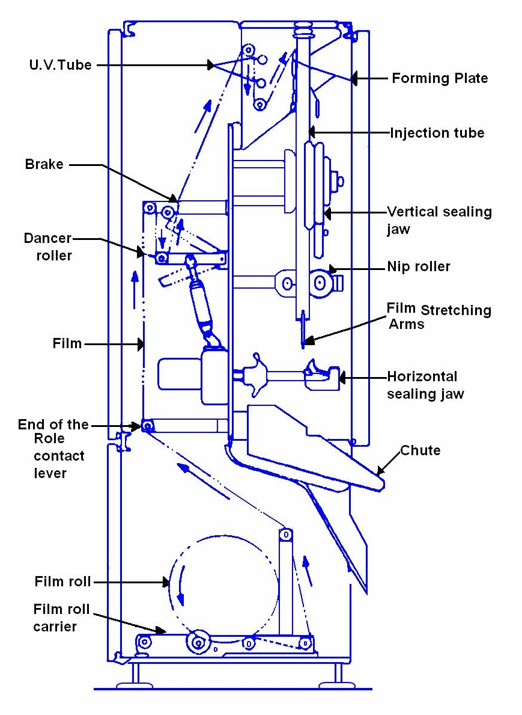
Film Feed Circuit in single head FFS Machine

Slide 4
Working of FFS Machine
The forming plates rolled the flat film in to tube with a certain band of overlap when the film is brought to the front side after passing over UV tube. The Fluid filling pipe is enveloped within the flexible film tube.
When the film tube passes over stationary jaw, the moving jaw of vertical seal supplied with variable voltage in a nichrome rod is engaged such that the heat is generated and allowing only the heat to pass on to the film and partly melting and fusing the vertical joint. The film is supported by Teflon cloth and rubber cushion, as well as protected by Teflon cloth from sealing rod to avoid the electricity passing to film and other parts.
During the period when the current does not pass, when the jaws are disengaged, the cooling water being circulated in the moving jaw, cools it and prevents continuous over heating of the sealing rod.

Slide 5
Working of FFS Machine
There are a pair of nip rollers below the filling tube which gives a holding and pulling down action with a device known as Clutch and Break device operated with clutch and break card in electro-pneumetically operated machine or mechanically in mechanical machine, when the jaws are disengaged, making the film to move to seal the next portion of vertical overlap.
Further lowering down, the film tube is engaged by horizontal jaws, at a sufficiently below the lower edge of fluid filling pipe. This arrangement allows the formation of lower seal of the packet, while the fluid is being filled to a known quantity.
The quantity of flow is controlled by an injection valve operated by a rod which is lifted by a solenoid coil position at the top of machine, just at the feeding line from the over head tank carrying the fluid to be filled.

Slide 6
Working of FFS Machine
When the filling of fluid and the horizontal sealing is complete, the horizontal jaws (as well as vertical jaws) get disengaged, and the nip rollers start rolling to bring the next length of film tube to be filled for next packet.
While the second packet is being filled, the first packet already filled will be getting the horizontal sealing of top portion of the filled packet. When the next time the jaws open, the first packet drops down by its own weight.
The above cycle of operation is repeated when the controls are in automatic operation, while single action takes place when in manual operation during initial adjustment of time and temperature combination for obtaining proper seal.
The jaws are engaged and disengaged with the help of an air operated piston, or in machines by mechanical means. It is divided into two broad categories

Slide 7
Controls in FFS machine
Adjusting the temperature of sealing rod by controlling the electric supply with Rheostat. Adjusting the time of sealing and cooling with sealing and cooling cards in electro-pneumetical controlled machine.
Adjusting the timing for the jaws to be engaged and simultaneously filling operations to take place for a known quantity of fluid with injection card and injection valve
Adjusting the timing for the jaws to be engaged and allow time for movement of film to the required length of package with clutch and break card
The other useful instrumentation are the end of film indicator (gives audio signal).
The equipment will require water for cooling the jaws at a fixed flow rate and of low temperature.
Compressed air (6 kg/cm² ) and free of condensed moisture through filter is required.

Slide 8
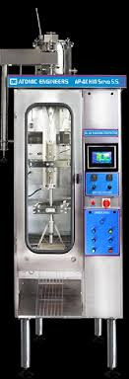
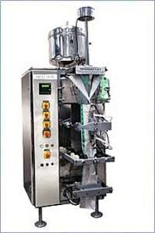
Front View of single Head FFS Machines

Slide 9
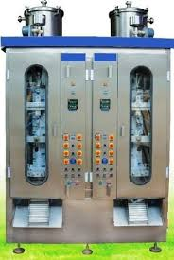
Front View of Double Head FFS Machine

Slide 10
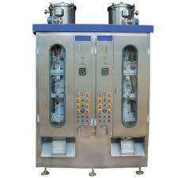
THANK YOU

