Slide 1
Parasitic Gastroenteritis of Ruminants
Dr. Pallav Shekhar
Asstt. Professor
Veterinary Medicine
UNIT-6

Slide 2
Parasitic Gastroenteritis of Ruminants
Nematodes
Trichostrongylus spp.
Ostertegia spp.
PGE
Cooperia sp.
Nematodirus spp
S.I
Abomasum. & S.I

Slide 3
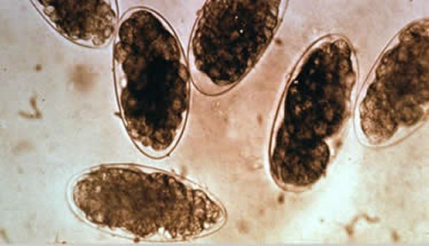
Eggs of PGE nematodes
Ostertagia spp
Trichostrongylus eggs

Slide 4
Life cycle
DIRECT

Slide 5
EPIDEMIOLOGY
Severe outbreak after first rain
Hot and Humid Climate
At very hot temperature, life span of larvae decreases.

Slide 6
Pathogenesis of abomasal infection
Ostertagia
(3rd Larval stage)
Abomasum
Infect Gastric gland
Produce large nodular lesion
Gland become non functional
Reduction of acid secreting parietal cell
Increase in Ph
(Ph of abomasum > 6-7)
Pepsinogen not converted into pepsin
Impairment of protein digestion
Blood gsatric level rises
Increase permeability of epithelial cells
Protein leakage
HYPOPROTEINEMIA

Slide 7
Pathogenesis of Intestinal Infection
Cooperia
Intestine
Acute inflammation
Thickening of Mucosa
Flattening of Villi
Enzyme reduced
Protein & mineral loss
Mal absorption

Slide 8
Clinical findings
Profuse watery diarrhea
Dehydration
Wt . loss
Sub mandibular edema

Slide 9
Clinical Pathology
EPG> 1000
High plasma pepsinogen level
Mild Anaemia
Marked reduction in serum albumin level
Differential Diagnosis
Colibacillosis
Salmonellosis
Viral gastroenteritis like RP, BVD.
Fascioliosis
Amphistomiasis
Coccidiosis
JD

Slide 10
Gross lesion
In Ostertagiosis there will be numerous raised nodules which may be discrete or confluent forming a Morroco Leather appearance of abomasum
Villus atrophy associated with intestinal Trichostrongylus spp. Initially there is acute but later appear as discrete patches like FINGER PRINT IMPRESSION.

Slide 11
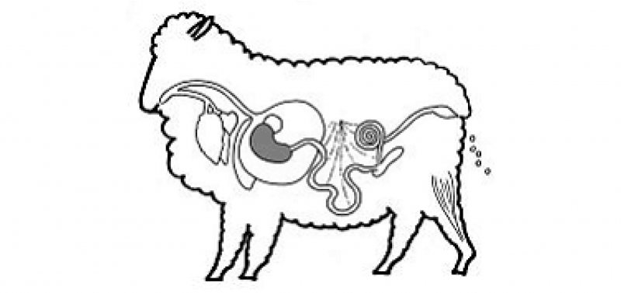
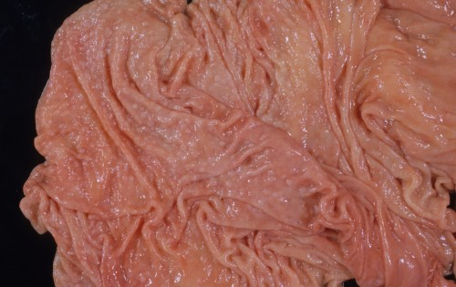
Morroco Leather Appearance of Abomasum

Slide 12
Treatment
Anthelmintics
Benzimidazole @5-10 mg /kg body wt.
Avermectin @ 0.2mg/Kg
Protein and Mineral supplements
Protein diet
Fluid and electrolyte therapy in serious cases
DNS
Imidazothiazoles @ Levamisole @7.5mg/kg b. Wt.
RL
Electrolytes
Mineral supplementation

Slide 13
Control
Rotational grazing
Mixed Grazing
Avoid stress
Proper feces disposal
Keep water and feed at high level from ground
High plane of nutrition and regular rotational deworming

