Slide 1
Pharmaceutical Uses of Abattoir By-Products
Dr. R. K. Jaiswal
Asstt. Prof.-cum-Jr. Scientist
Dept. of Livestock Products Technology
Bihar Veterinary College
Bihar Animal Sciences University
Patna-800014 (Bihar)

Slide 2
Glandular by-products
Animal glands have been used in medicine for their healing powers
Internally secreting, ductless glands called endocrine glands
0.28% of the animal's live weight
Digestive enzymes obtained from GIT and organs
Hormones and enzymes are extracted from animal by-products for pharmaceutical and medicinal purposes

Slide 3
Scope for utilization of glands in India
Collection and utilization of animal glands is neglected in India
Establishment of such a highly beneficial industry in this country should receive national importance
Unprocessed glands were also imported from abroad for the preparation of glandular products in India
Utilization of glands is economically possible only in large cities such as Mumbai, Kolkata, Chennai, Delhi, Hyderabad, Baroda, etc., where large numbers of animals are slaughtered.

Slide 4
Collection of glands
Glands should be collected from healthy animals
Removed within half -an–hour after slaughter
Not removed immediately, the hormones will deteriorate rapidly
Butchers, generally, do not remove the glands immediately : all active principles of the glands are destroyed by autolysis
Glands after removal should not be washed but may be rinsed quickly with cold water
After removal, the gland should be frozen without any delay.

Slide 5
Preservation of glands
Preservation applicable to all glands is freezing within an hour of collection and deliver them in a frozen condition to the pharmaceutical producers
Glands like pancreas, pituitary, thyroid, adrenal, etc., may be preserved by chemical means as for instance by immersing one lbs of gland in 1 lb. of acetone.
After 24 hours the glands must be removed and placed in fresh acetone.
The used acetone is then purified and used again.

Slide 6
In this process, the enzymes are inactivated and thus shelf-life is increased.
Fatty material, which generally interferes with the extraction of most proteins, is also eliminated.
The desired protein from the acetone can be directly extracted with usual solvents. The requirement of solvent is also minimized.
Percent phenol or percent formalin is sometimes used.

Slide 7
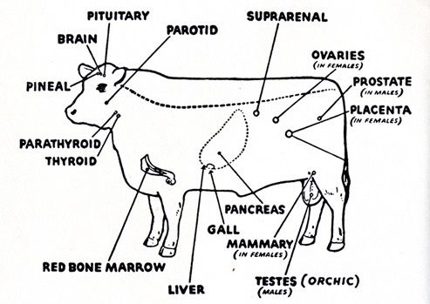
Important glands

Slide 8
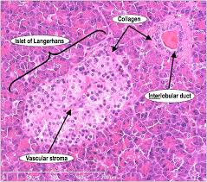
Pancreas
Insulin and other enzymes, which are used by tanneries industry
Mixed type of gland.
Insulin is the main hormone, extracted from the beta-cells with the help of acidified methanol.

Slide 9
One kg of fresh bovine or pig pancreas yields about 150 mg of crystalline insulin with an activity of 254 IU/mg of insulin.
Other biochemicals extracted from pancreas are:
Pancreatin – (Extract of pancreas)
Trypsin
Chymotrypsin
Amylase
Glucagon (alpha-cells)

Slide 10
Insulin production from pancreas

Slide 11
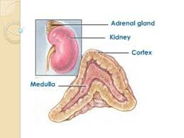
Supra renal or adrenal
This gland is of two parts – outer cortex and inner medulla.
Cortex yields corticosteroids, which are used in the treatment of Edison’s disease, to overcome shock in surgery and as a non-specific treatment.
Medulla of adrenal glands yields adrenaline and nor-adrenaline hormones.
Yield of adrenaline is 0.2% on fresh weight basis and 1% on dry weight basis.
It is extracted in water or alcohol.

Slide 12
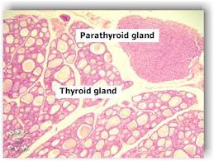
Thyroid and Parathyroid gland
Thyroid glands are two maroon coloured bodies situated on either side of trachea.
Acetone dried powder of this gland is used to extract thyroxine hormone with the help of Barium hydroxide.
Yield of the hormone is 0.08%.
Parathyroid are located near thyroid gland.
Parathromone is extracted from them.
It is used in the prevention of tetany and increase to the rate of calcium excretion.

Slide 13
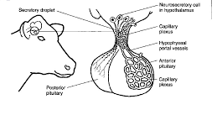
Pituitary gland
Anterior lobe hormones: Growth hormone, FSH, LH, ACTH and MSH
Posterior lobe hormones: Oxytocin & Vasopressin
Oxytocin
This can be extracted in 2 % acetic acid.
It initiates the uterine contraction and also milk-ejecting factor.
Vasopressin

Slide 14
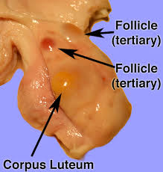
Ovaries
These are collected only from mature animals i.e. those having corpus lutea.
Ovaries are irregular, lobulated in appearance with large follicles projecting like small grapes.
All ovaries with cysts are discarded.
Sex hormones – estrogen and progesterone are extracted from ovaries.

Slide 15
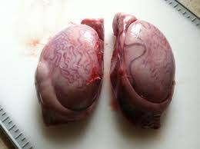
Testes
Also known as Fries/Mountain Oyster
Collected from mature animals that have been passed in antemortem examination and postmortem inspection.
Testosterone, a sex hormone is extracted from testes.
Hyaluronidase enzyme is made from bull or ram testes.
It is a very good spreading factor and used in several drugs to intensify their effect.

Slide 16
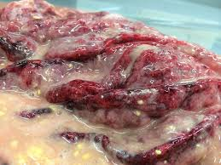
Stomach glands
Rennin or rennet:
Enzyme obtained from the lining of fourth stomach (abomasum) of milkfed calves.
The abomasum is cut out, packed and frozen without any washing.
Pepsin:
This is an enzyme obtained from the mucosal lining of the hog stomach.
Pink-red colour wrinkles and folds distinguish this part of hog stomach.

Slide 17
Situated between the folds.
The hog stomach is cut and the glandular linings are pulled away from the stomach wall and frozen as quickly as possible.
These can be preserved in 1% H2SO4 or the acetone-dried powder of the glands can be stored at room temperature but very low temperature is required during its preparation.
Peptone can be prepared from the remainder part of the hog stomach.

Slide 18
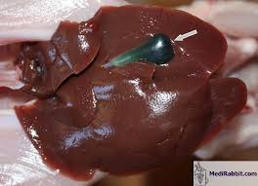
Gall bladder
It is attached to liver and contains bile, a dark golden-greenish viscous fluid of bitter taste.
Bile is slightly alkaline (pH 7.15) and has a specific gravity of 1.025.
It can be used as detergent in slaughter in slaughterhouses by dissolving in warm water (1:5 v/v).
Dried bile has medicinal use as a substitute in secretion deficiencies.
One kg of bile can be obtained from the gall bladder of 6 buffaloes or 55 sheep/goats, stored frozen.

Slide 19
Bile production

Slide 20
Heparin preparation

Slide 21
Liver extract preparation

Slide 22
Future Scope
Increased modernization of slaughterhouse for effective utilization of glandular byproducts.
Many synthetic preparations have been evolved, but products from natural resources are still cheaper.
Efforts are being made to create adequate facilities for the timely collection, immediate freezing and create trained manpower for preliminary processing of these glands in our country.
Various research laboratories are equipping themselves to develop new processes and improve the existing technologies.

