Slide 1
Protein metabolism- 2
Anil Gattani

Slide 2
Oxidative Deamination
Oxidative deamination
Removes the amino group as an ammonium ion from glutamate.
Provides α-ketoglutarate for transamination.
Mainly in liver and kidney
Notes:
2

Slide 3
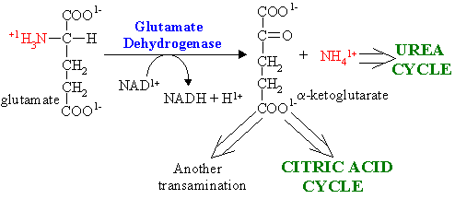
Oxidative Deamination
L-AA oxidase and D-AA oxidase act on L-AA and D-AA respectively and oxidatively removes NH₃ from AA.
Glutamate formed by transamination reactions is deaminated to α-ketoglutarate
Glutamate dehydrogenase - NAD⁺ or NADP⁺ is coenzyme
Other AA oxidases - (liver, kidney) low activity

Slide 4
Glutamate Dehydrogenase catalyzes a major reaction that effects net removal of N from the amino acid pool.
It is one of the few enzymes that can use NAD⁺ or NADP⁺ as e⁻ acceptor.
Oxidation at the α-carbon is followed by hydrolysis, releasing NH₄⁺.

Slide 5
Non Oxidative Deamination
Amino acid dehydratase- act on hydroxy AA (serine, threonine)
require pyridoxal phosphate
Histidase- on Histidine to NH₃ and urocanic acid
Desulfhydratase- on Sulphur containing AA

Slide 6
Summarized above:
The role of transaminases in funneling amino N to glutamate, which is deaminated via Glutamate Dehydrogenase, producing NH₄⁺.

Slide 7
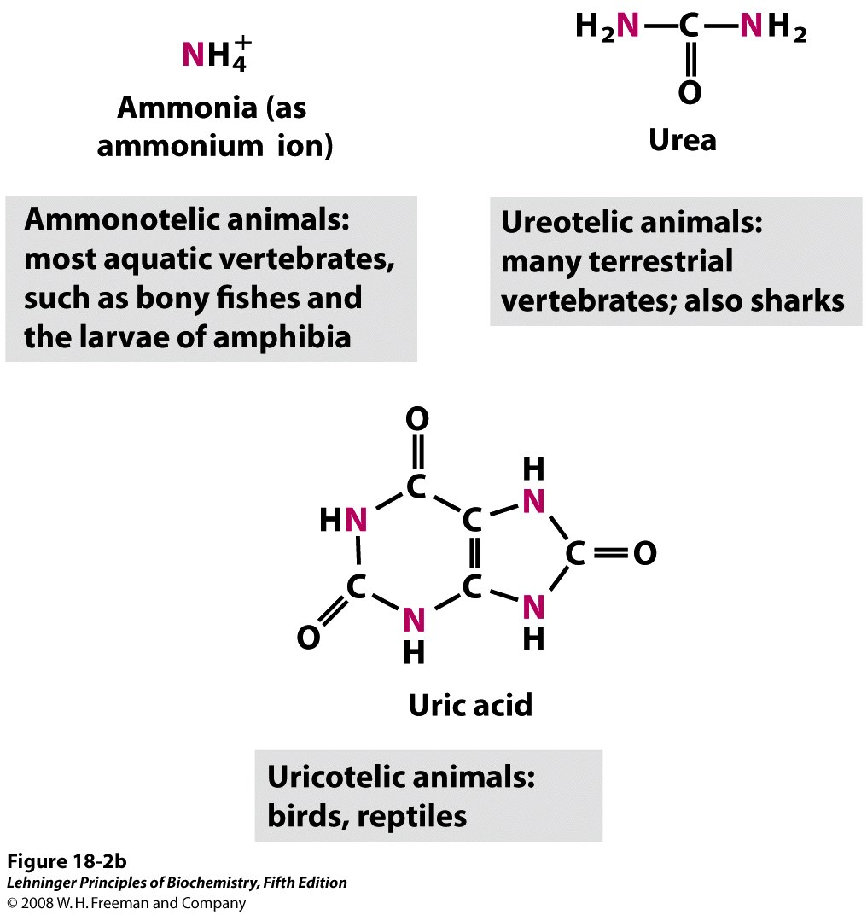
Excretory Forms of Nitrogen

Slide 8
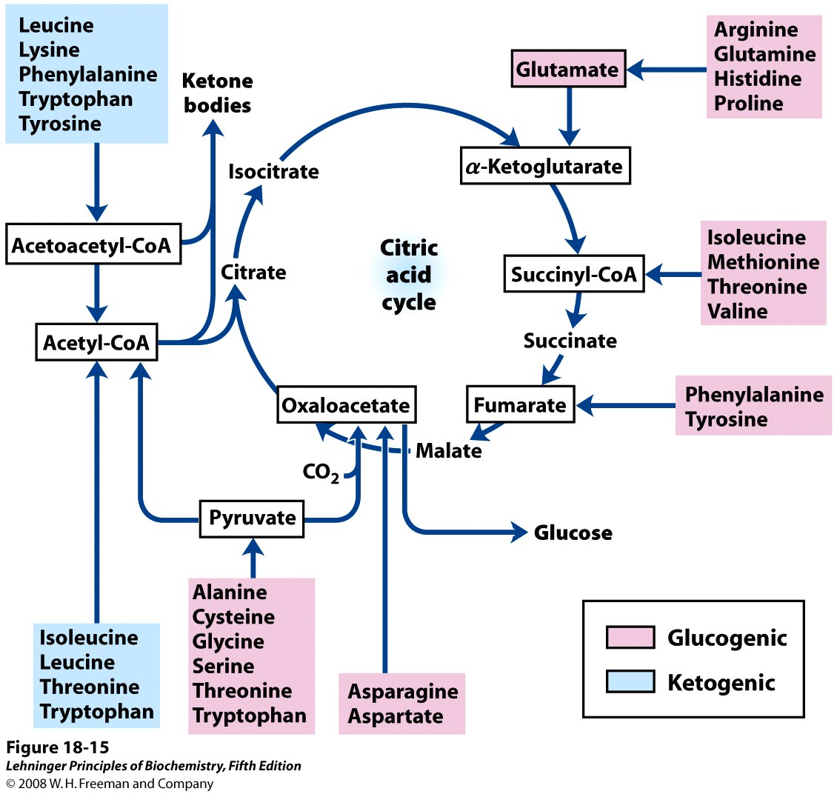
Summary of Amino Acid Catabolism
Notes:
FIGURE 18-15 Summary of amino acid catabolism. Amino acids are grouped according to their major degradative end product. Some amino acids are listed more than once because different parts of their carbon skeletons are degraded to different end products. The figure shows the most important catabolic pathways in vertebrates, but there are minor variations among vertebrate species. Threonine, for instance, is degraded via at least two different pathways (see Figure 18-19, 18-27), and the importance of a given pathway can vary with the organism and its metabolic conditions. The glucogenic and ketogenic amino acids are also delineated in the figure, by color shading. Notice that five of the amino acids are both glucogenic and ketogenic. The amino acids degraded to pyruvate are also potentially ketogenic. Only two amino acids, leucine and lysine, are exclusively ketogenic.
8

Slide 9
NH₃ Trasport
NH₃ is toxic and should be remove
Enhance amination of alpha ketogluterate to glutamate in brain leads to decreased TCA
Enhance glutamine formation from glutamate leads to decreased formation of GABA
Increased outflow of glutamine leads to increased entry of tryptophan result into increased serotonine concentration
Glutamine is osmotically active results cerebral edema

Slide 10
Substrates for the Urea Cycle
Above, amino groups are transferred to glutamate, from which ammonium is produced, and then used to make carbamoyl phosphate.
Below, amino groups are transferred to produce aspartate.
Notes:
This is the way that we get rid of nitrogen, as you recall, from Tuesday, 90% of nitrogen excretion is via urea. Other ways to do it, urea is a way that greatly reduces the amount of water that needs to be also excreted. Fish don’t use urea, have all the water they need. Terrestrial animals use urea as their major mechanism for getting rid of nitrogen. Urea cycle—series of reactions which accept the nitrogens and produce a product, urea. It’s a cycle dedicated to a single product, unlike krebs that produces a number of them. Same category of importance. Two sources of nitrogen are carbamoyl phosphate, via transamination reactions, amino group would get transferred by transamination to alpha ketoglutarate, then glutamate would be oxidatively deaminated to give a reduced product, to give ammonium ion, that’s incorporated into carbamoyl phosphate that’s the substrate. Other substrate for cycle is aspartate. Fist two steps are the same, then gulatmate transfers ammonium ion to oxaloacetate, diverting it out of krebs cycle and into urea cycle ,when there are limited amounts of oxaloacetate.

Slide 11
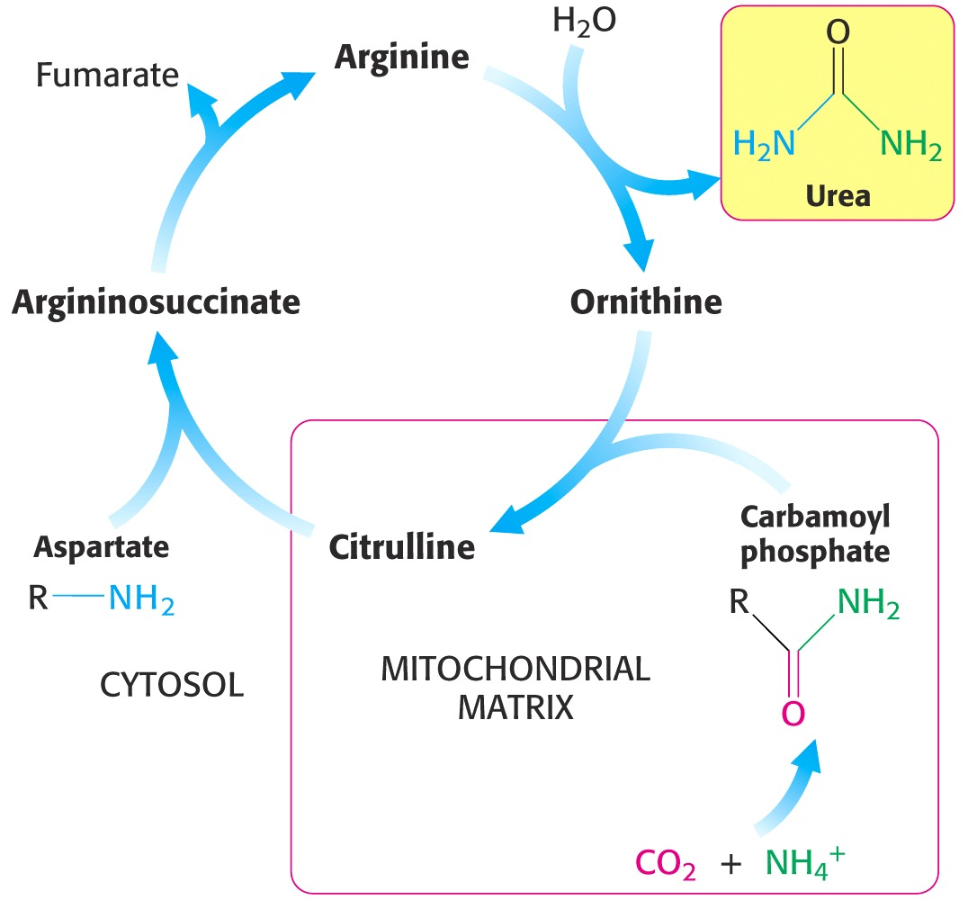
Urea Cycle
Aspartate and carbamoyl phosphate each deliver an amino group to the cycle.
The carbamoyl phosphate production and condensation occur in the mitochondrial matrix.
Fig. 23.16
Notes:
View of cycle, reiterates what was on previous slide, give names of intermediates. Ornithine and Citrulline are new ones. Carbamoyl phosphate production, in this case, remember that glutamate dehydrogenase creates ammonium ion, incorpoared into carbamoyl phosphate, condenses with Ornithine in mitochondrial matrix. Primary location of urea production in humans is in the liver, although it occurs in other tissues as well. Product is Citrulline, its condensed with other source, nitrogen, aspartate, and that gives Argininosuccinate, Fumarate released Arginine gives up urea by hydrolysis. Red box is the matrix, rest of it is in cytosol. Transporter molecules that transport Ornithine from cytosol to matrix and citrulline back to cytosol.

Slide 12
NH₄⁺ from Oxidative Deamination of Glutamate
Hexameric glutamate dehydrogenase is controlled allosterically.
High energy levels inhibit (ATP and GTP).
Low energy levels activate (ADP and GDP).
NADP⁺ can replace NAD⁺.
NH₄⁺ , which is toxic, is produced in the mitochondria and used to make carbamoyl phosphate.
Notes:
The glutamate dehydrogenase reaction. Reversal of reaction that occurs after nitrogen fixation. If we were capturing nitrogen from air. Glutamate is carrier of nitrogen, any other amino acid could contribute it, glutamate dehydrogenase produces NADH, energy rich. Urea is a waste management cycle, to get any energy out of it. Glutamate dehydrogenase is allosteric molecule, hexomeric, three dimers, its controlled allosterically, control is sensitive to energy levels. When you’re low in energy ,catabolize more amino acids, glutamate dehydrogenase is fired up, when you're high in energy, its reduced, amino acids in protein are the last source of energy.. Inhibited by ATP, GTP, activated by ADP and GDP. Straight monitoring by allosteric enzyme of energy levels in the cells represented by the puridine nucleotide triphosphates. NADP or NADPH can be used.

Slide 13
Carbamoyl Phosphate Synthesis
(p. 645)
Carbamoyl phosphate synthetase is in mitochondrial matrix.
NH₄⁺ is source of NH₃.
The hydrolysis of two ATP make this reaction essentially irreversible.
N-acetyl glutamate is an allosteric activator.
Notes:
Here is the carbamoyl phosphate synthesis, occurs in mitochondria. Used for other synthetic pathways also. In this one making urea. As the particular synthetase in mitochondrial matrix, takes bicarbonate, activates it with ATP, this then reacts with ammonium or ammonia to displace phosphate to get Carbamic acid , still bound to enzyme, reactive, this is then further activated at other end, with ATP, and get carbamoyl phosphate, substrate that I talked about, but energy use in this case makes this essentially a irreversible reaction, ADPs produced, occurring in matrix, under normal circumstances those ADP would be rephosphorylated. ADPs would disappear and we’ve got two steps where we are hydrolyzing ATP. N acetyl glutamate is an activator, later lecture, another carbamoyl phosphate synthetase where the N acetyl glutamate binds and has a different role. In this case its an activator

Slide 14
2 ~ P used
1. ARGININOSUCCINATE SYNTHASE 2. ARGININOSUCCINASE
3. ARGINASE 4. ORNITHINE TRANSCARBAMOYLASE
Notes:
Cycle with structures shown. Carbamoyl phosphate, condenses with Ornithine, this occurs in the mitochondrial matrix, Citrulline and other aspartate condensed etc etc. See that the nitrogens are shown in blue as opposed to yellow. Nitrogen from ammonium ion, incorporated into Citrulline, nitrogen from aspartate, two nitrogens covalently bound to carbon, with hydrolysis, elimination of fumarate, this is very close to urea, just need to hydrolyze this portion of molecule off. Given the names of numbers on scheme, names of enzymes please don’t memorize them. You may need to see them to sort something else out.

Slide 15
Connection to Krebs Cycle
Fumarate is oxidized to oxaloacetate by Krebs cycle enzymes, producing NADH.
Oxaloacetate accepts an amino group instead of being condensed with acetyl CoA.
Notes:
Cycle connected to Krebs cycle. Part of Krebs here, fumarate, if you hydrate it, get malate, oxidize it get ocaloaccetate, then that’s converted to aspartate. This part is what I showed you on the first slide where various amino acid are transferred, in time amino groups eventually to make aspartate. Fumarate, malate, and oxaloacetate are members, intermediates of Krebs cycle, oxaloacetate that was going to participate would be condensed with acetyl coA, could go round that cycle to get succinate to fumarate and back around. If both of those things are always occurring, the direction in which, if we think about oxaloacetate, when there is adequate amounts of other Krebs cycle inter mediates, would spend more of its time going through Krebs cycle, when there is enough energy from acetyl coA, oxaloacetate could go to citrate and go to Krebs cycle or if there is real surplus of energy, go out of mitochondria and get used to make palmitate. Schemes are all related.

Slide 16
Amino Acids to Urea
*Glutamate Dehydrogenase is the control site: ADP (+), GDP (+), ATP (-), GTP (-) and NADH (-).
Control at other sites by glucagon (+), cortisol (+), insulin (-), growth hormone (-).
Notes:
Here is all of that on one slide. In center Urea cycle, with four intermediates, producing urea, blue cods for nitrogen. Ultimate source of nitrogen is amino acid transferred to glutamate. The main control point for this scheme is the glutamate dehydrogenase, it responds to nucleotides, ADP GDP ATP GTP and also NADH being an energy rich molecule, signals to this enzyme, slows it down so there is less degradation of amino acids. At other sites, cycle is controlled by the usual cast of characters with regard to hormones and response to higher and lower energy. Glucagon and cortisol activates the sequence, insulin slows it down, growtg hormone—in order to grow, protein is essential, so growth hormone signaling the body to grow saves or initiates events that would reduce the consumption of amino acids.

Slide 17
Argininosuccinase Deficiency
Low dietary protein reduces need for urea cycle.
High dietary arginine provides a path for carbamoyl phosphate and aspartate nitrogens to produce argininosuccinate, which is excreted.
Notes:
For some people, they have inadequate amounts of argininosuccinate, that catalyzes the reaction that’s the number 2 on the cycle. Shows the same cycle that was before, for this individual, this reaction is to slow so you would no produce urea, have backup production of argininosuccinate, wouldn’t matter all that much, but further back up, to carbamoyl phosphate also backed up, get high ammonium ion production. Two things done, one is you reduce the amount of protein in the diet. Mechanisms now for identifying this before birth. Reduce the dietary protein. Their treatment, load diet with arginine. Minimize production of ammonium ion by glutamate dehydrogenase, go through single cycles of urea cycle starting with abundance of arginine. Eliminate serous problems

Slide 18
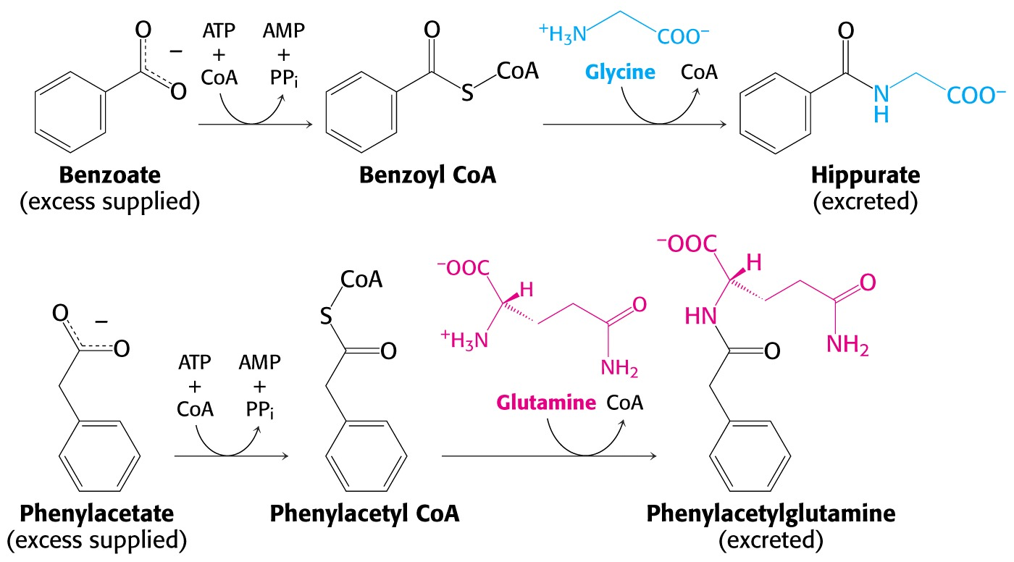
Carbamoyl Phosphate Synthetase Deficiency
Fig. 23.20
Hippurate and phenylacetylglutamine are excreted.
Amino groups to glycine and glutamine by transamination.
Notes:
Another strategy is to put benzoate in the diet. Enzymes that activate it, add coA, act with glycine. Idea hat glycine, can be made from serine etc, ways to channel nitrogens from other amino acids into glycine and get rid of it. Phenyl acetate is also activated with coenzyme A group, glutamine attached, and then that’s excreted.

