Slide 1
Puberty and Breeding patterns in animals
Dr Bhavna
Asstt. Prof.
Deptt. Of VGO

Slide 2
Puberty
An animal has reached puberty when it is able to release gametes (sperms in males and ovum in females) and to manifest complete sexual behaviour.
Age of first appearance of estrus.
At puberty, secondary sexual characters becomes quite conspicuous and animal is able to reproduce.

Slide 3
Reproductive organs increases in size and are able to show external symptoms in one way or other depending upon the species of animal.
Gonads also shows specific or characteristic functions i.e. hormone production and formation of gametes.
Enhanced gonadal functions are stimulated by anterior pituitary gonadotrophins and thus, affecting the reproductive cycle.

Slide 4
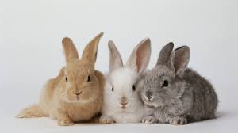
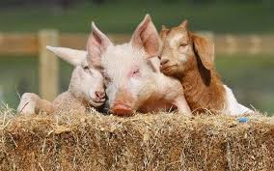
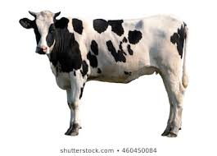
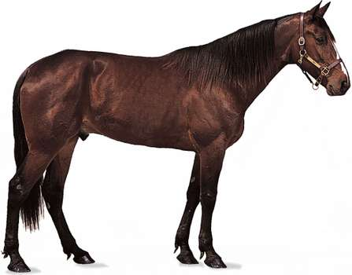
Age at puberty
Rabbits – 3-4 months
Sheep, Goat and Swine – 6-7 months
Cattle – 12 months
Horses – 15-18 months

Slide 5
Why the age at puberty is important?
Early conception
Early lactation/production
Increased lifetime reproductive rate

Slide 6
Factors affecting puberty
1. Breed
2. Climatic conditions
3. Season
4. Sex of animal
5. Level of nutrition
6. Management

Slide 7
Breed and genetic makeup
Generally species of smaller size experience puberty at early age as compared to species of larger size.
Genetic makeup do affects the age of puberty, particularly in exotic breed animals.
Zebu cattle generally comes in estrus at later stage as compared to exotic and crossbred animals.

Slide 8
Climatic factors
Climatic conditions like temperature, relative humidity, day length etc affects the age of puberty in all species.
Puberty in tropics occurs generally earlier as compared to animals which live in cold conditions.

Slide 9
Season
There are seasonal variations in some species of animals with respect to occurrence of puberty and reproductive cycle.
Short day breeders shows estrous when day length is short (winter) where as other species are long day breeders (summer).

Slide 10
Sex of animal
Generally, females of all species of animals show puberty earlier as compared to their male counterparts.
Gonadal as well as anterior hypophysis hormones are comparatively more active in females as compared to the males of same age.

Slide 11
Level of nutrition
Animals maintained on high plane of nutrition show puberty at early age as compared to poorly fed animals.
Imbalanced ration can affect the reproductive cycle in both males as well as females resulting in loss of reproductive cycle, thus delayed puberty.

Slide 12
Management
Maintenance/up keep of animals, feeding etc.
Detection of estrus at proper time.
* Lack of proper estrus detection in animals will result in great financial loss.

Slide 13
Breeding patterns in animals

Slide 14
Reproductive pattern of animals varies greatly in their natural habitat as compared to highly accustomed and protected environment.
Under domestic environment, tends toward a pattern which causes the young one to be delivered at the time of year, when temperature and feed availability is optimum.

Slide 15
Breeding Season
All females show seasonal cyclic changes in the ovarian activity but the degree of ovarian activity or inactivity is influenced by many factors like day length, environmental temperature, nutrition, presence of male etc.

Slide 16
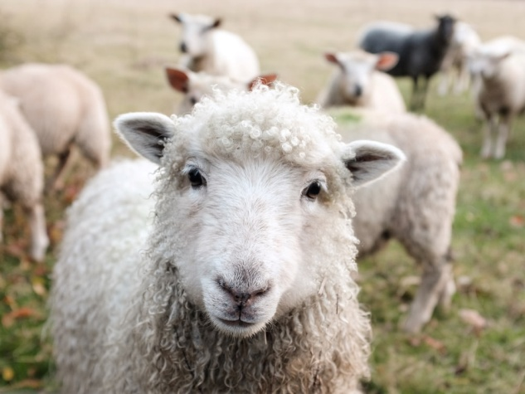
Deliver young ones at the optimum time of year
Seasonally polyestrous, breeding season length is such that young ones are born in spring.

Slide 17
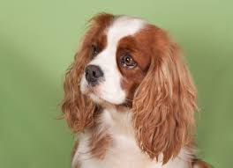
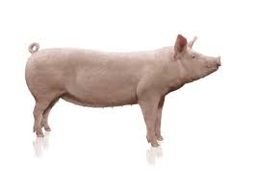
Seasonally monoestrous
Estrus occurs regularly throughout the year.
Seasonality is discrete.
In cattle, minimal fertility occurs in June and maximum in November.
In sow, fertility is lower in summer and also, the litter size is smaller.

Slide 18
The influences of season, feed supply and other environmental factors on reproductive pattern of animals are more pronounced in females.
There is quiescence/inactivity of male gonads and sometimes leading to cessation of spermatogenesis and also gonadal hormonal production.
Wild animals show a marked breeding seasonal activity and have a quite prominent breeding activity during such period, often called as rutting.

Slide 19
Silent ovulatory cycles always occur at the beginning as well as end of the breeding season.
Goats have a very well defined sexual season in temperate climates.

Slide 20
Important modulators of breeding season
1. Light
2. Temperature
3. Feed supply
4. Psychological factors

Slide 21
Light (Photoperiodism)
Seen mostly in short (sheep) and long (mare) day breeders.
In northern hemisphere of USA, ewes breed in the fall months such as September to November and five months later delivers the lamb in spring season.
If these ewes are transported to southern hemisphere, most of these will reverse their breeding pattern and start breeding during March to April.

Slide 22
Artificial manipulation of light in a closed environment will cause the ewes to breed when the length of day light hours are declining.
Birds and mares respond to lengthening of day light hours.

Slide 23
Mechanism of photoperiodism
Light stimulus
↓
Retina
↓Optic nerves
Hypothalamus in CNS
↓
GnRH
↓
Anterior pituitary
↓
Gonads

Slide 24
Temperature
Less clear than light.
Plays a major role in the regulation of sexual function in lower vertebrates, particularly reptiles.
Protection of ewes from higher summer temperature favours an early onset of breeding season.
Sperm output, sperm motility and farrowing rate are severely lowered when boars are submitted to summer temperatures (35°C).

Slide 25
Feed supply
An enhanced diet increases vigour particularly in herbivorous and omnivorous animals.
Ovaries show increased activity regardless of state of reproduction.
Monotoccous species (cow and mare) experience same ovarian response but the polytoccous species (sow) respond to increased nutrient intake by shedding more ova.
* Flushing (providing increased quantity and good quality of nutrients) litter size can be increases the chances of twinning and triplets.

Slide 26
Psychological factors
Closely related.
Male may refuse to copulate in an unnatural environment
New environment often increases its reproductive potential.
Addition of a ram to a flock of ewes in the late summer will hasten the onset of breeding by several days.
Recorded voice of boar is found to be quite effective in sows.

Slide 27
Based on breeding season and ovulation pattern
Spontaneous ovulators
Seasonal breeders
Non-seasonal breeders
Polyestrous
Eg. Mare, Ass (spring)
Ewe, Goat (onset of winter)
Monoestrous
Eg. Bitch
Continuous breeeders
Eg. Cow, Sow, Guinea pig, Monkey, Rat

Slide 28
Induced ovulators
Seasonal breeders
Non-seasonal breeders
Eg. Cat, Ferret and wild rabbit
Eg. Lab rabbit

