Slide 1
Class Lecture
RENNET SUBSTITUTES
Dr. Sanjeev Kumar
Associate Professor
Department of Dairy Technology
SGIDT, Patna-14

Slide 2
MILK-CLOTTING ENZYMES FROM PLANTS :
PAPAIN
Latex of the plant Carica papaya yields papain and several other proteases
Powerful milk clotting activity
Highly proteolytic
FICIN
Cheese made with Ficin develops bitter flavor ------ decreases in intensity during curing
OTHERS
Bromelain from pineapple---considered as a possible substitute for calf rennet
Used in the manufacture of Surati and Cheddar cheese

Slide 3
4. MICROBIAL RENNET
Milk clotting enzymes from bacteria like
Streptococcus liquefaciens,
Micrococcus caseolyticus,
Bacillus cereus,
B. polymyxa,
B. mesentericus,
B. coagulans
and
B. subtilis
-------------------------used as coagulating enzymes.

Slide 4
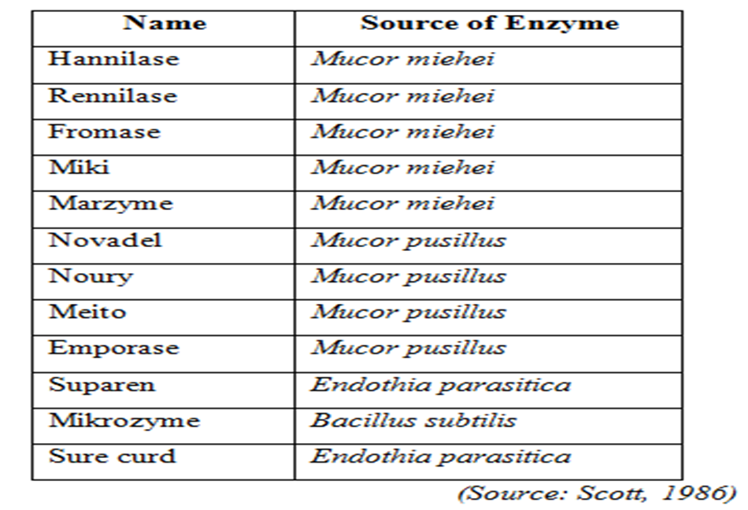
MICO-ORGANISMS USED IN COMMERCIAL PRODUCTION OF MICROBIAL RENNET

Slide 5
RECOMBINANT CHYMOSIN
Recombinant rennet/chymosin----- prepared by gene transfer technology
Enzyme can be isolated and used in cheese
making as a coagulant
Properties similar to that of calf rennet
Escherichia coli, Kluyveromyces lactis
and
A. niger var. awamori ------successfully used for production of calf rennet.

Slide 6
Advantages
Speciﬁc
Low proteolytic activity---- reduces the
chances of Bitterness in Cheese.
Properties similar to that of calf rennet--- quality
cheese production
Predictable coagulation behavior
Vegetarian approval

