Slide 1
REPRODUCTION OF FUNGI
Dr Manoj KUmar

Slide 2
TYPES OF FUNGAL REPRODUCTION
Fungi reproduce by three methods:
    A. Vegetative
    B. Asexual
    C. Sexual

Slide 3
VEGETATIVE REPRODUCTION
Inputs
Fragmentation
Outputs
Vegetative growth
Fission
New mycelium
Budding
New mycelium
Chlamydospores
New mycelium
Oidia
Rhizomorphs

Slide 4
Fragmentation
Text Title Here.
Edit Text Title.
Accidental severing of the mycelium into bits or fragments or by mechanical injuries
Mycelium breaks into segments of hyphae
Detachment
Segmentation
Vegetative reproduction
Apical growth develops into a new mycelium under favorable conditions.
New Mycelium
Division of cells
Each segment by further division of cells

Slide 5
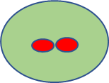
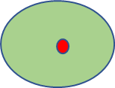
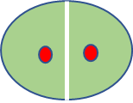
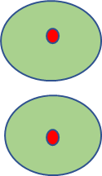
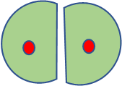
Fission
Text Title Here.
Edit Text Title.
First, the nucleus divides, followed by
the division of the cytoplasm and wall formation
Parent cell
Elongates and divides transversely into two daughter cells
Vegetative reproduction
Daughter cells separate and lead independent lives
Parent cell divides into two.

Slide 6
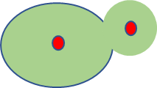
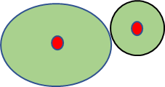
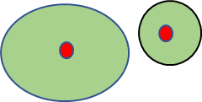
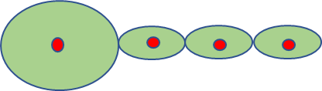
Budding
Text Title Here.
Edit Text Title.
Bud gradually enlarges and finally gets separated from
The parent cell by a cross wall
Parent cell generate
Small outgrowth, bud
Vegetative reproduction
Sometimes the bud
before separation from the parent cell may produce a new bud and in this way a chain of buds
may be produced
Daughter cell develops into new individual yeast.

Slide 7
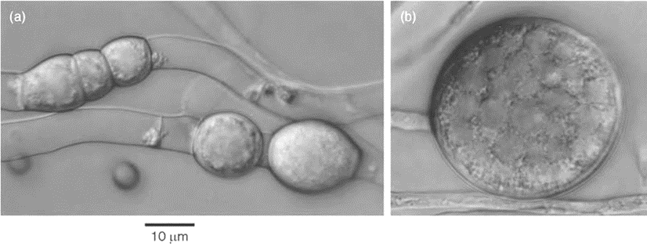
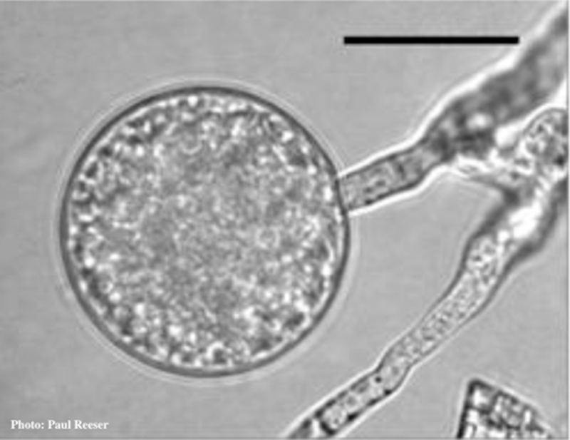
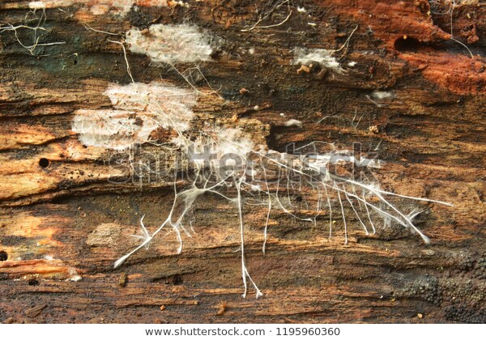
Chlamydospores
Many fungi forms banana-shaped macroconidia, smaller microconidia, and thick-walled chlamydospores
Text Title Here.
Edit Text Title.
chlamydospores develop thick,
resistant walls and accumulate food materials and thus help the fungus to tide over unfavorable
conditions.
Formed either singly or in chains in the vegetative hyphae
Vegetative reproduction
With the return of favorable conditions each chlamydospores develops into a new
mycelium..
Remains dormant till favourable conditions returns..

Slide 8
Oidia or arthrospore
Text Title Here.
Edit Text Title.
Fission of oidial cells
Into oidia. Note that each oidial cell
Oidiophores sprouted out from hyphae
Vegetative reproduction
Oidia or
Arthrospores detach from parent cell
.
Formations of a group of oidial cells in tandem.

Slide 9
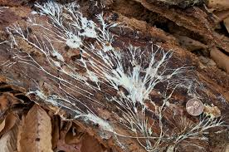
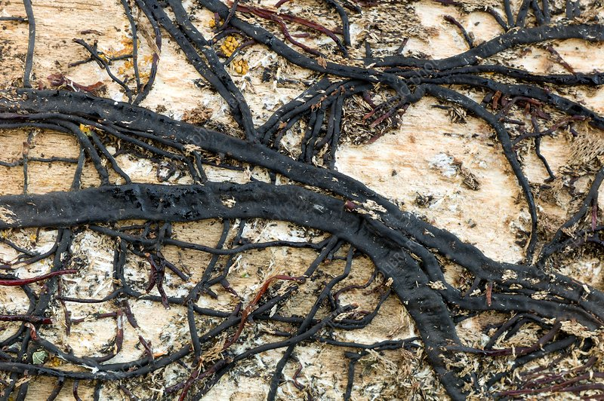
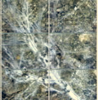
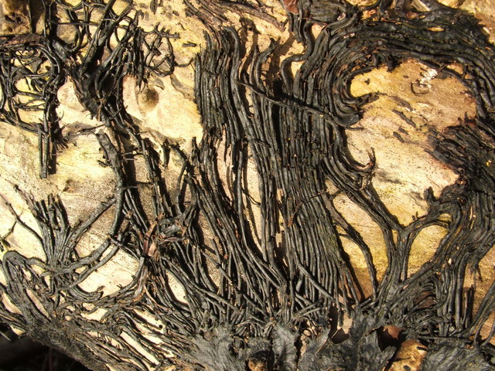
Rhizomorphs
Text Title Here.
Edit Text Title.
In some higher fungi, hyphae may become interwoven to form rope-like structures called rhizomorphs
Rhizomorphs serve as a means of
Perennation
Vegetative reproduction
Under favourable conditions, they resume growth to give rise to new mycelia.
Oidia or
Arthrospores detach from parent cell
.

Slide 10
Asexual reproduction
Asexual spores are formed after mitosis (mitospores) without the involvement of meiosis.
Fungi produce an enormous variety of asexual spores.
Fungi reproduce by three asexual methods:
The asexual reproduction in fungi occurs by producing :
    1. Sporangiospores
    2. Zoospores
    3. Conidiophores

Slide 11
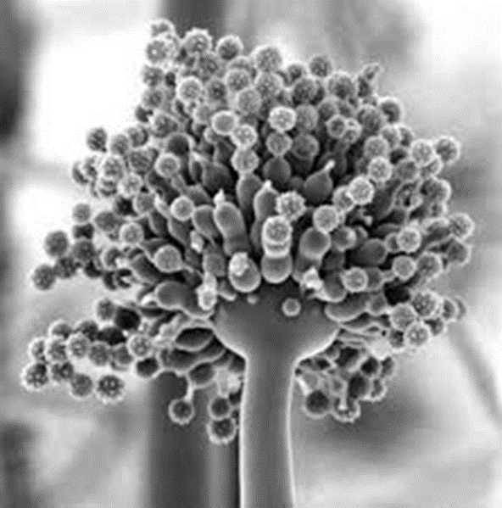
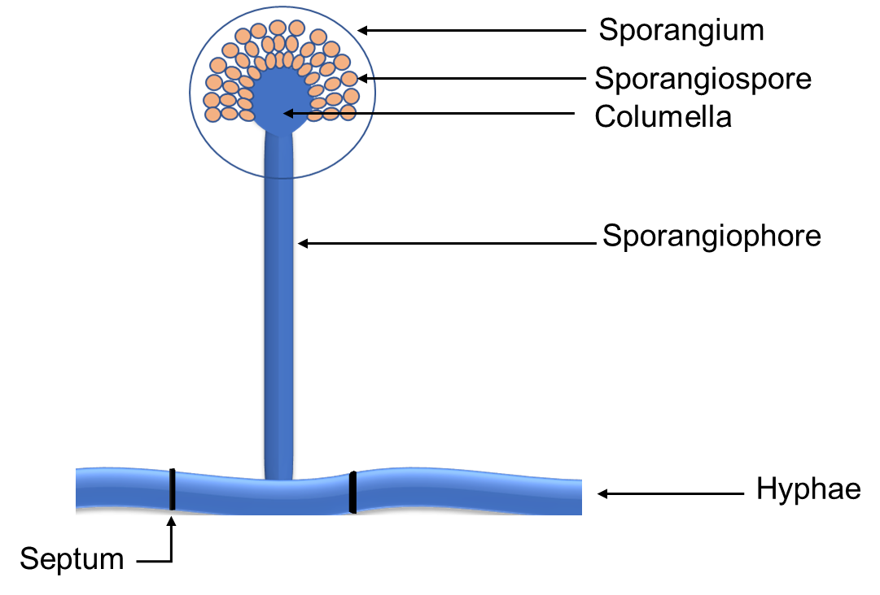
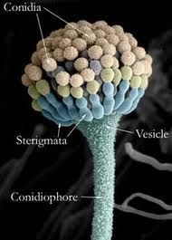
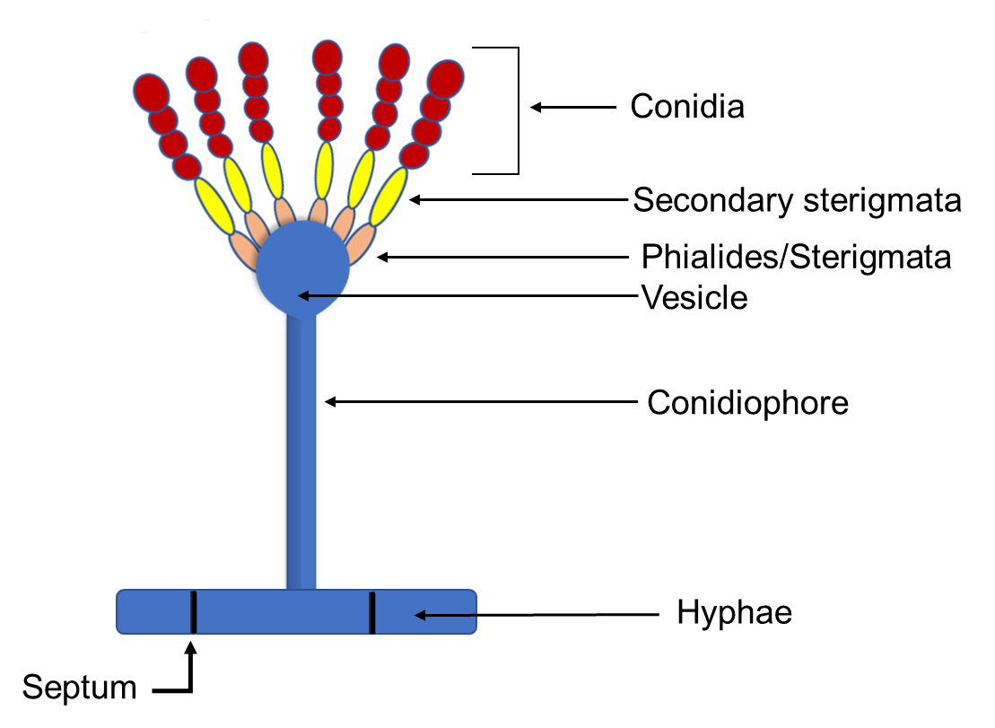
Asexual reproduction (Sporangiospores)
Sporangiospores are formed endogenously in a sporangium via cytoplasmic cleavage in the zygomycetes.
Fungi reproduce by three methods:
The asexual reproduction in fungi occurs by producing
sporangiospores produced inside a sac-like structure - sporangium.
hypha bearing a sporangium - sporangiophore., characteristically branched.
sporangiospores - motile or non-motile.
Non motile spores - conidium
characteristic feature of terrestrial species - Mucor and Rhizopus.
In contrast to zoospores, the aplanospores have a definite spore wall and are dispersed by wind and insects.

Slide 12
Asexual reproduction (Zoospores)
Division Oomycota motile biflagellate sporangiospores are produced.
These are called zoospores and the sporangium bearing them is called zoosporangium.
A zoospore is a motile spore lacking a cell wall.
After a swarming period it secretes a wall and germinates to form a germ tube.

Slide 13
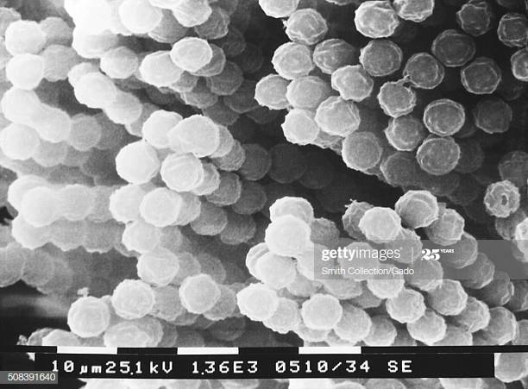
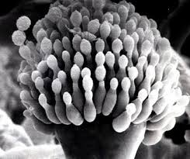
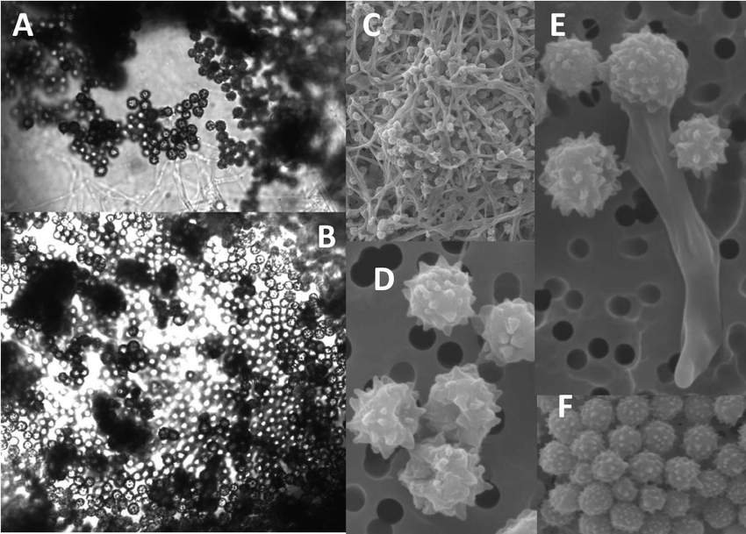
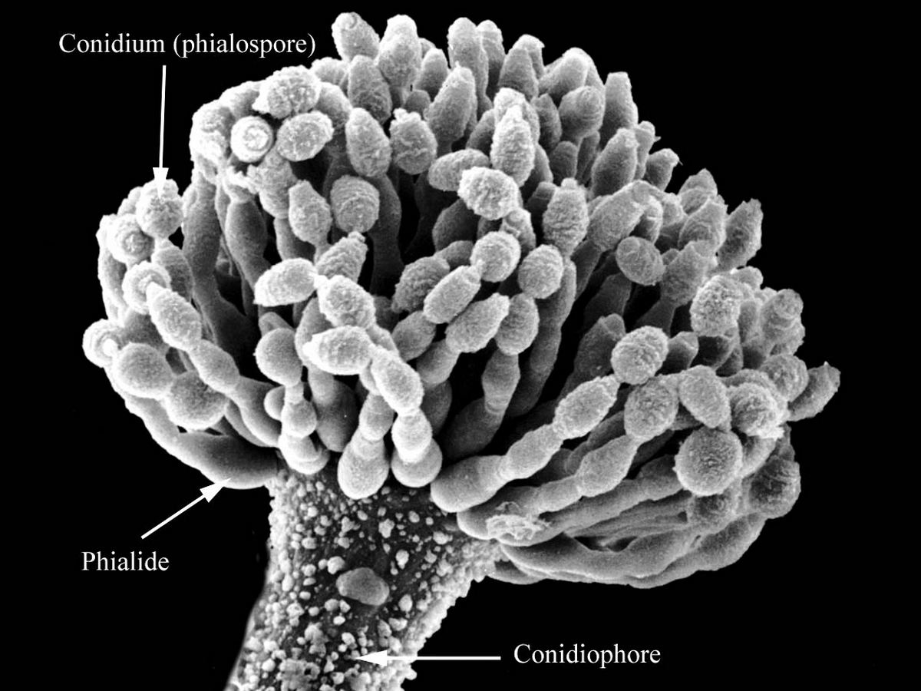
Conidiospores
conidia are non-motile, deciduous mitospores
formed externally as single separate cells.
develop either directly on the mycelium or on morphologically differentiated hyphae called conidiophores.
The conidiophores may be simple or branched, septate or aseptate.
The conidia are produced singly or in chains at the tips of the conidiophores e.g. Aspergillus or at the tips of their branches e.g., Penicillium.

Slide 14
Cell cycle of yeast (hyphae formation)
Hyphae formation of yeast cell
Unbudded yeast cell
Emergence of Hyphal germ tubes, hyphal germ tubes are narrower and more uniform than
hyphae having parallel-sided walls with no constrictions or branches
Mature hyphal mycelia

Slide 15
Thanks

