Slide 1
Rotameter and its Analysis
Dr. J. Badshah
University Professor – cum - Chief Scientist
Dairy Engineering Department
Sanjay Gandhi Institute of Dairy Science & Technology, Jagdeopath, Patna
(Bihar Animal Sciences University, Patna)

Slide 2
Advantages and Disadvantages of Rotameters
Advantages
No external power needed
Simple Reliable Design
Can Measure Liquid or Gas Flows
Scale is approximately linear
It can measure flow rates of corrosive fluid
Better range ability and suitable for transient flow rate also
Low cost and low pressure drop
Disadvantages
It should be mounted vertically
And requires lining mounting
Uncertainty of measurement
Difficult to handle the glass type
Accurate calibration for fluids to be measured

Slide 3
Principles and Working of Rotameter
It consist of tapered metering glass tube inside of which is located a rotor or active element (float). The float has higher specific gravity than that of fluid with tendency of moving down ward but the drag force of fluid in upward direction goes on decreasing due to variable increasing area of tube. The tube is provided a suitable inlet and outlet connection.
Fluid flow moves the float upward against gravity. At some point, the flowing area reaches a point where the pressure-induced force on the floating body exactly matches the weight of the float. The float will find equilibrium when the area around float generates enough drag equal to weight – buoyancy keeping the pressure difference remains constant.
As the float weight and gravity are constant, the distance float displaced upward is proportional to the flow velocity of the fluid passing through the tapered tube., which can be calibrated in terms of flow rates.

Slide 4
Analysis of Discharge in Rotameters
The float reaches a stable position in the tube when the upward force exerted by the flowing fluid equals the downward gravitational force exerted by the weight of the float.
A change in flow rate upsets this balance of forces. The float then moves up or down, changing the annular area until it again reaches a position where the forces are in equilibrium as :
Drag Force = Effective weight of float or bob
C_{d} A_{b} ℓ_{f} (v_{m} )² /2 = V_{b} g ℓ_{b} - V_{b} g ℓ_{f}
Therefore, v_{m} = [2g V_{b} / C_{d} A_{b} ] [(ℓ_{b} - ℓ_{f} )/ ℓ_{f} ]
Discharge Q = A . V_{m} , where A = π/4[(D +ay)² - d²)]
Where, Q = Discharge, C_{d} = Discharge coefficient, ρ_{f} = Density of fluid, ρ_{b} = Density of float, A_{b} = Maximum cross sectional area of float, A = annular area between float & tube and V_{m} = Mean Velocity of fluid through annular space, D = diameter of the pipe inlet, d =diameter of float or bob and a = constant or tapering gradient

Slide 5
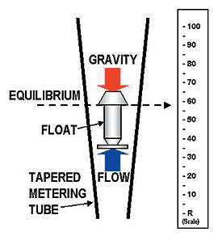
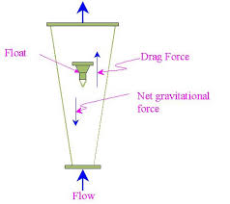
Rotameter in working

Slide 6
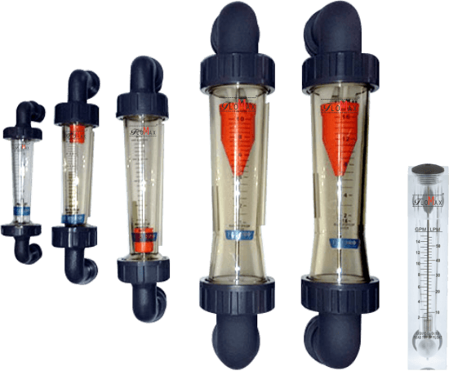
Rotameters of varying sizes

Slide 7
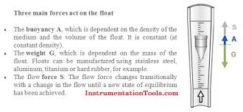
Working of Rotameter

Slide 8
Types of Rotameters
Glass tube Rotameters
Borosilicate glass and stainless steel float
Not suited are those which attack glass metering tubes, such as water over 90°C (194°F)
Metal Tube Rotameters
For Metal tube rotameter higher pressures and temperatures beyond the practical range of glass tubes, metal tubes are used.
These are usually manufactured in aluminium, brass or stainless steel.
Plastic Tube Rotameters
Plastic tubes are also used in some rotameter designs due to their lower cost and high impact strength.
They are typically constructed of polycarbonate, with either metal or plastic end fittings.

Slide 9
THANK YOU

