Slide 1
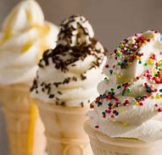
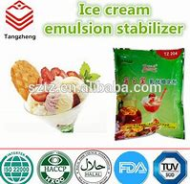
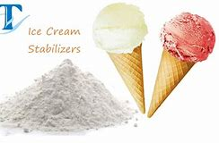
STABILIZERS
Dairy Technology
B.K.Singh,Dairy Technology

Slide 2
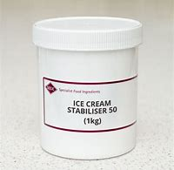
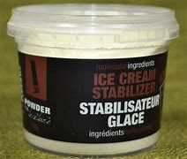
Stabilizers are a group of water-soluble or water-dispersible biopolymers used in small amounts (typically 0.2%) in ice cream, sorbets, water ices and other foods.

Slide 3
Role of Stabilizers in Ice Cream
To increase the viscosity of the mix.
To stabilize the mix i.e. to prevent wheying off
To help in suspension of flavouring particles.
To produce a stable foam with desired stiffness at the time of packaging
To reduce or slow down the growth of lactose crystals during storage mainly during temperature fluctuations.
To reduce moisture migration from the product to the package or the air
To help prevent shrinkage of the product volume during storage.
To provide uniformity to the product and resistance to melting.
To produce smoothness in texture during consumption.
Reduce the rate of meltdown (i.e. the rate at which ice cream melts).
Prevent shrinkage and slow down moisture migration out of ice.
Mask the detection of ice crystals in the mouth during eating.
Allow easier pumping and more accurate filling during processing.
Facilitate the controlled in corporation of air in the freezer.

Slide 4
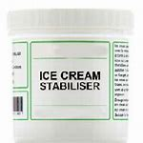
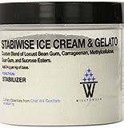
Classification of stabilizers
Proteins- Gelatin
Plantexudates – Arabic, ghatti, karaya and tragacanth gums
Seed gums – Locust ( carob) bean, guar, psyllium, starch and modified starches
Microbialgums – Xanthan
Seaweed extracts – agar, alginates, carageena
Pectins– low and high methoxyl
Cellulose– sodium carboxymethyl cellulose, microcrystalline cellulose, methyl and methylethyl cellulose, hydroxypropyl and hydroxypropylmethyl cellulose.

Slide 5
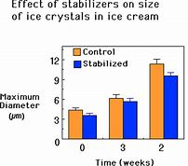
Properties of individual stabilizer ingredients
Sodium Alginate
Alginates are produced from the processing of brown seaweed, typically Macrocystis pyrefera. The algin found in kelp is present as a mixed salt (sodium and/or potassium, calcium, magnesium) with alginic acid. Through processing, the water-insoluble alginic acid is extracted and various water-soluble alginates can be produced. The most commercially utilized of the alginates is Sodium Alginate. Its ability to react with a divalent or trivalent metal ion (most commonly Calcium) to create a chemically set, irreversible gel has proved to be useful in many food applications.

Slide 6
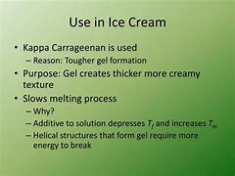
carrageenan

Slide 7
Locust Bean Gum

Slide 8
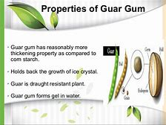
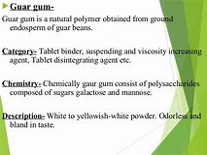
Guar Gum

Slide 9
Pectin
Pectin can be used as a thickener, stabilizer, emulsifier. It is a white, light yellow, light gray or light brown powder, slightly specific smell, insoluble in ethanol and other organic solvents. The methoxyl is higher than 7%, it is called high methoxyl pectin, or it is low-methoxyl pectin. The higher methoxyl content, the stronger the gel. Only when the sugar content is greater than the 60%,PH 2.6--3.4, high methoxyl pectin has the ability to gel; as long as there is a polyvalent metal ions, such as calcium, magnesium and aluminum plasma, low-methoxyl pectin can form gels.
Typical levels of pectin in fresh fruits vegetables are:
Apples, 1–1.5%
Apricots, 1%
Cherries, 0.4%
Oranges, 0.5–3.5%
Carrots 1.4%
Citrus peels, 30%
Rose hips, 15%

Slide 10
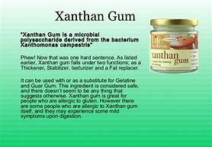
Xanthan gum

Slide 11
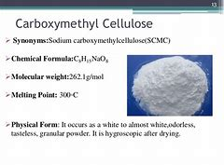
Sodium Carboxymethyl Cellulose

Slide 12
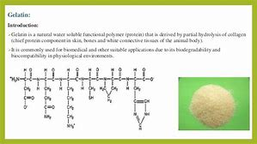
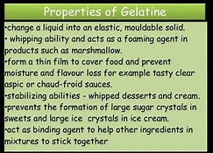
Gelatin

Slide 13
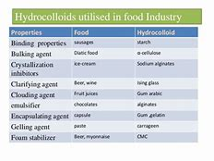
Other hydrocolloids

Slide 14
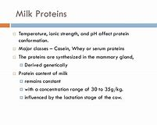
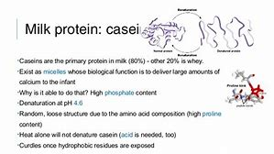
Milk proteins

