Slide 1
STRUCTURE AND COMPOSITION OF EGGS
Dr. S. P. Sahu
Department of LPM
Bihar Veterinary College, Patna- 800 014
Email: spsahuj@rediffmail.com

Slide 2
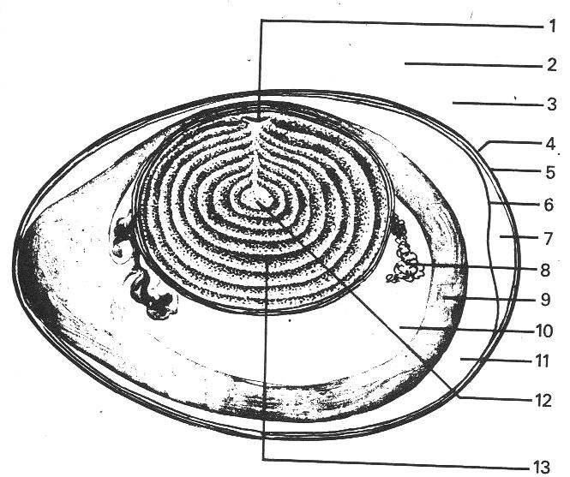
Structure of an Egg
1. Germinal Disc 2. Vitelline Membrane 3. Chalaziferous of White 4. Shell 5. Outer Shell Membrane 6. Inner Shell Membrane 7. Air Cell 8. Chalaza 9. Dense White 10. Inner Thin White 11. Outer Thin White 12. White Yolk 13. Yellow Yolk

Slide 3
Shell
The shell of an egg is porous to allow the developing chick to obtain oxygen.
The pores also allow water and carbon dioxide to escape.
Other than oxygen, bacteria and odours can enter the egg.
The membrane that lines the inside of a shell acts as a filter to protect against bacteria.
At one end of the egg, the membrane separates into an air space to supply the chick with oxygen.
The shell is generally strong but the older birds tend to produce weaker shells.
The shell’s colour varies according to the breed of the bird.

Slide 4
Egg white
There are two layers of egg white:
1. The thick white layer (nearest to the yolk)
2. The thin white layer (nearest to the shell)
Yolk
The colour of the egg yolk is related to the diet of the hen and is due to the presence of carotenes and colourings added to a hen’s feed.
The nutritional value of the egg is not affected by the colour of the yolk.
Eggs are a good source of high biological-value protein and easily digested.
88.5% of an egg is edible.

Slide 5
Composition of egg of various birds
S. No. | Birds | Egg weight (g) | Yolk (%) | Albumin (%) | Shell (%)
1. | Chicken | 50 | 31 | 58 | 11
2. | Quail | 10 | 32 | 48 | 20
3. | Turkey | 65 | 32 | 56 | 12
4. | Duck | 72 | 35 | 53 | 12
5. | Pigeon | 18 | 18 | 74 | 8

Slide 6
Nutritional value of egg
The nutritional content of egg white is:
■ 10.5% protein
■ 88.5% water
■ riboflavin and other B vitamins
■ a trace of fat.
The nutritional content of egg yolk is:
■ 16.5% protein
■ 33% fat
■ 50% water
■ fat-soluble vitamins A, D, E and K
■ mineral elements, including iron
■ lecithin (an emulsifier).

Slide 7
Nutrient composition (%) of chicken egg
S. No. | Nutrients | Whole egg | Yolk | Albumin | Shell & Membranes
1. | Major components | - | 31 | 58 | 11
2. | Water | 65 | 48 | 84 | 2
3. | Protein | 12 | 17.5 | 11 | -
4. | Fat | 11 | 32.5 | 0.2 | -
5. | Carbohydrate | 01 | 01.0 | 1 | -
6. | Ash | 11 | 1 | 0.8 | 93.5

Slide 8
Sizing of eggs: Chicken eggs are graded by size for the purpose of sales. Very large: 73 g and over, Large: 63-73 g, Medium: 53-63 g and Small: 53 g and under.
Use of Eggs:
Thickening. To thicken custards, sauces, soups, etc., because of the coagulation of the egg proteins.
Emulsifying. Egg yolk contains lecithin, which is an emulsifier and enables oil and water to be mixed without separating. It is used in making mayonnaise and cakes.
Binding. Ingredients for rissoles, croquettes, and meat or fish cakes can be bound together with egg.
Coating. Coating for fried foods because they form a protective layer on the outside of the food.
Glazing. Egg yolk, egg white or whole egg is brushed over pastries and bread to produce a golden brown shiny glaze during baking.

Slide 9
Composition of Chicken, duck and Quail meat
S. No. | Nutrient | Chicken meat | Quail meat | Duck meat
1. | Water | 66.00 | 62.65 | 53.88
2. | Protein | 20.20 | 26.00 | 13.48
3. | Fat | 12.60 | 03.30 | 19.68
4. | Minerals | 01.20 | 03.20 | 2.74
5. | K cal/100 g | 155 | 80 | 326

Slide 10
CULLING OF POULTRY
Culling is a procedure to separate uneconomical and diseased birds from the layer flock.
Natural phenomenon that there will some birds, which will not grow well and ultimately will become poor layers and uneconomic.
Culling should be done during night hour to avoid undue stress on birds due to excitement and handling.
1. Condition of bird: It includes health of the bird such as tight feathering with tail and wing feather, bright expression and alertness.
Lack of condition is exhibited by the appearance of comb and eye.
Birds showing pale and shrunken comb, emaciated face, thin breast, drooping wings and tail feathers should be culled.

Slide 11
Characteristics of good and poor layers
Character | Good layer | Poor layer
Head and nature | Strong, Square and broad at the top. All parts well- proportionate. Feminine in female and Masculine in male | Coarse, crow headed, narrow, tendency to masculine in female and feminine in male
Comb and wattle | Full, red, waxy and warm | Dry, scaly and cold
Beak | Short and solid well curved | Narrow, very long, thin sharp and pointed.
Earlobes | Full, waxy, colour as per breed specification | Shrunken, wrinkled, off colour than breed.
Eye | Bright, alert and well set | Dull, sleepy
Ear lobes | Bleached, thin and flat Bleached | Yellow
Neck | Stocky and rather short | Long and thin
Body | Capacious, broad and straight | Limited capacity, Narrow not Straight
Back | Deep and straight | Shallow, Barrel shaped
Pubic bone | Wide apart, thin soft and pliable Distance in between more than 2-3 fingers. | Closer to each other, thick and Stiff, distance in between loss than 2-3 fingers.
Distance between keel and pubic bones | More than 4-5 fingers | Less than 2-3 fingers.

Slide 12
Character | Good layer | Poor layer
Skin | Thin, Soft, oily and silky | Thick, dry rough and under laid with fat.
Abdomen | Large, soft and moist. Free from fat | Small, hard and fat deposits
Vent (for females) | Large, oval and moist | Small dry and round
Plumage | Tight, compact colour specific for breed | Loose, scattered off colour from breed
Legs | Thin, soft and heat at back | Thick hard and rounded at back
Shank | Dry old bristle soiled | yellowish, round, full
Toe nails | Stocky well curved | Long, thin and sharp – pointed
Temperament | Friendly and always happy | Shy, nervous frighten when caught
Appetite | Heavy eater and crop always nearly full | Poor eater, crop is near to empty
Pigmentation | Pigment disappears from beak skin, vent shank and wings as laying advance and they will appear faint in colour | Pigmented beak, skin and wings are brightly coloured.
Vent | Bleached, large oval and moist | Yellow round small
Time of moulting | Late and quick | Early and slow

Slide 13
2. Moulting patterns: Moulting is a natural physiological process to shed old feathers with new feathers at the end of first year of laying.
Early moulters (Before 72 weeks of age) are usually poor layers.
Such birds start moulting at early age and take unusual long time (24 weeks time) to complete moulting.
Often these birds stop laying during moulting periods.
They shed only on primary feathers, complete the moulting quickly by shedding two or more primary feathers together and complete the moulting with 4-8 weeks period.

Slide 14
3. Depigmentation: There is abundance of yellow pigments in the different parts of body of pullets.
This is due to the deposition of carotenoid pigment mainly xanthophyll which comes from feed.
As the pullets come in egg production, these pigments are transferred from body to eggs.
The depigmentation in good layer follows a particular pattern depending upon the blood circulation.
The order in which it disappears first from vent – eye ring- ear lobes- beak (beginning at the base and extends towards tip)- shank (first at the front and then at rear side).
4. Sexual maturity: Good layers mature earlier within 18-20 wks.
The birds which mature after 22 weeks should be culled out.

Slide 15
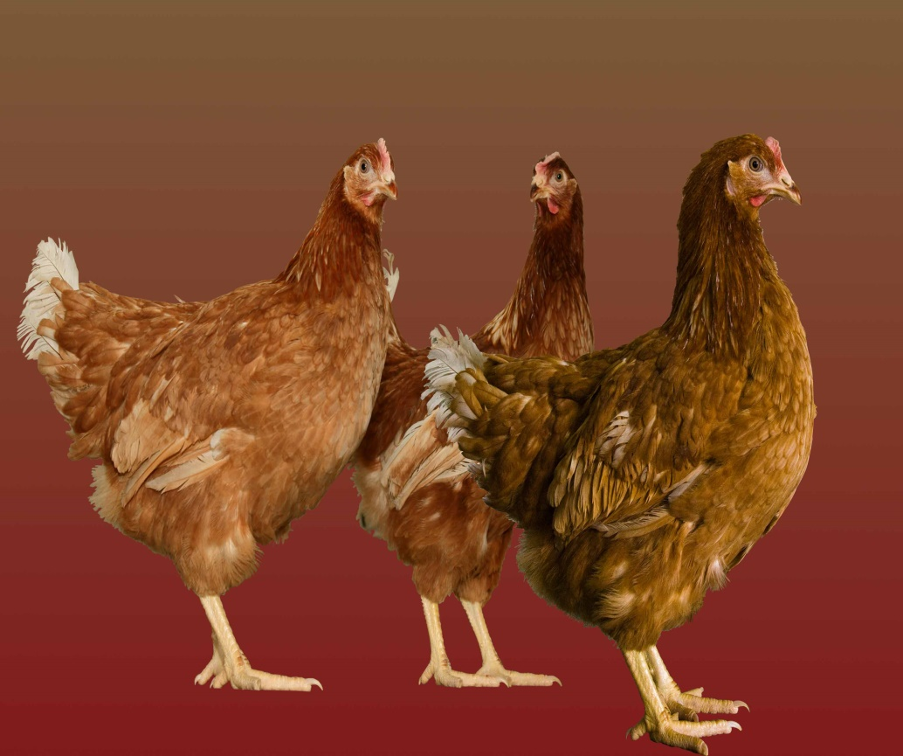
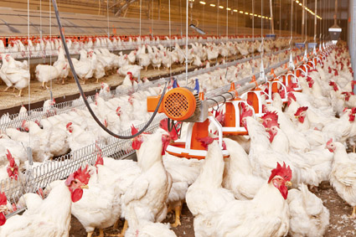
THANKS

