Slide 1
Nutritional Management of Livestock During Scarcity
Dr. Pankaj Kumar Singh
Assistant Professor (Animal Nutrition)
Bihar Animal Sciences University, Patna, India
E-mail: vetpank@gmail.com

Slide 2
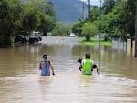
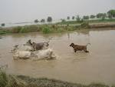
Introduction:
Natural calamities
Floods, droughts & cyclone
Produces scarcity of feeds.
Flood ` heavy loss of vegetation.
50-60% of the cropped area in flood affected area remain submerged
Minimum of 30 days to bring the field for cultivation purposes.

Slide 3
Kinds of damages caused by floods
Loss of standing crops due to submerging in flood water
Damage of stored dry roughage due to water soaking
and fungal growth
Washing away of dry roughage stored in open space
by aggressive currents of flood water.
Damage of stored food grains by water soaking &
fungal growth `production of harmful metabolites.
Pollution of water with dung, urine, debris and other
wastes.

Slide 4
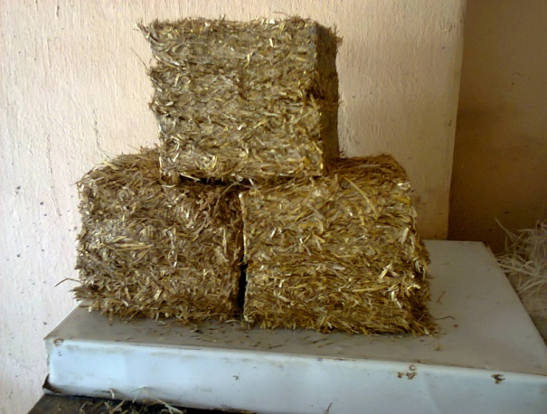
Feeding technologies to be used during and after flood
Complete feed blocks
Urea molasses mineral block licks
Urea treatment of straws
Use of dry and fallen tree leaves
Use of unconventional feeds

Slide 5
I. Use of dry and fallen tree leaves:
Shrubs and herbs like pipal, neem, mango, kathal, etc. other non-toxic tree leaves may also be fed to animals.
They are potential sources of much needed carotene, the source of vitamin A activity.

Slide 6
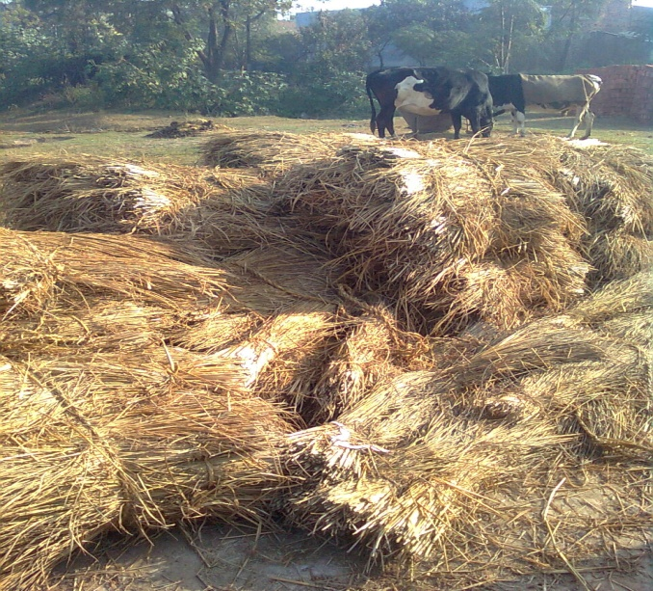
II. Use of conventional and unconventional feeds
A. Crop residue:
Paddy straw
It is usually stored on wooden or bamboo platform raised over the ground.
This is required to minimize spoilage in the heavy rainfall areas.

Slide 7
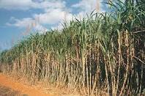
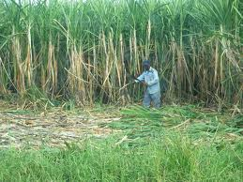
Sugarcane crop residue:
After harvesting the sugar cane the green tops available as a waste can be used for the - feeding livestock
The Bagasse may be used for the livestock (cattle and buffaloes ) feeding

Slide 8
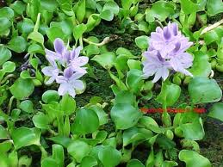
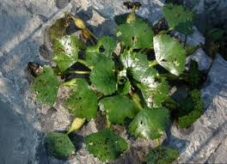
Aquatic plants:
Aquatic plants like water hyacinth, aquatic spinach, stalks and leaves of lotus plant (Neumbiull sp.), water chestnut (Trapa natans), hydrilla, pistia, aquatic weeds and . They are available readily at most of the places during floods, which can be used in different forms for feeding of animals during scarcity.

Slide 9
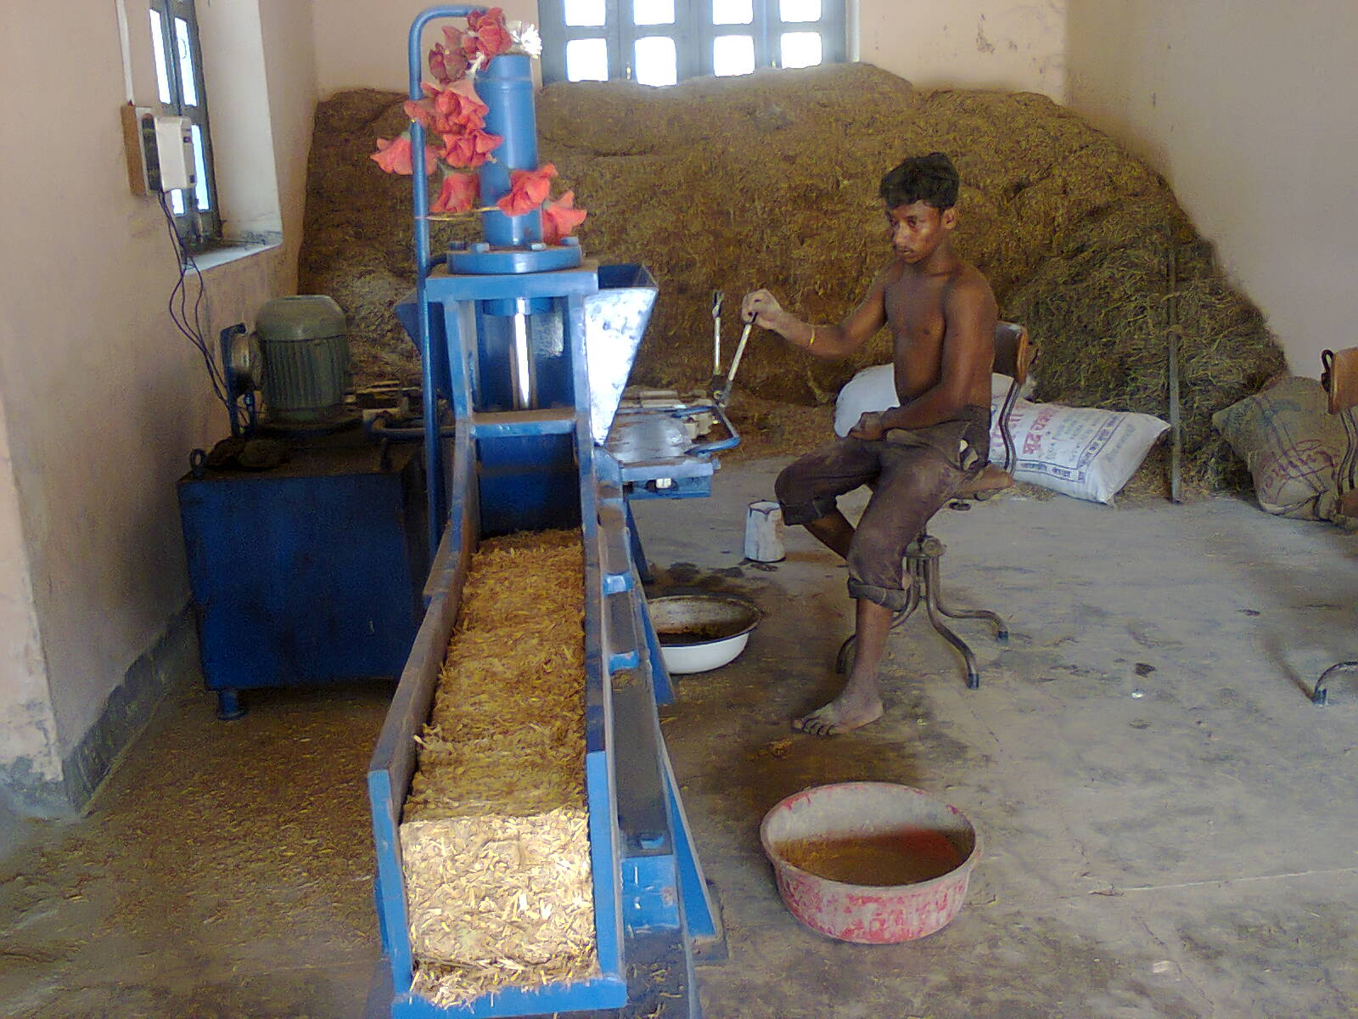
II. Complete Feed Block
It is densified product, containing both roughage & conc. in desired proportion to meet the requirement of target animal production.
Manufactured in complete feed block making machine
The machine is Simple in operation
Can compact all kinds of feed materials to square shape of desired thickness & weight

Slide 11
Complete feed block making machine
Components-
Hydraulic Cylinder
Power Pack
Electric control panel
Frame

Slide 12
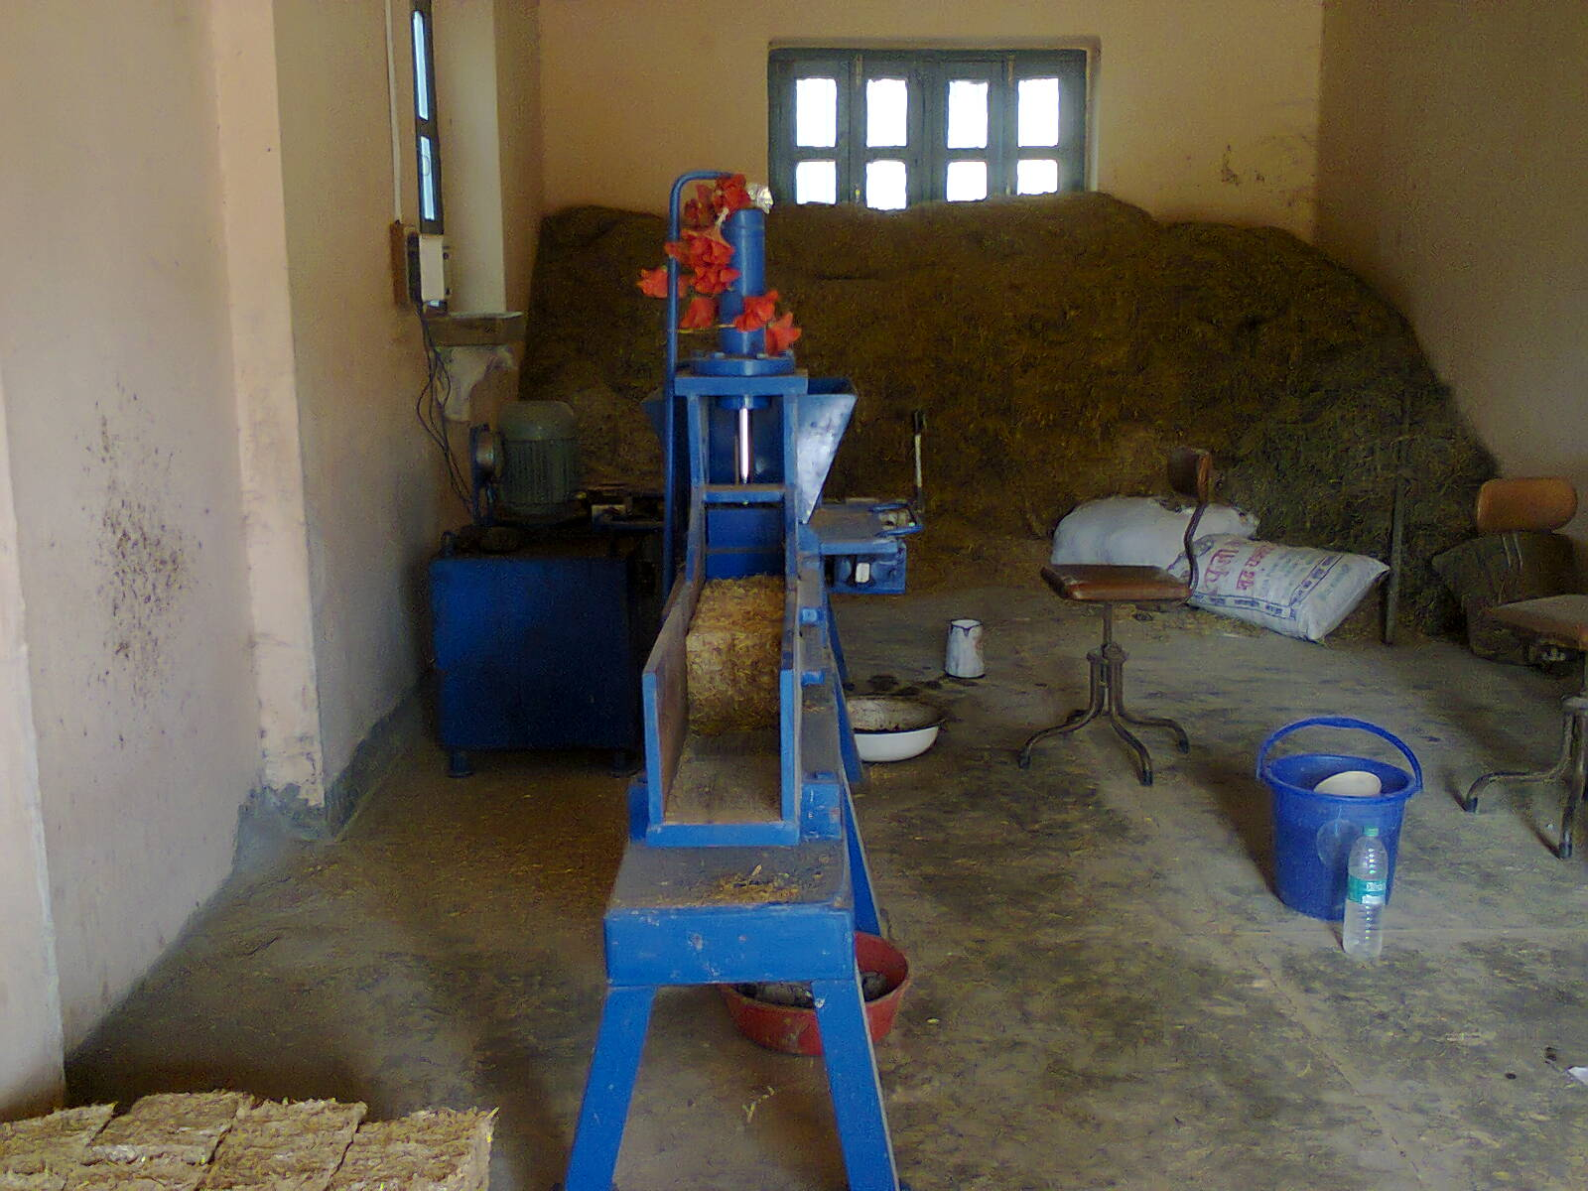
Complete feed Block Unit, Department of Animal Nutrition BVC, Patna

Slide 13
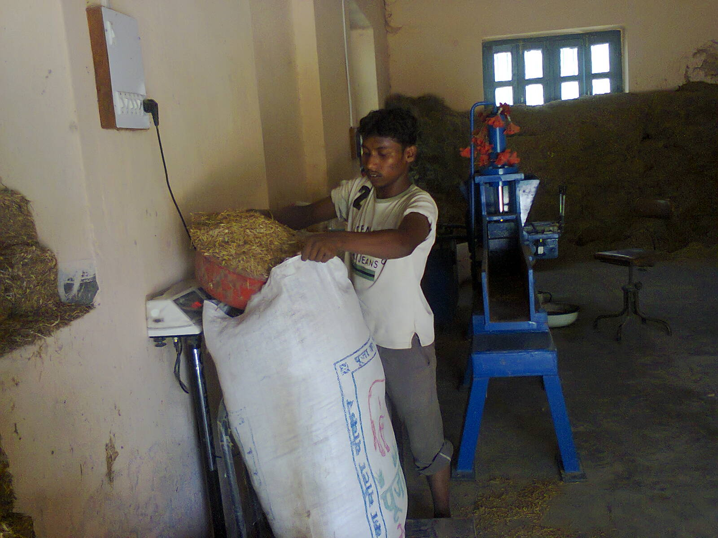
Collection and weighing of Feed Ingredients

Slide 14
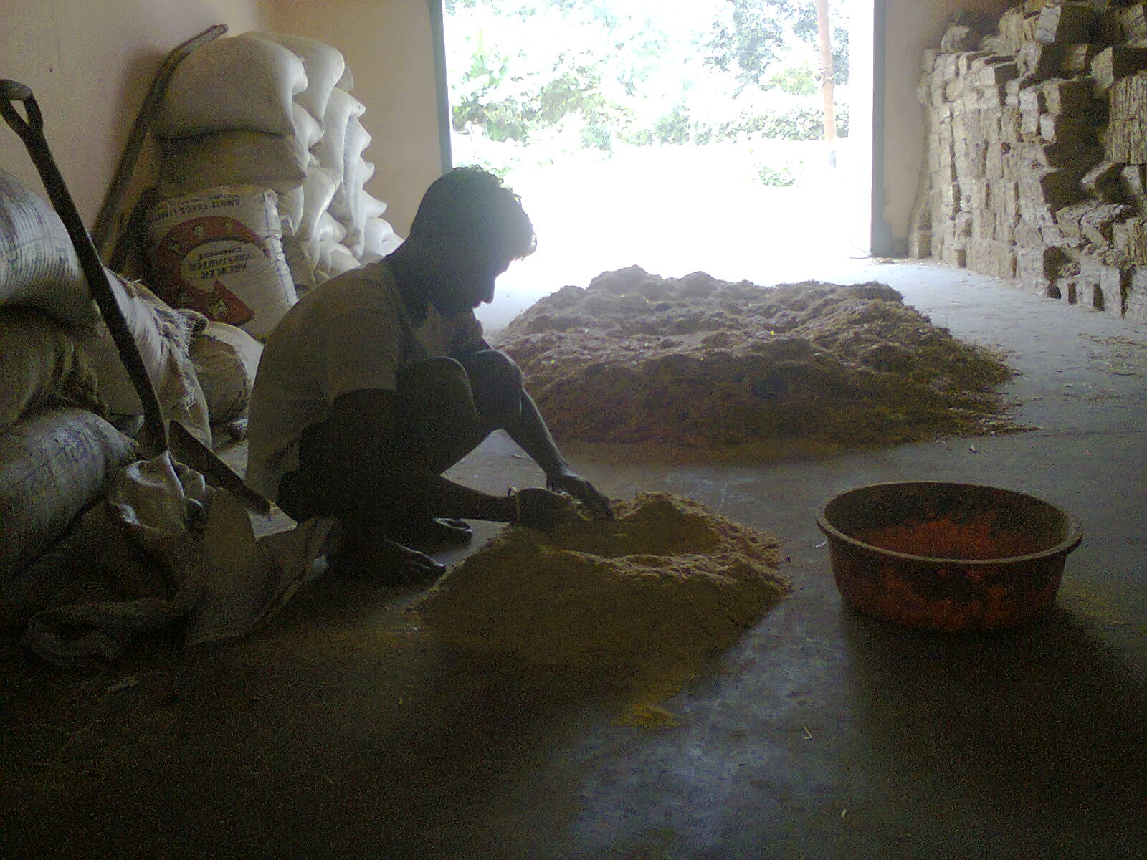
Mixing of ingredients

Slide 15
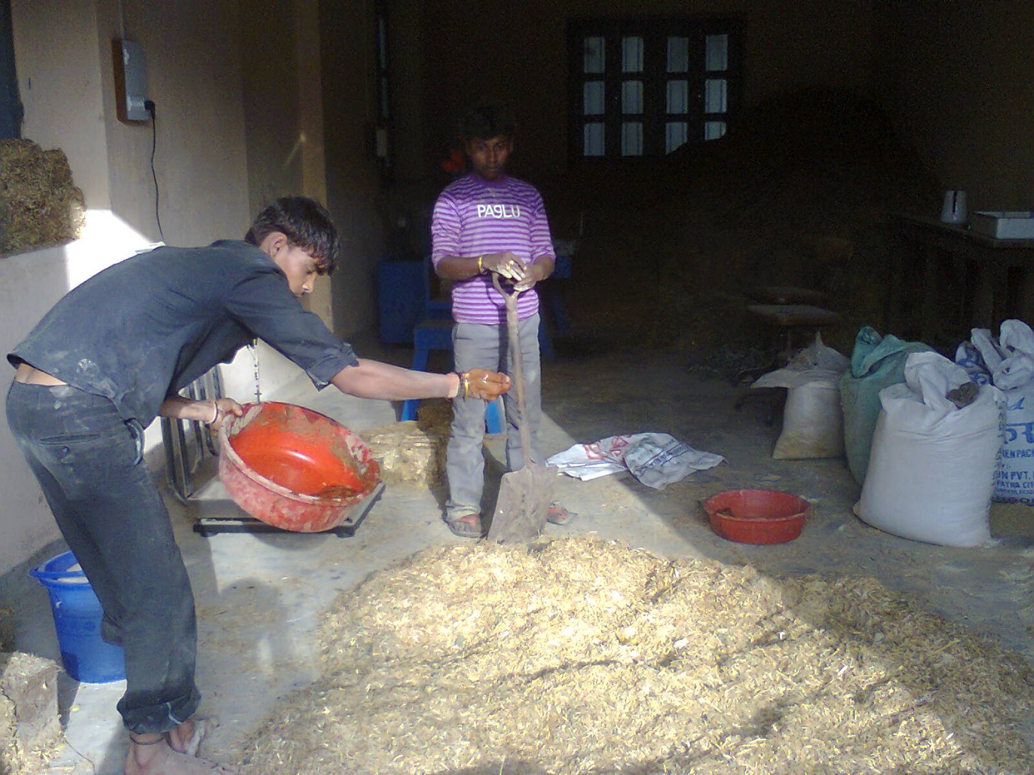
Mixing of feed ingredients

Slide 16
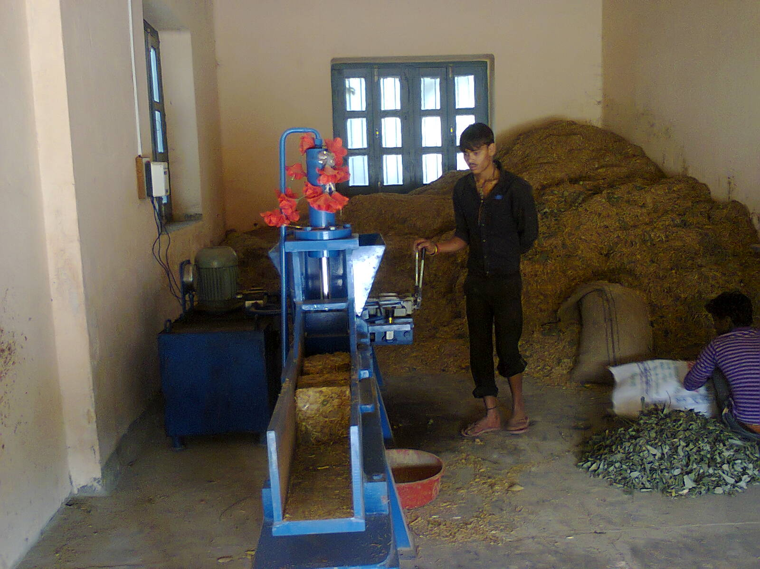
Manufacture of complete feed block

Slide 17
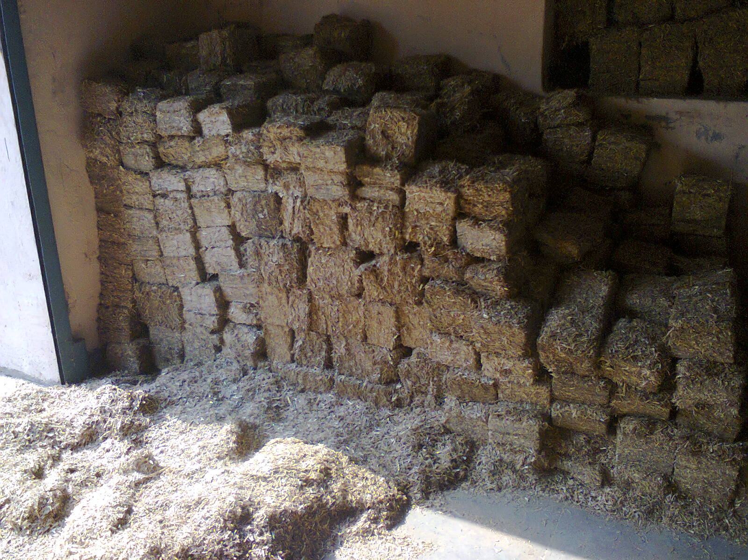
Complete feed blocks

Slide 18
Advantages of complete feed blocks
Non-conventional,less palatable feeds used to make ration economic.
Enhances bulk density
5-8 times for roughage alone
4-6 time for complete feed
During storage, prepared feed blocks required one third less space as compared to loose form and Reduces storage cost
Transportation of such blocks is convenient and trouble free.
-Reduces transportation cost.
Increased palatability
Increased voluntary intake
Increased nutrient utilization
Stable rumen environment
Minimal fermentation losses
Prevents loss of lighter nutrients resulted animal during feeding like sneezing.
Reduces the wastage of feed material by sneezing and
Save labour on feeding management

Slide 19
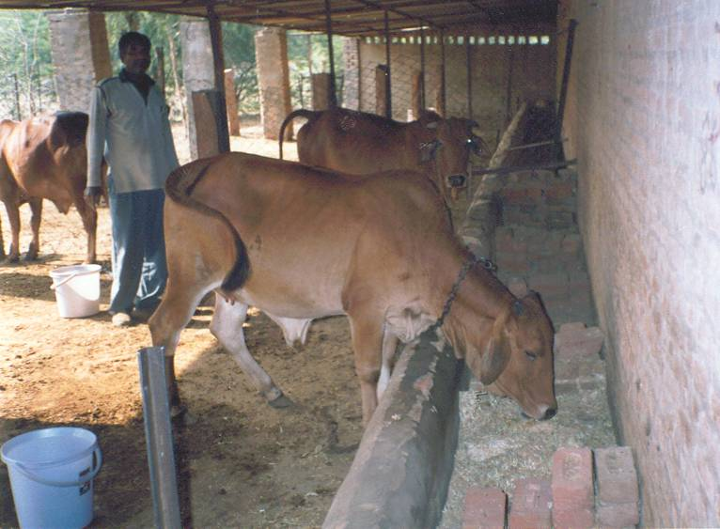
Performance of heifers on complete feed block

Slide 20
Parameter Block Mesh
DMI (% b.wt.) 4.38 4.12
N Balance (g/d) 8.0 5.9
15% higher b.wt. gain obtained in block feeding

Slide 21
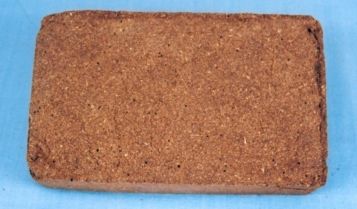
II. Urea-Molasses-Wheat bran Compact Feed Block

Slide 23
INGREDIENTS
I. Energy sources: MOLASSES
II. Nitrogen Sources
1. Non-Protein Nitrogenous Source : urea
2. Vegetable or True Protein: Any de-oiled seed cake like Soyabean meal, mustard oil cake etc.
III. Mineral Sources:
1. Common Salt
2. Mineral Mixture
IV. Structural Components: Wheat Bran/Rice Polish
V. Binder: Dolomite/ Calcite/Guar meal

Slide 24
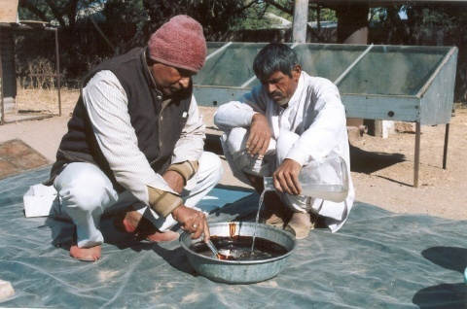
1. Weight 1.0 kg granular, fertilizer grade urea in glass or steel container and heat it with 500 ml (half litre) water, till it dissolves. Avoid over heating. While hot
2. Pour this solution (I) into a plastic tub containing 10.400 kg molasses, and mix with steel spoon.

Slide 25
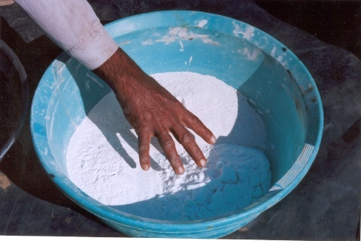
3. Prepare mixture of 1.0 kg common salt, 1.0 kg vitamin-mineral mixture, and 1.0 kg dolomitic lime or calcite.

Slide 26
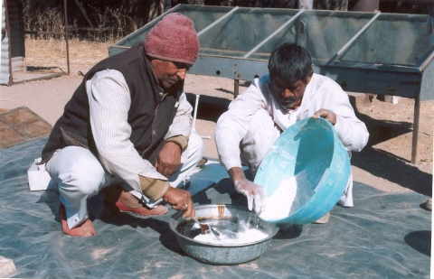
4. Pour all-mineral mixture into urea-molasses solution and go on mixing till homogenous suspension of urea-molasses-mineral is obtained.

Slide 27
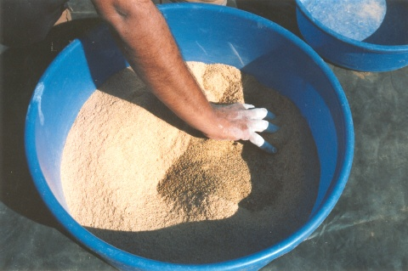
5. Take 7.400 kg wheat bran in a large sized plastic tub and add to it 0.500 kg de-oiled soybean meal or any oil-seed cake.
6. Mix well.

Slide 28
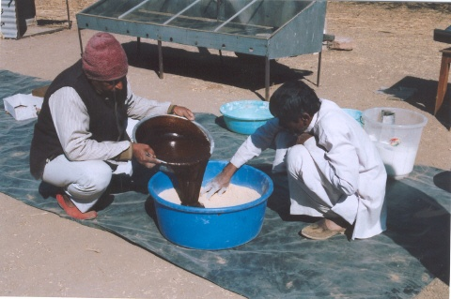
6. To this mixture, pour suspension of urea-molasses mineral ingredients (III), and mix all these contents till there is coating of (III), over the wheat bran-soya meal mixture.

Slide 29
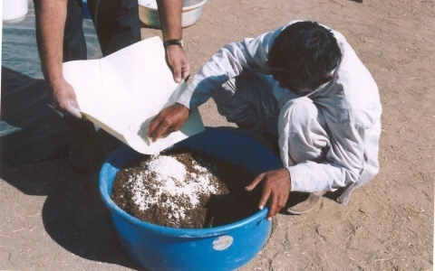
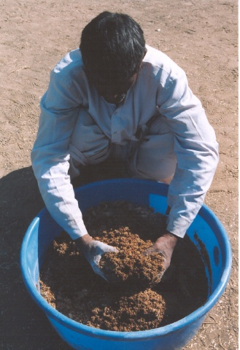
7. At last, slowly, sprinkle 240 grams of dolomite over the above mixture (IV) and mix thoroughly all the ingredients.

Slide 30
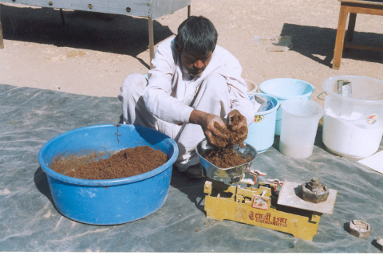
Processing & Mixing of ingredients
Weigh desired quantity of above mixture.

Slide 31
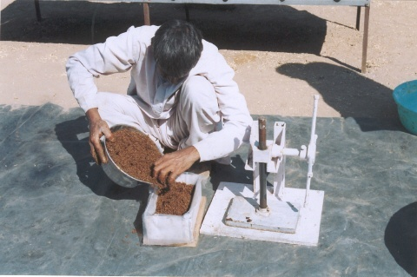
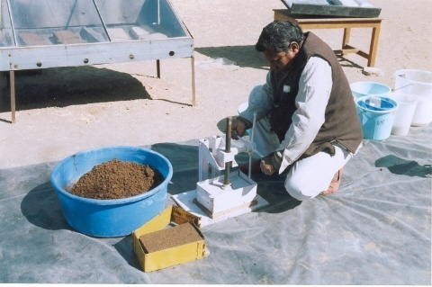
Transfer weighed mixture into the iron mould,
and press the material with screw type hand press machine

Slide 32
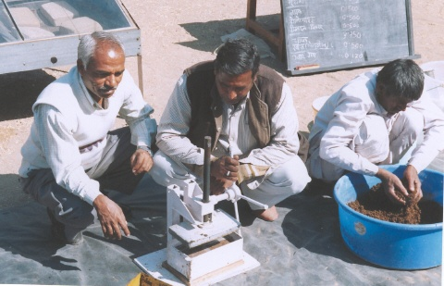
Allow to keep the pressed material in the mould for 24 hours.

Slide 33
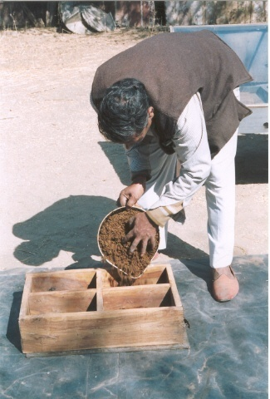
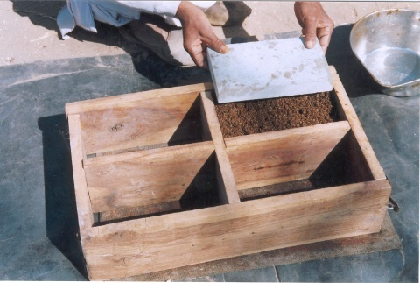
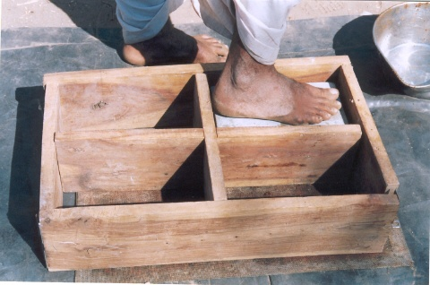
Alternatively mixture can be pressed in wooden mould.

Slide 34
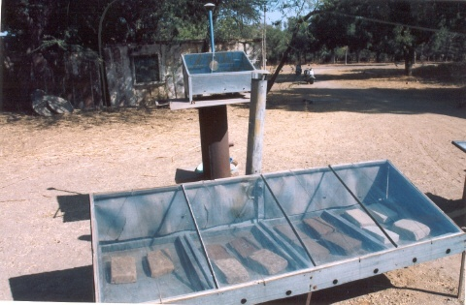
Dry the pressed material in: Solar drier or industrial electric oven
The dried block should not contain more than 15% moisture.

Slide 35
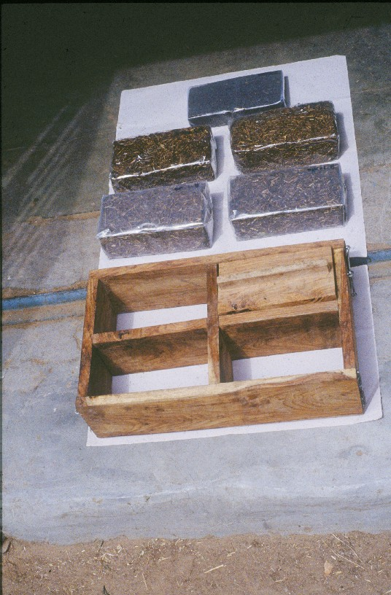
Dried feed block can be packed in a polythene wrapper.

Slide 36
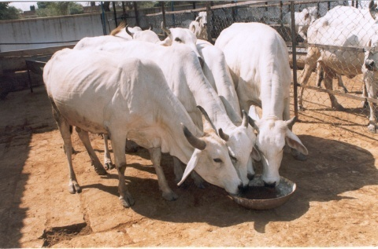
Feeding of Urea-Molasses mineral blacks
Heifers & a Milch Cow Licking Feed Block

Slide 37
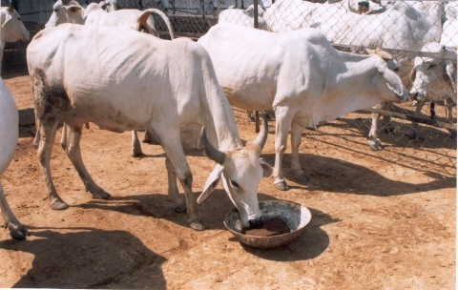
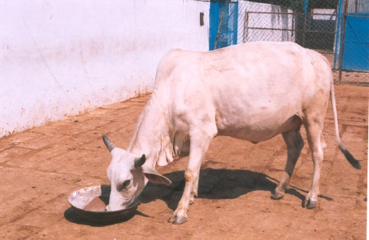
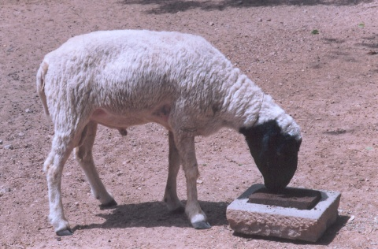
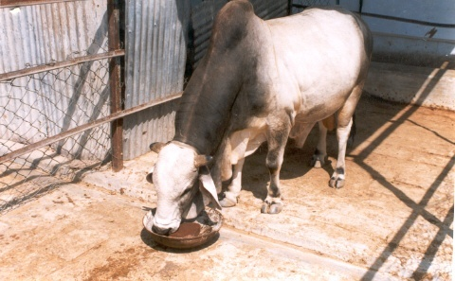
Licking the Urea-Molasses mineral Block

Slide 38
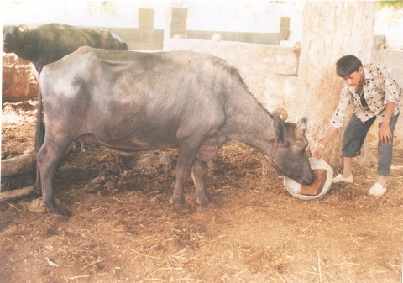
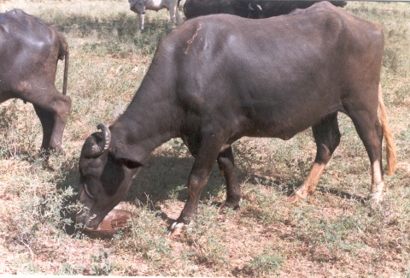
Buffalo Feeding on
Wheat Bran- Molasses
Multi-nutrient Feed Block
Effects
2-kg block in a buffalo last for 5-days.
Increased Feed intake
Corrected pica
Increased daily milk yield by 23%.
- A. K. Patel

Slide 39
Precaution of urea feeding:
Never feed to young animals below 6 months of age.
Never cross the limit of 116 gram of urea for adult cattle and 10 g for sheep.
Provide sufficient drinking water
Uniform mixing of urea is essential to avoid urea toxicity.
Avoid dietary inclusion of urea suddenly.
Provide sufficient amount of soluble carbohydrate for efficient utilization of urea (e.g Molasses)

Slide 40
Urea Toxicity:
Urea degrades to ammonia
Ammonia utilized by rumen microbes to synthesize microbial protein.
Microbial protein digested in small intestine to provide protein for animal use.
Optimum ammonia concentration:5-8 mg per 100 ml rumen liquor
Above this level blood ammonia level rises
1mg ammonia/100ml blood- toxic
3 mg ammonia/100ml blood- lethal

Slide 41
Urea Toxicity:
Common reasons:
Improper dose rate of urea
Improper mixing of urea in feed
Accidental use by animal at farmers door
Symptoms:
Bloat
Excessive salivation
Respiratory difficulty
Bellowing
Convulsion
Treatment:
Drenching of 20-40 litre cold water (inhibit ureolytic activity)
Drenching of 4-5 litre of 10% acetic acid (binds ammonia).

Slide 42
Post flood feeding management:
Animals should not be allowed to graze in water logged areas.
Feeds to be protected form fungal contamination and wet feeds to be dried and fed.
Provide clean drinking water to animals.
40-50g of salt per adult animal and 10-20g for small ruminants and calves to be provided daily through feed.
Attempts need to be made to provide ready to eat feed blocks particularly to the pregnant and lactating animals.
Requirement of energy may be met by providing crude molasses.
Top feeds / tree leaves available in the area be provided to meet the dry matter requirement.

Slide 43
Questions?

