Slide 1
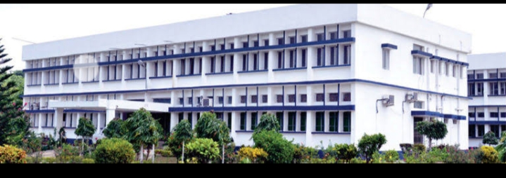
Physiology of Sensory Organ -Nouse
B.K.Singh, DairyTechnology

Slide 2
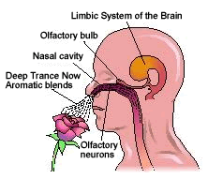
Nose
The human nose has several physiologic functions. As the air is inspired through the nose it is humidified and warmed by passing over the moist and warm nasal mucosa. The nose is an energy-conscious organ in that expired air is cooled and some of the moisture is recaptured. A nose is a protuberance in vertebrates that houses the nostrils, or nares, which receive and expel air for respiration alongside the mouth. Behind the nose are the olfactory mucosa and the sinuses. Behind the nasal cavity, air next passes through the pharynx, shared with the digestive system, and then into the rest of the respiratory system. In humans, the nose is located centrally on the face and serves as an alternative respiratory passage especially during suckling for infants

Slide 3
Two nasal cavities are separated by a smooth median septum.
The lateral walls of the cavities have a series of folds, approximately horizontal, varying from two to six.
The lower fold extends over most of the length of the nasal cavity.
The two above this called 'conchae' are smaller protruded into the cavities to provide 3 channels the inferior, median and superior meatus.
Each meatus is confluent with a large common meatus, which communicates with an olfactory left above the superior conchae and the septum.
These spaces are all connected by very narrow passage with the posterior naris (chaoana) And with the pharynx.
Add title

Slide 4
The upper and lower nasal passages are mere sites of 1 - 2mm.
The deeper part of the nasal cavity contains a pseudo - stratified columnar epithelium containing ciliated cells, whose cilia beat toward the choana.
The cavity also contains alvelo-tubular glands with mucifous cells.
Air entering nasal cavity is warmed and humidified by passage over the surfaces.
The olfactory region or olfactory epithelium is yellow - pigmented area about the size of a postage stamp, located in the upper part of the nasal cavity and above turminate bones.

Slide 5
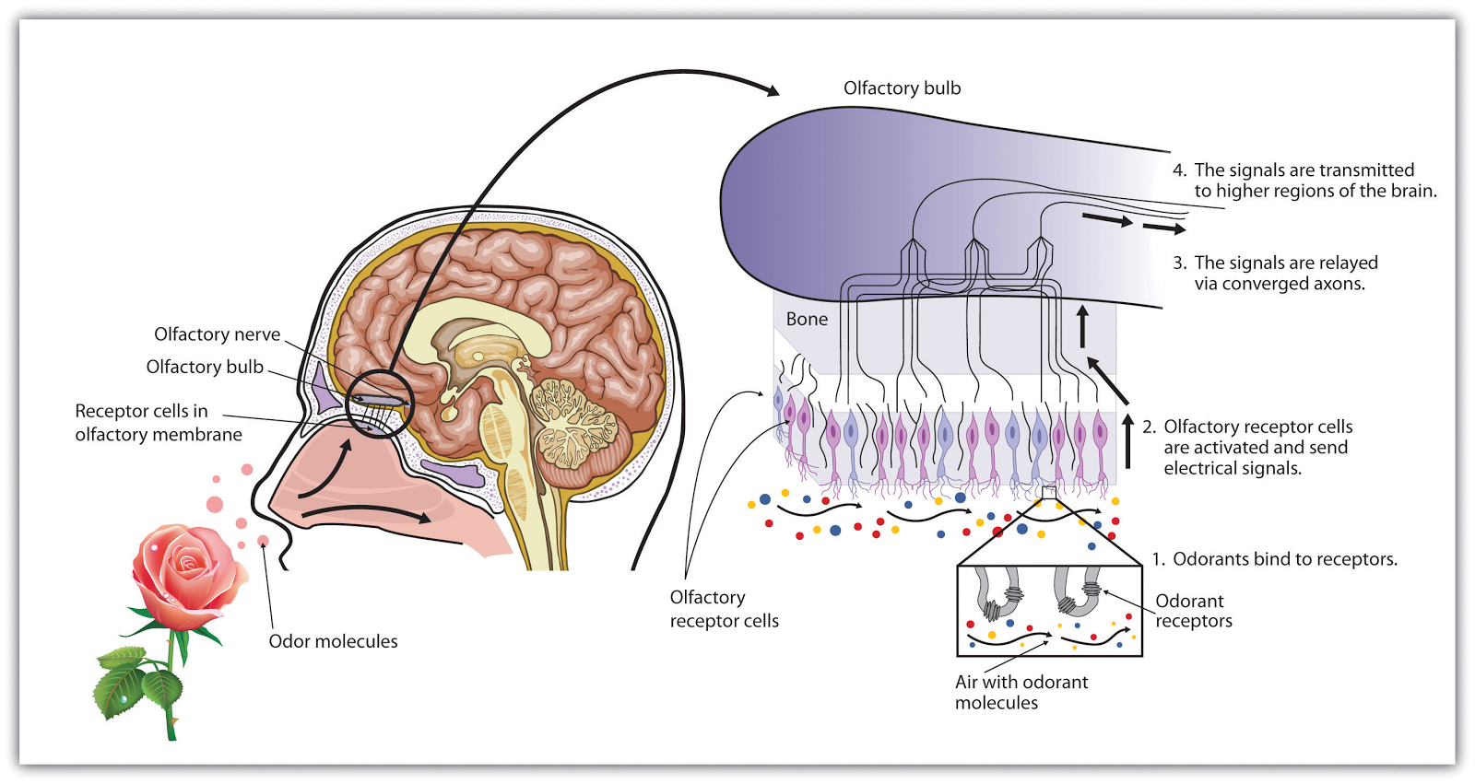
Olfactory cells (10 -20 million in man) through which odour are detected, are located in this area.
Each Olfactory cell terminates a number of hair like projections or extensions of the cell wall called cilia, which extend into the mucous lining of the olfactory epithelium.
1
6
2
4

Slide 6
Important Aspects of Odor perception
The prospective odor material must be volatile.
The odor - laden air must reach the olfactory receptions.
The differences in diffusion rates may be a factor in stimulation.
The odor must dissolve in aqueous mucus and then diffuse through it.

Slide 7
Odor Detection / Perception
The basic requirements
A substance must be volatile, and the molecules must make contact with receptors.
The volatility of a substance depends on its molecular weight and molecular bonding properties. The upper limit for 'smell ability ' is usually a molecular weight of about 300. Heavy molecular weight substance like proteins, starches, fat and many sugars are too heavy to be odors.
Molecular bonds vary with the chemical compounds and temperatures.
1
2
3
4
6

Slide 8
Compounds that are more volatile are derived from liquids than from solids. Increase in temperature increases volatility of both states.
Ododoriferous substances, must be adsorbed/adhered to the chemo - receptors, i. e. it should be soluble to some extent in the membrane constituents, which consists of lipids, proteins and water.

Slide 9
Adaptation
Perception of a constant odor diminishes with the elapse of time is known as adaptation. It results in decline in sensitivity, increase in threshold. The rate of adaptation is a function of the stimulus intensity. As the adaptation occurs there may be a progressive change in the nature of odor. Fatigue for one odor may even raise the threshold for others

Slide 10
Odor stimuli
Odor is the property of a substance /s that is perceived in the human and higher vertebrates, by inhalation in the nasal or oral cavity, that makes an impression upon the olfactory area of the body and that during and as a result of such inhalation, it does not cause or result in choking, irritation, cooling, warmth, drying, wetting or other functions foreign to olfactory area.
Impure odors are defined as those in which other senses in addition to the olfactory are excited.

Slide 11
THEORIES OF OLFACTION
AMOORE'S STEREOCHEMICAL TIHEORY:
The theory proposes that olfactory receptors are sensitive to the size, shape and the electronic status of the odorant molecule. This theory is based on nerve impulse electrical conduction. It has been reported that nerve fiber (axon) membranes were composed of a lipid double layer with adsorbed protein on the inner and outer surfaces of axon. In the resting state, there was an excess of sodium and chloride ion on the outer surface and an excess of potassium ions on the inner surface of the axon.

Slide 12
THEORIES OF OLFACTION
WRIGHT'S VIBRATIONAL THEORY:
It has been suggested that the odor stimulus be conveyed at long range from the source to the nose or antenna by propagated electromagnetic radiation, as by ultraviolet or more likely infrared lengths. This was further modified by Wright, suggesting that the odors of the given chemicals are a function of their 'intrinsic molecular vibration frequencies, within the far infrared region of the electromagnetic spectrum (100-700 cm-I).
BEET'S PROFILE-FUNCTIONAL GROUP THEORY:
Beets stated that two molecular attributes were important in determining the characteristic odor: 1] the form and bulk of the molecule and the nature and disposition of the functional groups of the molecule.

Slide 13
OLFACTORY ABNORMALITIES
Cryptosmia : obstruction in nasal passages.
Anosmia: temporary / permanent loss of smelling capacity
Hemianosmia or Hyperosmia : excessive response.
Merosmia: loss of only certain odors.
Heterosmia / Parosmia : false odor perceived
Autosmia : odor sensation in absence of odor stimuli
Cacosmia : persistent perception of unpleasant odors.

