Slide 1

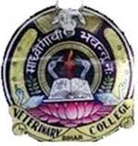
SEWAGE PURIFICATION AND DISPOSAL

Slide 2
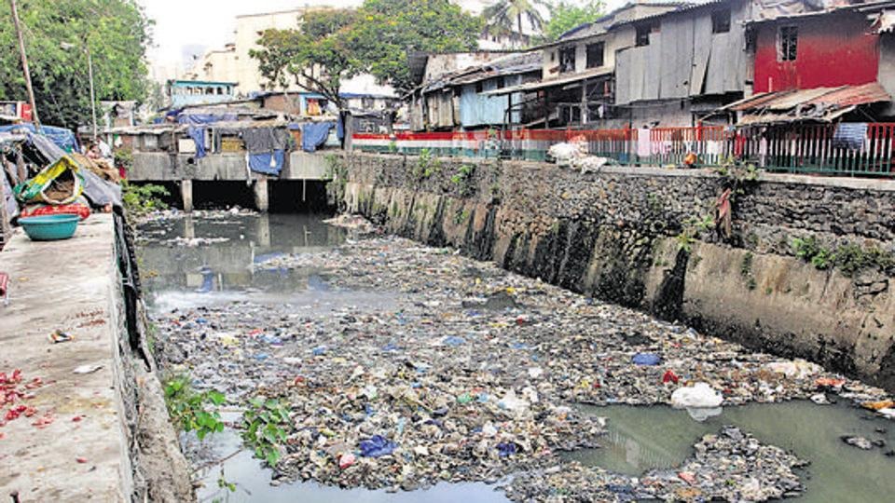
.
SEWAGE
Is the waste water from a community, containing solid and liquid excreta derived from housed, street and yard washings, factories and industries
Resembles dirty water with unpleasant smell.
Sullage: Waste water which does not contain human excreta (Kitchen and bathrooms waste water)

Slide 3
Amount of sewage:
Habit of people: More use-more sewage
Time of the day and season
  “Average amount of sewage which flows through a sewerage system in 24 h is called as dry weather flow.”
  Health aspects:
    Creation of nuisance, unsightliness and unpleasant odors.
    Breeding of flies and mosquitoes
    Pollution of soil and water supplies
    Contamination of food
    Increase in the incidence of disease especially enteric and helminthic diseases.

Slide 4
Composition of Sewage
99.9% Water+ 0.1% solids (organic/inorganic in suspension/solution).
Offensive oudour: Organic matter
May contain no. of pathogenic m.o.:
    1g faeces: 1000 million of E. coli
    10-100 million: faecal Streptococci
    1 to 10 million : C. perfringens spores
Human: 100 g average faeces/day

Slide 5
AIM of Sewage Purification
Raw sewage should not be discharged in rivers/ sea or other sources.
  O2 utilized by aerobic m.o. of sewage--------lack of O2----------death of aquatic life.
  H2S production--------offensive odour
  AIM:
  To stabilize the organic matter ----------safely disposal
  To convert the sewage water into effluent with acceptable standard of purity so disposed on land, river, sea etc.
  A standard test that is an indicator of organic content of sewage is BOD (Biochemical Oxygen demand)

Slide 6
Expression of strength of sewage
BOD: Amount of O2 absorbed by the sample of sewage during a specified period (5 days) at specified temperature (20⁰C) for aerobic destruction or use of organic matter by living organisms.
  Natural water: 1mg/l Untreated domestic sewage: 300mg/l
  Strong sewage: ≥300mg/l Weak sewage : 100mg/l
COD: It measures the oxygen equivalent of that portion of organic matter in a sample which is susceptible to oxidation by strong chemical oxidizer
Imp. in toxic waste.
Suspended solids: domestic sewage : 100 (weak) to 500 mg/l (strong sewage)

Slide 7
Decomposition of organic matter
In sewage takes place by 2 ways:
Aerobic: Most efficient method
Require continuous supply of free dissolved oxygen
Organic matter Bacteria, fungi & protozoa CO2, H2O, Ammonia, nitrates & sulphate
2. Anaerobic: Effective when sewage is highly concentrated with plenty of solids
Slower Extremely complex mechanism
Methane, ammonia, CO2 and H2

Slide 8
Modern sewage treatment
Based on biological principles---------------Anaerobic and Aerobic bacteria.
Treatment divided into 2 stages:
Primary Secondary
Solids are separated by screening and Effluent ---------Aerobic oxidation
sedimentation----------Anaerobic digestion
(1st stage of purification) (2nd stage of purification)

Slide 9
Modern Sewage Treatment Plant

Slide 10
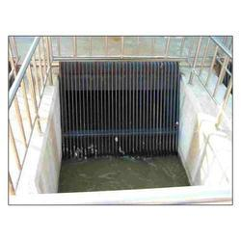
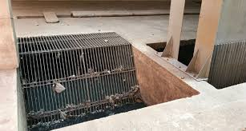
PRIMARY TREATMENT
Screening:
  Sewage first passed through metal screen
  (Vertical or inclined 5 cm apart: fixed type or moving type)
  Large floating objects are screened
  Required time to time removal either manually or mechanically
  Disposed off by trenching or burial method

Slide 11
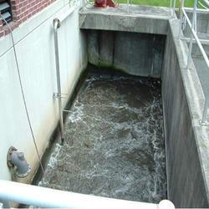
2. Greet chamber/detritus chamber:
  Sewage then passed through a narrow chamber
  10-20 meter length
  Maintain constant velocity 1 foot/sec.
  Allow settlement of heavier solids (sand/gravels) and pass through of organic matter
  Required periodic or continuous removal
  Disposed off by trenching or dumping

Slide 12
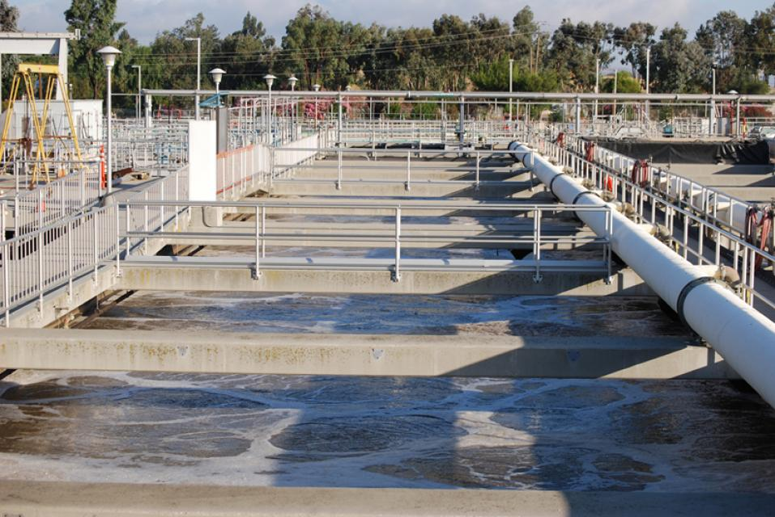
3. Primary sedimentation: in a huge tank, holds ¼ to 1/3 of dry weather flow.
Velocity: 1-2 feet/ min.
Retention time : 6-8 h
Purification: Sedimentation
50-70% solids settle down due to gravity

Slide 13
30-40 % reduction of coliform organisms
Settle down organic matter called as sludge (removed mechanically)
Complex organic matter broken down------simpler soluble substances and ammonia.
Fats and grease rise on the surface-----Scum
Trade waste: require treatment with lime, aluminium sulphate and ferrous sulphate (ppt of animal protein)

Slide 14
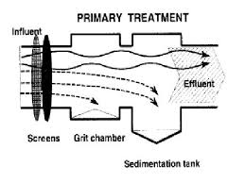
Secondary treatment
Primary treatment-------------------organic matter in solution/colloidal state and numerous living organisms
High BOD value-----pollution of soil/water
Subjected to Aerobic oxidation either by:
  Trickling filter method
  Activated sludge method

Slide 15
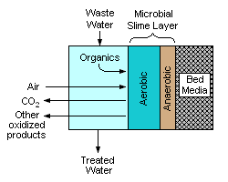
Trickling filter method
Percolating filter: a bed of crushed stones or cinker
1 – 2 meter (4-8 ft.) deep
2-30 m (6 -100 ft.) diameter
Effluent from Prim. Sed. Tank sprinkled uniformly over the bed through revolving device (hollow pipes with holes in row).
Over the surface and down of filter complex biological growth (zoogleal layer) consists of algae, fungi, protozoa and bacteria occurs.
Effluent percolate through filter bed----------oxidized
Wind blows freely through beds supplying oxygen
Zoogleal layer lives, grows and dies---------sloughs off----break away and washed down (light green, flocculent material called humus.
Oxidized sewage --------------------secondary sedimentation tank/ humus tank
Depends on population size

Slide 16
Activated sludge process
Modern method of purifying sewage.
The heart: Aeration tank
Effluent from pri. Sed. Tank mixed with sludge from final settling tank (activated sludge/ return sludge: rich in culture of aerobic bacteria).
Activated sludge: effluent= 20-30%
Mixture -------------Aeration in aeration chamber for 6-8 hrs.
Aeration by Mechanical agitation or by compressed air from bottom (diffused aeration*better)
Organic matter-------------------CO2, nitrates and water
Typhoid and cholera organism- dies, coliform-reduced
Occupy less space and require skilled operations
Suitable for large cities (1 acer of this works for 10 acers of percolating filter)

Slide 17
Secondary sedimentation: 2-3 h detention period
Sludge called as aerated sludge/ activated sludge----dehydrated--valuable manure (inoffensive, rich in bacteria, nitrogen and phosphates).
Part of sludge in aeration tank and part moves to sludge digester.

Slide 18
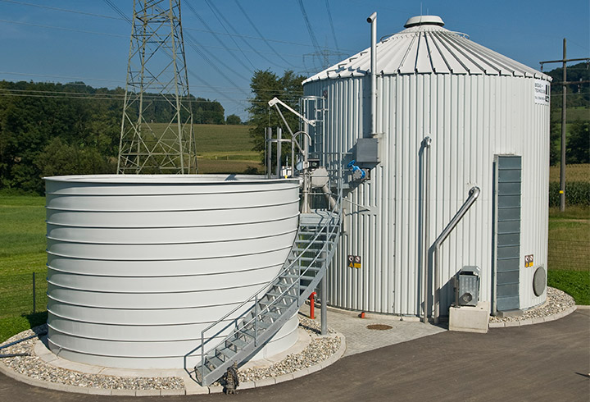
Sludge digestion
1 million gallons of sewage----------15-20 tons of sludge.
It is a thick black mass containing 95% water and have revolting odour.
Methods of disposal:
Digestion: incubated under favourable conditions of temperature and ph-----------anaerobic auto-digestion----complex solid broken down into---water, CO2, methane and ammonia.
  Volume---reduced.
  Takes 3-4 weeks to complete.
  Residue---in offensive, sticky and tarry mud, dry readily form excellent manure
2. Sea disposal: By pumping into sea
3. Land: composting with town refuse

Slide 19
Disposal of effluent
1. By dilution: Rivers and streams
  Diluting capacity depends on dissolved oxygen contents of receiving bodies.
  Effluent should not have more than 30 mg/l suspended solids and BOD5 should not exceeds 20 mg/l ( 8:1 dilution)----Royal commission of England 5th report.
  2. Disposal on land: irrigation

Slide 20
Other method of sewage disposal
  Sea outfall
  River outfall
  Land treatment
  Oxidation pond
  Oxidation ditches

Slide 21
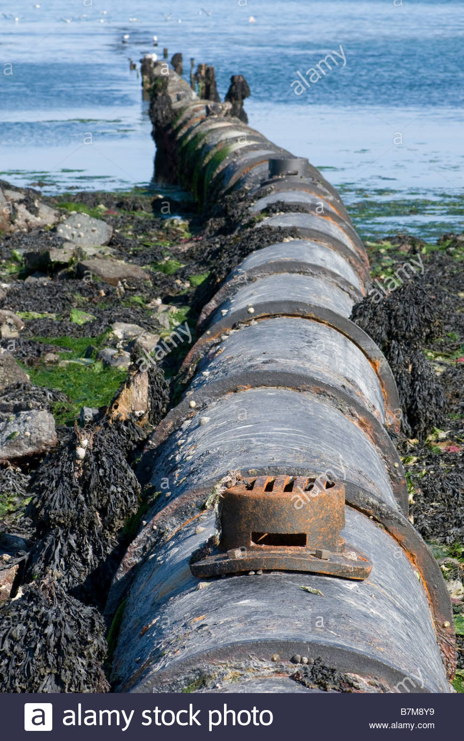
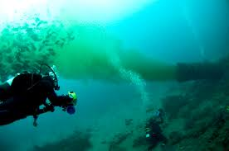
  Sea outfall
Discharge sewage into sea in deep at many points

Slide 22
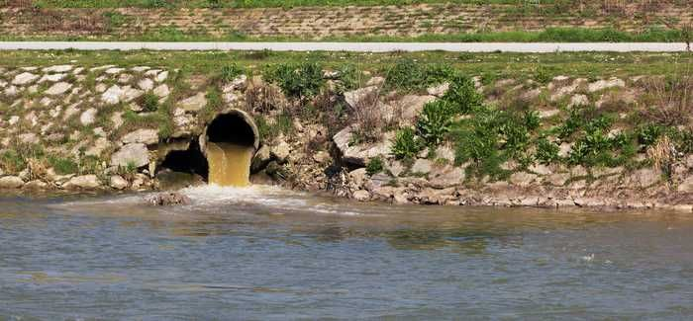
  River outfall

Slide 23
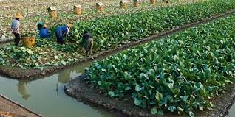
3 Land treatment/ sewage farming/broad irrigation:
In many Indian towns and cities
Sewage of 100-300 persons----an acre land
During rainy season badly managed farms stink a condition called as sewage sickness (lack of aeration and rest pause on land.

Slide 24
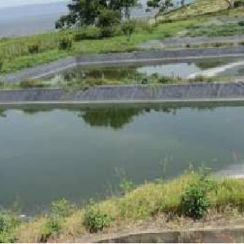
  Oxidation pond: Stabilization pond, redox pond, sewage lagoons
  Open shallow pool 1-1.5 m deep with an inlet and outlet.
  1. Algae
  2. Bacteria
  Sunlight

Slide 25
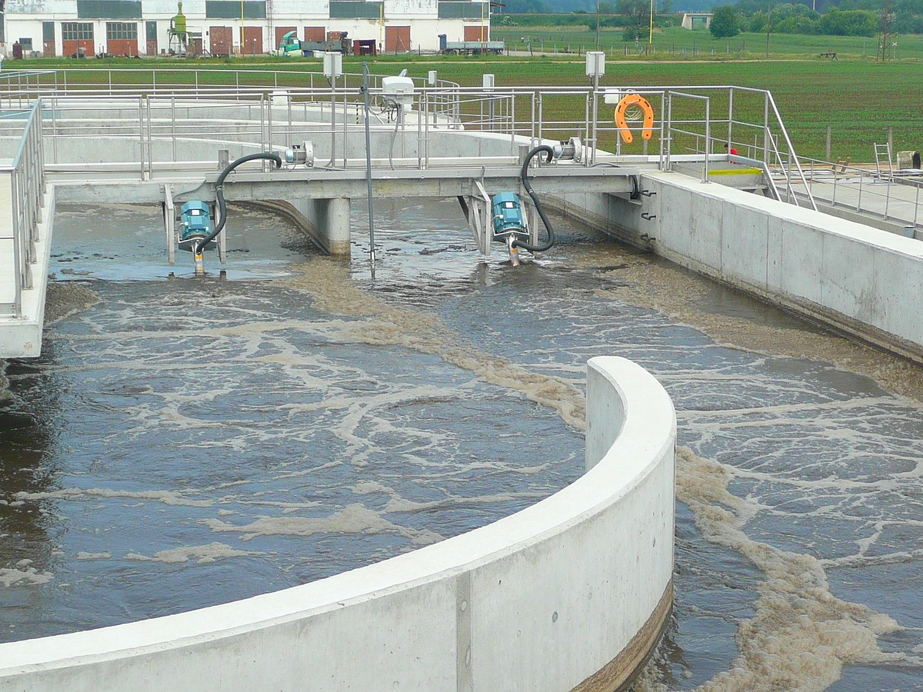
  Oxidation ditches/ Aerated lagoons: Mechanical rotor used fro extended aeration
  For 5000 -20,000 population require 22 acre land for oxidation pond and 2.5 acers for aerated lagoons.
  Low cost methods

Slide 26
THANKS

