Slide 1
Surgical Affections of Trachea

Slide 2
Trachea
Rhinotomy-Incision into nasal cavity
Tracheostomy-Creation of temporary to permanent opening into the trachea.
Vocal cordectomy- )Debarking or Devocalization)-Resection of vocal cord.

Slide 3
Trachea Injury
Bites, Bullet injury and automobile accident etc.
Sign: Respiratory distress, bleeding from nose.
Conservative Treatment: ASD, Broad spectrum antbiotics, NSAID.
Avoid entering Antiseptic solution into trachea- it leads to inflammation and fatal broncho-pneumonia.

Slide 4
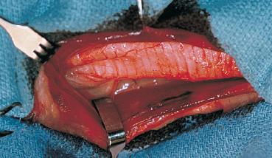
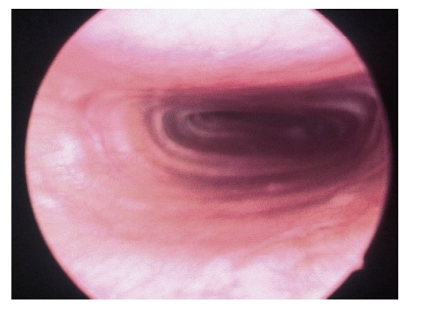
Tracheal Collapse
Tracheal obstruction caused by cartilage flaccidity and fattening.
Cartilage rings flaccidity and fattening:
Congenital/Aqured
Congenital:Deficiency-Gycosaminoglycans, Chondroitine, calcium and glycoprotein.
Aquired: Cushing’s Syndrome, chronic respiratory tract disease.
Obesity

Slide 5
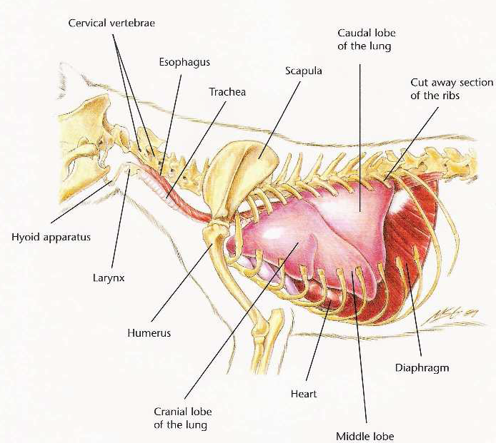
Clinical sign
Cervical part: Trachea collapsed during Inspiration
Thoracic Part: Trachea collapsed during Expiration
Coughing during excitation
Dyspnea and Gagging while eating.

Slide 6
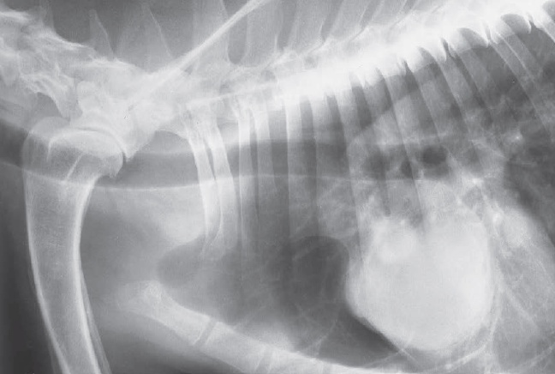
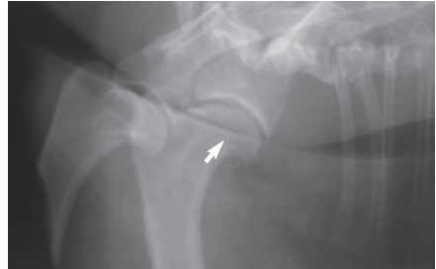
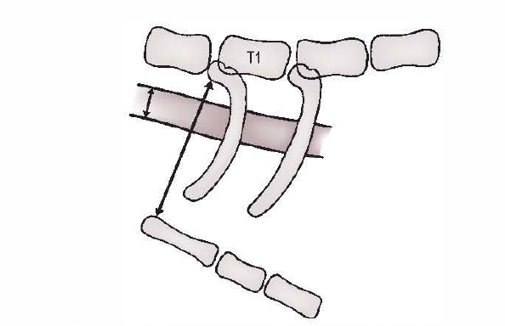
Normal
Tracheal collapse
Trachea diameter should be 20% of Thoracic inlets

Slide 7
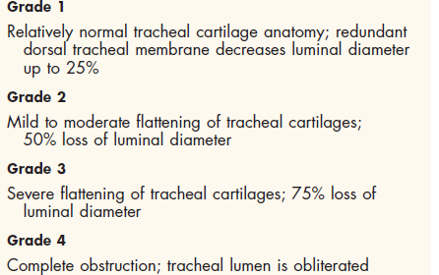
Grading

Slide 8
Medicinal Treatment
Theophylline @10 mg/kg 12 hours
Prednisolone: @1-2 mg 12-24 hrs.
Amoxycillin:@22 mg/kg 12 hours

Slide 9
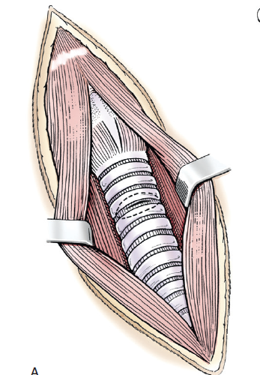
SURGICAL CORRECTION

Slide 10
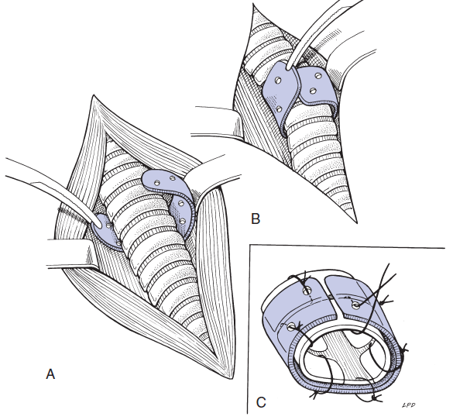
Extra luminal Stents
3 ml polypropylene syringe case

Slide 11
Endoluminal Stents-Palmaz stents
Implant should remain 10 mm from larynx and carina.

Slide 12
Tracheostomy
Indications:
Upper respiratory tract obstruction
Swelling around throat region due to Haemorrhagic septicaemia
Fractured/collapsed tracheal ring due to trauma
Prior to operation of nasal cavity/paranasal sinus
Snake bite

Slide 13
Tracheostomy
Site: Junction between uppen and midle third of neck (2nd to 5th tracheal ring)
Incision should not exceed half of both adjacent tracheal ring width
Horizontal incision on annular ligament connecting tracheal ring
Incision should not be more than 1/3 circumference of trachea
Tube should not occupy more than 50% of tracheal lumen
Leave the wound for open healing to prevent complication of emphysema

Slide 14
Tracheostomy in Horse

Slide 15
Bronchiectasis- Localized or diffuse destructive lung disease that results in severe dilation of large airway with accumulation of secretion.
Surgical Correction- Lobectomy of the affected lung lobe

Slide 16
Roaring
Recuurent laryngeal nerve supply intrinsic muscle of larynx-outward movement of arytenoids cartilageDilation of larynx
Condition mostly unilateral with common in left side.
During inspiration –Roaring or whistling sound appears.
Surgical operation is called-Ventriculectomy, Stripping of ventricle or Hobdaying.

Slide 17
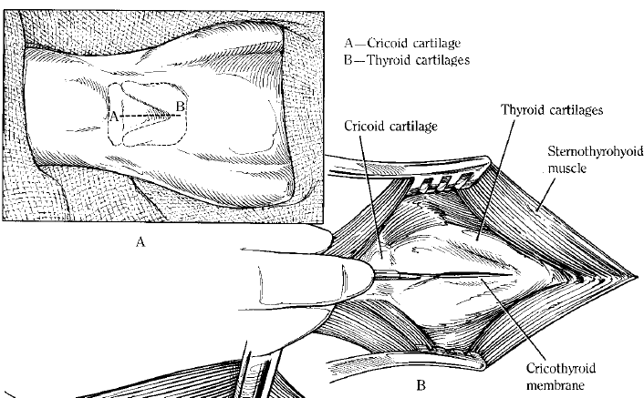
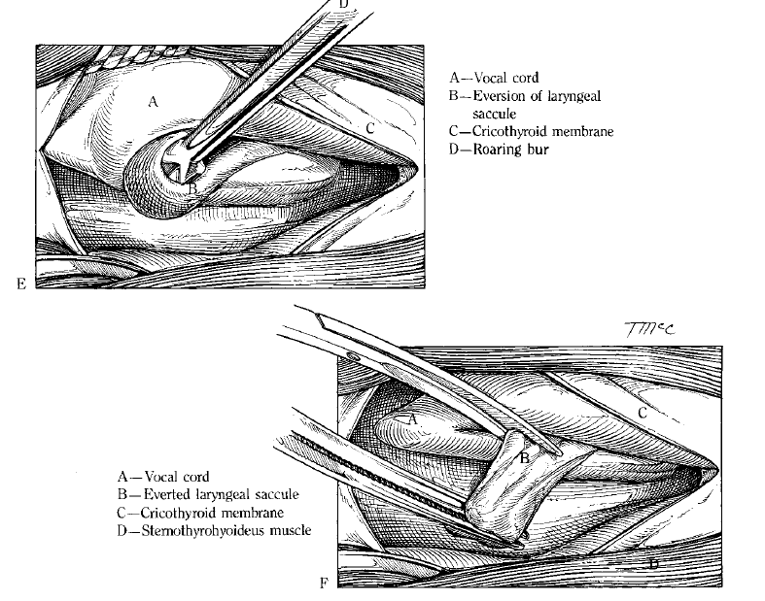
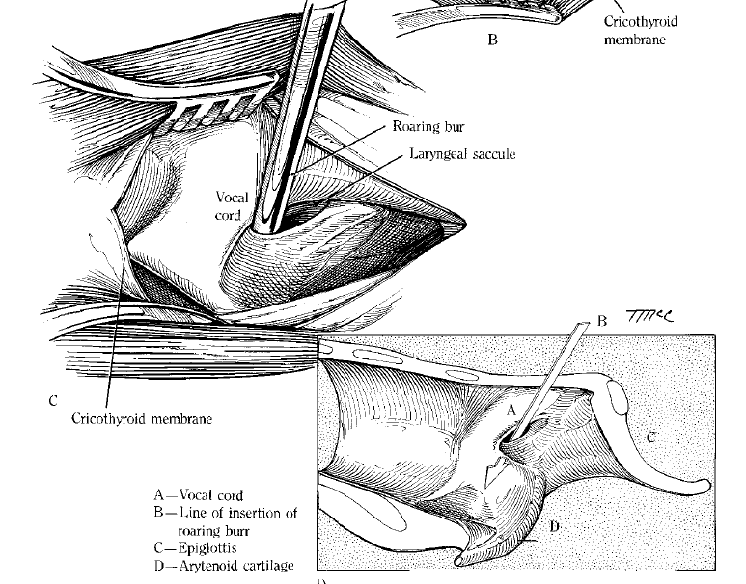
Ventriculectomy, Stripping of ventricle or Hobdaying

Slide 18
Vocal-cordectomy
Aim: To remove the vocal cords that emit sound
Debarking: Vocal cord snipped of by scissors
Nstrument: Gruenwal’s nasal punch forcep
De-bleating in sheep after performing laryngotomy.

Slide 19
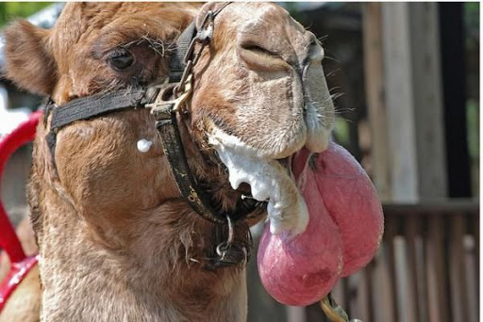
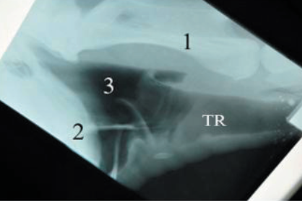
Soft Palate Injury in Camel
Soft palate(Dulla)-a unique diverticulum of soft palate in camel
It get extruded from mouth cavity during rut (Breeding season)
Protruded dulla is vulnerable to get trauma by sharp molar or canine of same animal or violent fighting between two male

Slide 20
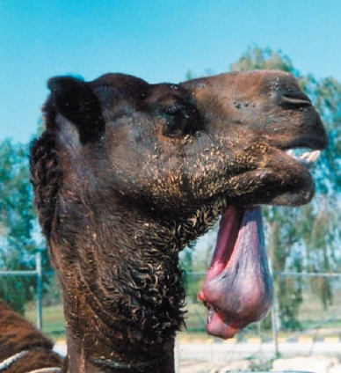
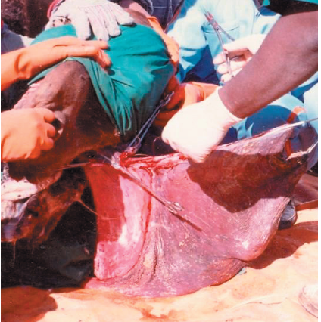
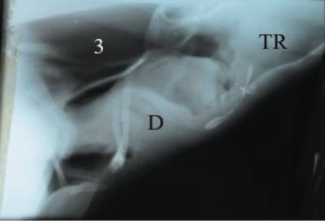
Dulla in Camel
Amputate soft palte from its caudal attachement under deep sedation and local infiltration with 2% lignocaine
Large stump may sucked into the laryngeal cavity that may cause death by asphyxia

Slide 21
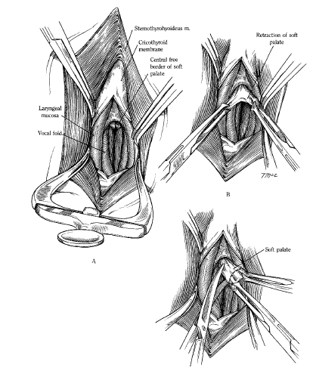
Resection of soft palate in Horse
Indications: Dorsal displacement of soft palate(DDSP)
Resection of cyste/Granuloma
Itiology:
Neuropathy of the pharyngeal branch of Vagus nerve.
Guttural pouch mycosis
Retropharyngeal lymphadenopathy

