Slide 1
URINARY SYSTEM

Slide 2
Kidneys are large lobulated structure.
Right kidney is placed below the last rib upto 2nd and 3rd lumber transverse process.
Left kidney is placed more ventral under 2nd or 3rd to 5th lumber vertebrae.
The ureters run and enters the dorsal wall of the urinary bladder.
The male urethra is divided into pelvis and extra pelvic part.
The urethra extends down from the pelvic part around the ischial arch down ventrally as a part of penis and gradually tapers down the preputial part of penis.
The penis of ram is similar to that of a bull except the free part and glans .

Slide 3
In the terminal part urethra extends beyond the glans as the urethral process which is about 4 cm long.
Obstructive Urolithiasis-
Calculi form in both castrated and uncastrated males and also in females.
Obstructive urolithiasis is problem of castrated adult males.
Also recorded in uncastrated male calves of cows and buffaloes.
The obstruction in the flow of urine due to calculi may occur in any part of the urinary tract but mostly in urethra.

Slide 4
Most common site in cattle is distal to sigmoid flexure.
Frequently the calculus gets lodged between the ischial arch and sigmoid flexure.
Sometimes may obstruct the neck of urinary bladder.
In few cases large calculus obstruct the urethra and multiple calculi recovered from the bladder.
Rare cases obstruct the ureters.

Slide 5
In buffaloes, calculi are mostly lodged at the glans penis or at the sigmoid flexure and also obstruct neck of urinary bladder.
Most common site in sheep are urethral process at distal end of penis and region of sigmoid flexure.
Clinical Examination:
Obstruction in flow of urine leads to futile and painful attempt by the animal to void urine.
In delayed cases urinary bladder gets rupture (cystorrhexis)
In case of nephrolith – No relief from from pain.

Slide 6
Clinical signs of retention of urine –
Anuria and less severe in partial retention.
Dry muzzle, sunken and anaemic eyes, salivation, rough coat, turgid skin, anorexia and suspended rumination.
The animal passes dry mucous coated balls and variable degree of dehydration.
If bladder intact rectal palpation reveals a fully distended urinary bladder.

Slide 7
UB crosses physiological limit gets ruptured.
Subserous or incomplete rupture usually causes atony of bladder such cases are more difficult to treat following complete rupture.

Slide 8
Rectal exam reveals splashing sound and collapse bladder difficult to palpate.
Where tear as on dorsum, UB bladder usually contains some urine and hang down in abdominal cavity.
Fluid thrill on abdominal ballotment.
Water belly evident.
Paracentesis abdominis done for correction
In sharp edges of calculus have reptured urethra subcutaneous infiltration of urine occurs.
Cellulitis may over perineal and preputial regions
Necrosis of area involved.

Slide 9
The abdominal fluid Creatinine concentration is 2-3 times higher than plasma conc.
Severe degree of dehydration, laboured breathing ,arched back, and protruded rectal mucosa indicate poor prognosis.
In nephritis and atonic bladder have little chance of recovery.
Location of calculous diagnosis is difficult due to sigmoid flexure prevent catheterisation.
Radiography is also difficult to locate.

Slide 10
POST SCROTAL URETHROTOMY
Bovine restrained in a lateral recumbency
20-25 cm long incision site from scrotum to ischial arch prepared for emergency.
LA is given on midline about 20cm length
Incise the skin and S/C tissue, muscle bluntly dissected.
Minimal haemorrhages in post scrotal area
Penis comes out by passing finger
Fascial covering removed by gentle incision
Penis can be exteriorized by strengthening the sigmoid flexure
Urethra lies n urethral groove ventrally.
Thoroughly examined to palpate the calculi.

Slide 11
Nick given on site of calculi and pressed to remove the calculi
Firmly lodged calculi require Allies tissue or Artery forceps to hold and pull out.
Sterilised Polyethylene tube is passed inside urethra
Size of tube used to snuggly fit the lumen
The other end of catheter is passed down urethra and anchored with the prepucial sheath to prevent dislodgement
Snuggly fitted catheter prevent seepage of urine and allows healing of wound without suture also prevent narrowing of lumen.
Muscle are also left unsutured.
Skin and S/C suture is closed with Hz mattress or interrupted suture using non-absorbable suturing material.
About 2-3 cm catheter protrude beyond the preputial opening.

Slide 12
Catheter is kept for 3-4 weeks.

Slide 13
ISCHIAL URETHROTOMY
Penis can not be pulled out in incision in the ischial arch
On linear incision on ischial arch
On exposing the penis directly faces the surgeon.
The catheter is passed through the urethral nick into the bladder and other end is anchored in the ischial region
Catheter is dislodged by movement of tail.
This technique is commonly used in Western country.
After a few days animal used for meat purpose.

Slide 14
CYSTORRHAPHY
Rupture of urinary bladder most common in complete destruction.
Dorsal tear sometimes heals spontaneously
Ventral tear required surgery.
Repair of urine bladder taken after removal of calculi
Cystography is done in standing position
Left laparotomy is performed after linear infiltration of xylocaine 2% below the external of the ileum.
Laparotomy incision should be large as much to introduce both hand into abdominal cavity.
Urine is siphoned out from ab cavity as much possible
Urinary bladder is located and presence of calculi and blood clot should carefully removed.

Slide 15
Catheter is passed through tear in the bladder and also passed through post-scrotal urethrotomy upto entire length of urethra 2-3 cm beyond the post- preputial sheath.
The upper layer of urinary bladder is weak and necrotic subtotal cystectomy required
Urinary bladder is sutured by continuous lock stitch suture using absorbable suture material.
Second row of continuous suture is also used to seal the wound
Remove the blood clots, cast cells, shreds etc.
Abdomen is closed in a routine manner.

Slide 16
RUPTURE OF URETHRA :
It might occur due to irregular sharp edge calculus causes trauma leading to seepage urine in subcutaneous tissue.
Swelling observed in the urethral area.
Multiple stab incision in the affected area and sufficient hydrotherapy help to drain urine and lessen its irritant effect.
Magnesium sulphate – glycerine paste in the initial stage and bismuth –Iodoform paraffin paste (BIPP) and other antiseptic and fly repellent creams helps to remove necrotic tissue.
Antibiotic and analgesic should be given.

Slide 17
TRAUMETIC-RETICULIPERITONITIS
TRP is disease of gastric – intestinal tract in cattle.
Cattle and buffalo ingest foreign bodies due to their indiscriminate feeding habit.
Due to nutritional deficiency ingest various types of foreign bodies.
Sometime animal may consume ropes, plastic, sheets etc.
Metallic foreign bodies also recovered from reticulum.
Foreign bodies are swallowed straight into the reticulum where they inflict trauma in the reticulum and peritoneum causing traumatic reticulo-peritonitis.

Slide 18
Higher incidence of TRP found in buffalo than cattle.
Buffalo above 6 yrs of age show very high incidence.
When foreign body is ingested get lodged into honey comb pattern at the reticulum.
Non potential foreign bodies like nuts, coins and stones are harmless and may passed out ultimately through faeces.
Potential foreign bodies like nails, needles and sharp wires may cause complications other than reticulitis.
Sequelae to potential foreign bodies may cause traumatic sternebrae, traumatic pericarditis, vagal indigestion, pyothorax, abscessation of liver and spleen, diaphragmatic hernia, traumatic pneumonia and pleurisy.

Slide 19
Extensive adhesions of the reticulum with the diaphragm or other structure might interfere with the reticular contractions and eructations process.
Localised peritonitis may be developed.
Clinical Signs:- Reccurent tympany, complete or partial anorexia, retarded or suspended rumination, less milk yield.
In foreign body syndrome, chronic tympany may be absent.
In acute cases reduction in milk yield .
Stiffness of forelimb and abducted elbow also observed.
Grunt, nearly abnormal heart, distressed respiration and regurgitation may occur advanced cases of DH.

Slide 20
Diagnosis:- History and clinical signs.
Neutrophilia with shift to left
Radiography showed nature and extent of damage caused by foreign body.
IB,s are located in the lower cranial, lower caudal and mid central part of the reticulum.
Treatment :
Rumenotomy done to remove foreign body.
Rumenotomy is indicated to remove impacted feed, trichobezors, phytobezors and other foreign body.

Slide 21
RUMENOTOMY
Incision parallel and lateral to last 5cm below lumber transverse vertebrae.
It is easier to approach the hand upto reticulum.
Local infiltration is given at the site of incision.
Furious animal require light sedation for normal standing.
Operative area thoroughly cleaned and shaved.
After scrubbing drap the area for operation
Animal kept in trevis and left area facing the surgeon.

Slide 22
The skin and muscle should be incised enough to enter hand of surgeon to explore the outer surface of rumen and reticulum.
Weingarth rumenotomy ring fitted at the site
The front of ring is fixed to the dorsal wound by thumb screw.
A part of rumen is brought out of the abdominal incision and one of rumen forcep is fixed to the dorsal part of the rumen wall.
The forceps is then hooked into the dorsal eye of the frame.
Similar procedure repeated at ventral part of rumen at a distance of 10-12 cm from the dorsal forcep.
Exposed part of the rumen incised and hooked at the cut edges of rumen wall.
Scalpel should be discarded.

Slide 23
After evacuating some contents of rumen, hand introduced into cavity to explore the foreign body in rumen and reticulum.
Penetrating foreign bodies are generally removed.
A magnet in hand used to remove loose foreign bodies.
Various types of foreign bodies are removed.
An Abscess in the reticulum can be incised by BP blade.
A cold and thick abscess should be cleaned before suturing.
Surgeon again rescrub the hand.
Rumen is sutured with catgut no. 2 using lambert pattern and reinforced with another layer cushing pattern.
Continuous lock stitch suture is using to close the muscle and peritoneum.
Skin suture closed with horizontal mattress pattern.

Slide 24
OMASAL IMPACTION
Secondary to rumen impaction and is result of poor quality food.
The omasum gets distended with stagnation of ingesta and absoprtion of fluid.
Signs: Anorectic, listless and dehydration shows stasis and absence of omasal sounds on auscultation at the level of right elbow at the 9th intercostal space.
Treatment: 4-5 litres liquid paraffin or mineral oil is administered through stomach to soften the content.
Rumen is massaged with fist and knee.

Slide 25
Above treatment fails then rumenotomy.
Mineral oil is given directly into the omasum through tube inserted by rumen incision during rumenotomy to soften the content.

Slide 26
HERNIA
Protrusion of the contents of a body cavity through normal or abnormal opening either to lie beneath the skin or occupy another body cavity.
It may be congenital or acquired.
The primary predisposing cause of acquired hernia is mostly trauma or increased intra-abdominal pressure.
Contents of hernia: -
It has tree parts
(i) Hernial ring (ii) Hernial Sac (iii) Hernial Contents

Slide 27
The hernia sac made up of tissues that enclose the hernia content.
Hernial sac is usually skin, muscular fibres, fibrous tissue and parietal peritoneum.
No hernial sac in DH.
Classification:
Classified according to its location, Functional alteration, content and cause.
Location:
(i) External hernia:- Consists of hernial ring, hernia sac and contents of hernia. ex- Ventral hernia, umbilical hernia.
(ii) Internal hernia Which lacks of hernia sac, eg. DH, gut tie.

Slide 28
Functional Alteration:
(i) Reducible hernia: Contents of hernia sac can be returned into original position through hernia opening
(ii) Irreducible hernia: Contents of hernia sac can not be returned to the original position through the hernial opening.
It could be of three types
(i) Hernia with adhesions:-adhesions between sac and its contents prevent reduction.
(ii) Incarcerated hernia:- Hernial content become too voluminous to be replaced through a narrow hernial ring.

Slide 29
(iii) strangulated hernia:- When blood vessels supplying the hernial contents are affected to cause complication like necrosis and extensive adhesions.
Contents of sac:- Enterocele- (intestine), epiplocele (omentum), enteroepiplocele (intestine plus omentum), reticulocele (reticulum), Hysterocele (uterus) and vesiculocele (urinary bladder).
Cause- (i) Traumatic hernia :- Which occurs due to injury e.g. ventral hernia.
(ii) Infectious hernia:-which occurs following destruction of abdominal wall due to infections.

Slide 30
Diagnosis:-External hernia has an external swelling. The swelling varies in shape and size and differentiated from other swellings. Such as abscess, cellulitis, haematoma, cyst and neoplasm.
In reducible hernia, the ring can be easily palpated. Incarcerated hernia ring is not felt easily because it is impossible to reduce the contents.
In strangulated hernia symtoms like abdominal pain, fever and evidence of bowel obstruction may coincide with the swelling
Radiography may be helpful to identify the contents of irreducible hernia in small ruminants and calves.
Exploratory puncture may also helpful to know the contents of swelling.

Slide 31
UMBILICAL HERNIA
Generally seen in bovine calve, more frequent in female than male.
It can be congenital or acquired in nature.
Acquired hernia is noticed few weeks after birth.
It is hereditary.
The umbilical opening in the fetus allows the passage of the urachus and umbilical blood vessels.
After birth these structure are disrupted or severed and umbilical opening closes around the cord. The wound heals cicatrization and represents umbilicus.
Due to improper closure of the umbilicus opening at birth or from maldevelopment or hypoplasia of the abdominal muscles, a defect may remain in the mid ventral to form congenital opening

Slide 32
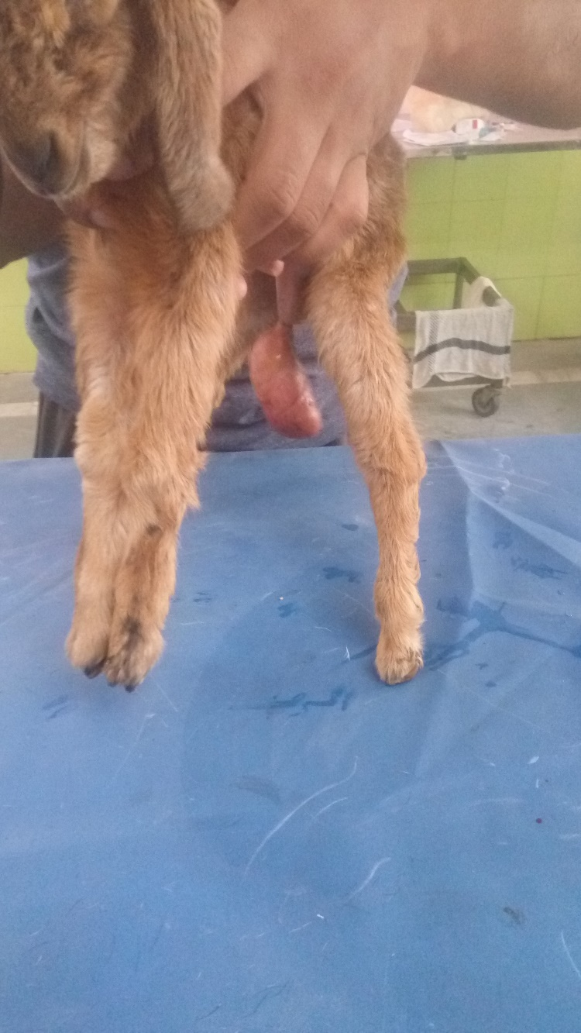

Slide 33
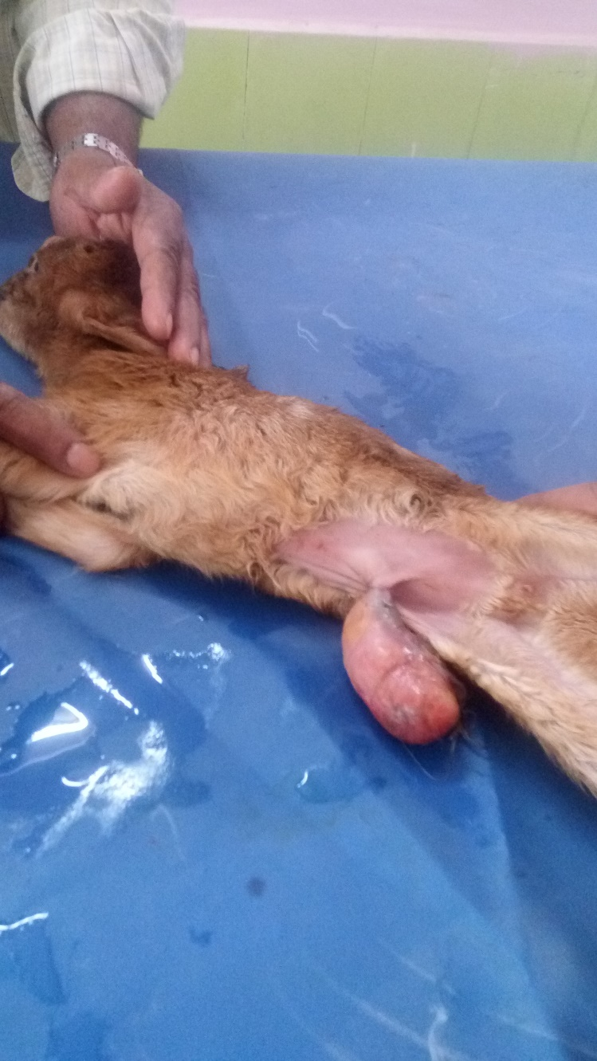

Slide 34
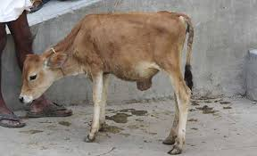

Slide 35
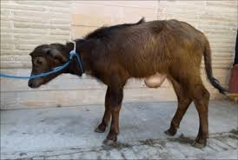

Slide 36
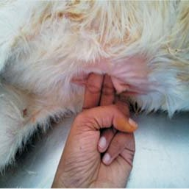

Slide 37
Acquired umbilical hernia occurs primarily due to manual breaking or resecting of the cord to close the abdominal wall.
Excessive straining due diarrhea or constipation or infection of the cord preventing natural closure of the umbilical resulting to hernia.
Clinical signs:- Discrete spherical swelling seen on umbilicus. Contents are usually fat and omentum. Sometime contains loops of small intestines. The sac is formed by skin, fibrous tissue and peritoneum.
Treatment:- Treated by conservative and surgical methods.
Belly bandages reduce the hernia and allows the hernial ring to close by cicatrization. Previously hernial clamp is used to control the hernia

Slide 38
Radical surgery is performed.
After fasting animal controlled in dorsal recumbency and liberal operation area is prepared for surgery.
Local anesthesia is infiltrated and adequate elliptical incision is made through skin or each side of swelling.
The skin incision are joined on the midline cranially and caudally.
The skin between the two elliptical incision is resected from the hernial sac and discarded.
The skin lateral to the incisions is then undermined to expose the hernial ring.
The sac is freed from the ring by blunt dissection and the intact sac is deposited into the abdominal cavity.

Slide 39
A circular hernial ring should be converted into an oval shape for smooth closure by incising the ring caudally and cranially with V-shaped incision.
The ring is then closed by placing a series of overlapping sutures through its edges using heavy nonabsorbable suture material.
The Skin is closed by mattress with non-absorbable suture material.
Post-operative management should be done.

Slide 40
VENTRAL OR ABDOMINAL HERNIA
Hernia through any part of the abdominal wall other than natural office
If hernia is ventral to the stifle skin fold.
Hernia is in the flank region are lateral abdominal hernia.
Common in ruminants and acquired in nature.
Trauma such kick, horn thrust or violent contact with blunt objects or abscess in the abdominal cavity.
Abdominal distention due to pregnancy or violent straining during parturition

Slide 41
Excessive long caudal incision for CS.
Commonly seen in along the costal arch, high or low in the flank, between the last few ribs or in the ventral abdominal wall near the midline.
It is difficult to palpate the ventral hernial ring during initial stage due to oedema or haematoma in the surrounding tissues.
Wait for inflammatory swelling to subside before examination is done to confirm the diagnosis.
this delay may also facilitate repair as recently traumatized tissues do not hold suture firmly.
The hernial sac formed by the skin and subcutaneous tissues may or may not be lined with the peritoneum.

Slide 42
Lack of peritoneal covering favours the development of adhesions between the viscera and sac and finally may cause incarceration or strangulation.
The nature of hernial contents depend on the site of the herniation.
A hernia in the left flank may contain the rumen.
Treatment:-
Herniorrhaphy is elective.
Delay the surgical repair for at least one week after injury.
Prolonged delay may cause complication.
If hernia is complicated due to incarceration or strangulation, immediate surgical intervention required.

Slide 43
After linear incision skin is separated from swelling.
Hernial Sac is separated from ring.
Viscera separated from adhesion and returned into abdominal cavity.
The thick mass of fibrous tissue involving hernial swelling may be resected.
Ring edge are trimmed to provide raw surface.
The rent in the abdominal is then closed with sutures.
Hernioplasty may be required in some cases.

Slide 44
INGUINAL OR SCROTAL HERNIA
Protrusion of an abdominal organ through the inguinal canal is Bubonocele.
If contents coming up to scrotum is Oscheocele.
Contents may be omentum, intestine or both.
Sometime UB.
Generally acquired in rams and bulls.
Congenital inguinal hernia bovine calves and lambs.
Scrotal hernia may be traumatic in origin - Mounting.

Slide 45
May be unilateral or bilateral.
The abdominal canal is slite like space between abdominal muscle.
CLINICAL SIGNS:- Swelling in the inguinal canal or neck of scrotum.
Bulls refuse to mount.
Enlarged scrotum touches ground in rare cases.
When hernial contents strangulated shows systemic signs.
Rectal examination may help in diagnosis.
TREATMENT:-
The animal is tranquilized and kept in lateral recumbency with affected side up.

Slide 46
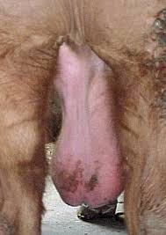

Slide 47
The upper hind limb is abducted for maximum exposure.
Local anesthesia infiltrated.
Skin incision over swelling.
The hernial content returned into abdominal.
Ring sutured with overlapping suture.
The incision over sac is closed with simple continuous suture.
Another technique through paralumbar fossa

Slide 48
PERINEAL HERNIA
Protrusion of the abdominal or the pelvic viscera through the pelvic diaphragm which supports the rectal wall.
Common in dog.
The perineum is part of the body wall that covers the pelvic cavity outlet while surrounding the anal and urogenital canals.
Tearing of diaphragm muscles leads to herniation.
Reducible swelling observed along the side anus or vulval lips,
Contents are generally UB and retroperitoneal fat.

Slide 49
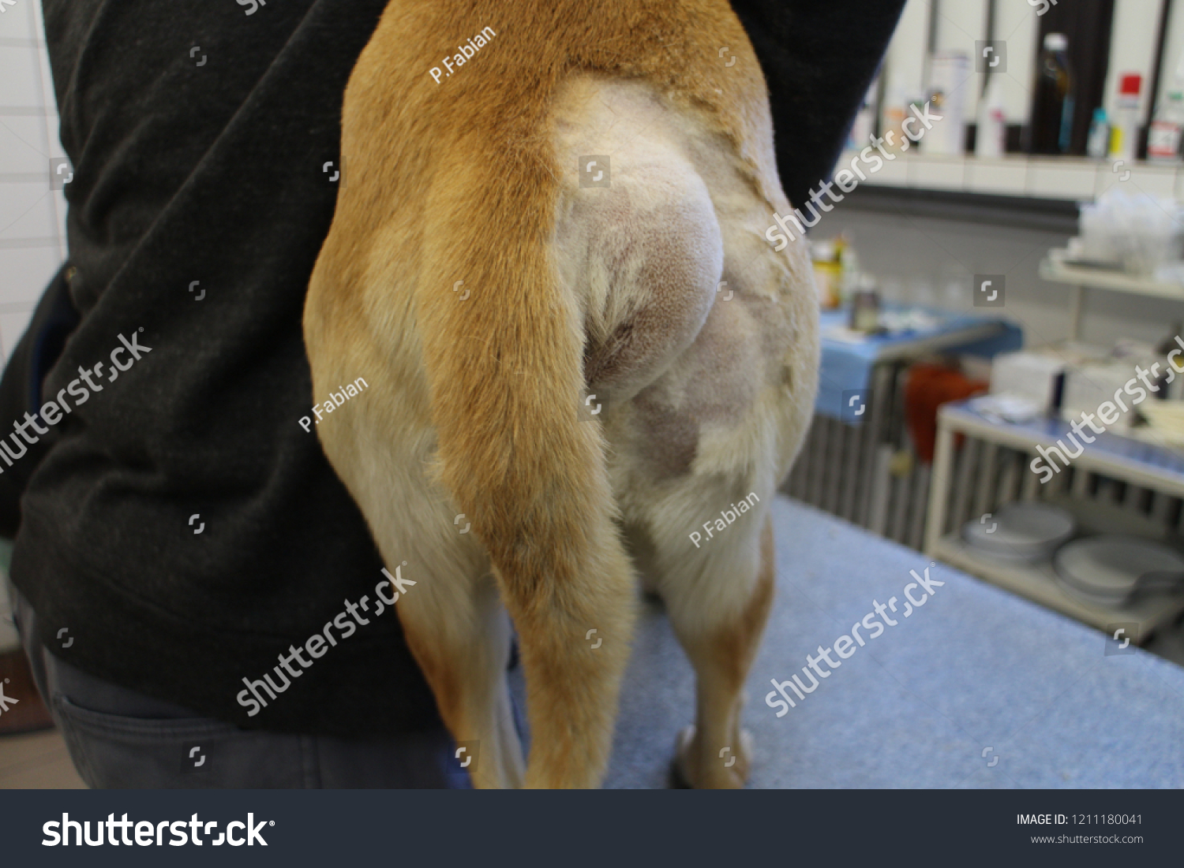

Slide 50
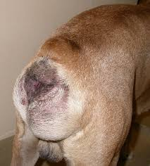

Slide 51
Sedation of animal with GA kept in either lateral or sitting position.
A purse string suture placed around the anus after placing gauge plug in the anal opening.
A slightly curve incision given vertically.
Subcutaneous tissue separated expose the organs,
Contents retuned into original position sutured with two layer suture
Skin closed with mattress suture.

Slide 52
DIAGPHRAGMATIC HERNIA
Passage of abdominal viscera into Thoracic cavity.
Congenital or acquired
Commonly reticulum but sometime other organs may also involved.
Frequently in buffalo.
AETIOLOGY:
Weakening of diaphragm by TRP
Congenital weak point of diaphragm
During pregnancy or act of parturion.

Slide 53
Presence of foreign body in the reticulum
Abscess formation in the diaphragm
Tympany, advance pregnancy, straining at the time of parturion.
CLINICAL SIGNS:-Recurrent tympany, abrupt fall in milk yield, scant defecation or diarrhea with smell, regurgitation, aspiration pneumonia , brisket oedema with or without jugular pulsation, abduction of limb, chronic cough, weakness, dehydration.
Pathology:- In buffalo DH occurs mostly in right hemidiaphragm -90% and rarely in left 7% or in centre 3% . Generally one hernial ring but occasionally multiple hernial ring.
The extent of reticular herniation through diaphragmatic rupture varies in different animals.

Slide 54
DIAGNOSIS:- History, clinical signs, recent parturition, Muffled heart sound, reticular sound heard cranial to 6th rib,
Pain or contrast radiography, left flank laparotomy, Exploratory laparotomy and rumenotomy.
Laparo-rumenotomy is primary step.
TREATMENT:-
Laparo-rumenotomy, Evacuate the content, Foreign body removed.
Two technique- Thoracic and abdominal.
Kept off feed 48 hours following rumen evacuation.
Corticosteroid given before operation
Animal is anaesthetized with 5% thiopentone and 2-4% Halothane.

Slide 55
After intubation endotracheal tube connected to positive pressure ventilator for intermittent positive pressure
Abdominal Approach:- Animal controlled in dorsal recumbency.
Right hemi diagram prepared for surgery.
The abdomen is entered through an incision of 25 to 35cm in length.
Five cm caudal to xiphoid cartilage and running to costal arch.
Least haemorrhage.
The adhesion between reticulum and diaphragmatic ring are severed by blunt dissection.
The palm of hand is glided through the hernial ring to carefully break the adhesion between reticulum and thoracic organs.

Slide 56
The reticulum is withdrawn into abdominal cavity and ring is closed with continuous lock stich suture using nonabsorbable suture material.
The suture starts from lower part of the ring.
Abdominal wall is closed with two to three layer.
Thoracic approach:-
Right or left lateral thoracotomy.
A cutaneous incision 25 cm in length is made midway on the 7th rib and extended ventrally to the costo-chondral junction.
The technique of rib resection to the thoracic cavity.
After pleura has been incised the herniated reticulum comes in view.

Slide 57
Adhesions of the reticulum with the lungs, pericardium and pleura ae separated carefully by blunt dissection.
The reticulum is freed from ring by breaking the adhesions with a gentle blunt dissection.
The reticulum is then pushed into abdominal cavity.
Ring is closed as the same way.
Negative pressure in the chest cavity is created by suction of air.
The respirator is disconnected
The endotracheal tube removed after swallowing reflex.
The animal came into sternal recumbency.

Slide 58
Post-operatively
Broad spectrum antibiotic 7-10 days
Analgesic 3 to 5 days.
Adequate fluid therapy.
In brisket oedema diuretics may used.
Suture after 10 to 12 days.

