Slide 1
THROMBOSIS
Dr. SANJIV KUMAR
ASSTT. PROFESSOR,
DEPTT. OF PATHOLOGY, BVC, PATNA

Slide 2
DEFINITION
Abnormal formation of a blood clot within the vasculature of a living animal.
A mass of fibrin and or platelets along with other blood elements

Slide 3
LOCATION
Blood or lymphatic vessel
Heart (Mural thrombi)
Free in their lumens (Thrombo-embolism)

Slide 4
CAUSES AND MECHANISM
Endothelial damage
Hemodynamic changes
Hypercoagulability of blood

Slide 5
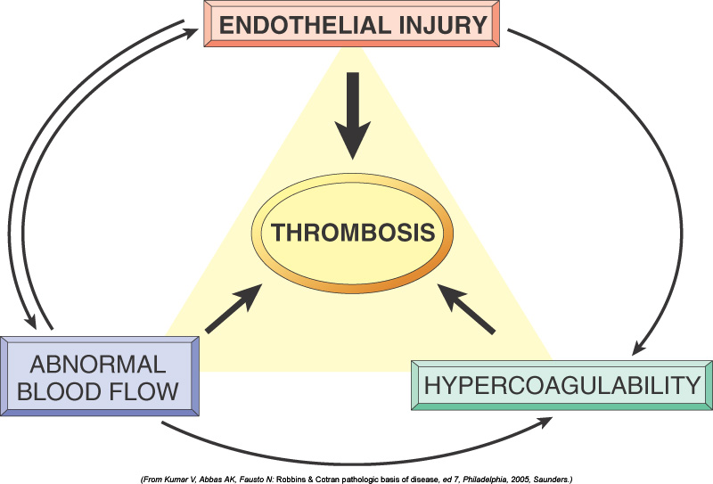

Slide 6
ENDOTHELIAL DAMAGE
Mechanism
Damage to endothelial cells- Release of tissue thromboplastin
Subendothelial components-Collagen, fibronectin
Platelet adhere to the exposed sub-endothelial collagen
Tissue factor released by the damaged endothelial cells activate the coagulation cascade
Decreased PGI2, decreased nitric oxide (NO)
Release of TXA2 causes vasoconstriction
timulates aggregation

Slide 7
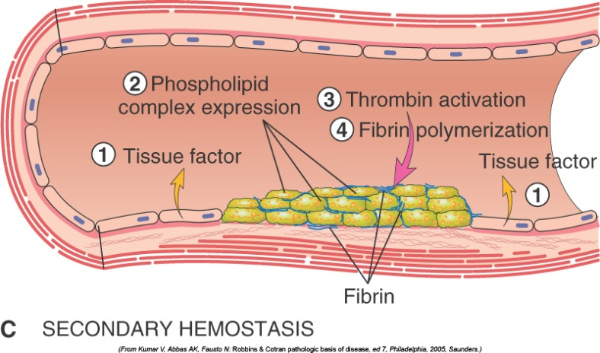
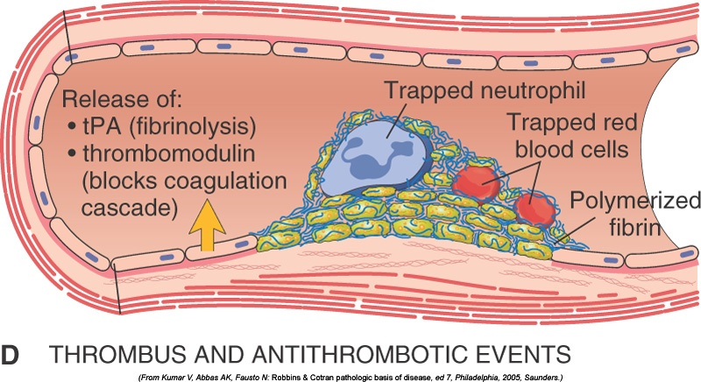

Slide 8
HEMODYNAMIC CHANGES
Abnormal blood flow
Turbulence or blood stasis
Disrupts laminar flow of blood
Platelets coming in close contact with vascular wall
Coagulation factors are activated
Endothelial injury result in release of tissue factor

Slide 9
HYPER-COAGULABILITY OF BLOOD
Favours thrombosis due to a change in make-up of the formed elements of the blood
Inherited deficiency of anticoagulent component such as protein C
Imbalance in procoagulent and anticoagulent components in the blood
Patients with certain kinds of cancer and dogs with hyperadrenocorticism-hyper-coagulable state

Slide 10
Morphologic appearance of thrombus Depends upon the location and composition (relative proportion of platelets, fibrin and erythrocytes)
Cardiac and arterial thrombi are pale thrombi.
Venous thrombi are dark red.
RBC’s are often incorporated into a loose meshwork of platelets and fibrin.
Cardiac and larger arterial thrombi often have a laminated appearance created by rapid blood flow characterized by alternating layers of platelets (dark) and fibrin intermixed with Rbc’s and leucocytes (pale)-Lines of Zahn

Slide 11
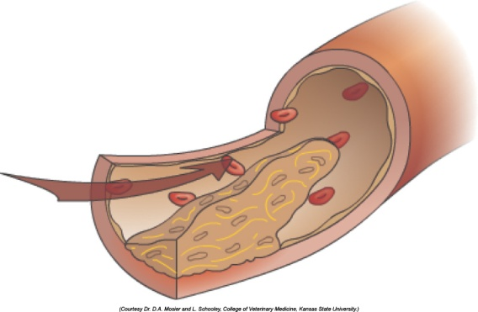
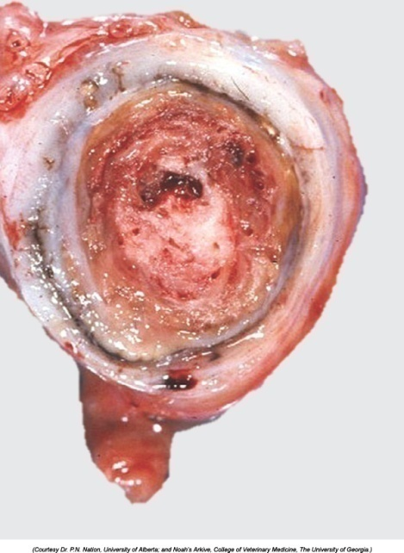

Slide 12
POSSIBLE OUTCOME
Propagation- A small thrombus can become a large thrombus as more platelets and erythrocytes and fibrin accumulate.
Dissolution- Thrombus may undergo dissolution.
Thromboembolism- parts of the thrombus may dislodge and form a new thrombus or obstruction at a distant location.
Infarction and ischaemia-Reduced blood flow to tissue (ischemia) or complete obstruction of blood flow so that the tissue dies (Infarction)
Organization and Recanalization- The thrombus is converted to fibrous connective tissue. This scar tissue may contract allowing re-establishment of blood flow through recanalized vessel.
Disseminated intravascular coagulopathy (DIC)-When numerous thrombi are formed simultaneously in a widespread manner (infectious or neoplastic diseases)-coagulation factors and platelets become depleted- causes disseminated haemorrhage.

Slide 13
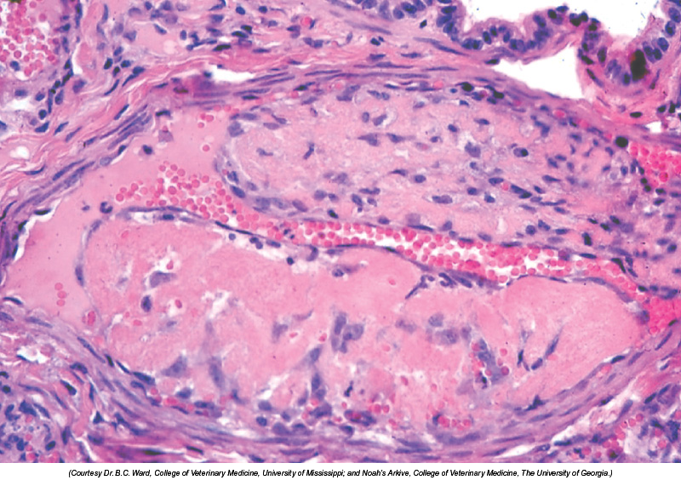
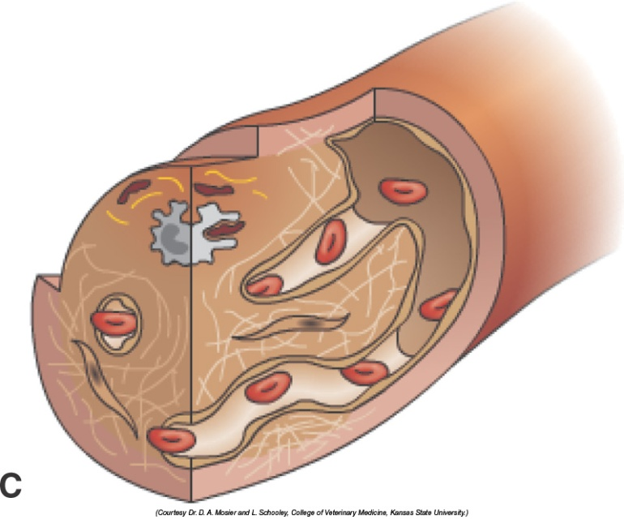
RECANALIZATION

Slide 14
DIFFERENCE BETWEEN PM CLOT AND THROMBUS
PM CLOT
Blood clots within the vasculature after the death of animal. These clots are shiny, red, gelatinous.
Have yellow plasma near the surface-chicken fat clot and while base is red because rbc’s settle down in the clot-Currant-jelly clot.

Slide 15
Character | Thrombus | PM Clot
Size | Fills the vessel | Smaller than vessel
Surface | Rough | Smooth, shiny and glistening
Attachment | Point of attachment with vessel wall | Not Attached
Structure | Laminated appearance | Homogenous
Color | Red, white or mixed | Red or chicken fat
Endothelium | Roughened | Smooth

