Slide 1
Application of Membrane Processing: RO, UF, NF and MF
Dr. J. Badshah
University Professor – cum - Chief Scientist
Dairy Engineering Department
Sanjay Gandhi Institute of Dairy Science & Technology, Jagdeopath, Patna
(Bihar Animal Sciences University, Patna)

Slide 2
Application of Membrane Processing
Changing pattern of milk consumption is stressing on individual use of its components.
Whey which has high BOD value is being efficiently concentrated form protein . Then, the lactose in the permeate solution can also be handled by RO.
It saved energy in transportation, due to concentration.
Cheaper method of drying. Pumping is involved, as against evaporation of moisture.
Possibility of incorporating whey proteins into cheese.
Pollution due to whey is controlled, as whey contains lactose.
Milk also can be concentrated without damage to protein or changing flavour unlike in concentration and drying.
Other industrial uses, like water purification, fractionation & concentration in Food and Pharmaceuticals, recovery of various components of waste for further use.

Slide 3
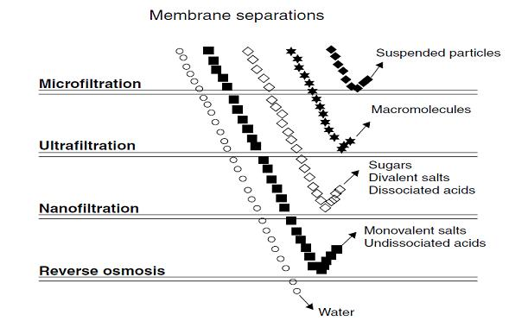
Types of Membrane Separation Processes

Slide 4
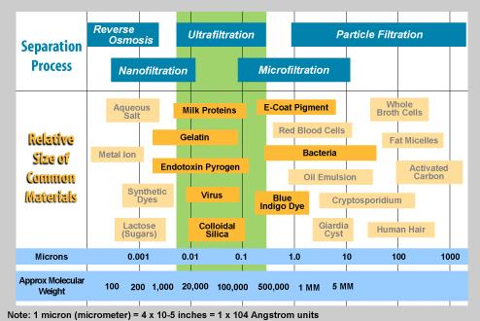
Membrane Processes in relation to molecular weight and sizes

Slide 5
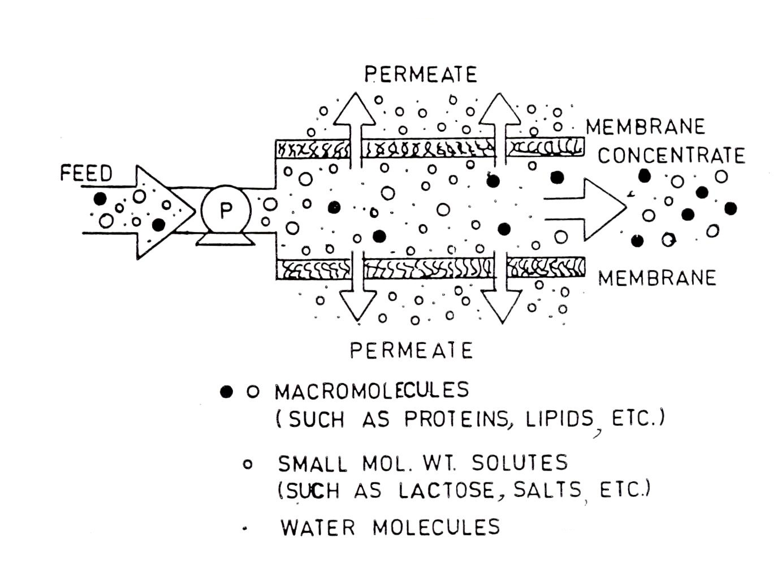
Membrane separation under Pressure

Slide 6
Ultrafiltration (UF)
A pressure driven membrane process (approx. 1 -10 bar)
Separation and concentration of substances having a molecular weight between 10³ – 10⁶ Dalton.
High molecular weight component, such as protein, and suspended solids are rejected as retentate
While all low molecular weight components such as lactose, salts and water pass through the membrane freely as permeate.
No rejection of mono and disaccharides, salts, amino acids, organics & inorganic acids or sodium hydroxide.

Slide 7
Characteristics of UF Membranes
Characteristics
Membrane : Asymmetrical
Thickness : 150 – 250 µm
Thin film : 1 µm
Pore size : 0.2 – 0.02 µm
Rejection : Retentate of Macro molecules, proteins, polysaccharides
Filteration : Permeate of Small mol. Weight solutes (Lactose, salts, water)
Membrane materials : Ceramic, PSO, PVDC, CA, thin film
Membrane module :Tubular, hollow fibre, spiral wound, plate-and-frame
Operating pressure :1-10 bar
Mechanism of membrane retention : Molecular screening
Typical flux :30 – 300 lit/m²h

Slide 8
Microfiltration Process
A pressure-driven employing pressures considerably lower than others especially Reverse Osmosis.
UF is considered to involve the processing of dissolved macromolecules, while MF involves separation of dispersed particles such as colloids, fat globules or cells.
MF can be considered to fall between UF and conventional filtration, although there is overlap at both ends of the spectrum

Slide 9
Terms in relation to Membrane separation
Retention Factor: It specifies the ability of a membrane to retain that molecule. R= (C_{f} – C_{p /} C_{f} ), where, C_{f} = Conc. of that molecule in feed and C_{p} = Conc. Of that molecule in permeate
In Batch process where the concentrations are continually changing, R varies and then the realistic value can be,
Ln (C/Co) = R ln (Vo/V) where, Co = Initial concentration at Vo
C = Conc. at any other volume V
Separation Factor (s) a measure of performance of the membrane in separating solvent and solute. S = C f / C p and R = 1 – (1/S)
S is a concept more appropriate to water purification than milk concentration.

Slide 10
Concentration Polarization
Increase in concentration of solids in the direction towards the membrane due to the extraction of permeate through the membrane.
The rediffusion of concentrated solids back into the feed is governed by Fick’s law. This law describes molecular diffusion .
J_{AB} = - D_{AB} (dc_{A} / dz)
Where J_{AB} Molar flux of component A in the direction of Z of mixture of AB (kg mol of A/m² s)
D_{AB} Molecular diffusivity of component A in component B (m² / s)
c_{A} Concentration of component A (kg mol / m³ )
z distance (m)
Flux: Rate of extraction of permeate, measured in litres/sq. h
The flux or the flow rate in the membrane under laminar flow is governed by Hagen Poiseuille equation. This equation relates the pressure drop, path geometry and viscosity of fluid flowing through membrane under laminar condition.
Where average velocity , pressure drop , D is diameter of pores µ is viscosity, L length of the pipe

Slide 11
Reverse Osmosis
RO membranes separate or retain solutes with a molecular weight greater than 150 Dalton (D).
It is basically dewatering process which operates at pressures at least five to ten times higher than those employed for UF.
Hence fats, proteins, lactose and all undissociated minerals are retained and concentrated by the membranes and only water and some ionised minerals are allowed to pass with permeate.
If pressure greater than osmotic pressure of the solution is not applied, the osmosis will remain continue to equilibrate the concentration by diffusion of water molecules toward solution.
If the molecular weights of molecules to be separated/retained are less than 2000 to 3000 D, the osmotic pressure of the solution becomes significant, the operating pressure in RO is rather high for example from 20-100 bars to overcome the osmotic pressure.
On application of pressure in solution, it would reverse the flow and the RO process would starts with flow of water from solution to dilute solution/water. As a result the concentration of solution is increased.

Slide 12
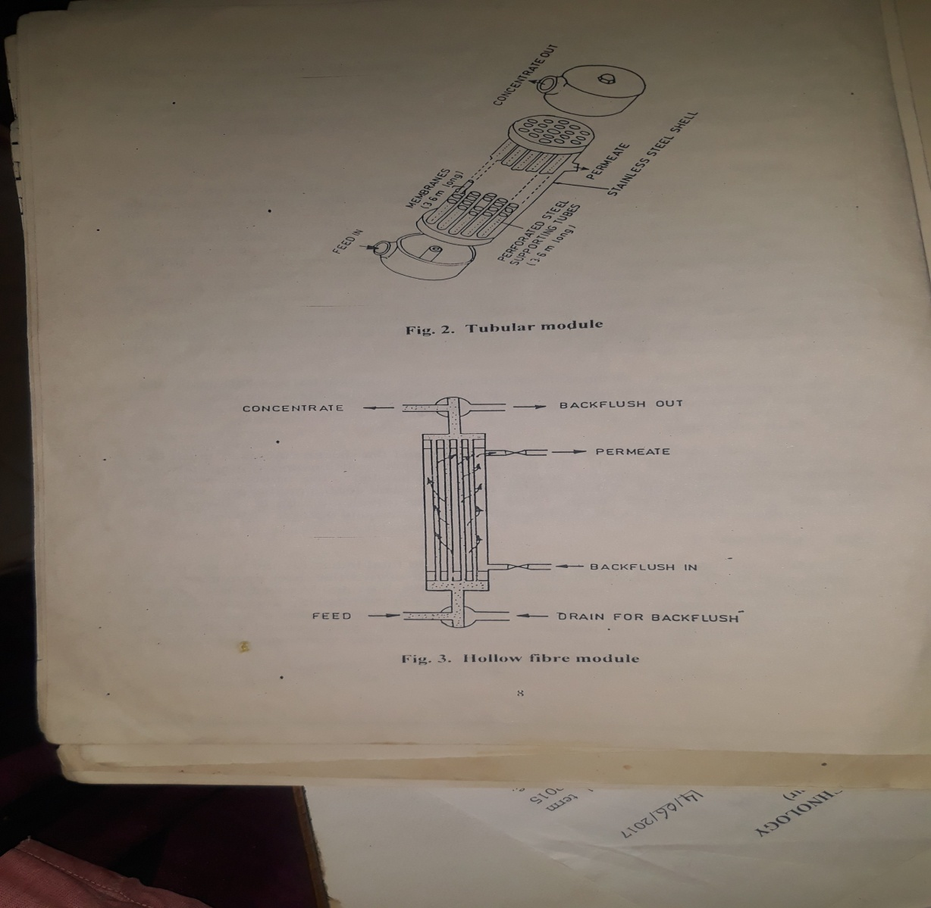
Tubular Module and Hollow Fibre Module

Slide 13
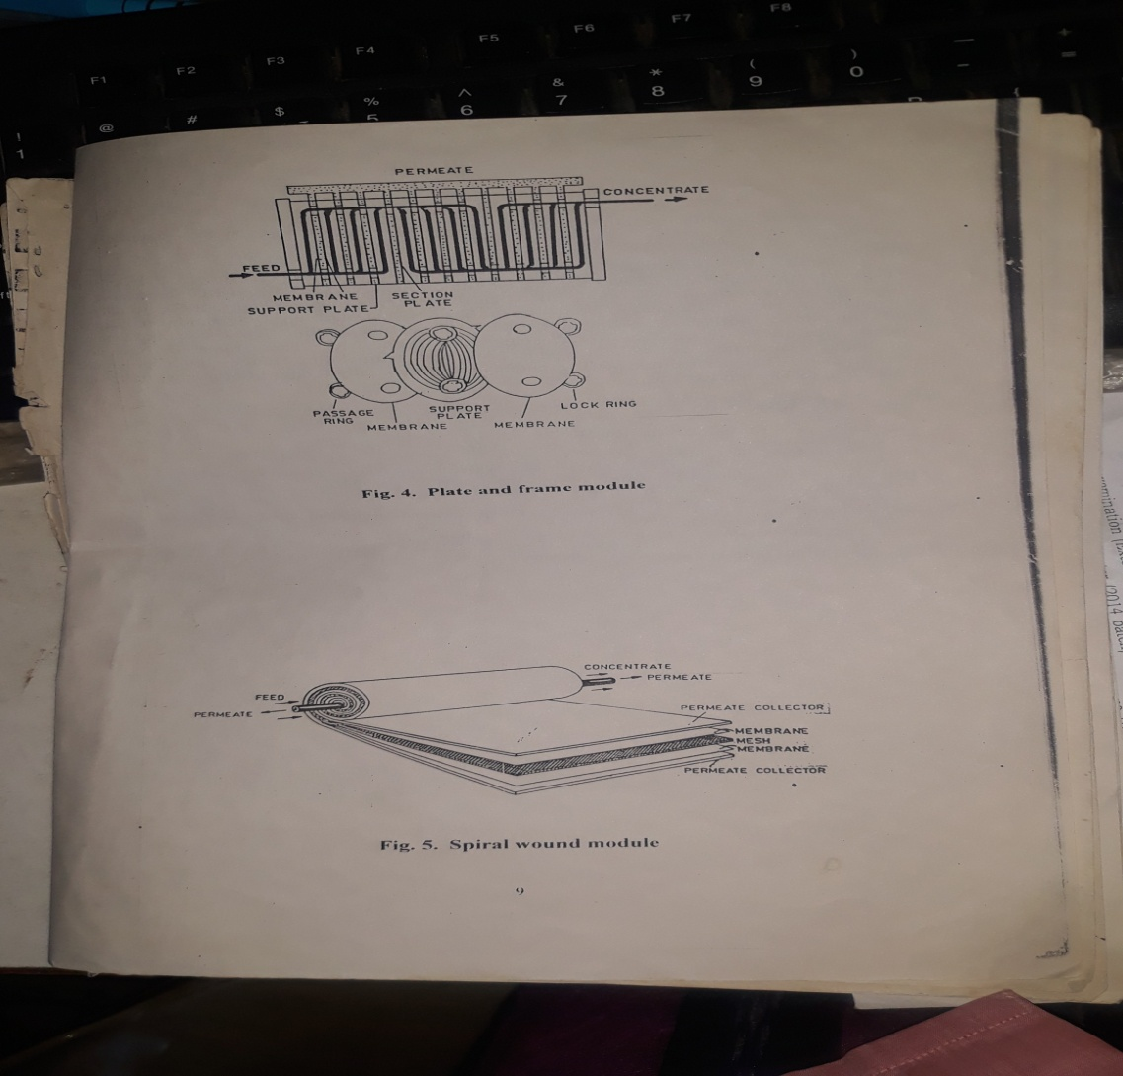
Plate and Frame Module and Spiral wound Module

Slide 14
Applications of Membrane Technology in Dairy
RO for Bulk Transportation of Raw Milk: Various operating parameters have been standardized for the optimization of the process of dewatering of milk through RO. It would reduce bulk and transportation cost
Fractionation of Milk Proteins into various constituents having unique functional characteristics. Most of the milk proteins are separable depending upon selective screening from UF membrane process from skim milk. From largest size to least size the milk proteins are as follows:
Lipoproteins in milk fat globule membrane ≥ Casein micelles ≥ Immunoglobulins ≥ Lactoferrin serum albumin ≥ ß-lactoglobulin ≥ α-lactalbumin ≥ casein –derived peptides.
Demineralisation and Delactosation of Dairy Products particularly whey.
NF allows selective rejection of low molecular weight species and particularly the monovalent ions during the course of concentration. The degree of demineralisation for rennet whey, cheese whey and acid casein whey provides more interesting challenges.

Slide 15
Applications of Membrane Technology in Dairy
Recycling water of condensate from evaporator by UF/RO processes. It will effectively removes impurities and help to recycle the water instead of wasting it.
Preparation of Biological Peptides: Membrane UF is used as the most appropriate tool for separating low molecular weight peptides and also free amino acids from protein substrate utilizing enzymes.
These biological peptides have been implicated in physiological roles such as bio-transfer of trace elements, immuno-modulation, antihypertension, antithrombosis, regulation of gastroitestinal tract and the general behaviour.
Production of Pasteurised milk with extended Shelf life: With the use of Micro-filtration process, the bacterial counts in skim milk is reduced by more than 99%. The permeate of MF is without bacteria and it would be standardised with cream permits production of superior quality of pasteurised milk with extended shelf life.

Slide 16
Applications of Membrane Technology in Dairy
Preparation of Rasogolla Mix Powder: Cow milk is ultafiltered to about 3- fold concentration to achieve a product containing all the milk proteins and part of minerals and lactose. To adjust similar to chhana, the UF retentate has to be diafiltered. The pasteurized cream is added to diafiltered retentate followed by spray drying adopting standard conditions.
Cheese Making: The use of UF is in the manufacture of soft Cheese. It increases the yield of cheese up to 10-30% due to entrapment of whey proteins and possibly additional bound wayer associated with the whey prteins. It reduces the energy requirement during heating and cooking steps.
Manufacture of low lactose Powder: Lactose intolerance is a global problem. UF can be employed to manufacture low lactose powder. Additional diafiltration treatment is employed to further reduce lactose.
Manufacture of Milk Concentrates and Nondairy whitener based on UF & diafiltration with protein purity of 50-85% of skim milk and drying of concentrates.

Slide 17
THANK YOU

