Slide 1
ULCERATIVE LYMPHANGITIS
Anil Kumar
Asst. Professor
Dept. of VCC
UNIT-5

Slide 2
ULCERATIVE LYMPHANGITIS
Synonym: Pigeon Fever in Horse
Ulcerative lymphangitis is a sequel to bacterial infection(s) of the cutaneous lymphatic vessels of Equines, ultimately affects the performance of horse dueto lameness and deformity of the limbs.
The organism produces various extracellular exotoxins, which play a role in virulence.
Etiology: Corynebacterium pseudotuberculosis
Host Range: Equids, sheep, goats, cattle, buffalo, camelids, and rarely humans.
Clinical Signs:Three forms have been described in horses:
Limb infection/Ulcerative lymphangitis
External abscesses
Enternal infection

Slide 3
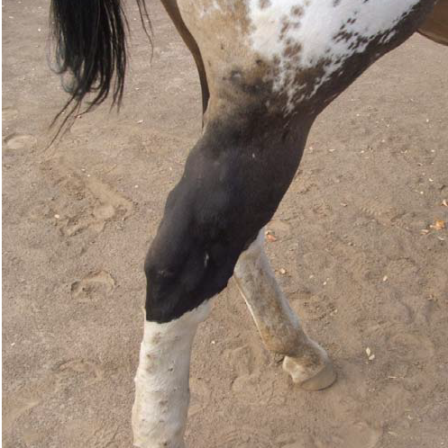
Limb infection:
There is severe limb swelling and cellulitis, with multiple draining tracts following lymphatics.
One or both hind limbs are affected cause severe lameness, fever, lethargy and anorexia.
In chronic stage , resulting in limb edema, prolonged or recurrent infection, lameness, weakness, and weight loss
Ulcerative lymphangitis

Slide 4
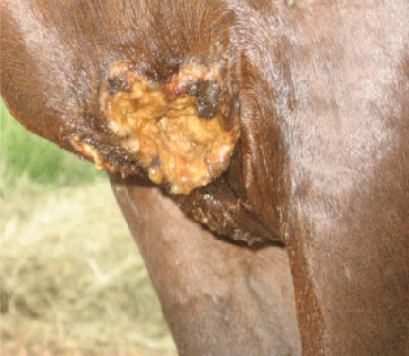
External Abscesses:
Most common manifestation
a single or multiple abscesses can occur anywhere on the body (prepuce, mammary gland, triceps, axilla, limbs, and head), but most frequently develop in the pectoral region along the ventral midline of the abdomen and swelling appears as a pigeon’s breast.
Abscess may ooze odor-free purulent exudate and are usually well encapsulated.
External abscesses do not usually develop signs of systemic illness
Fig. : The bursting nodules can
discharge pus

Slide 5
Internal infection:
Occurs in approximately 8% of affected horses
The organs most commonly involved are liver, kidney, spleen and lungs.
Pregnant foal may abort due to placentitis or fetal infection
The most common clinical signs to be remembered
concurrent external abscesses
decreased appetite
fever, lethargy
weight loss
Signs of respiratory disease or abdominal pain.
Other signs observed in horses with internal abscesses include ventral edema, ventral dermatitis, ataxia, hematuria (due to renal abscesses), and uncommonly, abortion.

Slide 6
Transmission:
It may be transmitted through horse-to-horse contact or from infected to susceptible horses via insects, other vectors, or contaminated soil
The portal of entry is through abrasions or wounds in the skin or mucous membranes.
Mechanical vectors (Haematobia irritans, Musca domestica, Stomoxys calcitrans)
ventral midline dermatitis is a predisposing cause of infection.
Diagnosis:
Bacterial culture of aspirates or exudate
Clinical pathological abnormalities:
anemia of chronic disease,
leukocytosis with neutrophilia,
hyperfibrinogenemia, and
hyperproteinemia.

Slide 7
iii. Diagnosis of internal infection is based on clinical signs, clinicopathological data, serology, diagnostic imaging and bacterial culture.
iv. Serologic testing:
Synergistic Hemolysis Inhibition (SHI), may aid in diagnosis of internal abscesses.
Treatment:
Drainage of external abscesses
Antimicrobial therapy as penicillin G, macrolides, tetracyclines, cephalosporins, chloramphenicol fluoroquinolones and rifampin may be recommondded.
Trimethoprim-sulfa (5 mg/kg based on the trimethoprim fraction, twice daily orally) or

Slide 8
Procaine penicillin (20,000 U/kg twice daily intramuscularly) are effective for external abscesses especially on the ventral midline.
Rifampin (2.5-5 mg/kg twice daily orally) in combination with ceftiofur (2.5 – 5 mg/kg twice daily intramuscularly) appears highly effective for treatment of internal abscesses.
Internal abscesses have also respond well to enrofloxacin (7.5 mg/kg once daily orally).
The average duration of antimicrobial therapy for internal infection is 4-6 weeks which is best determined by repeat abdominal ultrasound and clinicopathologic results.
Physical therapy (hydrotherapy, hand walking, and leg wraps)as well as NSAIDs are also recommended.

Slide 9
Zoonotic Potential:
Human illness through working with infected sheep developed axillary lymphadenitis.
Prevention and Control:
Wearing of gloves when working with affected horses followed by hand washing is indicated.
Isolation of affected horses from naive herd mates
Protecting horses from insect exposure by regular application of insect repellants.
Meticulous wound care (topical fly repellants, antimicrobial ointments and bandages) to prevent infection from a contaminated environment

