Slide 1
MANAGEMENT OF COMMERCIAL POULTRY
By:
Dr. Ravikant Nirala
Assistant Professor, LPM, BVC, Patna

Slide 2
BROODING MANAGEMENT OF CHICKS
The term brooding refers to a process of providing extra warmth to the chicks for first few weeks to overcome the heat loss from their body.
This is very essential because chicks do not have well developed heat regulating mechanism and have very little feathers for insulation.
In chick rearing, the first four weeks of life is the most difficult and crucial. Slight error in management at this stage may result into heavy mortality or adverse effect on growth and consequently reduction in egg production ability of the hen.
Thus, profitable poultry business depends upon the successful brooding programme.

Slide 3
Methods of Brooding Chicks
1. Natural Method : by brood hen
2. Artificial Method : (A) Hot Room Brooding
(B) Cold Room Brooding a) by using brooder
b) by using spot light
c) by infra-red bulb.
In artificial method, the chicks (0-8 weeks) are reared in a brooder house, where they are provided optimum temperature, ventilation, feed and water for normal growth. Usually the chicks are kept in brooder house for about 8 weeks, but if large number of chicks are to be reared in a small brooder house then the chic-s are transferred into another house at about 4 weeks age.
Types of Brooder : Several types -
1. Lamp Brooders using kerosene as source c; neat. Used to raise about 50 chicks.
2. Portable Brooders equipped with hovers ^r canopies for conserving heat to a limited area, using kerosene, coal, gas or electricity (used in Cold room brooding).
3. Continuous Brooders, used for large operations, are heated by con1 or gas. Hot water or warm air is distributed from a central heating system (used in Hot room brooding).
4. Battery / Cage Brooders are usually heated electrically. Now a days two types of brooders are in common practice.
i) Hover or Canopy type (in deep litter pen) very common. The hover with 1.8 meters (6 feet) diameter can accommodate 500 chicks.
ii) Battery brooder (in cage brooding).

Slide 4
CARE AND MANAGEMENT OF GROWERS:
1. After 8 weeks of age, the chickens are called growers. If the size of flock is small, brooder house itself is used as grower house after removing brooders and chick guards. However, if the farm is of 2000 or me e birds, separate grower house should be constructed.
2. Chicks are transferred from brooder house to grower house at 8 weeks of age and then kept here up to 17-18 weeks of age. Before the chicks are transferred to grower house, the chick mash is gradually replaced by growler mash (75:25, 50:50, 25:75, chick: grower mash).
3. The litter is generally kept 6 inches (15 cm) thick. Temp. about 75° F (23°C) & humidity 50 %.
4. Large sized hanging feeders and waterers (with guards) should be placed in adequate numbers to provide required feeding and watering space. Feeders should be adjusted to birds’ shoulder level.
5. Floor space, Feeding space and Watering space (cm) required for growers is as follow:
Age (weeks) Floor Space/ Bird (cm) Feeding Space/ bird (cm) Watering Space/100 birds
Linear Fountain type
9-12 950 7.5 100 18.0
13-20 1900 12.5 250 22.5

Slide 5
6. There are no any special points in grower management, except that they should never be exposed to increasing day length/ lighting hours, as it leads to early sexual maturity, small eggs, lower production, early maturity and occasionally protrusion of vent/cloaca. Constant lighting of only 12 hours should be provided to growers.
7. For economical egg production, the modern trend in raising grower's is the restricted feeding which is of two types: (a) Quantitative restriction
(b) Qualitative restriction
In first type of restriction (skip a day feeding or restricted feeding hrs), the birds are fed 70-80 % of their actual requirement. In second type of restriction, the birds are led low protein mash (16%). Restricted feeding of grower' not only helps in reducing the teed cost, but also results in improved egg production curve and reduction in number of small eggs in early phase of laying due to slight delay in sexual maturity. ISI (1979) also recommended 16% crude protein and 2600 k cal ME/kg and 8 % CF in growler mash. Feed consumption in grower period is 5.89 kg/chick, i.e. 65-70 g/bird/day.

Slide 6
CARE AND MANAGEMENT OF LAYERS
(1) Floor Space
(2) Feeding
(3) Litter Management
(4) Importance of Light in poultry Management
The pullets after debeaking are transferred to layer house at about 120 days age, so that they get accustomed to the atmosphere of layer house, develop habit to lay in nests and to prevent broodiness.
The grower mash is gradually replaced by layer mash in that it contains 18 % crude protein and quite high amount of calcium (2.75 %).
Layers are the productive birds. Therefore, every care should be taken to see that they get floor space, feeding space and watering space to perform at an optimal level.

Slide 7
Importance of Light in poultry Management
Light acts as a powerful stimulus in 'birds and has profound effect on sexual maturity and egg production. Therefore, planned lighting programme is a must for profitable, egg production.
Light stimulates the hypothalamus via the optic nerves which in turn regulates the anterior pituitary. Under this stimulation pituitary releases the hormones FSH and LH, which are responsible for follicular development, arid ovulation respectively.
The response of artificial light in increasing egg production is through following means.
(i) Primary effect of added light is to stimulate the reproductive processes to get more production through above mechanism.
(ii) It increases feed consumption by providing extra feeding hours. Thus more nutrients are available

Slide 8
for growth as well as egg production,
(iii) It helps to regulate the day length. In India day length is less by 2 hours in winter. This can be compensated by artificial lighting,
Electric lights (incandescent) are the best form. of artificial light. The required intensity is 1 foot candle of illumination at the bird level. Increasing illumination above this level induce more cannibalistic tendency in which picking and feather pulling are common and the birds are highly nervous. The usual recommendation is to supply 1 bulb watt for 2 birds to provide 1 foot candle light. Intensity of light in poultry house is influenced by the following factors.
(i) Power of electric bulb. (ii) Distance of the bulb from the floor level.
(iii) Distance between the two bulbs. (iv) Type of the light source.
(v) Condition of the light source.

Slide 9
For maintaining desired intensity following few points should be kept in mind while planning for lighting.
(a) Arrange the -bulbs in such a way that there is no necessary to use bulb more than 40-60 watt
capacity. With large bulb light distribution is less uniform.
(b) Height of bulb should be about 7 - 8 feet above litter/floor.
(c) Distance between the two bulb should be 1 ½ times, the distance from the bulb to the bird level.
(d) Bulbs should be cleaned every fortnight. This is because very dusty bulbs emit 1/3 less light than

Slide 10
clean bulbs. Replace burnt out bulbs each day.
(e) Intensity of light at bird level can be increased by use of right type of reflectors. A clean reflector will increase the light intensity at birds’ level by 50 %. Flat type reflector should be preferred instead of cone shape. Reflector should be 10-12 inches in diameter.
(f) Forty watt bulb per 200 sq. ft. area should be provided.
Broilers :
Broilers should be provided 24 hours light for all the 8 weeks to obtain maximum weight gain.
(5) Provision of Laying Nests
(6) Collection of eggs
(7) Culling
(8) Deworming
(9) Provision of Perches or Roosts

Slide 11
Poultry house construction
Orientation: Under tropical conditions the poultry have orientation should be North-South i.e. width extending from north to south and length extending from east to west. Such orientation not only avoids direct sun light radiation into the poultry house, but also minimize the spacing of rain water into poultry houses.
Width of house: Width of open sided poultry house should be between 18-22 feet and never more than 24 feet. Houses wider than this will not be able to provide ample ventilation during hot weather. Houses wider than this will also demand additional interior support that may also interfere with equipment or manure removal.
length of house: Any convenient length. Because automatic feeding equipment will limit the length of the poultry house, the equipment manufacture should be consulted about the optimum length of the feeding system.
Height of house: Most open sided house have a stud that is 8 feet long. The stud represents the distance from the foundation to the roof line.
In areas when the temperature is exceptionally high throughout the year, the stud length be increased to 10 feet.
High rise houses, with manure storage areas below the cages or slates should be as high as 14 feet or more the eaves.
Floor: The floor of each poultry house should be elevated by at least 30 cm from outside ground level to prevent seepage and rain water entering into the poultry house. The top of the floor should be finished with cement concrete or covered with granite or cement slabs, for efficient cleaning and disinfection.

Slide 12
Walls: In open sided tropical houses the wall side should not be more than 30 cm height except the pillars. In case of cage house there should not be any long axis side wall above the floor level, for allowing optional cross ventilation and quick drying of cage manure. The space between the top of the side wall and roof, at eaves would be covered with 1-2 cm size, 20-22 gauge, G.I. wire mesh.
Roof: poultry house roofing may be covered with straw, coconut leaves, light roof, plastic, aluminum or asbestos sheet depending upon the planning and budget of the farmer. Local availability, environment condition and cost factor must be thoroughly probed. The overhang should be extended by at least 3 to 5 feet on either side depending on the height. This protects the birds from exposure to direct sun light and splashing of rain water.
Partition: Each poultry house may be partitioned into pens of different length depending upon the number of bird per batch. This will be applicable to broiler house where the birds are old in batches. Partitioning of houses also found in layer house for easy maintenance. The partition walls between pens should be 10-15 cm thick and 3,-5, height to prevent jumping of birds from one pen to other. The top of the wall shall be tapered of towards the center to prevent perching of birds.
In the case of layers, brooder stage and grower stage may be reared in a single house with layer house separately or separate houses for brooder, grower and layer may also be provided.
Building material of construction: Choice of selecting the roofing material depend upon the structural strength required, the isolative characteristic, availability, cost of material etc.
Asbestos sheets or tiles are most commonly used roofing materials. Framings are usually done by wood or steel. Cages and other equipment can be supported either from the roof tresses or from the ground.

Slide 13
Housing type
Free range/ extensive
Semi-intensive
Intensive -
A. Environment Controlled
B. Open- (a.) Deep litter (b.) Cage system
Fold unit
Backyard

Slide 14
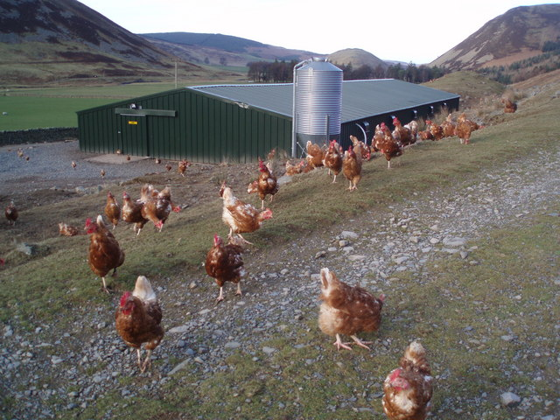
Free range

Slide 15
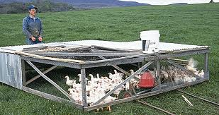
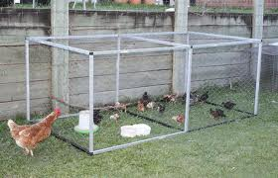
Semi intensive

Slide 16
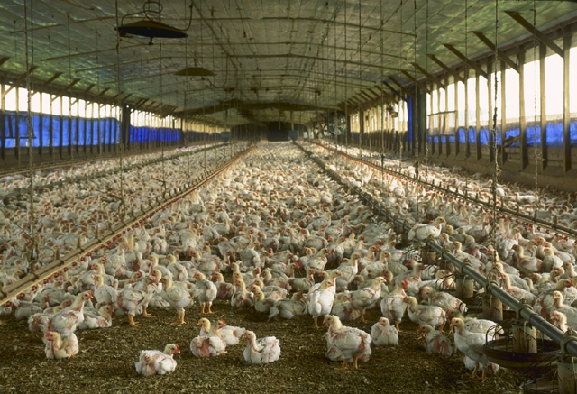
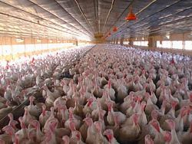
Litter system of Poultry Production
Note the natural ventilation and insulation used in this turkey house

Slide 17
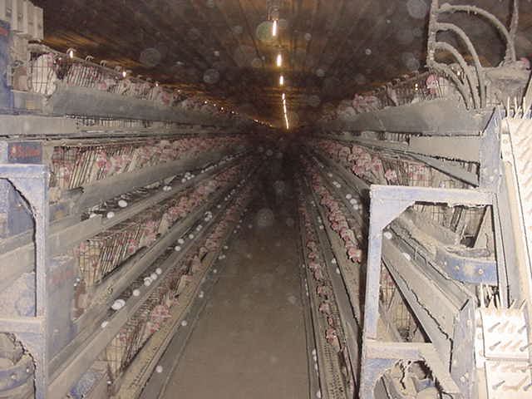
Cage system of rearing aided by computer

Slide 18
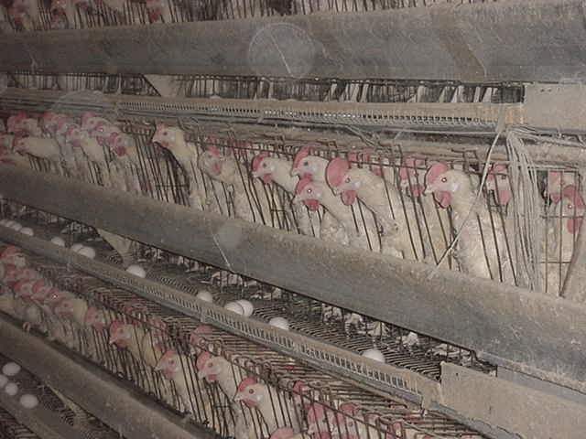
Poultry Housing and Equipment in automatic cage system of rearing

Slide 19
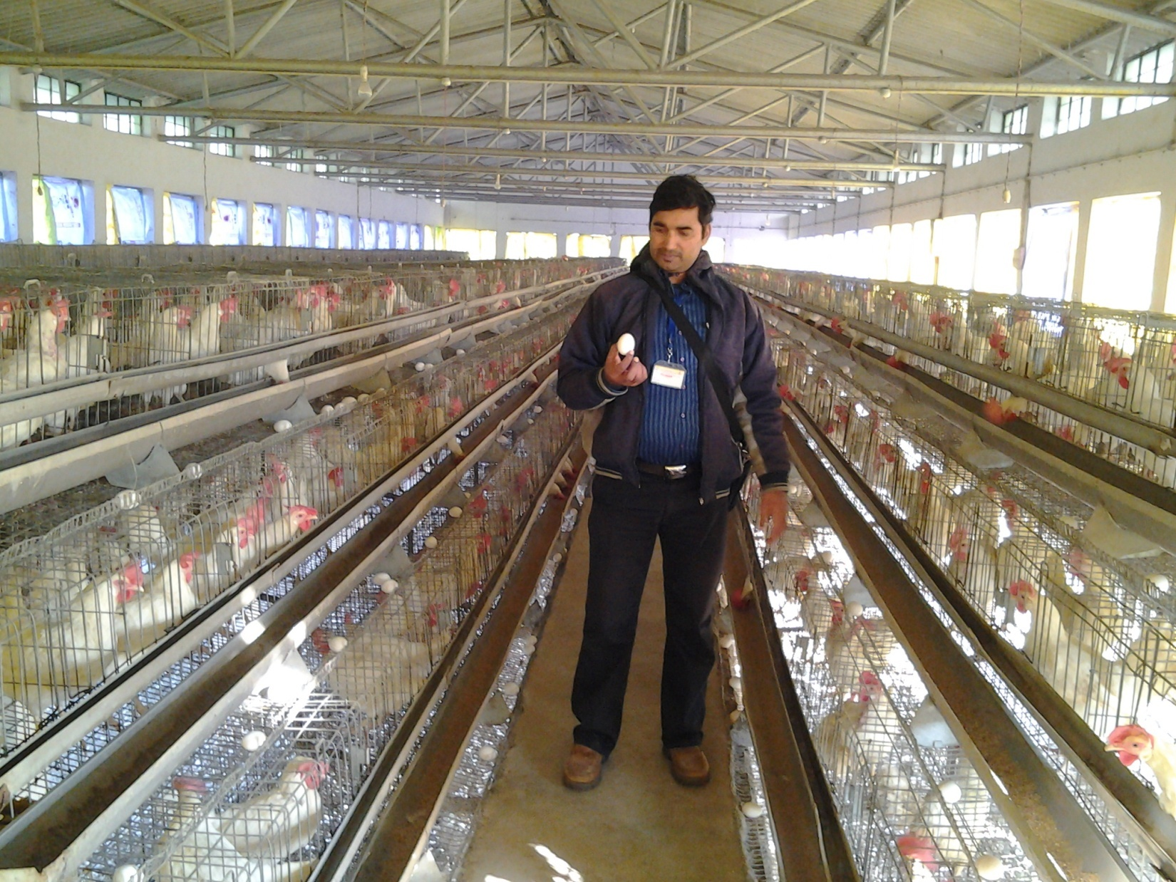

Slide 20
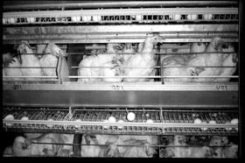
Laying hens
Prefer a temperature of 70-72° F
Sophisticated ventilation is required to support this battery cage arrangement.
Note the eggs in the trays below the hens.

Slide 21
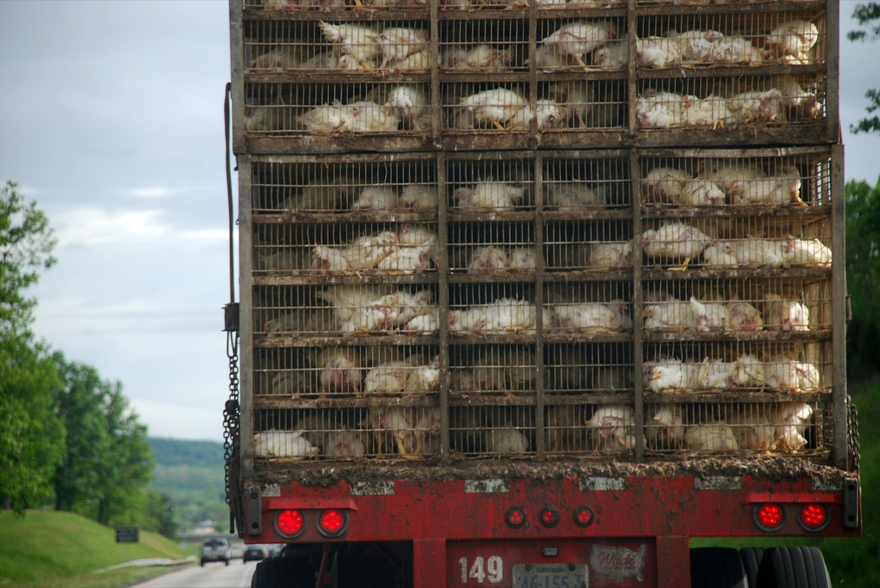
Poultry carried for market

Slide 22
Low input technology and backyard farming

Slide 23
Description of cut-up parts of chicken :
Breast (including keel bone) : Breast separated from back by a cut starting at the shoulder joint and going through the junction of vertebral and sternal ribs. Neck skin is not included.
Wing : It includes the entire wing with all muscles and skin intact. If wing tips are removed, should be stated.
Drum sticks : They are separated from thigh by a cut through the knee joint (femoral tibial and patellar joint).
Thighs : they are disjointed at the knee and hip joints. They include neither the pelvic bone nor the oyster.
Neck : It is separated from carcass at the shoulder joint and include neck skin.
Back : include scapula, vertebrae, vertebral ribs, pelvic bones, with all muscles and skin intact. Back may be separated into front and rear portions by transverse cut between thoracic and lumbo-sacral vertebral regions.
Giblets : It includes liver from which the gall bladder is removed, the gizzard from which the lining and content removed, and the heart removed with pericardium.
Halves : They are obtained by cutting the ready-to-cook carcass in half by saw lengthwise through the centre of the vertebral column and sternum.
Quarters : Front and rear (light and dark) quarters are separated from halves by a cut from a point directly rear to sternum and through the vertebral column at the junction of thoracic and lumbo-sacral regions.

Slide 24
Thanks

