Slide 1
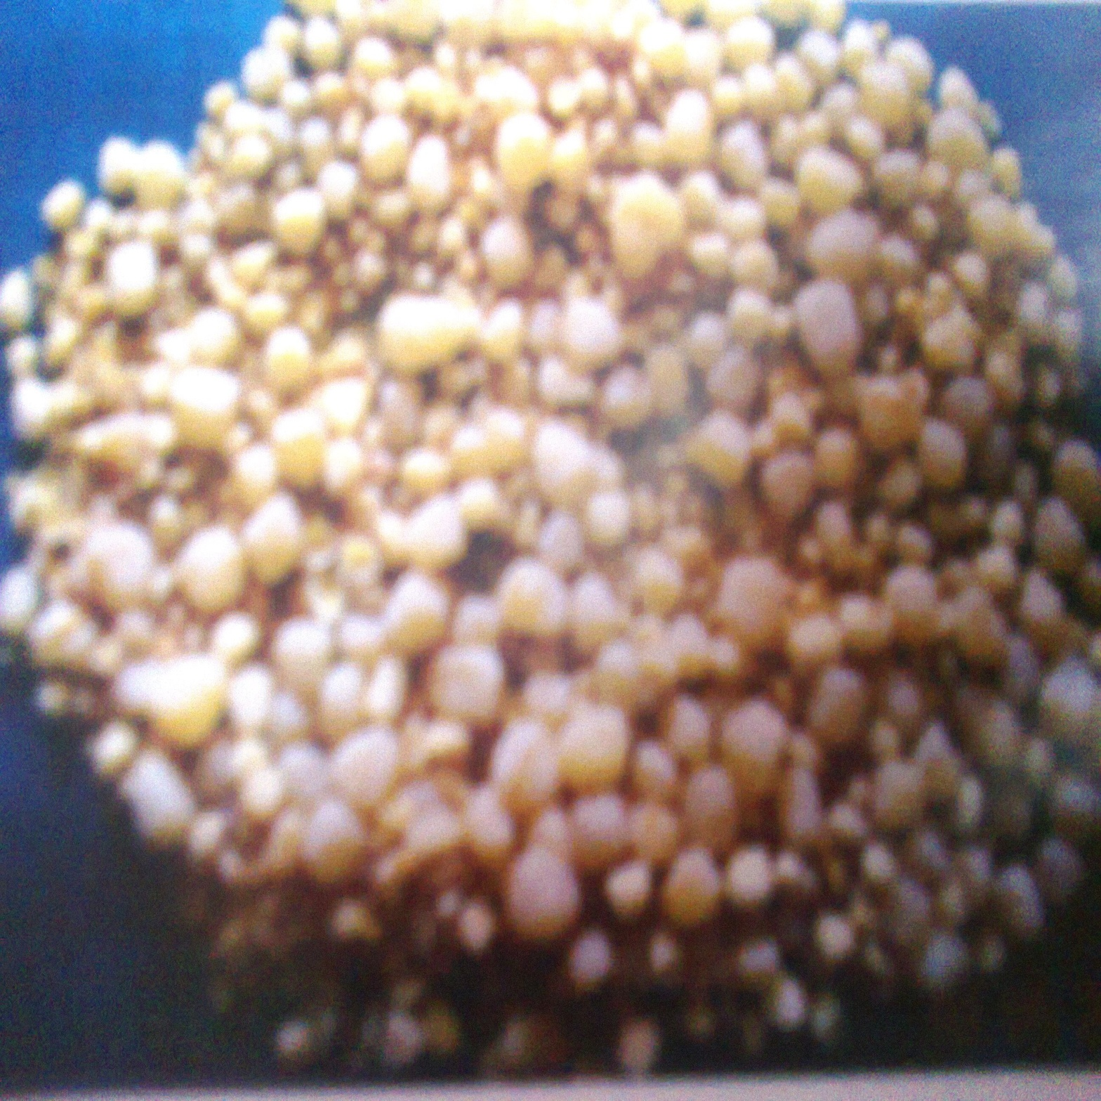
Urolithiasis

Slide 2
Management of Urolithiasis in Domestic Animals
Urolithiasis- Partial or Complete obstruction in the flow of urine due to presence of calculi in urinary system
Mostly commonly affected species– Cattle> Sheep/Goat >Buffalo, Dog
Male>Female

Slide 3
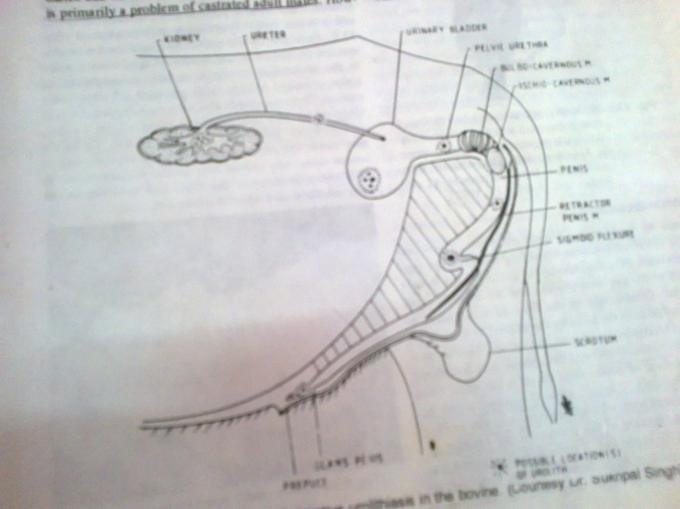
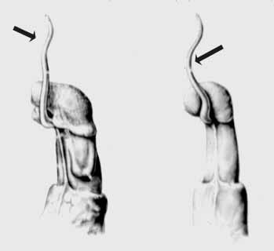
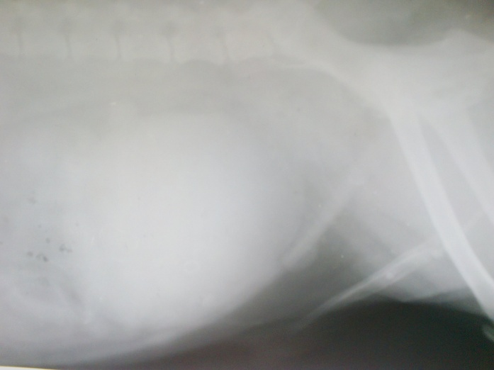
Anatomy Of Urinary System & Common Sites Of Obstruction
Bovine-Sigmoid flexur
Sheep/Goats: Urehral process
Dog: Proximal to Ospenis
Bovine/Caprine: Post scrotal sigmoid flexure
Camel: Pre- scrotal sigmoid flexure

Slide 4
Factors Responsible For Uroliths Formation
Season-
Winter-Reduced water intake
Summer- Less availability of water, dehydration
Diet-High concentrate/low roughages with large amount of (P)
Low magnesium level-calcium phosphate crystal
High silica containing Grasses -Wheat, oat, barley straw.
Vit. A ↓ -promotes epithelial desquamation act as nidus.

Slide 5
Composition Of Calculi Based On Urine pH.
Calculi mainly consist salts of Ca, Mg, NH4 -Phosphate, Oxalate and Carbonate.
Acidic urine: -Dog , Cat: Oxalate, Carbonate salt of Ca, Mg, NH₄
Alkaline urine: Cattle, Buffalo, Sheep/Goat- Phosphate salt of Ca, Mg, NH₄

Slide 6
Composition Of Calculi In Animals
Dog- Struvite (Magnesium Ammonium phosphate), Calcium oxalate, Urate, Cystine, Silicate, Calcium Phosphate.
Horse- Calcium Carbonate
Ox- Struvite, Calcium Oxalate, Silicate, Calcium Phosphate.
Sheep & Goat- Struvite, Calcium Oxalate, Silicate, Calcium Phosphate.

Slide 7
Clinical Sign
Partial obstruction-
Uneasiness, Abdominal pain (Colicky), Stranguria, Dribbling urine and haematuria
Complete obstruction-
Colic sign-teeth grinding, Rear leg stamping, Circling of tail, Distended urinary bladder ( Rectal palpation)
Goat/ Sheep- Frequent bellowing

Slide 8
Diagnosis
Large animals- Rectal palpation Distention of urinary bladder
Small animal- Palpation of belly
Urinalysis-Presence of pus cells, blood cells, and different types of crystal.

Slide 9
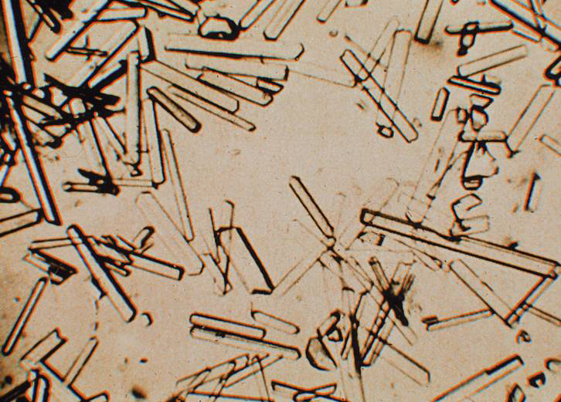
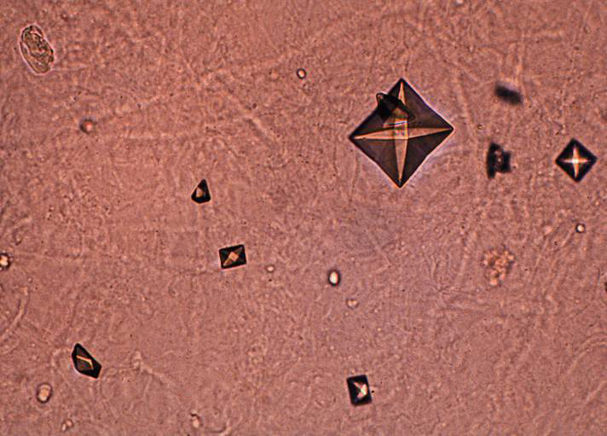
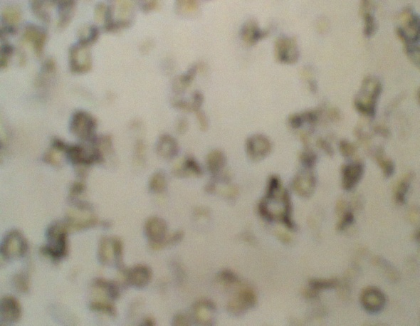
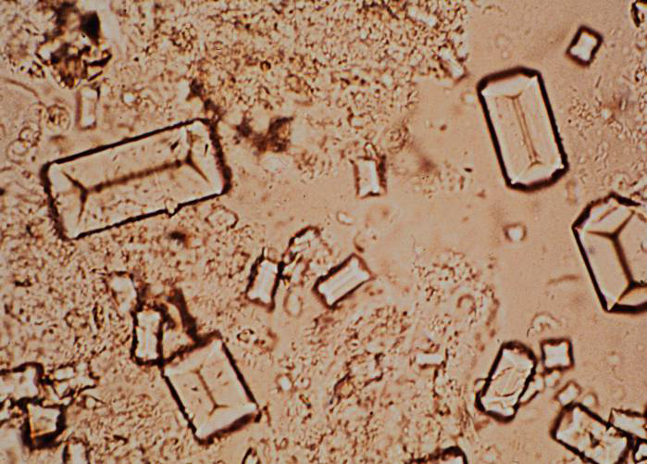
Photomicrographs of different types of Urine crystal
Calcium Phosphate- columnar structure
Oxalate- envelope-shaped
Mixed Crystaluria
Struvite Calculi- coffin-lid shaped

Slide 10
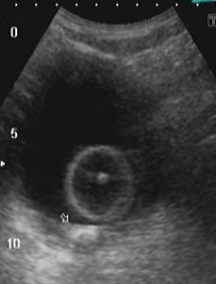
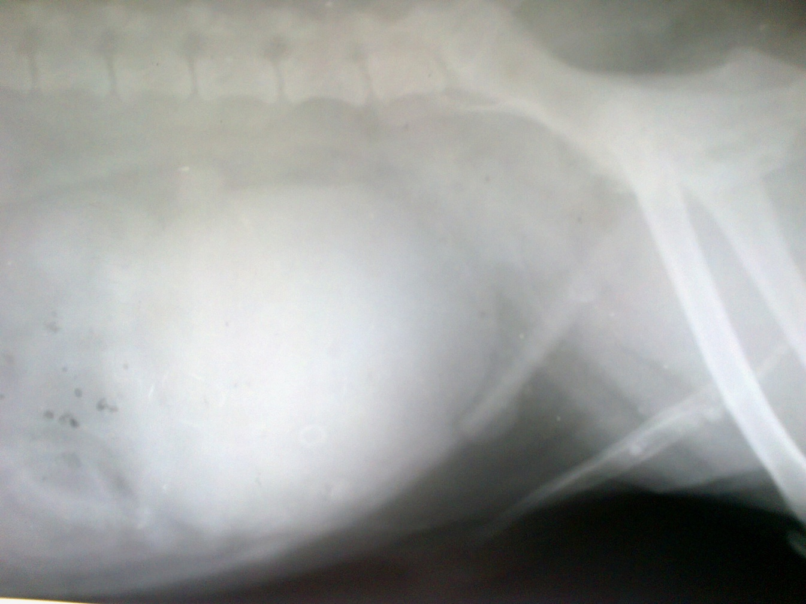
Ultrasonography/ Radiography
Distended Urinary Bladder
Calculi in urethra proximal to Ospenis
Calculi in Urinary Bladder

Slide 11
Electrolyte Imbalances
Hyperkalaemia,
Hyperphosphataemia,
Hyponatraemia,
Hypochloraemia
Hypocalcaemia

Slide 12
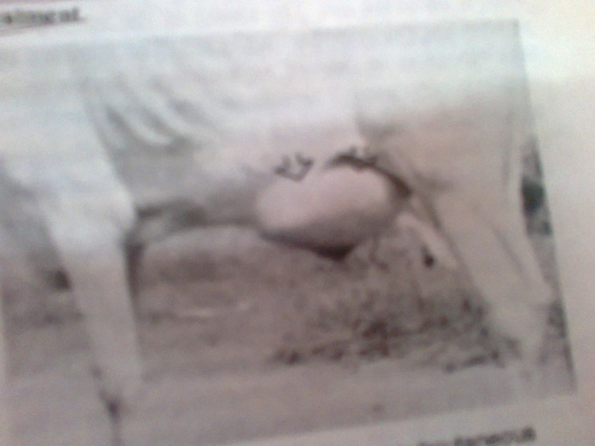
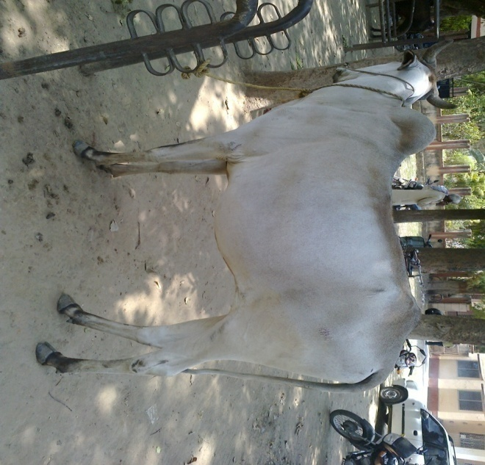
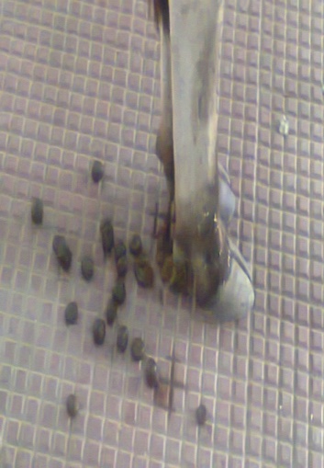
Within 48-72 hr- either urethra or bladder ruptured , colic sign disappeared.
Urethra ruptured ventral edema
Bladder ruptured- Water belly condition
Dry and mucous coated dung ball

Slide 13
Prognosis
Severe dehydration, laboured breathing, arched back and protuded rectal mucosa indicate poor prognosis
Cases of nephroliths and atonic bladder have little chances of recovery

Slide 14
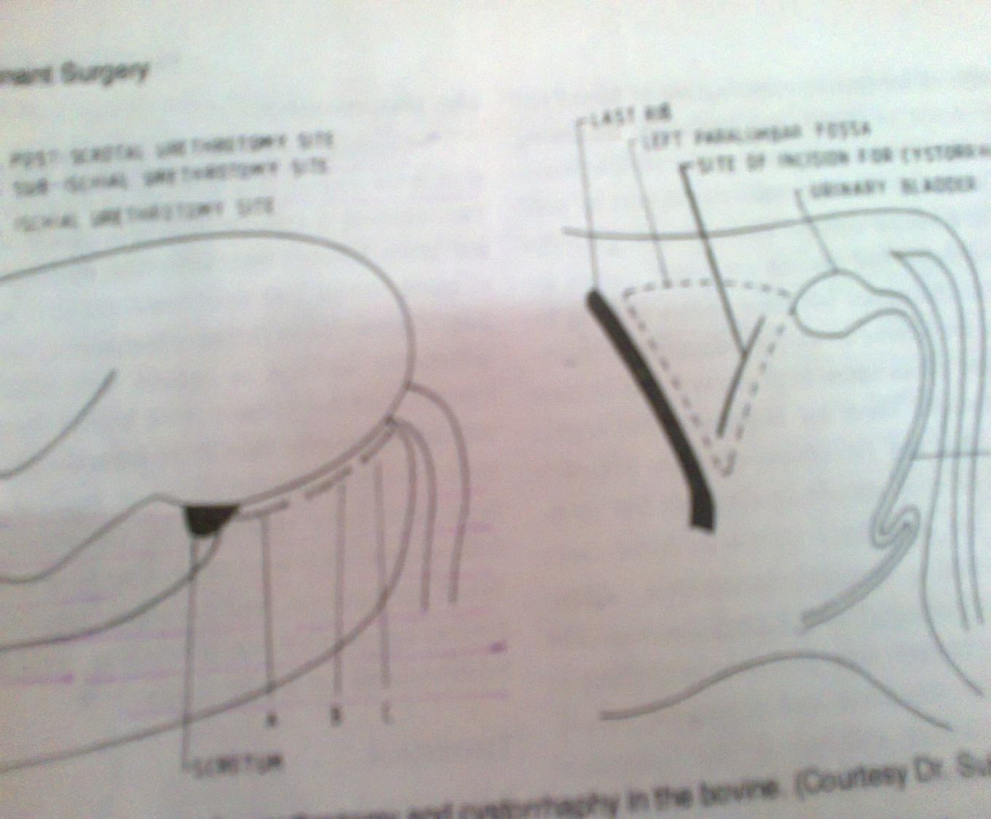
Surgical Correction

Slide 15
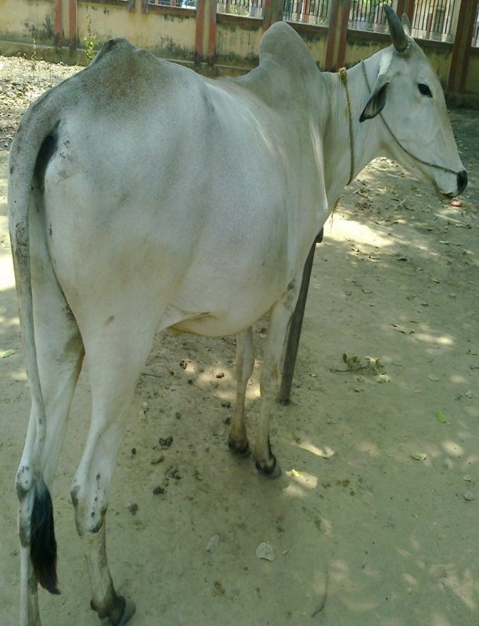
UROLITH IN BULLOCK
RUPTURED URINARY BLADDER

Slide 16
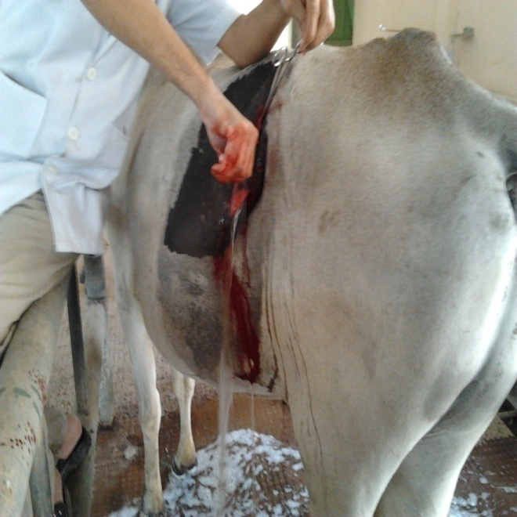
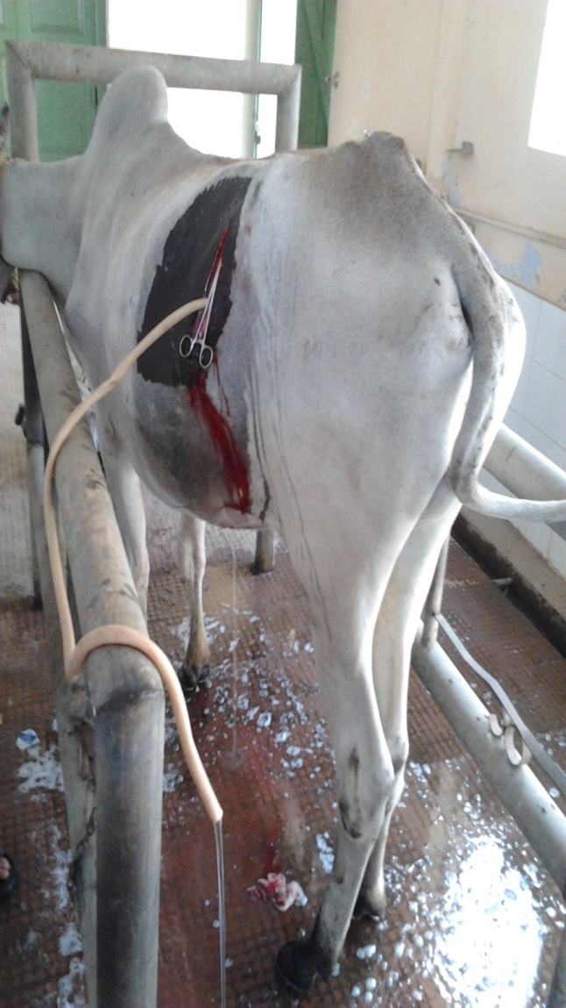
Uroabdomen/Uroperitonium: Accumulation of urine in the peritoneal cavity
DRAINING URINE AND URINARY BLADDER REPAIR

Slide 17
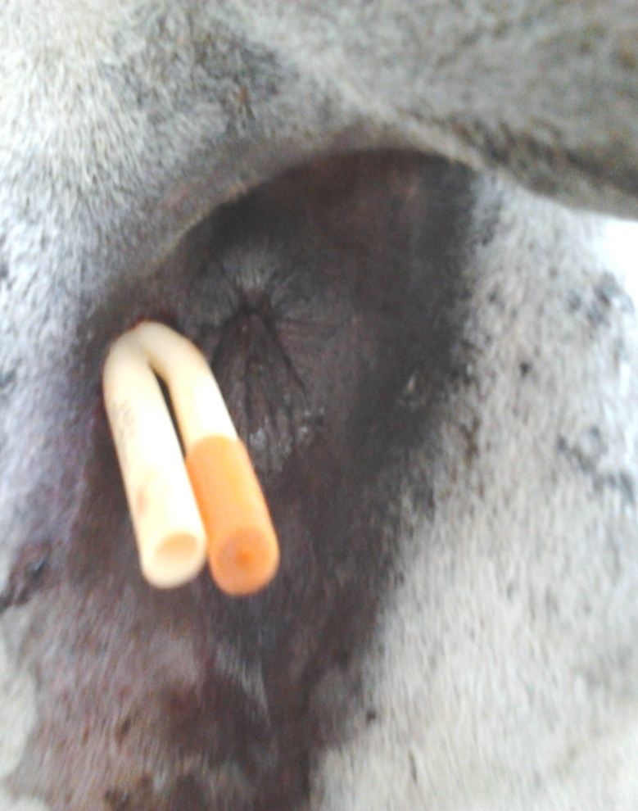
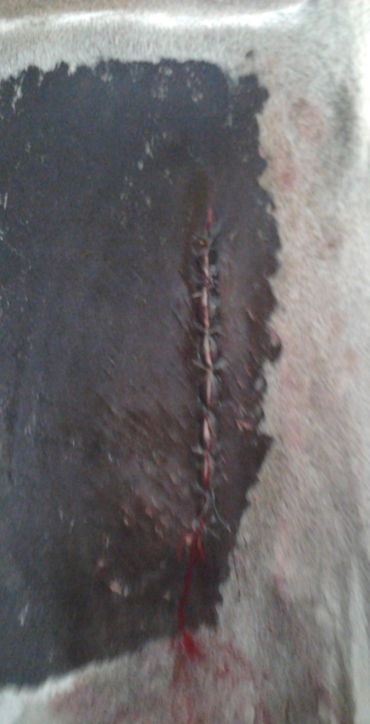
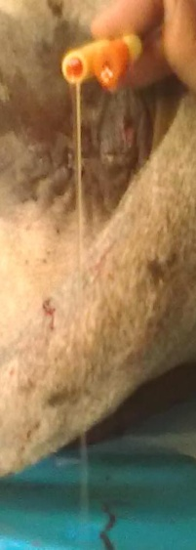
Folley’s catheter passed in UB
Closure of incision line

Slide 18
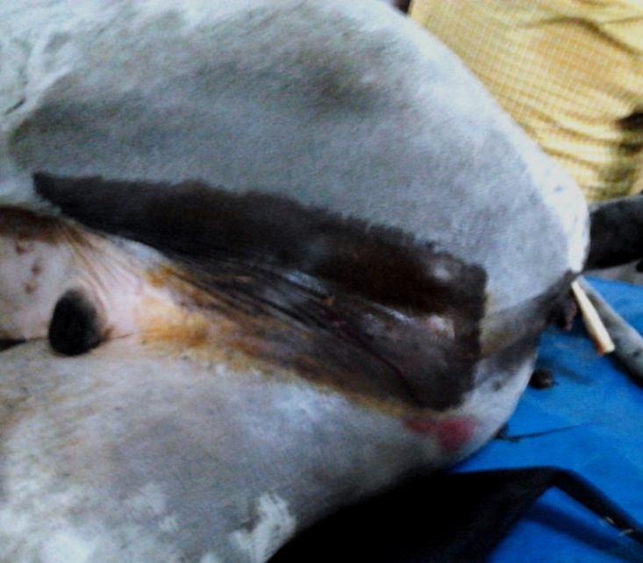
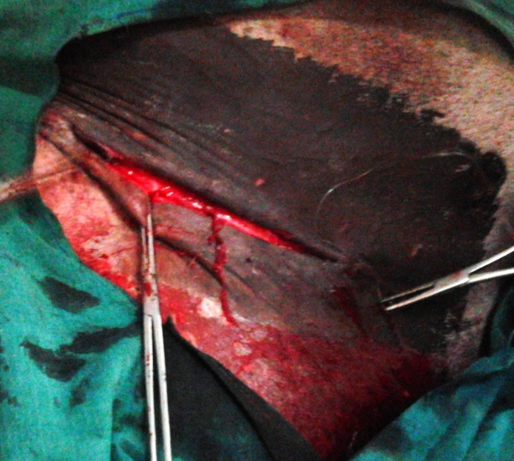
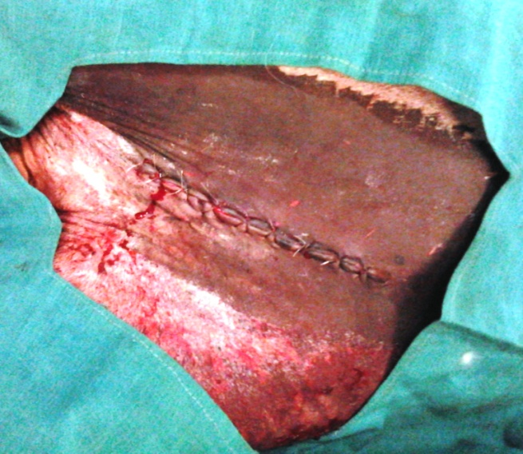
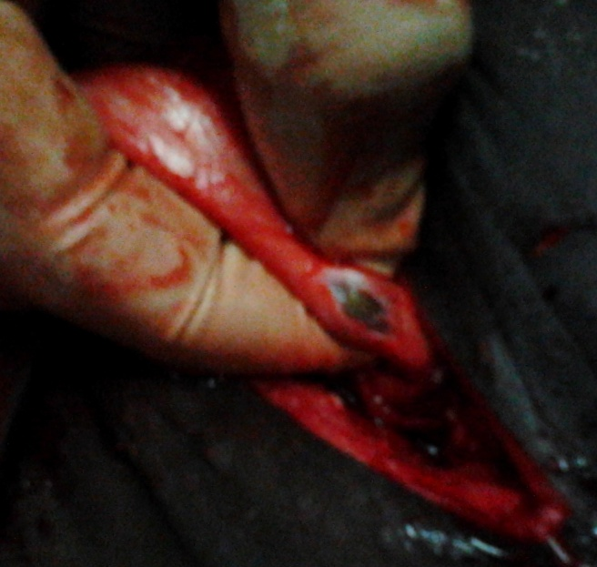
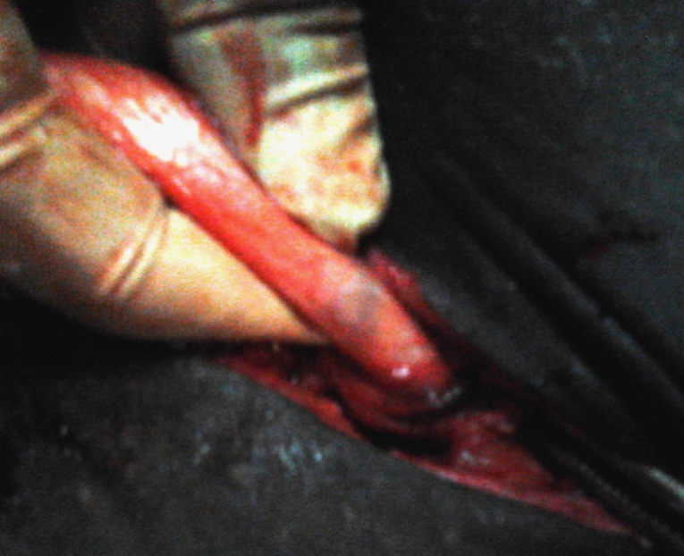
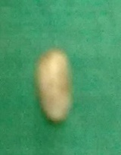

Slide 19
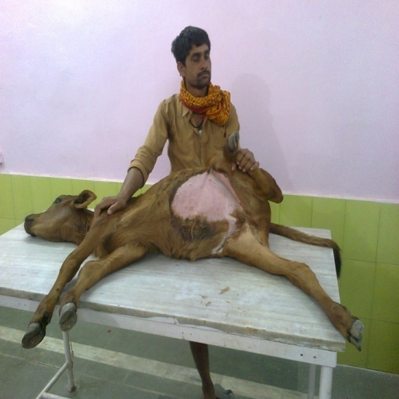
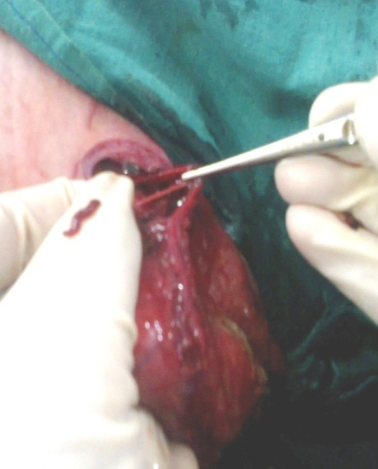
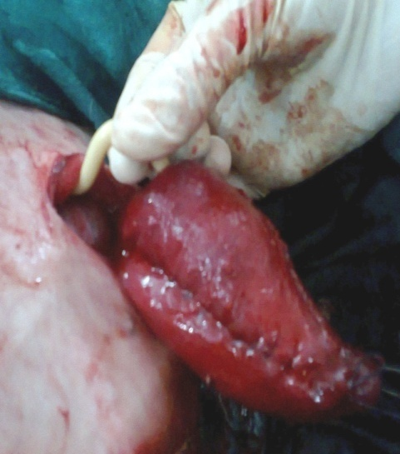
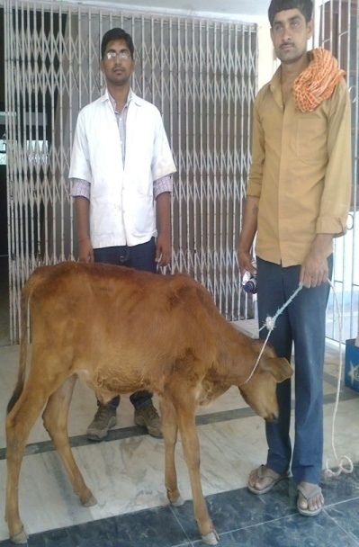
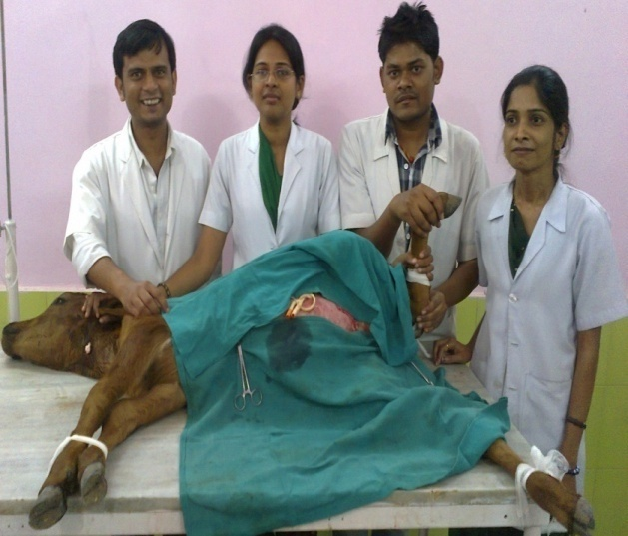
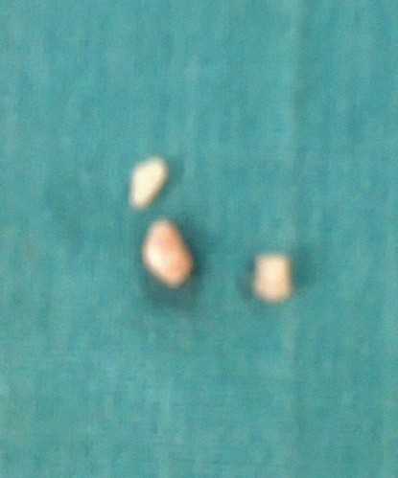
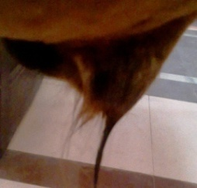
URINARY BLADER RUPTUR IN CALF Cystorrhaphy and Tube cystostomy

Slide 20
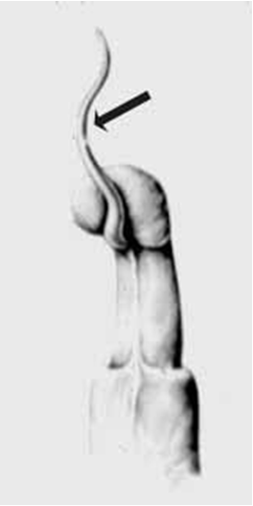
Management of urolithiasis in goat Amputation of urethral process
Amputaion of urethral process

Slide 21
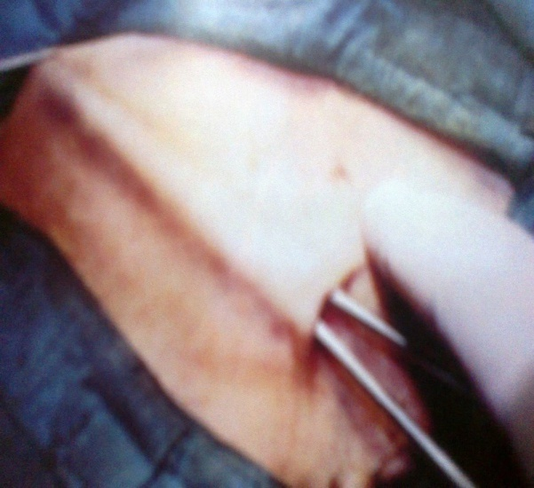
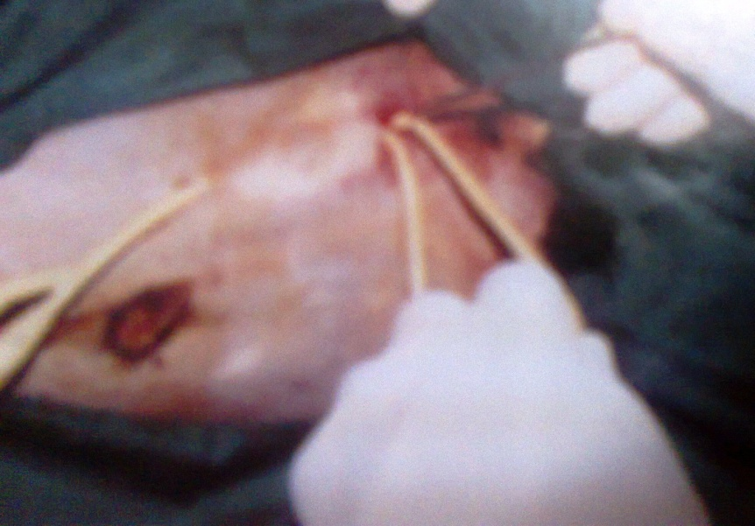
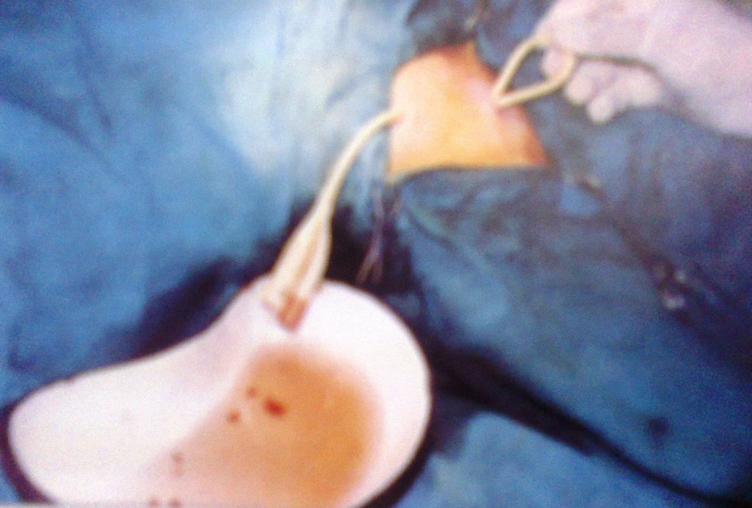
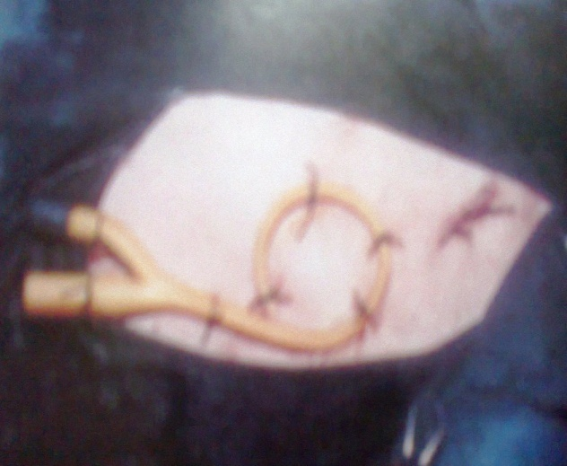
Management of urolithiasis in goat Tube cystostomy

Slide 22
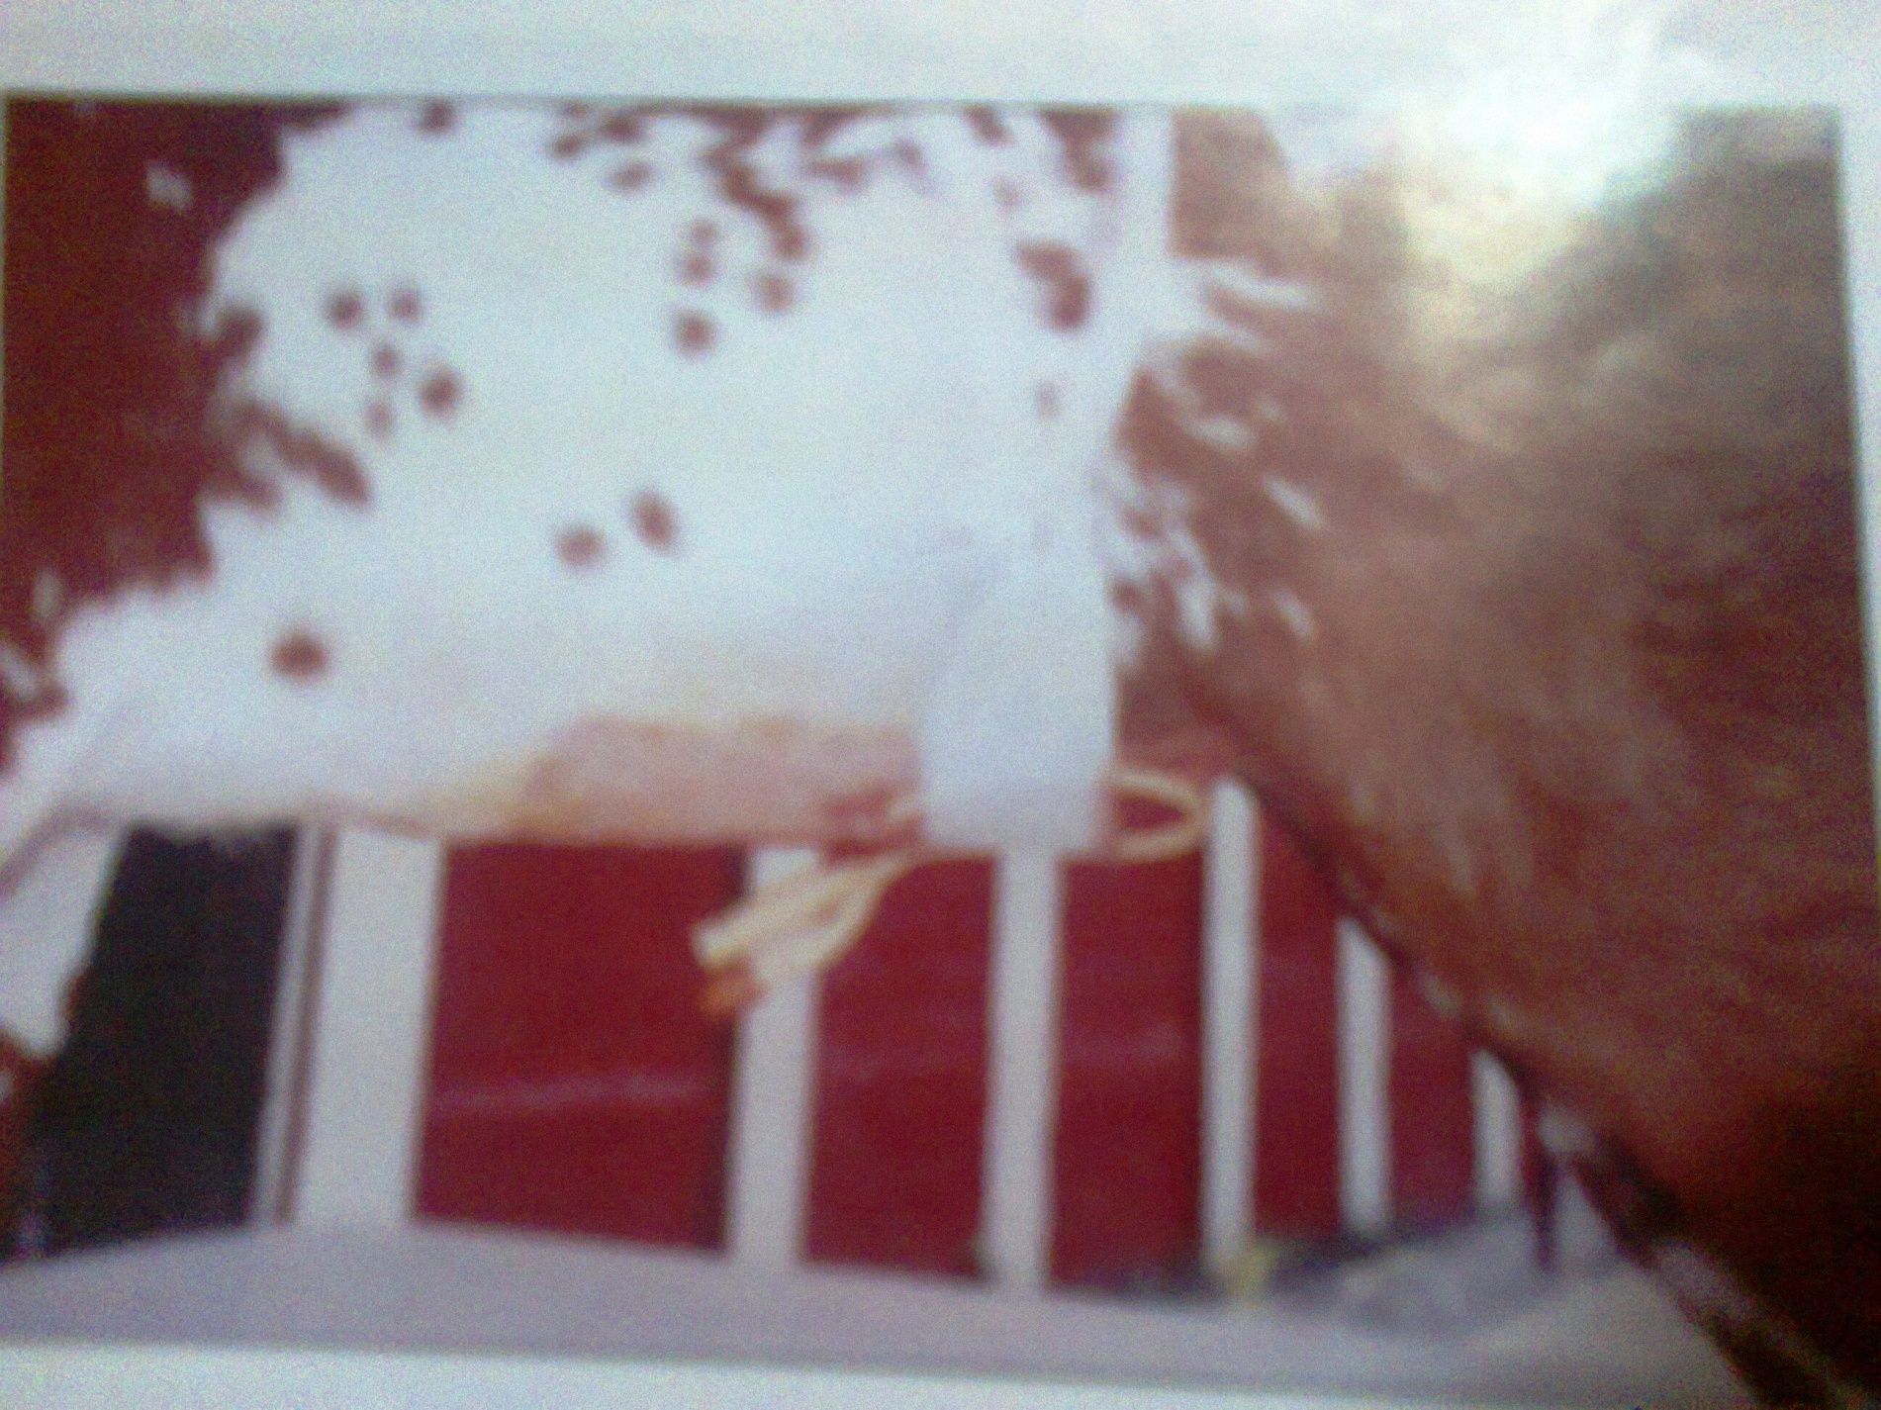

Slide 23
Post-operative care
Adequate fluid therapy
Analgesic and antibiotic-5-7days
Indwelling catheter- 2wks
Water should be provided ad lib
Ammonium chloride 5gm bid 15days

Slide 24
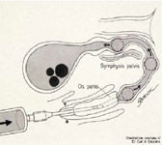
Management of urolithiasis in Dog Urohydropropulsion
Verify and localize the urethro-liths with the aid of appropriate
imaging procedure(s).

Slide 25
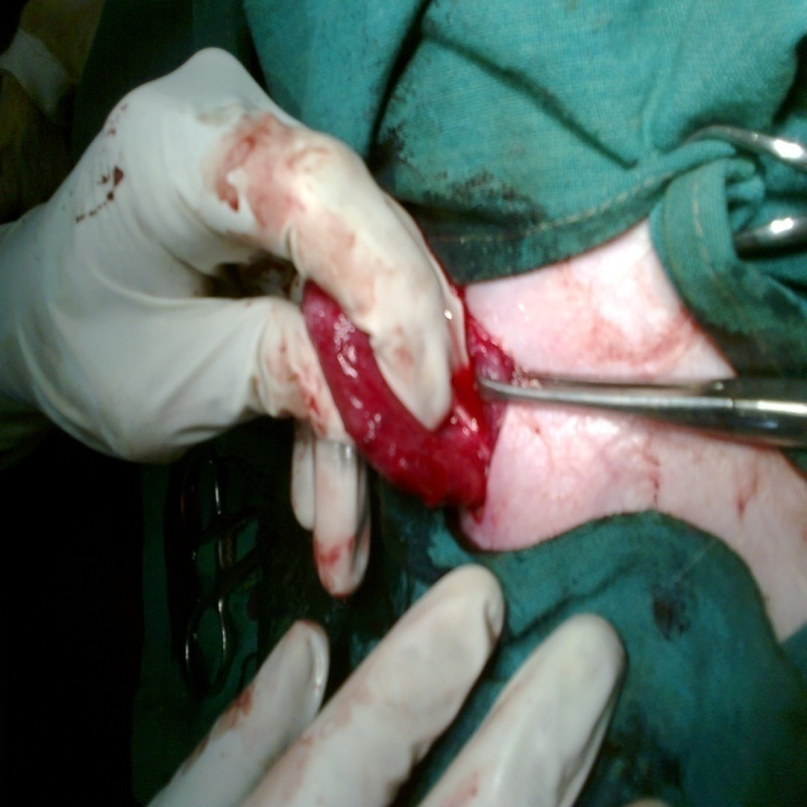
Cystotomy to remove stone from bladder
Cystotomy: Incision into urinary bladder
Urethrotomy: Incision into urethra

Slide 26
Post operative care
Broad spectrum antibiotic
Antispasmotic
Tab. Cyston for one months

