Slide 1
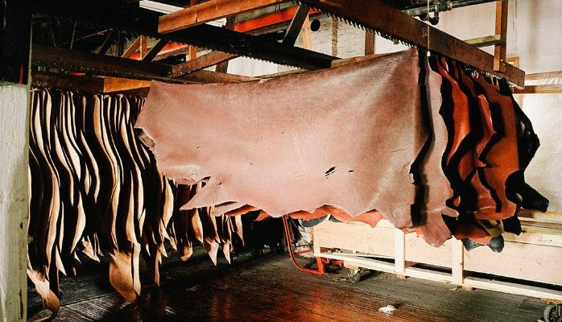
Utilization of Skin and Hides
(A part of Unit III- 3rd Prof. Year)
Dr. Gargi Mahapatra
Asst. Prof. cum Jnr. Sc.
Dept. of Livestock Products Technology
Bihar Veterinary College
BASU, Patna.

Slide 2
Destination of Hide/ Skin
Hide/Skin
Drying/ Curing
Conditioning
Tanning
Post-Tanning Operations
Leather
(End/Final Product)

Slide 3
Important Points
Skin of sheep and long haired goats are washed on the flesh side up.
After drying the hides are conditioned and then sent to tanneries.
Green Hides- Fresh hides which have been flayed, fleshed, trimmed and washed. These are delivered to the tanneries as early possible.

Slide 4
Preservation of Hides and Skin
First step in hide preservation-
Methods – Air Drying &
Practiced in areas where relative humidity is low
Techniques
Ground Drying
Suspension Drying
(Frame Drying, Line Drying &
Drying
Hide Curing
Done immediately after flaying
Techniques
Dry Salting
Wet Salting
Tent Drying)

Slide 5
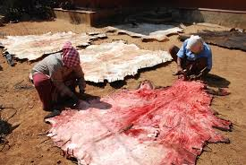
Ground Drying
Hides stretched out fleshed side up on the ground and air dried.
Advantages:
Cheap, Easily adaptable by rural population
Adequate for Fallen hides
Disadvantages:
Blemishes and Putrefaction at follicular level hence poor quality leather produced.
High temperature(summers) causes wrinkling

Slide 6
Suspended Drying
Hides are dried in suspended manner
Advantages
Simple, cheap and effective way of drying.
Easily adaptable in tropical countries.
Free circulation of air around the hide.
Skin becomes lighter thus cheaper to transport.

Slide 7
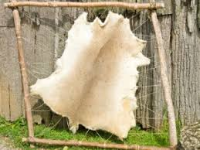
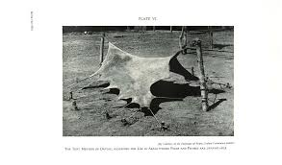
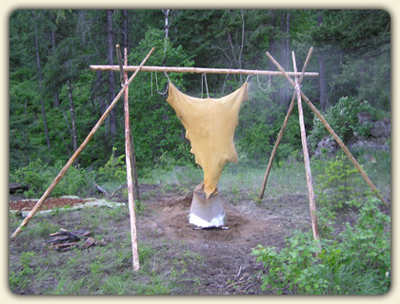
Suspended Drying Techniques
Frame Drying
Practiced on angled frames fixed on a tripod/stand
Line Drying
Skin suspended on horizontal chords with flesh side up, practiced for sheep and goat
Tent Drying
Hide supported on ground in shape of a tent by chords and wires
*Irrespective of the method of drying hide takes a minimum of 7 days to dry.

Slide 8
Hide Curing
Wet Salting
(Hide retains 35% water)
Curing solution prepared (23 kg salt+ 62 kg water for 100 kg of hides)
Hides soaked in pits, 1.25m deep.
Soaking times varies from 2 days for fleshed hides to 2 weeks for un-fleshed hides.
Brining liquid maintained at room temperature.
Dry Salting
(Hide retains 12% water)
Hides kept flesh side up
2-3 mm thick layer of fine salt applied
Weight of salt equal to weight of hide
Hides stacked on one another, to a max. height of stack 1m.
Practiced in rooms maintained at 15°C and 85-90% relative humidity.

Slide 9
Conditioning of Hides
Washing and Soaking
(Hides soaked in zinc chloride+ soda ash+ borax Solution)
All proteins of blood and lymph removed
Hide rehydrates and restores its shape
Fleshing
Extra flesh stripped off with a serrated knife
Liming and Dehairing
Hides soaked in saturated lime solution with 0.1% sodium sulphide
Applied to loosen hair and epidermal cells

Slide 10
Contd….
Washing and Deliming
Hides washed with mild acid to neutralize the lime
Batting
Hides treated with proteolytic enzymes at pH 8.5
Results in soft and pliable pelt
Such pelts tanned by vegetable tanning
Pickling
Pelts pickled in bath of 1% Sulphuric acid and 10% salt in water, maintained at a pH of 2-2.5 for 2-3 hrs
Such pelts are tanned by chrome tanning process

Slide 11
Tanning
Process of conversion of hides/ skins to insoluble and non-putrescible leather without destruction of original structure.
Process requires approximately 5-6 hrs
Types
Vegetable Tanning
Chrome Tanning

Slide 12
Vegetable Tanning
Delimed pelts are immersed in natural tanning liquor of progressively stronger concentration. The tannin diffuses and imparts uniform colour
Used for heavy leather articles like belts, saddle, harness etc.
Tanning producing plants are
Avaran ( Cassia auriculata),
Babul (Acacia arabia),
Myrabalan (Terminalia chebula)
Konnan (Cassia fistula).

Slide 13
Chrome Tanning
A more modern, quicker and popular technique.
Yields softer, stronger and supple leather.
Types
Single Bath Process- Chrome salts prepared in a solution and then applied on skin. The strength of the solution is then gradually increased
Double Bath Process- Chemical interaction forming the chrome solution is practiced on skin itself.
Usually sodiumbichromate is reacted with maltose and sulphuric acid to get chromic sulphates.
Chromic sulphates are applied @ 1.5-2.0% at a pH of 2.5 , then increased to pH of 3.5.

Slide 14
Post tanning Operations
Setting out and Wiring
Hide passed between two large rollers
Remove excess of tanning liquor and moisture
Splitting and Shaving
Practiced to adjust leather thickness
Dyeing
To produce desired color
Fat Liquoring
Lubrication with oil to adjust firmness

Slide 15
Contd…
Staking
Makes the leather more pliable
Buffing
Smooth the grain surface of leather for better appearance
Final product is called buffed leather
Glazing
Done in case of chrome tanning
Glass cylinders are rolled on the surface of the buffed leather
This process produces high luster on the grain surface

